Slide 1
Introduction to Metadata
What is Metadata?
March 2016

Slide 2
Learning Objectives
After completing this lesson the participant can:
  explain the concept of metadata through the use of analogies
  describe metadata as the contextual component of the data set
  explain the role of metadata in the National Spatial Data Infrastructure

Slide 3
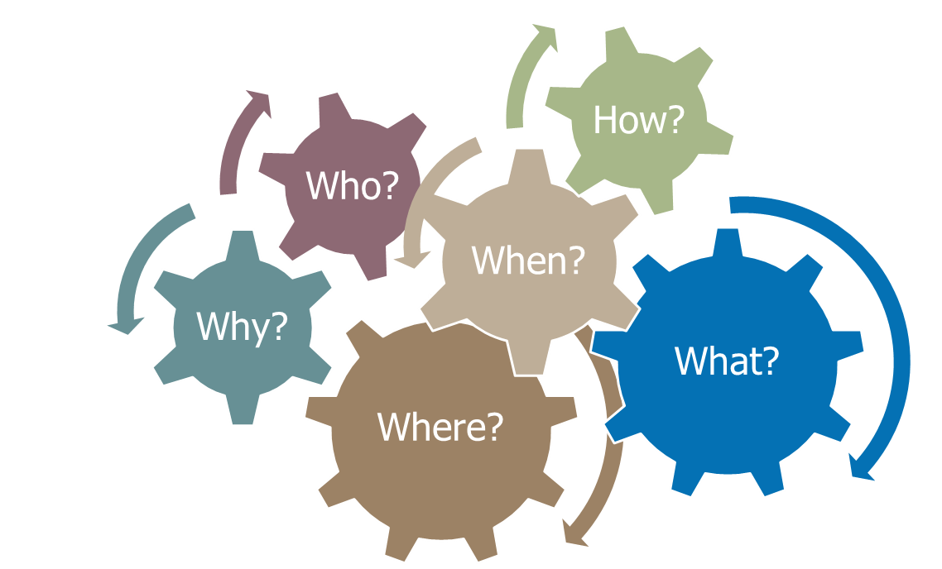
Data About Data
Metadata is the data, or information, about the data.
It is the:
of your data
Notes:
A metadata record documents key information about your data

Slide 4
Data Reporting
Who
created the data?
manages the data?
Where
is the study area?
can I access the data?
What
is the data content?
source data was used?
How
was the data created?
is the data distributed?
When
is the time period of the content?
was the data created?
Why
was the data created?
are there missing values?
Notes:
Metadata provides answers to questions you may have about your own or another’s data.

Slide 5
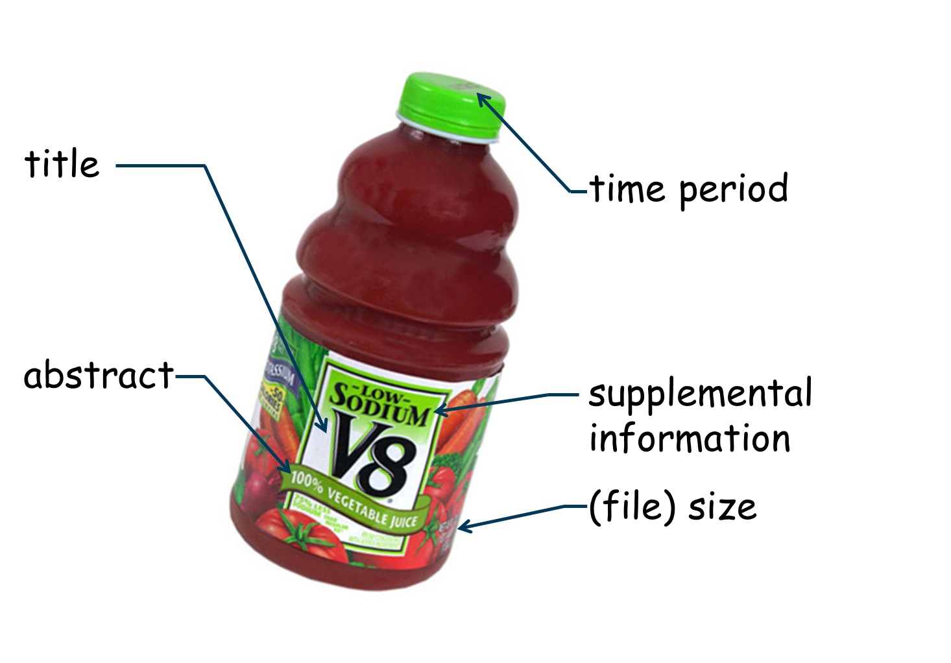

A Label For Your Data
Notes:
Consider metadata an information label for your data.
In this example the:
Front label indicates: the title (Vzz), a short abstract (100% juice) about the content, the size (64 oz.) of the resource, and some supplemental information (sodium content) that consumers may consider valuable. The timestamp on the cap indicates the time period or freshness of the resource.

Slide 6
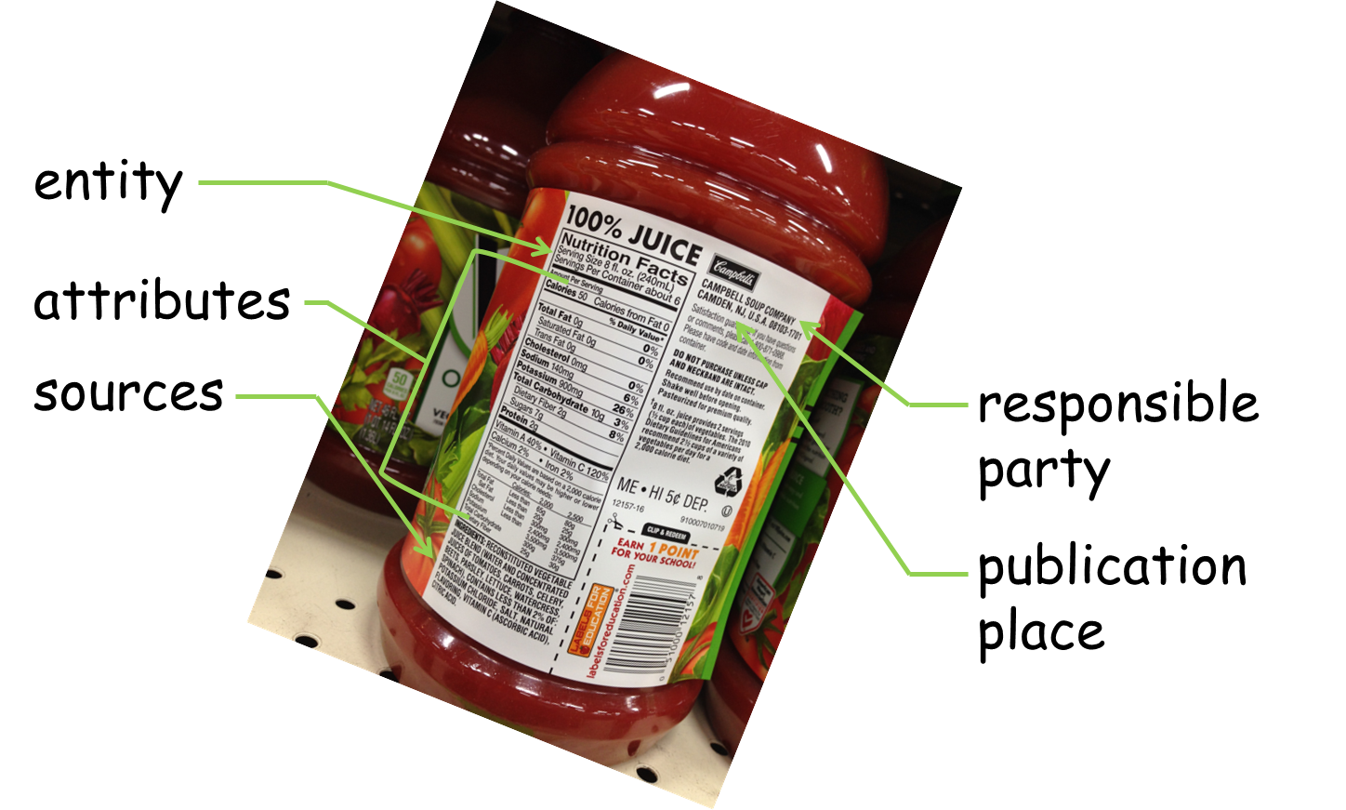
A Label For Your Data
Notes:
Consider metadata an information label for your data.
In this example the:
Back label indicates: the entity that is being described (a serving size), the attributes (nutrition) for the entity, the sources (ingredients) used to develop the resource, the party responsible for the data (Campbell Soup Company), and the place were the data was published (produced)
a short abstract about the content, the size of the data, and some supplemental information about the sodium content that consumers may consider valuable
The timestamp on the cap indicates the time period or freshness of the data

Slide 7

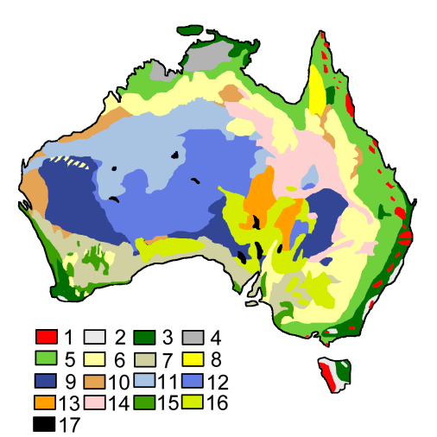
Metadata Is Part of the Data
content context
Metadata gives context to data content
DATA
Metadata
Title
Responsible Party
Purpose
Abstract
Geographic Extent
Time Period of Content
Sources Used
Process Description
Positional Accuracy
Entities and Attributes…….
phenomena
map / image / database
metadata
abstraction
abstraction
Notes:
Geospatial data selects and represents (abstracts) the character of the phenomena that is of interest
in this case, the location of specific tree types
a different abstraction may instead capture the color, height, and/or near-infrared reflectance (NIR) of the trees
The metadata selects and represents (abstracts) specific information about the data that is needed assess, apply or manage the data

Slide 8
Metadata Aids Data Discovery
Metadata enables users to search for data by:
Location
Theme
Time Period
Publisher
Attributes
more…
Notes:
Metadata is a powerful tool for data discovery. It enables users to query the data based on their use criteria.

Slide 9
Metadata Aids Data Discovery
Data Management System
Geographic Information System (GIS)
Database Management System (DBMS)
other…
Metadata enables users to search their own:
Metadata enables user to search external:
Data Distribution Systems
Data Catalogs
Data Servers
Web-mapping Applications
other…
Notes:
Metadata can be used to find your own data.
It can also be used to discover data produced by others if the metadata is published and made available for search.

Slide 10
Spatial Data Infrastructure
tools
people
policies
Data communities and organizations
can facilitate data sharing by
establishing a
Spatial Data Infrastructure
that coordinates
the type of data to be shared
and establishes tools, standards
and policies for the benefit of
data producers and consumers
standards
Notes:
A Spatial Data Infrastructure (SDI) can be developed by a community or organization to facilitate data sharing.
A SDI is composed of an agreed upon set of:
Tools (online catalogs, webmapping applications, etc.)
Standards (metadata, web publication, etc.) and
Policies (content, access, use, etc.)

Slide 11
National Spatial Data Infrastructure
The U.S. National Spatial Data Infrastructure (NSDI) was developed to improve data sharing and use among all sectors of
government,
academia, and
the private
sector
access
NSDI
National Spatial Data Infrastructure
…a set of actions and new ways of accessing, sharing and using geographic data that enables far more comprehensive analysis of data to help decision-makers choose the best course(s) of action
share
use
Notes:
The US NSDI is intended as a base or structure of practices and relationships among data producers and users

Slide 12
The NSDI and Geospatial Platform
The Geospatial Platform (GeoPlatform.gov) is the implementation component of the NSDI for the delivery of data, services, and applications that support informed
decision-making
about national
and regional
issues
Geospatial Platform
…provides shared and trusted geospatial data, services, and applications for use by the public and by government agencies and partners to meet their mission needs
data
applications
services
Notes:
The GeoPlatform is the online implementation of the NSDI. It provides direct access to the tools, policies, standards, and communities that comprise the NSDI.

Slide 13
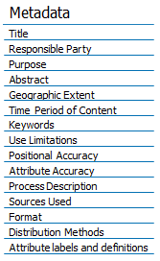
Metadata Supports the NSDI
Metadata supports the NSDI by fueling the Geospatial Platform with needed information
NSDI
access
share
Use
  download and request
GeoPlatform
data
services
  publish, present and communicate
applications
  visualize and explore
Notes:
The NSDI is a concept for data access, sharing, and use.
The GeoPlatform provides the real-world data, services, and applications to realize the NSDI concept.
Metadata provides the information needed by the GeoPlatform to connect users with available data, services, and applications.

Slide 14
Discussion
What metadata elements do you need to access, share, and use your data?
What are the benefits of having a ‘label’ for your data?
What other organizations would you include in your Spatial Data Infrastructure?
Are there data resources of interest to your organization in the GeoPlatform.gov Data Catalog?

