Slide 1

DCF Fiscal Update
WHSFMA Conference
May 8, 2019
John Tuohy, DCF Regional Operations

Slide 2

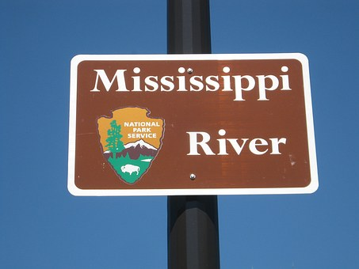
Navigating the Big Muddy

Slide 3
Topics for DCF Presentation
General Fiscal Updates
Child Care Updates
Child Welfare Updates
Youth Justice Updates
Child Support Updates
Questions

Slide 4

General Fiscal Updates

Slide 5
General Fiscal Updates
Report instances of misuse of DCF systems
https://dcf.wisconsin.gov/form/report-system-misuse
Late final expense reports:
  Not accepted for child care administration.
  Provide justification for late expenses.
DCF 1 Uniform Fee Rule – still working on a draft rule.

Slide 6
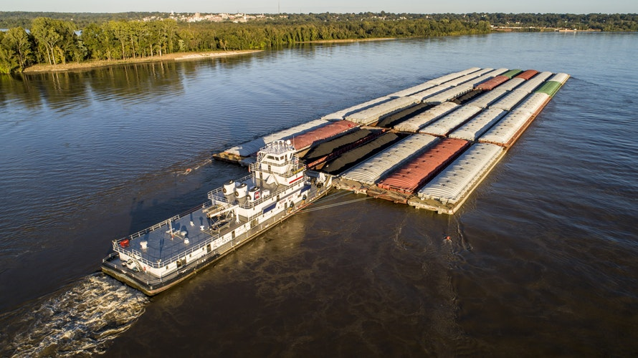
Child Care Updates

Slide 7
Child Care Updates
Child Care Administration Contract:
  CY 2018 contract closeout – have enough underspending to cover all overspending.
  CY 2018 deob/reobs being processed. Contract amendments will be sent in May.
  Base funding level will be used for CY 2020 allocations. Allocations based on county share of caseload.

Slide 8
Child Care Updates
2019-21 Biennial Budget:
  Increase Shares reimbursement rates to child care providers – cover 50% of providers.
  Increase Shares reimbursement rate for certified providers to be the same as licensed family providers.
  Full funding for rate increases implemented in SFY 2019.

Slide 9

Child Welfare Updates

Slide 10
Child Welfare Updates
Child Welfare Funding:
  In-Home Safety Services (IHSS)
    Extending 2018 contracts into 2019.
    Change to cost reimbursement for 2020.
  Post-reunification Services (PS)
    Phased out due to federal IV-E waiver ending.
    Can claim expenses through 9/30/2019 for persons enrolled as of 9/30/2018.
  Reimbursement for OHC costs of trafficked youth – see DSP Memo 2019-10.

Slide 11
Child Welfare Updates
Child Welfare Funding, Cont.
  Children and Families Allocation – CY 2020 base amount same as CY 2019 (not counting proposed increase in 2019-21 budget).
  Kinship Care:
    Important to report benefit payment costs timely due to SFY limits on TANF appropriations to DCF.
    Increased Kinship Care caseload statewide.

Slide 12
Child Welfare Updates
2019-21 Biennial Budget:
  Governor proposed $15 million for Children and Families Allocation; counties seeking $30 million.
  Increase IHSS funding for statewide expansion.
  Increase Home Visiting funding for additional grants.
  2.5% foster care rate increases in 1/2020 and 1/2021. Funds added to Children and Families Allocation.

Slide 13
Child Welfare Updates
2019-21 Biennial Budget, cont.
Children can be placed with parents in AODA treatment programs (part of Family First Act).
Increase in Tribal Family Services Program funding.
Additional funding for CCWIS system.

Slide 14
Child Welfare Updates
IV-E Updates
Federal IV-E waiver expires. Need to protect the IV-E claim and prepare for federal IV-E reviews.
Financial metrics for payments – DCF will develop report to monitor these metrics:
  In process checks.
  Outstanding overpayments.
  Over limit trust accounts.

Slide 15
Child Welfare Updates
Program Updates
Child and Family Services Review PIP being finalized with federal government.
Family First Prevention Services Act:
  State requested extension until Fall 2021.
  IV-E funding for in-home services to prevent removal of children. Services must be evidence based.
  Limits IV-E funding for congregate care placements.
  Kinship navigator grants.
  State background checks for RCC/group home staff.

Slide 16

Youth Justice Updates

Slide 17
Youth Justice Updates
Youth Justice Allocations:
  Youth Aids statewide amount for 2020 same as 2019.
  No change to youth Aids funding in 2019-21 budget.
  Youth Aids, Community Intervention Program and Emergency funding formulas/criteria remain the same.
  2019-21 budget directs review of Youth Aids formula.
  Innovation grants instead of early intervention grants.
Youth Risk Assessment Tool:
  YASI assessment tool selected for state wide use.
  Phase 1 counties start in mid 2019, phase 2 in 2020.

Slide 18
Youth Justice Updates
Youth Corrections Redesign:
  Counties submitted letters of interest in March for Secure Residential Care Centers for Children and Youth (SRCCCY).
  Act 185 provided $40 million to DOC for SRCCCY construction grants. Governor request for additional bonding in capital budget denied by Legislature.
  Legislation introduced to modify Act 185 timeframes and make technical corrections. Status is unclear.
17 Year Olds
  Governor proposed returning 17 Y.O. to youth justice system with $5 million funding in 2019-21 budget. Proposal will be pulled from the budget bill as policy.

Slide 19

Child Support Updates

Slide 20
Child Support Updates
Funding formula for 2020 same as 2019.
2019-21 budget includes increased GPR funds for child support agency operation.
2019-21 budget eliminates birth cost recovery; proposal is opposed by child support agencies.
Expanding non-custodial parent support projects.
Modified cooperative agreements to include indirect costs.
May require additional cost detail for CY 2020.

Slide 21

Questions?
John Tuohy, DCF Director of Regional Operations
John.Tuohy@Wisconsin.gov

