Slide 1

Game On with Windows
& Xbox One
Shahed Chowdhuri
Senior Technical Evangelist
Microsoft

Slide 3





Speaker
Shahed Chowdhuri
Sr. Technical Evangelist @ Microsoft
Technology Areas
Enterprise Web/Software Development
Game Development
Mobile Application Development
Cloud Solutions
Online
LinkedIn: http://linkedin.com/in/shahedc
Meetup: http://www.meetup.com/DC-MS-Devs/
Twitter: http://twitter.com/shahedC
Blog: http://WakeUpAndCode.com

Slide 4
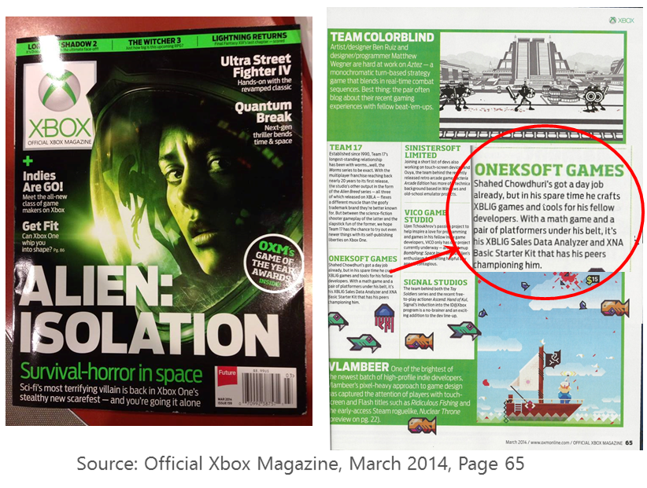
Independent Game Development
Xbox 360 games
WW dev tools
MVP award
Xbox mag →
FB groups admin
  Xbox One
  Unity
  HoloLens
  Construct 3

Slide 5
Announcements
Notes:
Speaker notes:
Deliver video content or stream video to audiences large or small to any device(Web or Mobile) anywhere reliably and in scale.
Helps you create versatile media workflows for ingesting, encoding, protecting and streaming content to audiences on-demand or broadcast live.
Powerful and extensible platform with broad set of first and third-party capabilities to support complete end-to-end media workflows.
Integration with Office 365 empowers organizations of all sizes helps to use videos to enhance sharing, collaboration and communication.
Azure Media Player, an automated online player solution, supports all the usual industry standards like HTML5 video, Media Source Extensions and rights management through Encrypted Media Extensions. The focus here is on open standards, but on older browsers, the player can fall back on Flash or Silverlight.

Slide 6
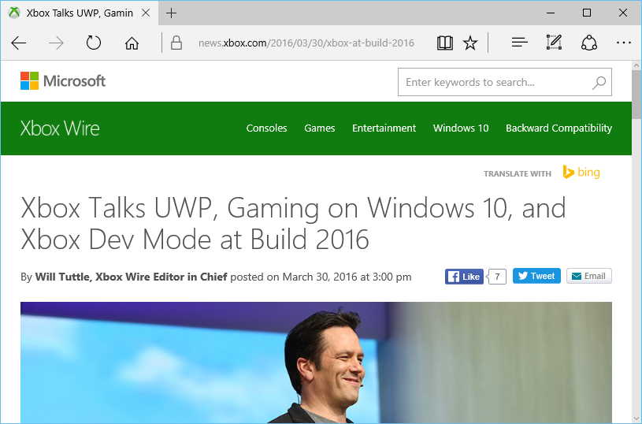
Things to Know: From Build 2016
Xbox Dev Mode Activation
UWP on Xbox One
Visual Studio 2015 Update 2
Windows 10 Insider Program
Windows 10 Preview SDK
Windows Dev Center
3rd Party Tools
ID@Xbox
https://news.xbox.com/2016/03/30/xbox-at-build-2016/
Notes:
Speaker notes:
Deliver video content or stream video to audiences large or small to any device(Web or Mobile) anywhere reliably and in scale.
Helps you create versatile media workflows for ingesting, encoding, protecting and streaming content to audiences on-demand or broadcast live.
Powerful and extensible platform with broad set of first and third-party capabilities to support complete end-to-end media workflows.
Integration with Office 365 empowers organizations of all sizes helps to use videos to enhance sharing, collaboration and communication.
Azure Media Player, an automated online player solution, supports all the usual industry standards like HTML5 video, Media Source Extensions and rights management through Encrypted Media Extensions. The focus here is on open standards, but on older browsers, the player can fall back on Flash or Silverlight.

Slide 7
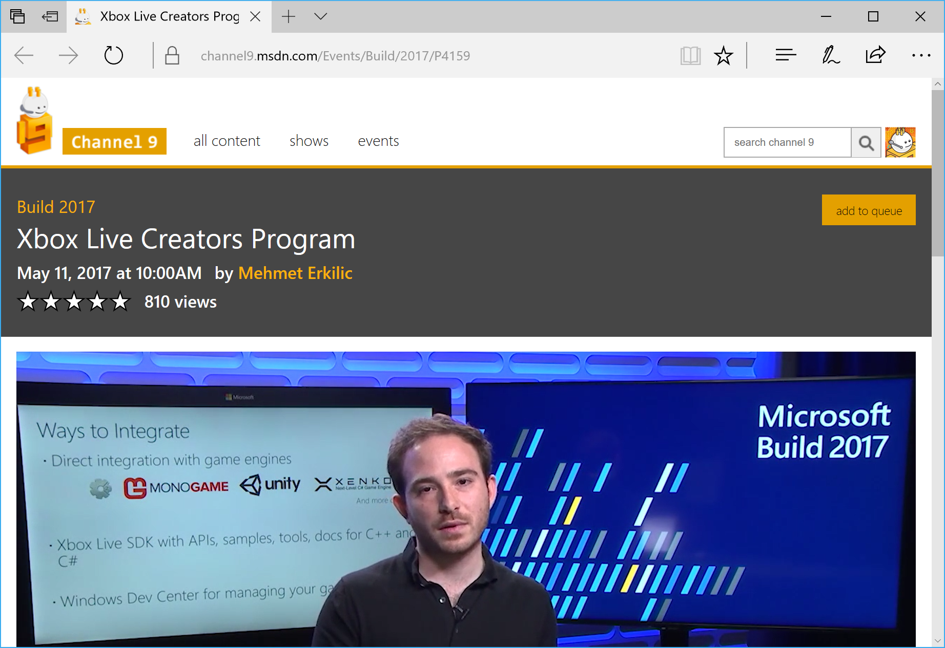
Things to Know: From Build 2017
XBL Creators Program
Simple, Open, Ready
Standard Store Policies
No Licensing
Easy Configuration
Self-Publishing
55M+ Active Gamers
Useful Feature Set
https://channel9.msdn.com/Events/Build/2017/P4159
Notes:
Speaker notes:
Deliver video content or stream video to audiences large or small to any device(Web or Mobile) anywhere reliably and in scale.
Helps you create versatile media workflows for ingesting, encoding, protecting and streaming content to audiences on-demand or broadcast live.
Powerful and extensible platform with broad set of first and third-party capabilities to support complete end-to-end media workflows.
Integration with Office 365 empowers organizations of all sizes helps to use videos to enhance sharing, collaboration and communication.
Azure Media Player, an automated online player solution, supports all the usual industry standards like HTML5 video, Media Source Extensions and rights management through Encrypted Media Extensions. The focus here is on open standards, but on older browsers, the player can fall back on Flash or Silverlight.

Slide 8
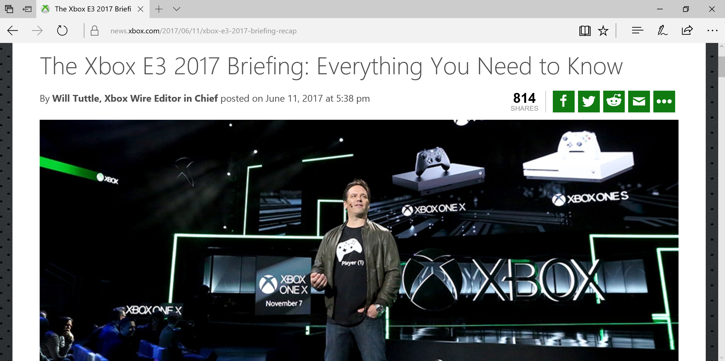
Things to Know: From E3 2017
Xbox One X
4K Gaming
Creators Program
3rd Party Tools
ID@Xbox!
Xbox One S
Xbox One
Back-Compat
https://news.xbox.com/2017/06/11/xbox-e3-2017-briefing-recap/
Notes:
Speaker notes:
Deliver video content or stream video to audiences large or small to any device(Web or Mobile) anywhere reliably and in scale.
Helps you create versatile media workflows for ingesting, encoding, protecting and streaming content to audiences on-demand or broadcast live.
Powerful and extensible platform with broad set of first and third-party capabilities to support complete end-to-end media workflows.
Integration with Office 365 empowers organizations of all sizes helps to use videos to enhance sharing, collaboration and communication.
Azure Media Player, an automated online player solution, supports all the usual industry standards like HTML5 video, Media Source Extensions and rights management through Encrypted Media Extensions. The focus here is on open standards, but on older browsers, the player can fall back on Flash or Silverlight.

Slide 9
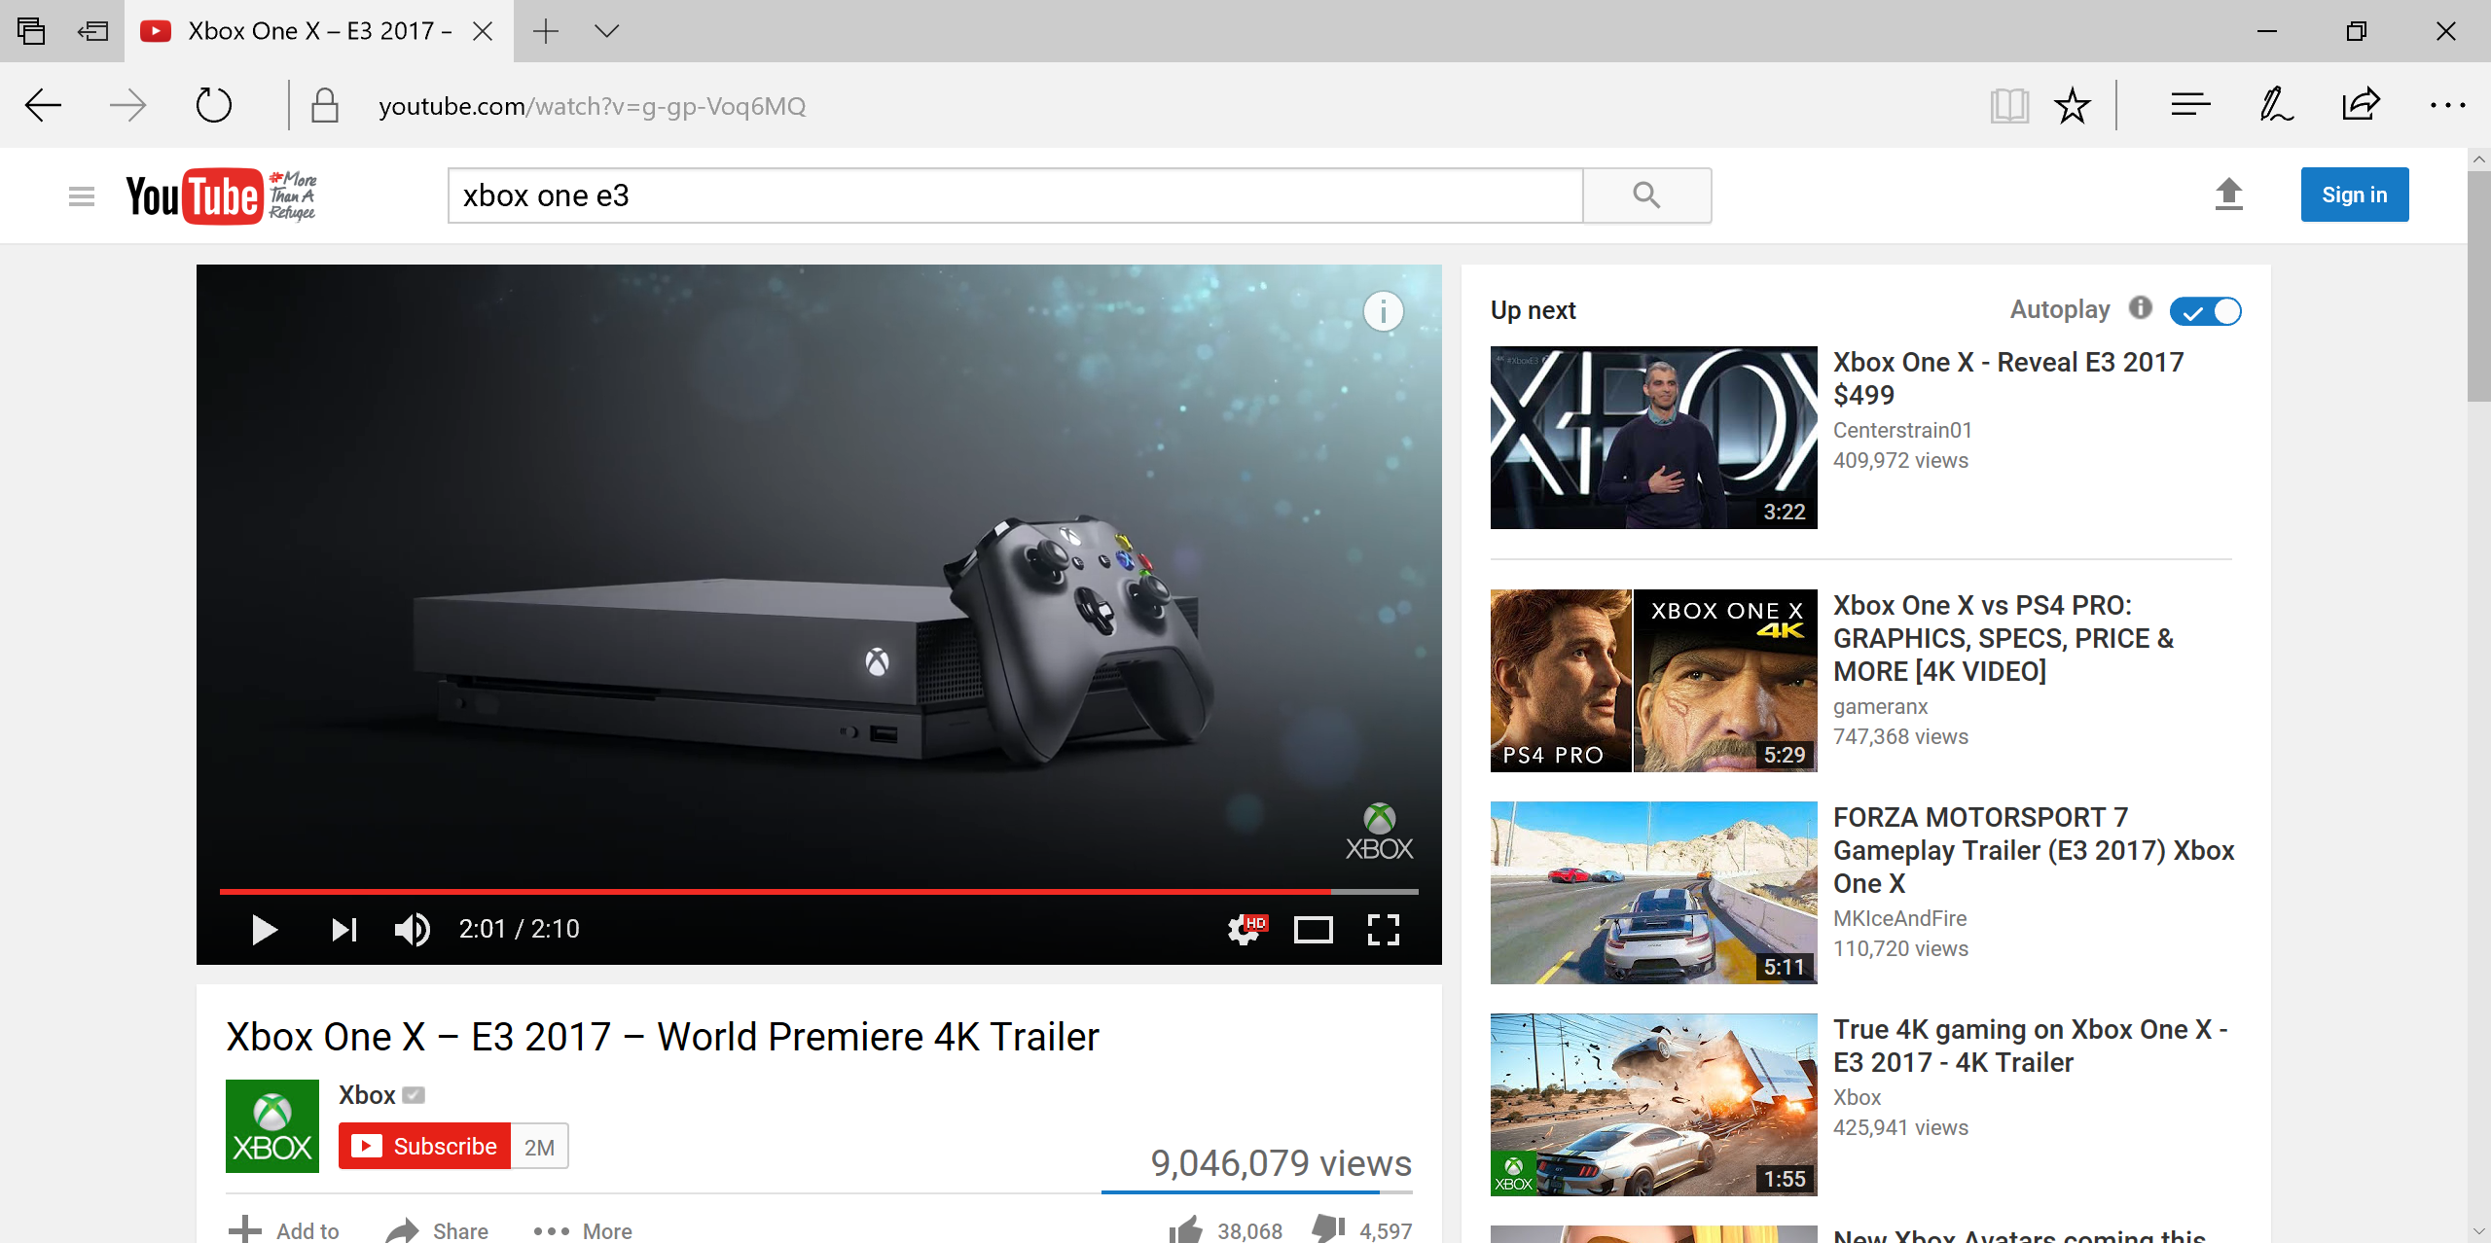
Xbox One X at E3 2017
https://www.youtube.com/watch?v=g-gp-Voq6MQ
Notes:
Speaker notes:
Deliver video content or stream video to audiences large or small to any device(Web or Mobile) anywhere reliably and in scale.
Helps you create versatile media workflows for ingesting, encoding, protecting and streaming content to audiences on-demand or broadcast live.
Powerful and extensible platform with broad set of first and third-party capabilities to support complete end-to-end media workflows.
Integration with Office 365 empowers organizations of all sizes helps to use videos to enhance sharing, collaboration and communication.
Azure Media Player, an automated online player solution, supports all the usual industry standards like HTML5 video, Media Source Extensions and rights management through Encrypted Media Extensions. The focus here is on open standards, but on older browsers, the player can fall back on Flash or Silverlight.

Slide 10
UWP &
Dev Mode
Notes:
Speaker notes:
Deliver video content or stream video to audiences large or small to any device(Web or Mobile) anywhere reliably and in scale.
Helps you create versatile media workflows for ingesting, encoding, protecting and streaming content to audiences on-demand or broadcast live.
Powerful and extensible platform with broad set of first and third-party capabilities to support complete end-to-end media workflows.
Integration with Office 365 empowers organizations of all sizes helps to use videos to enhance sharing, collaboration and communication.
Azure Media Player, an automated online player solution, supports all the usual industry standards like HTML5 video, Media Source Extensions and rights management through Encrypted Media Extensions. The focus here is on open standards, but on older browsers, the player can fall back on Flash or Silverlight.

Slide 11







Developer Opportunities
Community and Engagement Building Tools
GAME DVR
Over 1B game clips from the most trusted promoters: your friends.
LEADERBOARDS & FEATURE STATS
Build asynchronous competition between friends or let players compare their profiles for bragging rights.
CONNECTED STORAGE
Gamer profiles and game saves can roam to any device your game ships to through the Windows Store.
CLUBS
Player-managed experiences to create community around any common interests and the games that they love.
GAME HUBS
Publisher-managed experiences to draw players into a community setting to share or celebrate game media & news!

Slide 12
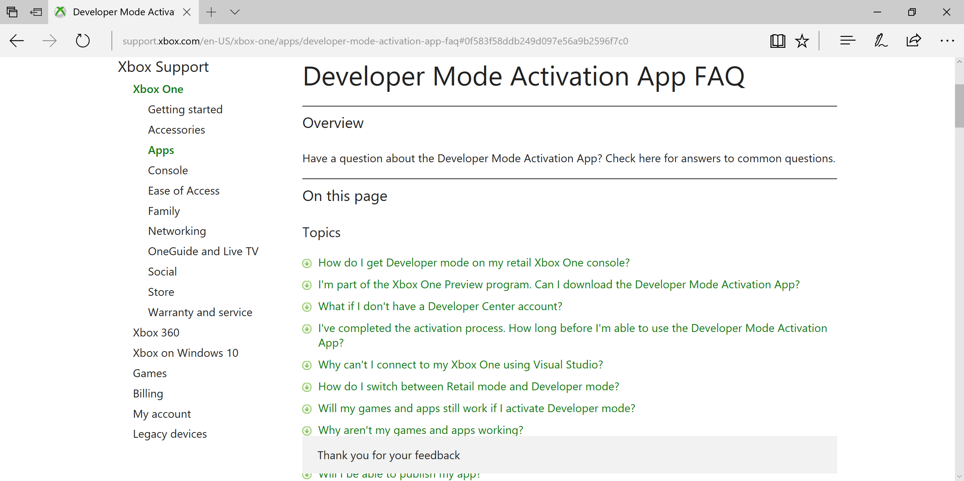
Xbox One Dev Mode Activation
http://support.xbox.com/en-US/xbox-one/apps/developer-mode-activation-app-faq
Notes:
Speaker notes:
Deliver video content or stream video to audiences large or small to any device(Web or Mobile) anywhere reliably and in scale.
Helps you create versatile media workflows for ingesting, encoding, protecting and streaming content to audiences on-demand or broadcast live.
Powerful and extensible platform with broad set of first and third-party capabilities to support complete end-to-end media workflows.
Integration with Office 365 empowers organizations of all sizes helps to use videos to enhance sharing, collaboration and communication.
Azure Media Player, an automated online player solution, supports all the usual industry standards like HTML5 video, Media Source Extensions and rights management through Encrypted Media Extensions. The focus here is on open standards, but on older browsers, the player can fall back on Flash or Silverlight.

Slide 13
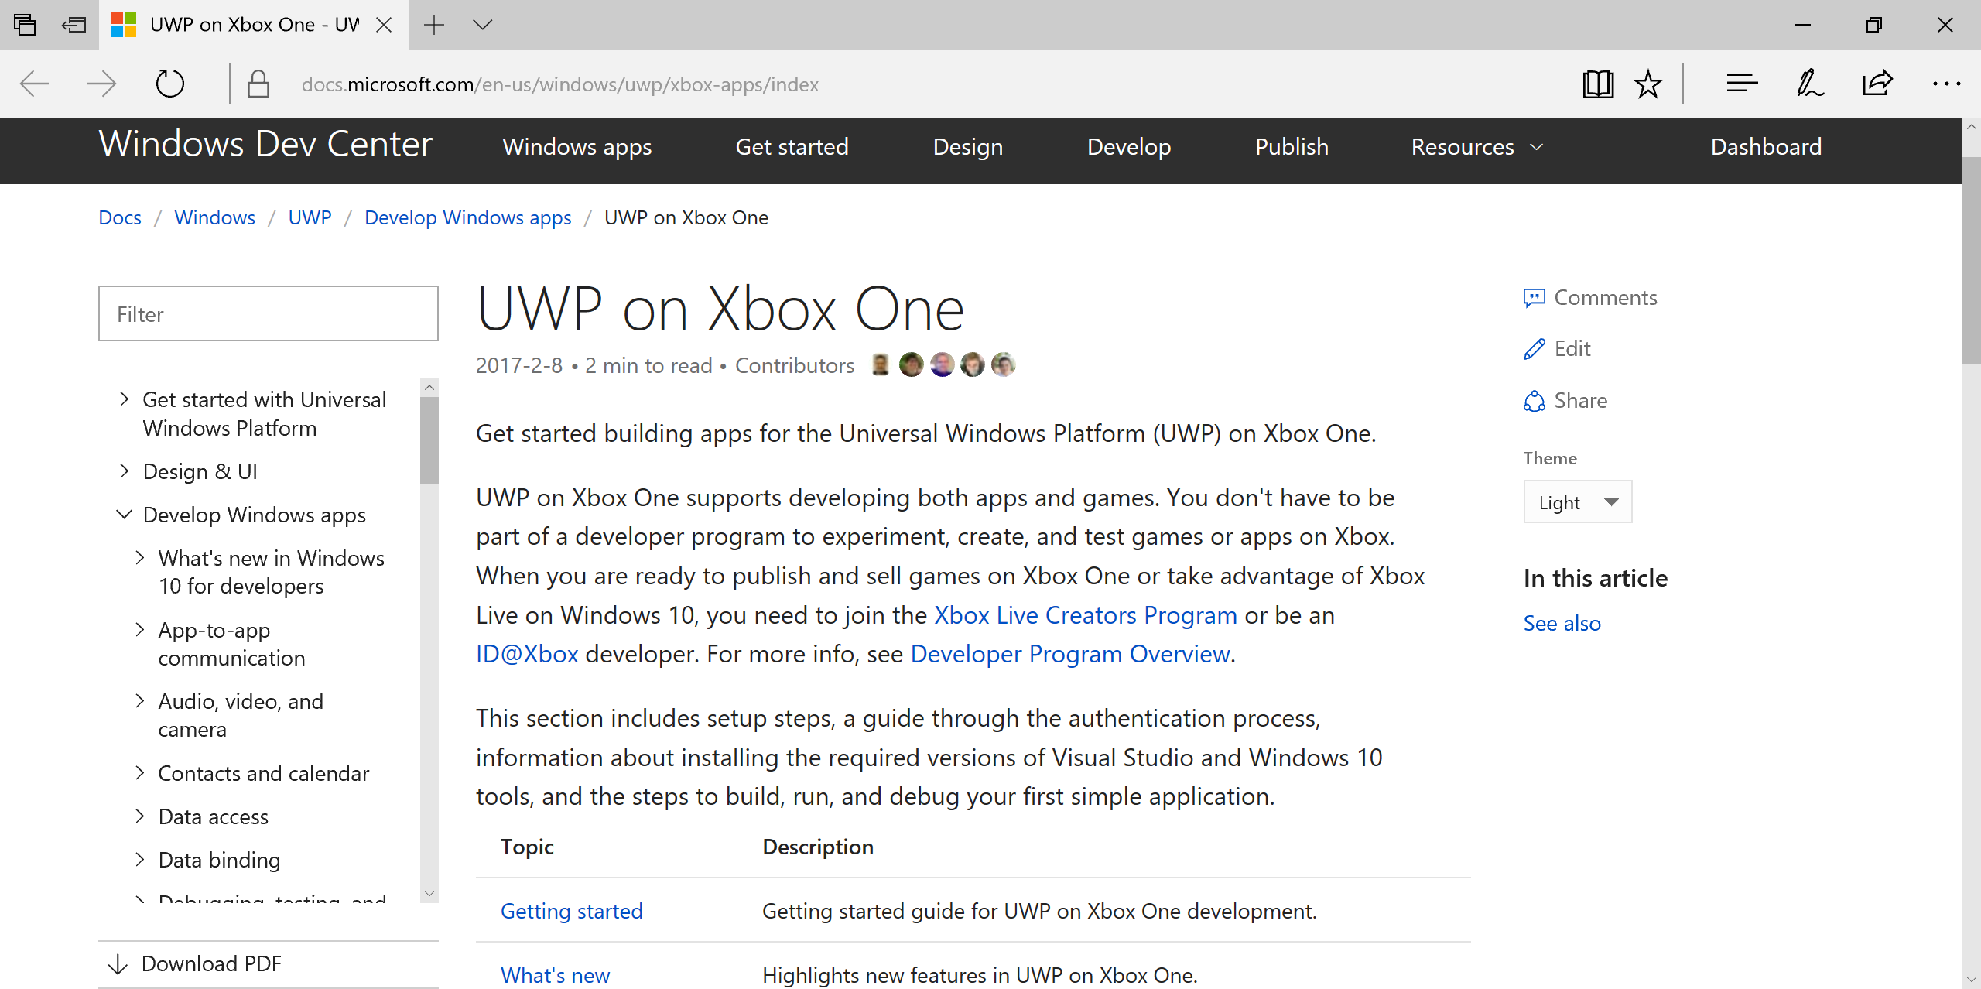
UWP on Xbox One
https://msdn.microsoft.com/en-us/windows/uwp/xbox-apps/index
Notes:
Speaker notes:
Deliver video content or stream video to audiences large or small to any device(Web or Mobile) anywhere reliably and in scale.
Helps you create versatile media workflows for ingesting, encoding, protecting and streaming content to audiences on-demand or broadcast live.
Powerful and extensible platform with broad set of first and third-party capabilities to support complete end-to-end media workflows.
Integration with Office 365 empowers organizations of all sizes helps to use videos to enhance sharing, collaboration and communication.
Azure Media Player, an automated online player solution, supports all the usual industry standards like HTML5 video, Media Source Extensions and rights management through Encrypted Media Extensions. The focus here is on open standards, but on older browsers, the player can fall back on Flash or Silverlight.

Slide 14
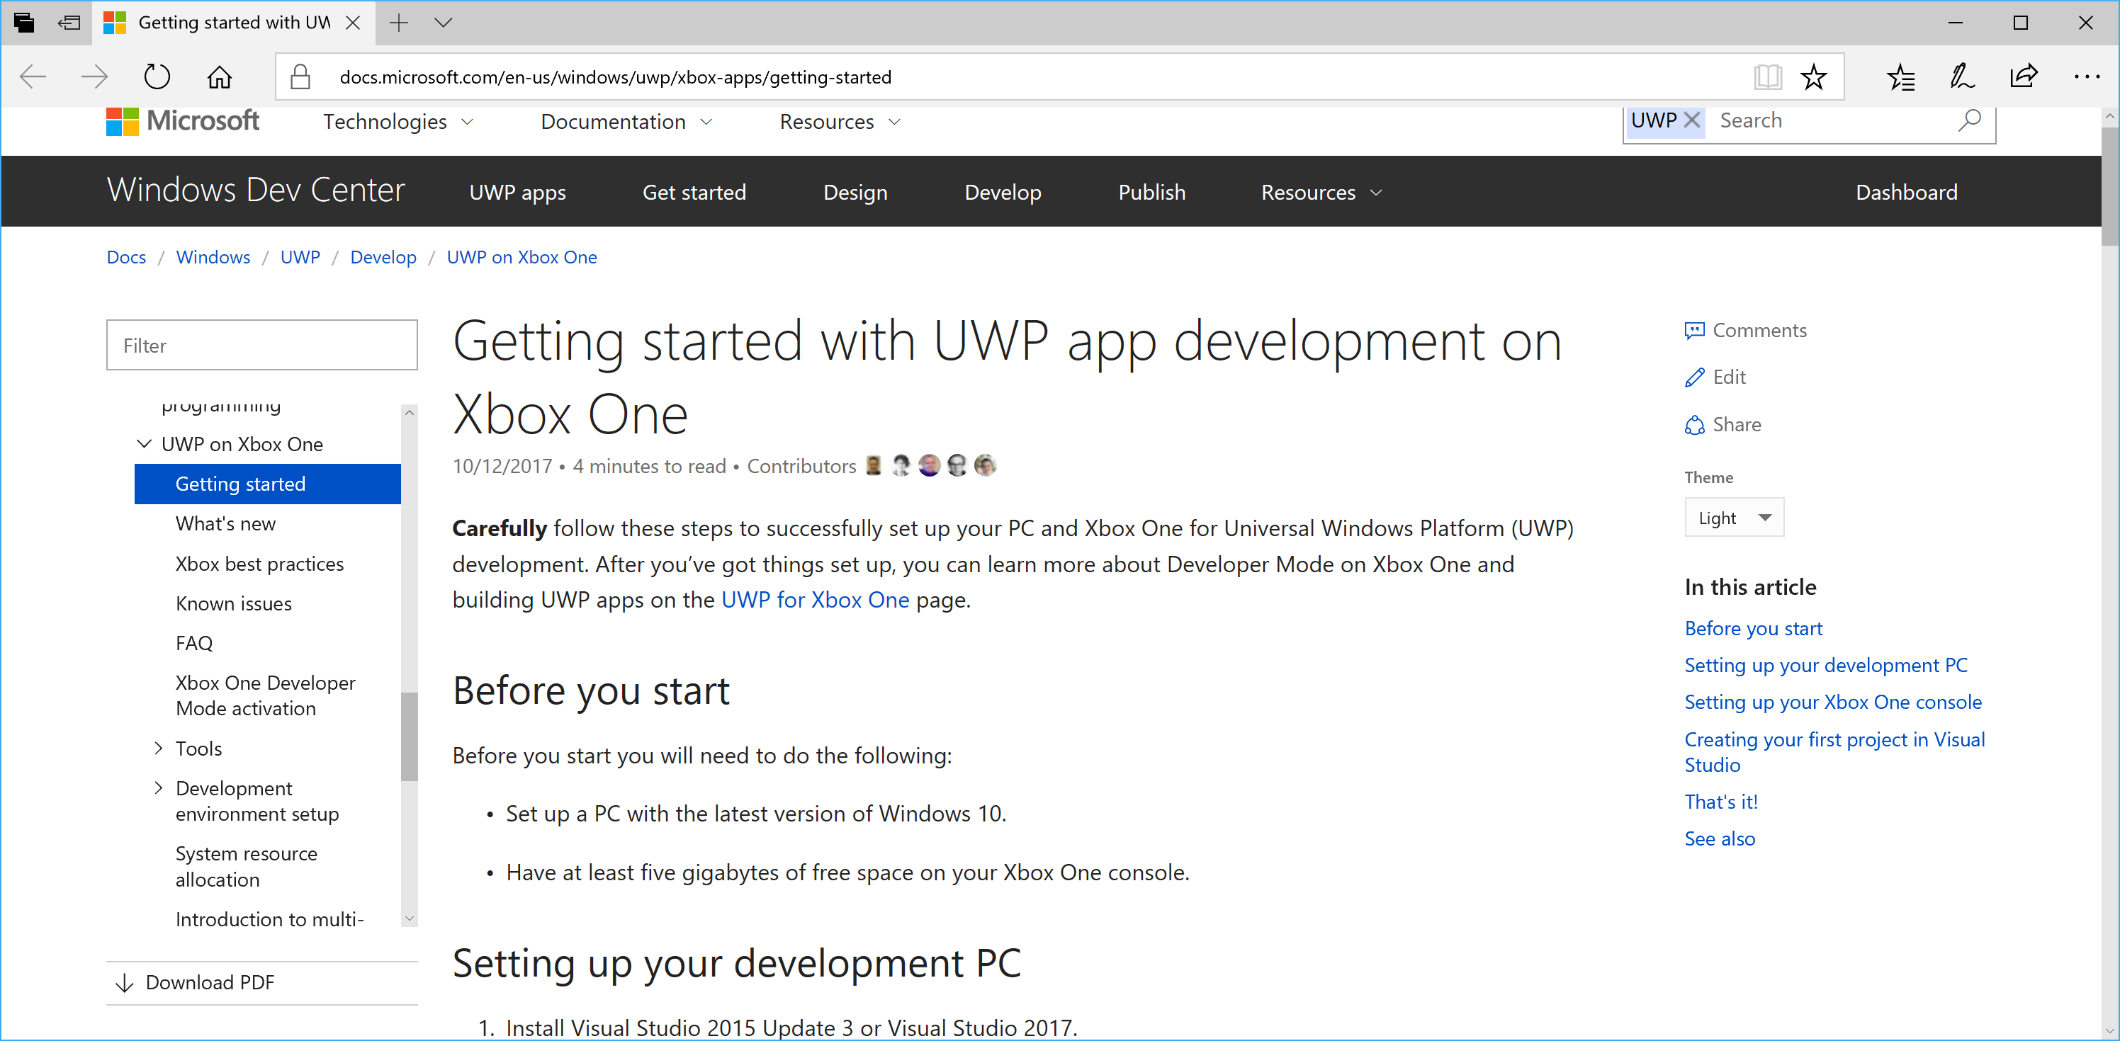
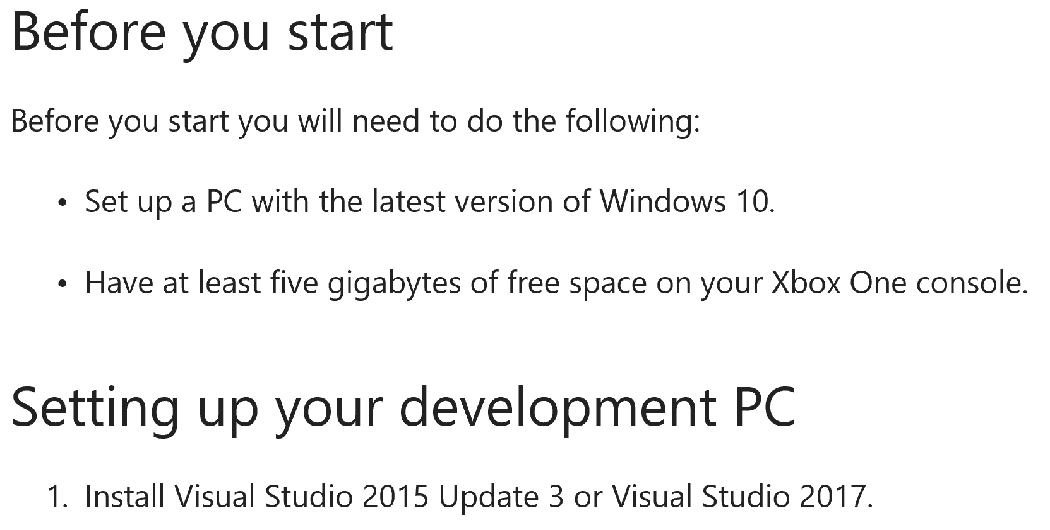
UWP on Xbox One: Getting Started
https://msdn.microsoft.com/en-us/windows/uwp/xbox-apps/getting-started
Notes:
Speaker notes:
Deliver video content or stream video to audiences large or small to any device(Web or Mobile) anywhere reliably and in scale.
Helps you create versatile media workflows for ingesting, encoding, protecting and streaming content to audiences on-demand or broadcast live.
Powerful and extensible platform with broad set of first and third-party capabilities to support complete end-to-end media workflows.
Integration with Office 365 empowers organizations of all sizes helps to use videos to enhance sharing, collaboration and communication.
Azure Media Player, an automated online player solution, supports all the usual industry standards like HTML5 video, Media Source Extensions and rights management through Encrypted Media Extensions. The focus here is on open standards, but on older browsers, the player can fall back on Flash or Silverlight.

Slide 15
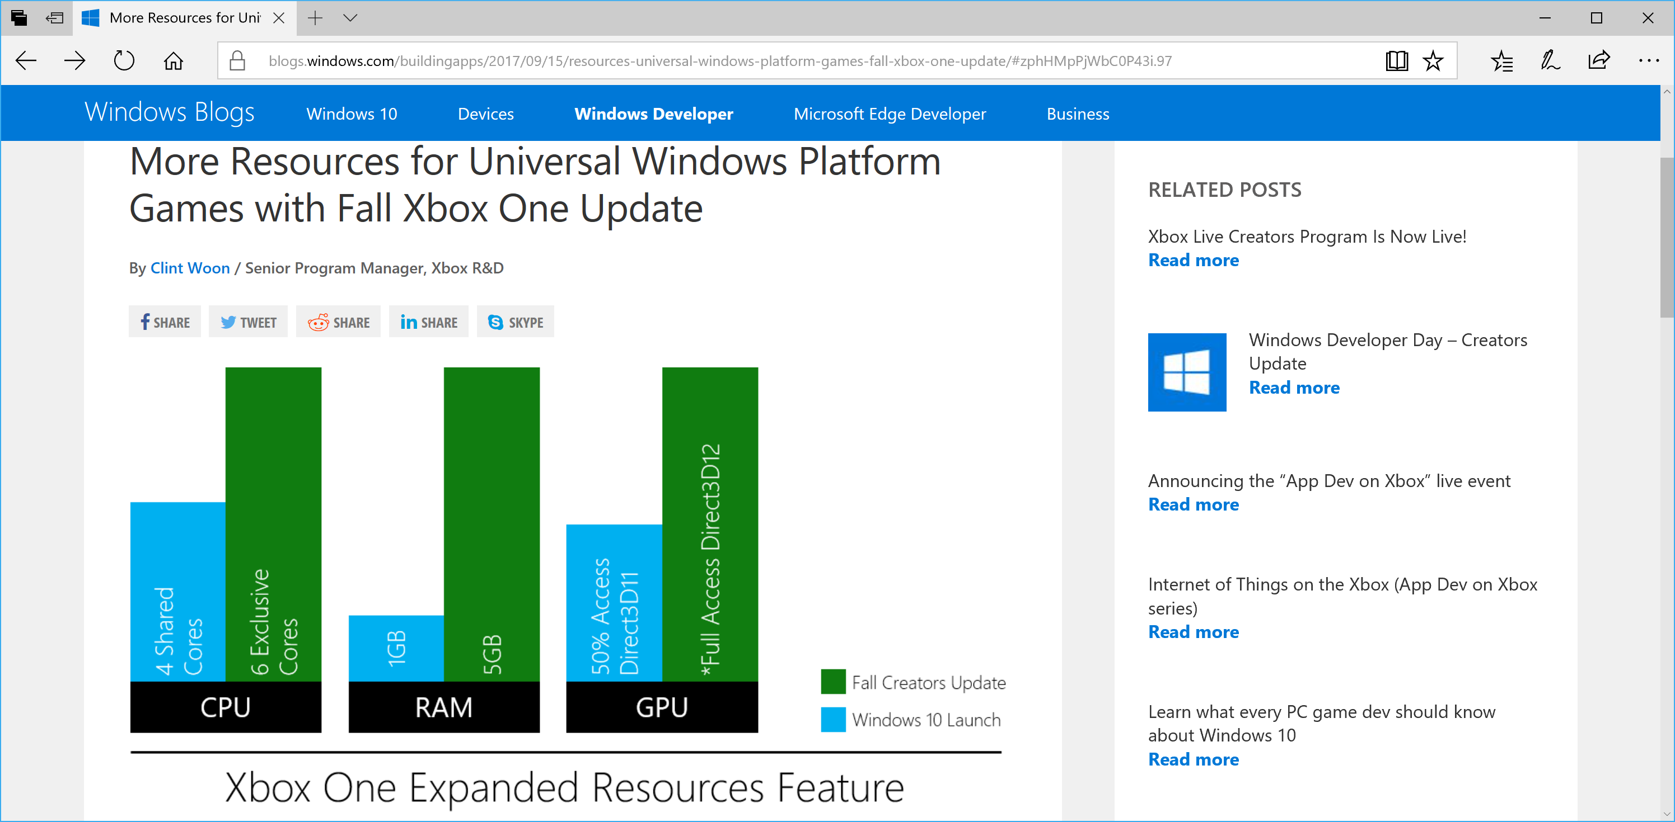
More Resources for UWP!
https://blogs.windows.com/buildingapps/2017/09/15/resources-universal-windows-platform-games-fall-xbox-one-update/
Notes:
Speaker notes:
Deliver video content or stream video to audiences large or small to any device(Web or Mobile) anywhere reliably and in scale.
Helps you create versatile media workflows for ingesting, encoding, protecting and streaming content to audiences on-demand or broadcast live.
Powerful and extensible platform with broad set of first and third-party capabilities to support complete end-to-end media workflows.
Integration with Office 365 empowers organizations of all sizes helps to use videos to enhance sharing, collaboration and communication.
Azure Media Player, an automated online player solution, supports all the usual industry standards like HTML5 video, Media Source Extensions and rights management through Encrypted Media Extensions. The focus here is on open standards, but on older browsers, the player can fall back on Flash or Silverlight.

Slide 16
Xbox Live
Creators Program
Notes:
Speaker notes:
Deliver video content or stream video to audiences large or small to any device(Web or Mobile) anywhere reliably and in scale.
Helps you create versatile media workflows for ingesting, encoding, protecting and streaming content to audiences on-demand or broadcast live.
Powerful and extensible platform with broad set of first and third-party capabilities to support complete end-to-end media workflows.
Integration with Office 365 empowers organizations of all sizes helps to use videos to enhance sharing, collaboration and communication.
Azure Media Player, an automated online player solution, supports all the usual industry standards like HTML5 video, Media Source Extensions and rights management through Encrypted Media Extensions. The focus here is on open standards, but on older browsers, the player can fall back on Flash or Silverlight.

Slide 17
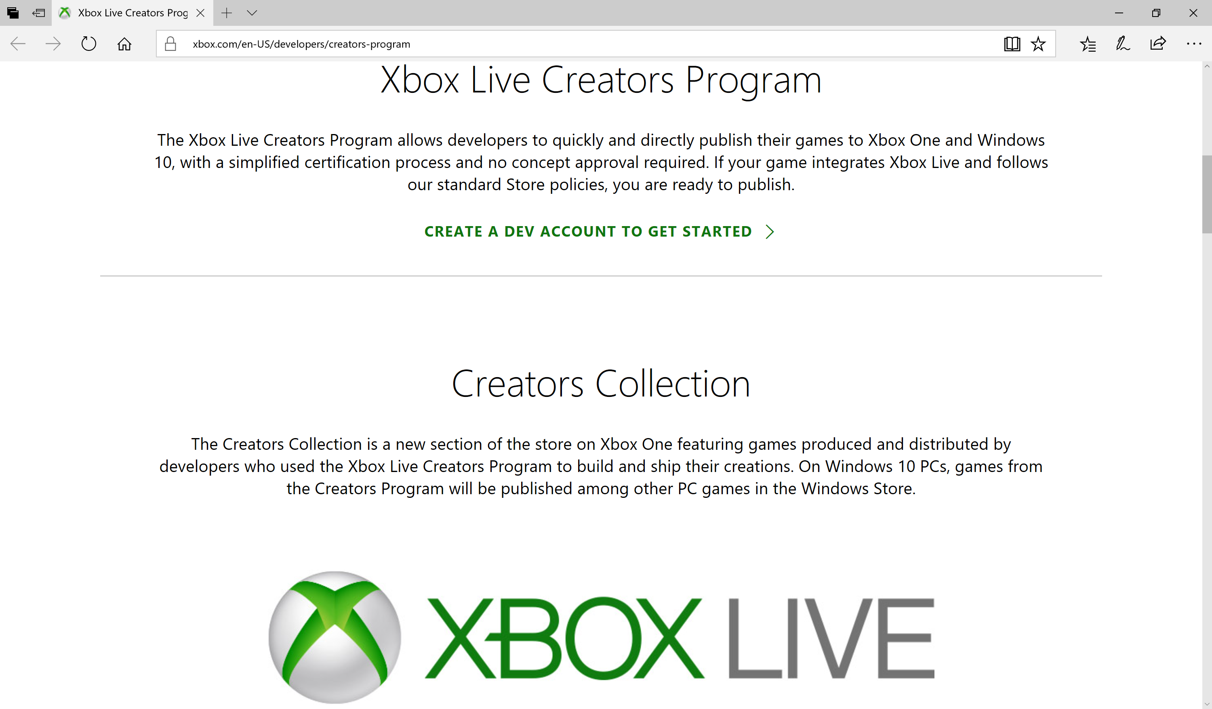
https://developer.microsoft.com/en-us/games/xbox/xboxlive/creator
Notes:
Speaker notes:
Deliver video content or stream video to audiences large or small to any device(Web or Mobile) anywhere reliably and in scale.
Helps you create versatile media workflows for ingesting, encoding, protecting and streaming content to audiences on-demand or broadcast live.
Powerful and extensible platform with broad set of first and third-party capabilities to support complete end-to-end media workflows.
Integration with Office 365 empowers organizations of all sizes helps to use videos to enhance sharing, collaboration and communication.
Azure Media Player, an automated online player solution, supports all the usual industry standards like HTML5 video, Media Source Extensions and rights management through Encrypted Media Extensions. The focus here is on open standards, but on older browsers, the player can fall back on Flash or Silverlight.

Slide 18
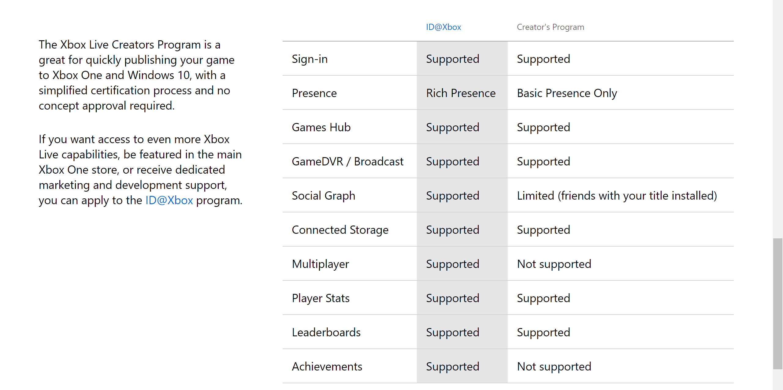
https://developer.microsoft.com/en-us/games/xbox/xboxlive/creator
Notes:
Speaker notes:
Deliver video content or stream video to audiences large or small to any device(Web or Mobile) anywhere reliably and in scale.
Helps you create versatile media workflows for ingesting, encoding, protecting and streaming content to audiences on-demand or broadcast live.
Powerful and extensible platform with broad set of first and third-party capabilities to support complete end-to-end media workflows.
Integration with Office 365 empowers organizations of all sizes helps to use videos to enhance sharing, collaboration and communication.
Azure Media Player, an automated online player solution, supports all the usual industry standards like HTML5 video, Media Source Extensions and rights management through Encrypted Media Extensions. The focus here is on open standards, but on older browsers, the player can fall back on Flash or Silverlight.

Slide 19
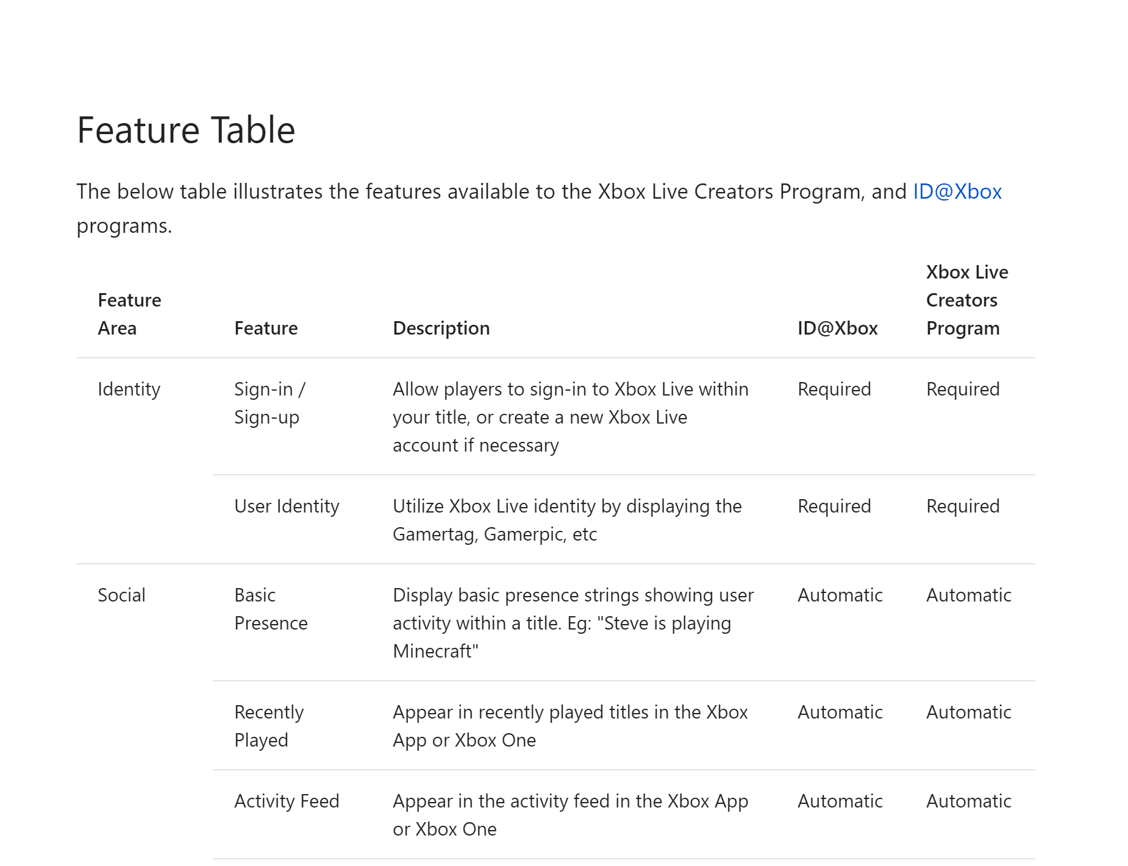
https://docs.microsoft.com/en-us/windows/uwp/xbox-live/developer-program-overview#feature-table
Notes:
Speaker notes:
Deliver video content or stream video to audiences large or small to any device(Web or Mobile) anywhere reliably and in scale.
Helps you create versatile media workflows for ingesting, encoding, protecting and streaming content to audiences on-demand or broadcast live.
Powerful and extensible platform with broad set of first and third-party capabilities to support complete end-to-end media workflows.
Integration with Office 365 empowers organizations of all sizes helps to use videos to enhance sharing, collaboration and communication.
Azure Media Player, an automated online player solution, supports all the usual industry standards like HTML5 video, Media Source Extensions and rights management through Encrypted Media Extensions. The focus here is on open standards, but on older browsers, the player can fall back on Flash or Silverlight.

Slide 20
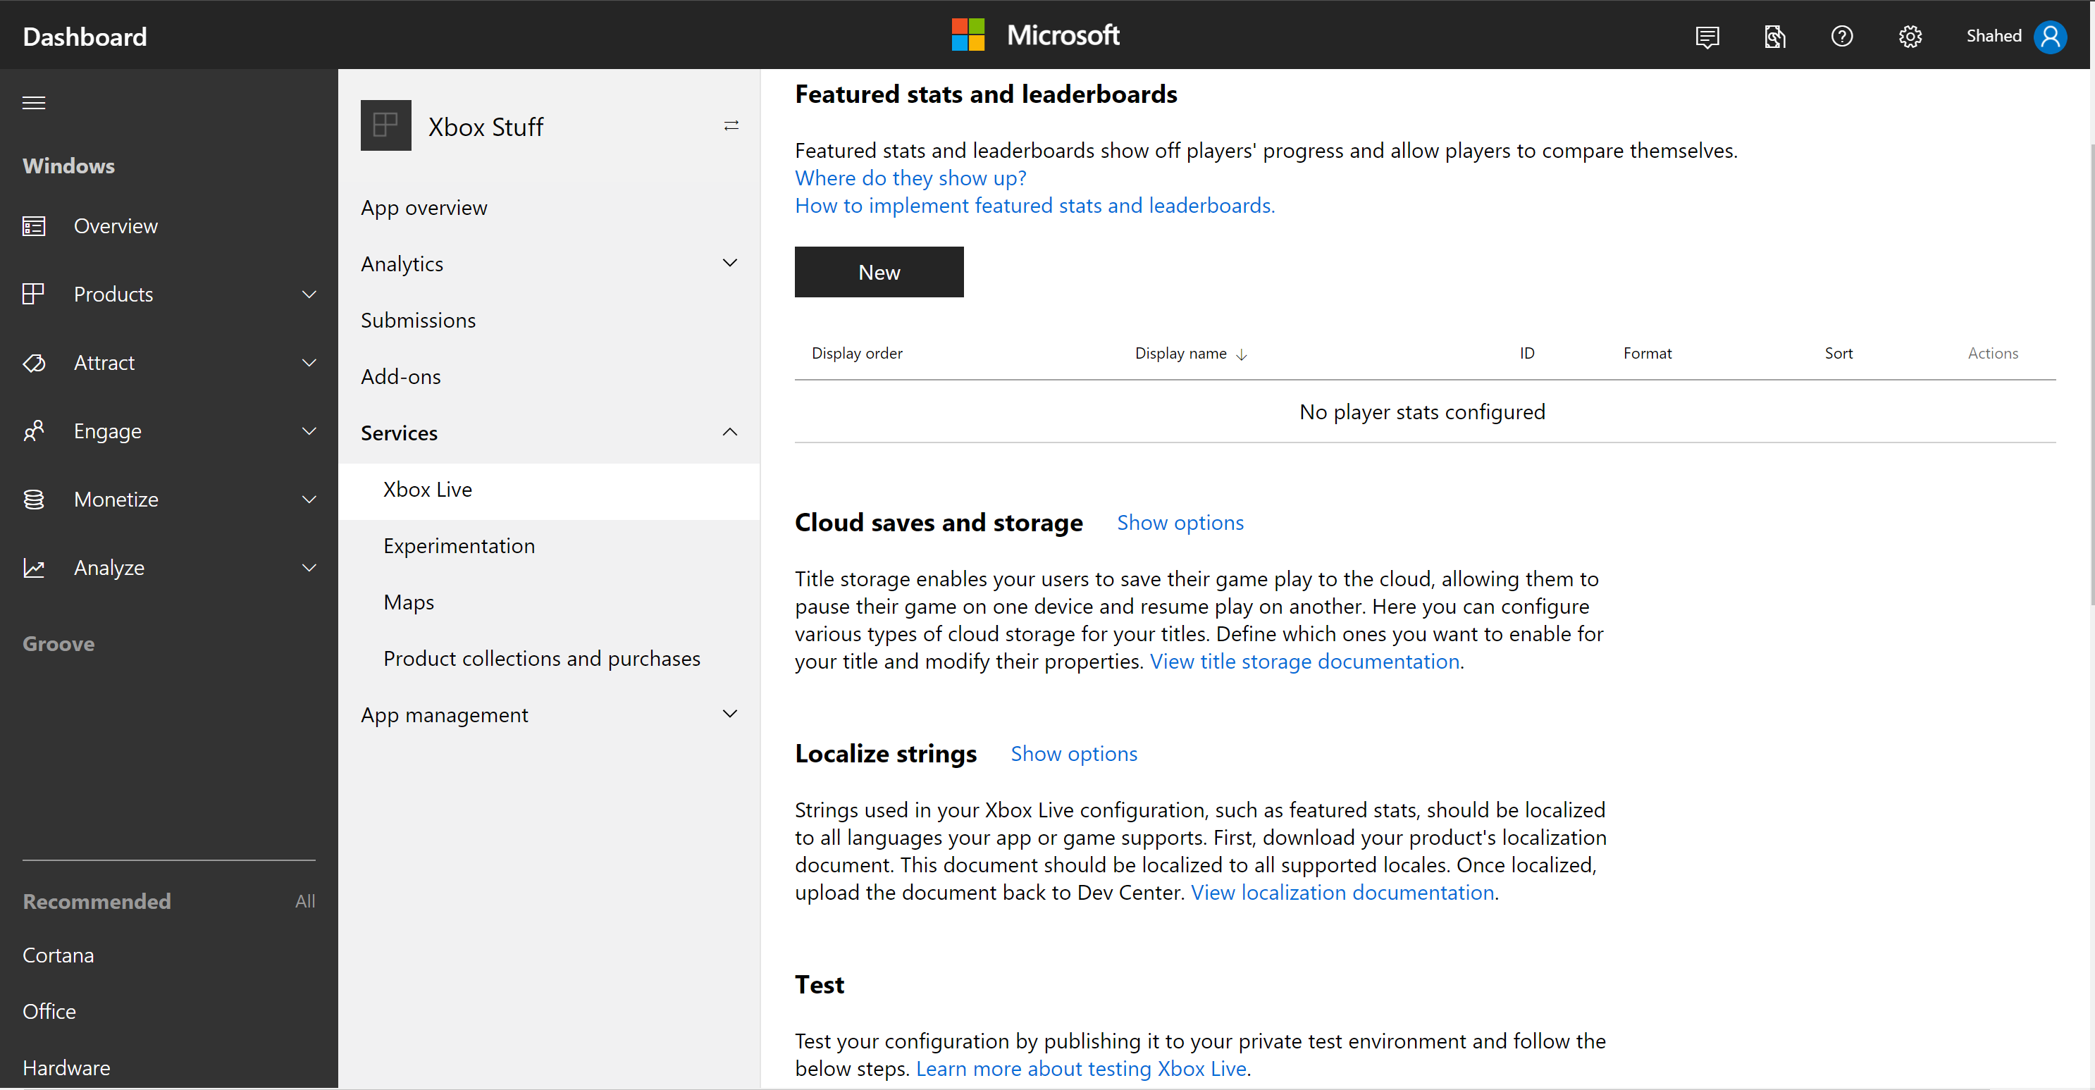
Notes:
Speaker notes:
Deliver video content or stream video to audiences large or small to any device(Web or Mobile) anywhere reliably and in scale.
Helps you create versatile media workflows for ingesting, encoding, protecting and streaming content to audiences on-demand or broadcast live.
Powerful and extensible platform with broad set of first and third-party capabilities to support complete end-to-end media workflows.
Integration with Office 365 empowers organizations of all sizes helps to use videos to enhance sharing, collaboration and communication.
Azure Media Player, an automated online player solution, supports all the usual industry standards like HTML5 video, Media Source Extensions and rights management through Encrypted Media Extensions. The focus here is on open standards, but on older browsers, the player can fall back on Flash or Silverlight.

Slide 21
Visual Studio & Windows 10
Notes:
Speaker notes:
Deliver video content or stream video to audiences large or small to any device(Web or Mobile) anywhere reliably and in scale.
Helps you create versatile media workflows for ingesting, encoding, protecting and streaming content to audiences on-demand or broadcast live.
Powerful and extensible platform with broad set of first and third-party capabilities to support complete end-to-end media workflows.
Integration with Office 365 empowers organizations of all sizes helps to use videos to enhance sharing, collaboration and communication.
Azure Media Player, an automated online player solution, supports all the usual industry standards like HTML5 video, Media Source Extensions and rights management through Encrypted Media Extensions. The focus here is on open standards, but on older browsers, the player can fall back on Flash or Silverlight.

Slide 22
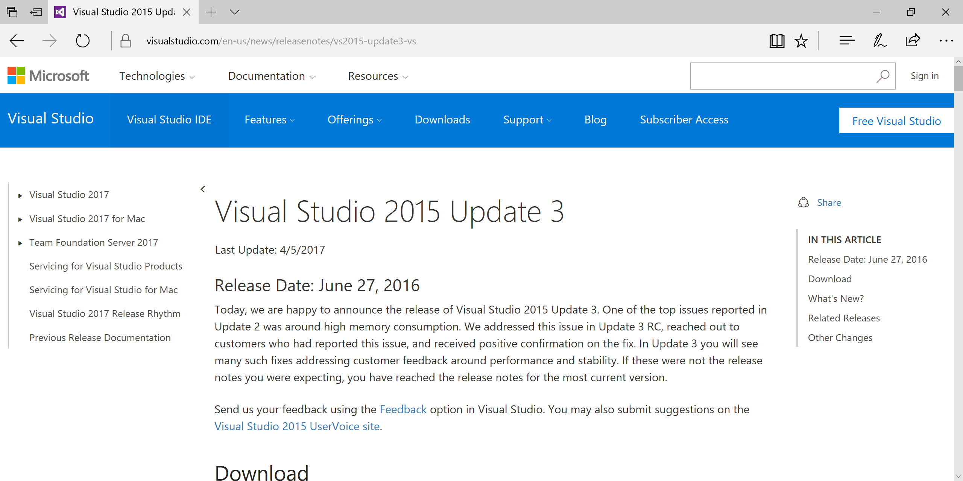
Visual Studio 2015 Update 3
https://www.visualstudio.com/en-us/news/releasenotes/vs2015-update3-vs
Notes:
Speaker notes:
Deliver video content or stream video to audiences large or small to any device(Web or Mobile) anywhere reliably and in scale.
Helps you create versatile media workflows for ingesting, encoding, protecting and streaming content to audiences on-demand or broadcast live.
Powerful and extensible platform with broad set of first and third-party capabilities to support complete end-to-end media workflows.
Integration with Office 365 empowers organizations of all sizes helps to use videos to enhance sharing, collaboration and communication.
Azure Media Player, an automated online player solution, supports all the usual industry standards like HTML5 video, Media Source Extensions and rights management through Encrypted Media Extensions. The focus here is on open standards, but on older browsers, the player can fall back on Flash or Silverlight.

Slide 23
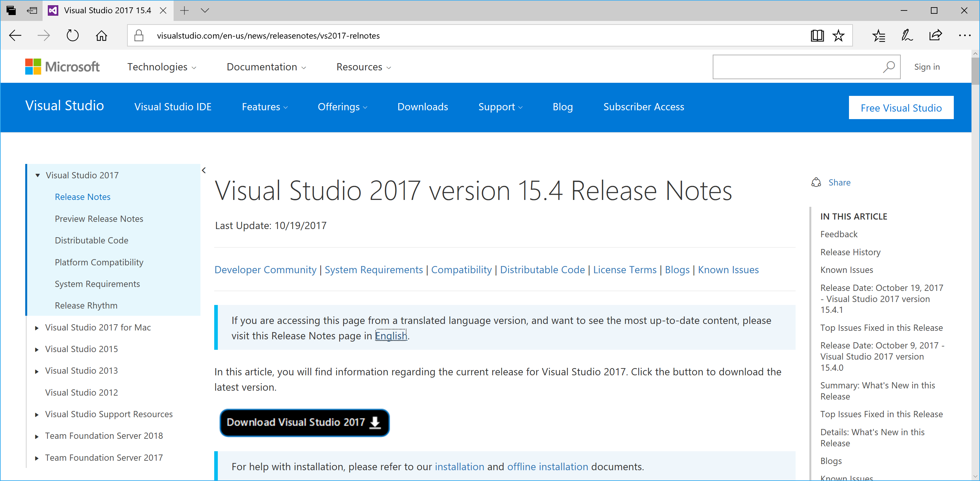
Visual Studio 2017
https://www.visualstudio.com/en-us/news/releasenotes/vs2017-relnotes
Notes:
Speaker notes:
Deliver video content or stream video to audiences large or small to any device(Web or Mobile) anywhere reliably and in scale.
Helps you create versatile media workflows for ingesting, encoding, protecting and streaming content to audiences on-demand or broadcast live.
Powerful and extensible platform with broad set of first and third-party capabilities to support complete end-to-end media workflows.
Integration with Office 365 empowers organizations of all sizes helps to use videos to enhance sharing, collaboration and communication.
Azure Media Player, an automated online player solution, supports all the usual industry standards like HTML5 video, Media Source Extensions and rights management through Encrypted Media Extensions. The focus here is on open standards, but on older browsers, the player can fall back on Flash or Silverlight.

Slide 24
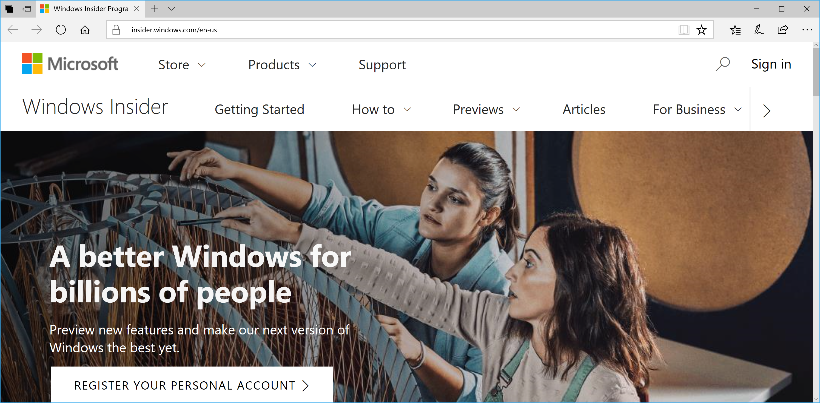
(OPTIONAL) Windows 10 Insider Program
https://insider.windows.com/
Notes:
Speaker notes:
Deliver video content or stream video to audiences large or small to any device(Web or Mobile) anywhere reliably and in scale.
Helps you create versatile media workflows for ingesting, encoding, protecting and streaming content to audiences on-demand or broadcast live.
Powerful and extensible platform with broad set of first and third-party capabilities to support complete end-to-end media workflows.
Integration with Office 365 empowers organizations of all sizes helps to use videos to enhance sharing, collaboration and communication.
Azure Media Player, an automated online player solution, supports all the usual industry standards like HTML5 video, Media Source Extensions and rights management through Encrypted Media Extensions. The focus here is on open standards, but on older browsers, the player can fall back on Flash or Silverlight.

Slide 25
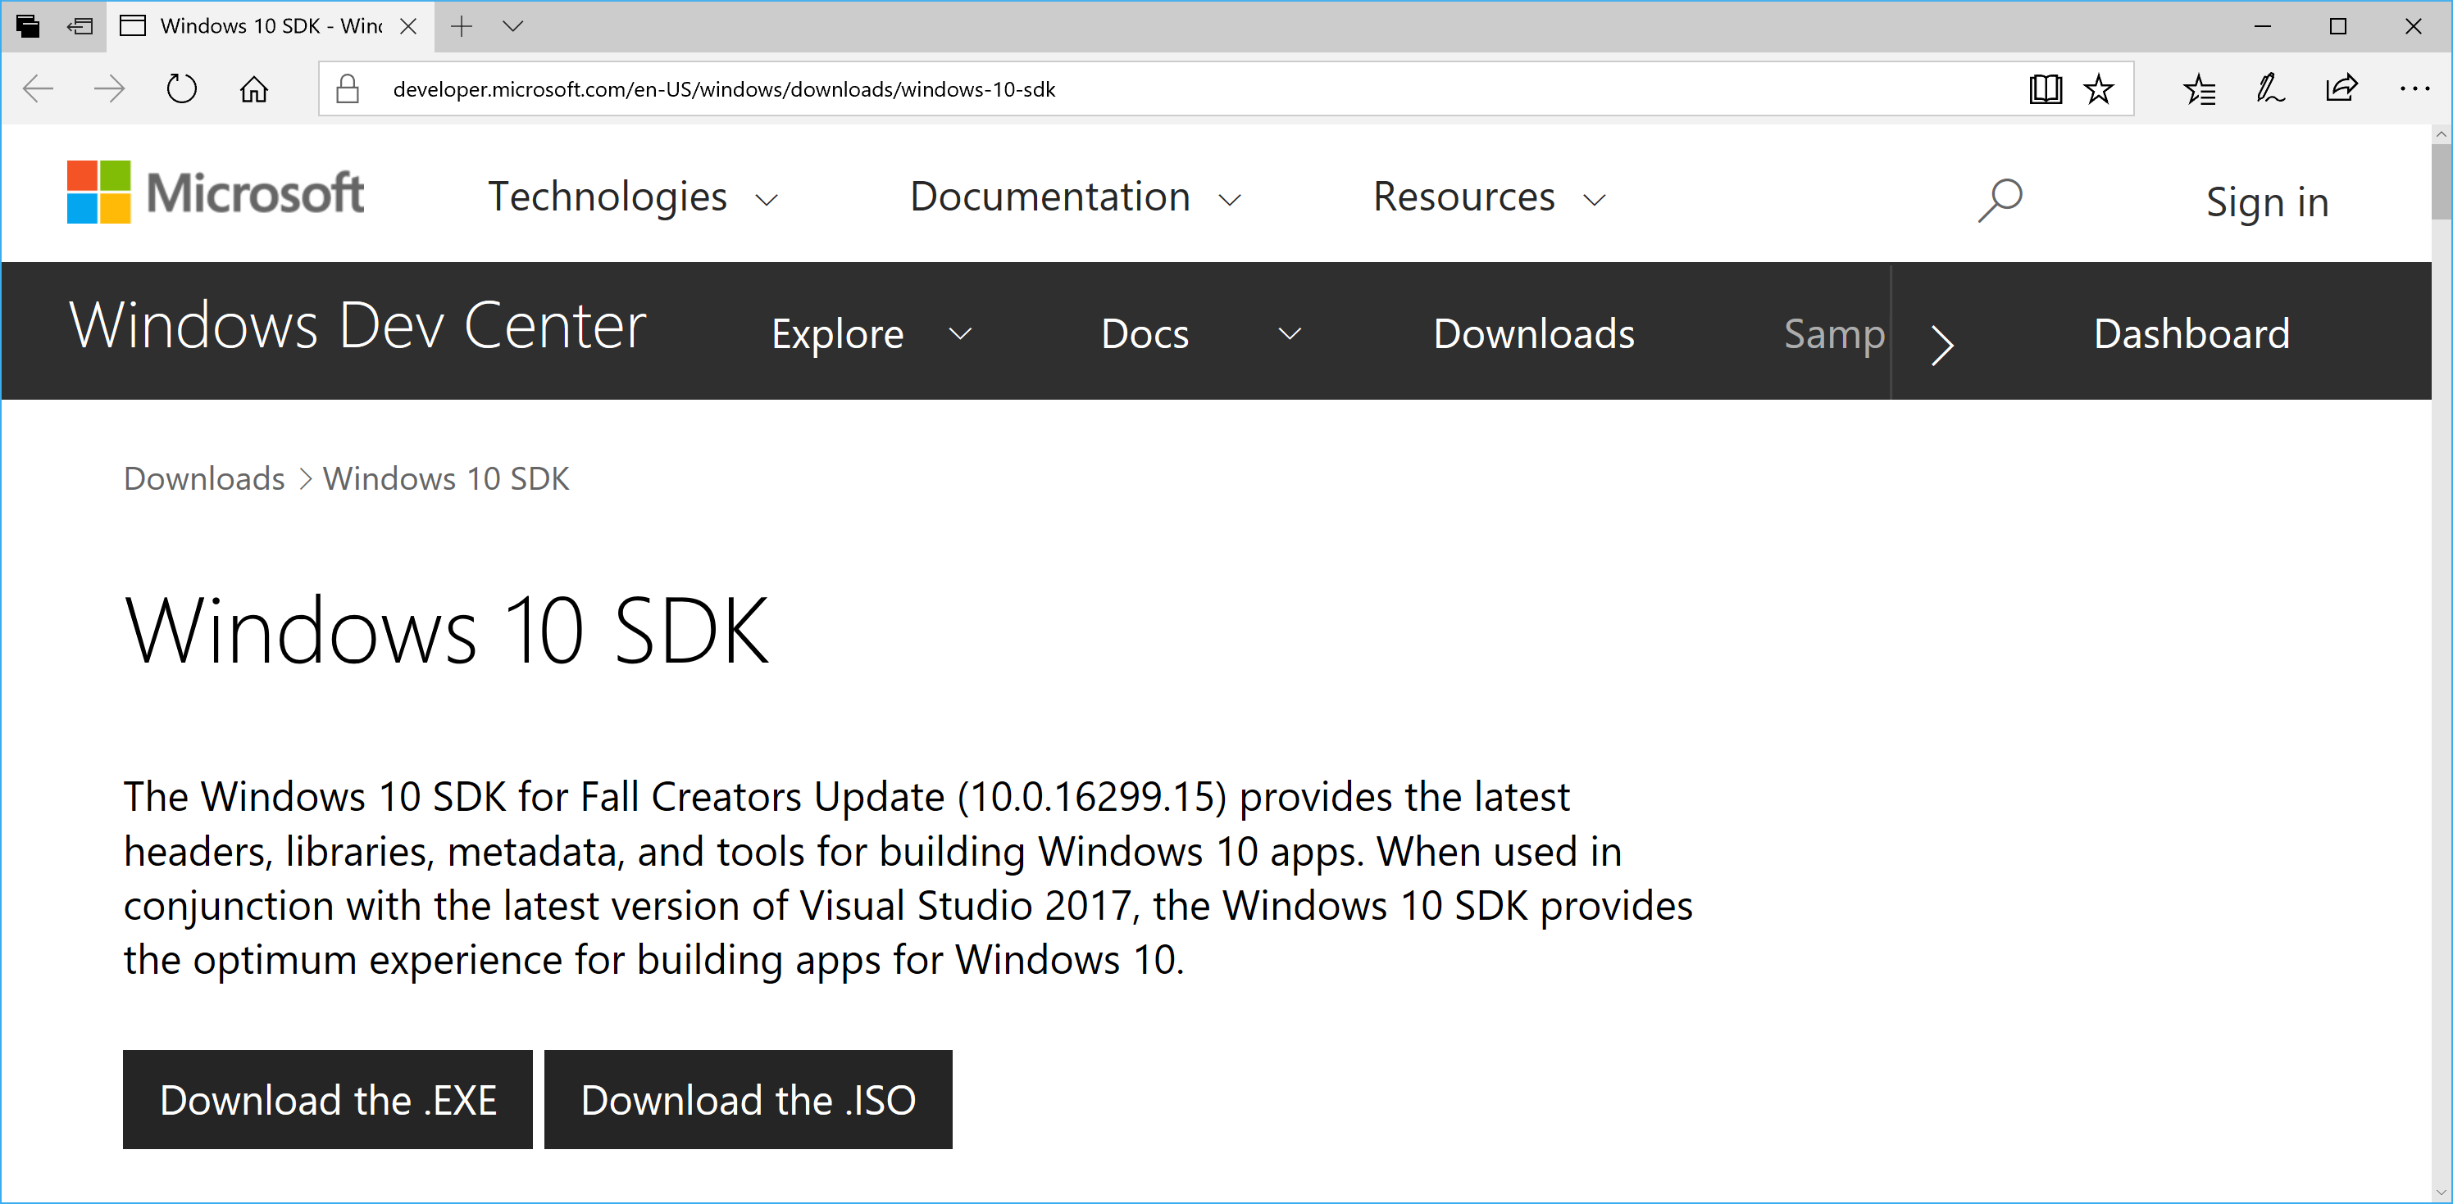
Standalone Windows 10 SDK (included with VS2017)
https://developer.microsoft.com/en-US/windows/downloads/windows-10-sdk
Notes:
Speaker notes:
Deliver video content or stream video to audiences large or small to any device(Web or Mobile) anywhere reliably and in scale.
Helps you create versatile media workflows for ingesting, encoding, protecting and streaming content to audiences on-demand or broadcast live.
Powerful and extensible platform with broad set of first and third-party capabilities to support complete end-to-end media workflows.
Integration with Office 365 empowers organizations of all sizes helps to use videos to enhance sharing, collaboration and communication.
Azure Media Player, an automated online player solution, supports all the usual industry standards like HTML5 video, Media Source Extensions and rights management through Encrypted Media Extensions. The focus here is on open standards, but on older browsers, the player can fall back on Flash or Silverlight.

Slide 26
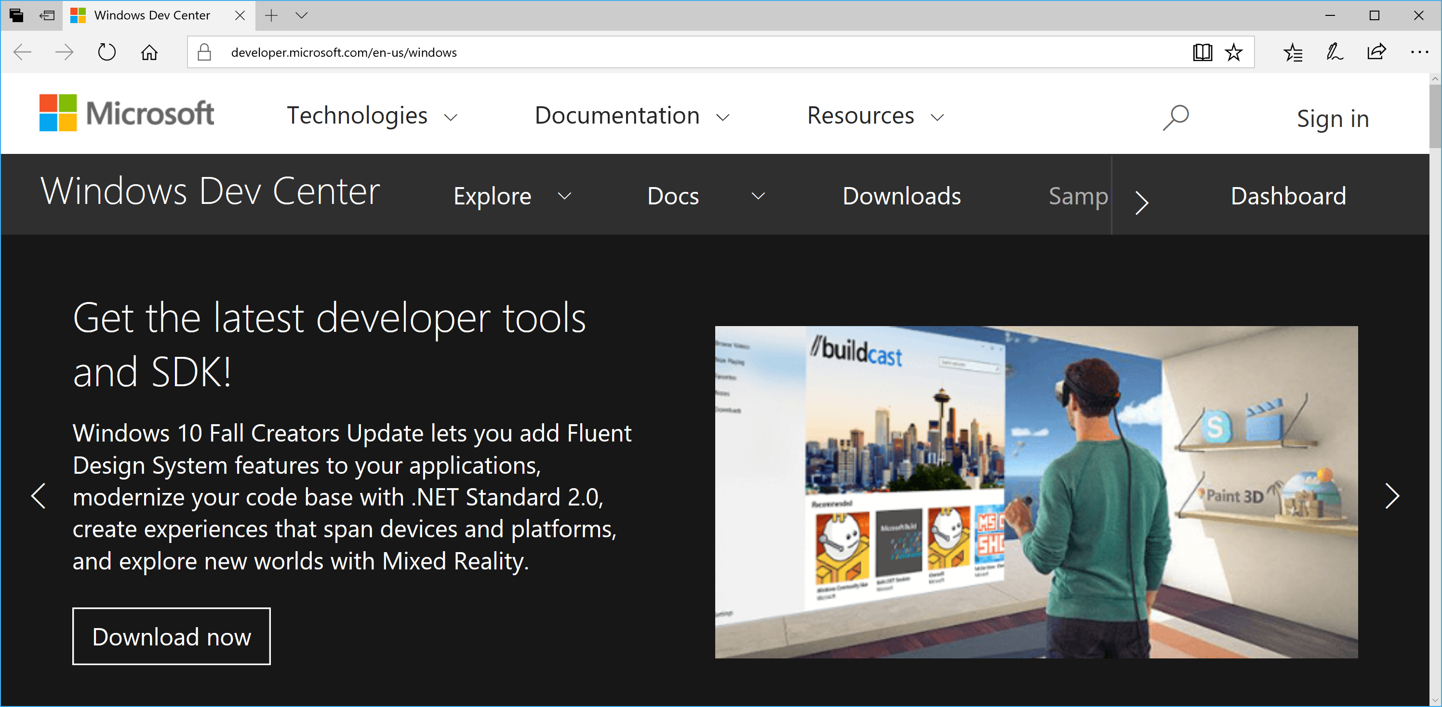
Windows Dev Center
http://dev.windows.com
https://developer.microsoft.com/en-us/windows
Notes:
Speaker notes:
Deliver video content or stream video to audiences large or small to any device(Web or Mobile) anywhere reliably and in scale.
Helps you create versatile media workflows for ingesting, encoding, protecting and streaming content to audiences on-demand or broadcast live.
Powerful and extensible platform with broad set of first and third-party capabilities to support complete end-to-end media workflows.
Integration with Office 365 empowers organizations of all sizes helps to use videos to enhance sharing, collaboration and communication.
Azure Media Player, an automated online player solution, supports all the usual industry standards like HTML5 video, Media Source Extensions and rights management through Encrypted Media Extensions. The focus here is on open standards, but on older browsers, the player can fall back on Flash or Silverlight.

Slide 27
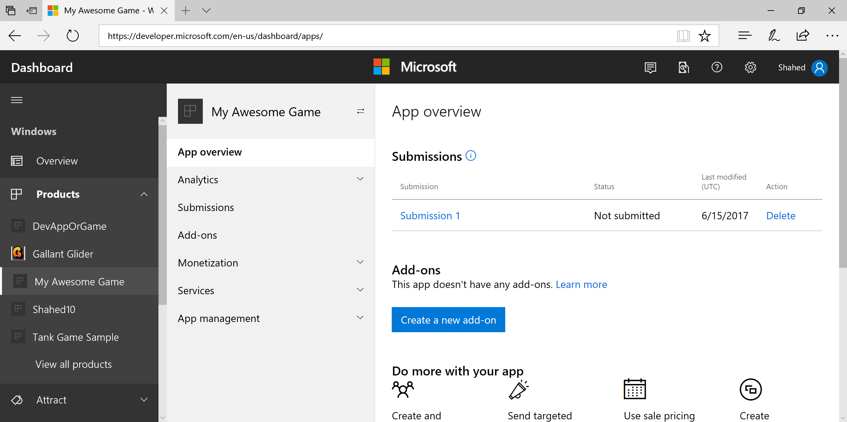
Windows Dev Center: Dashboard
Notes:
Speaker notes:
Deliver video content or stream video to audiences large or small to any device(Web or Mobile) anywhere reliably and in scale.
Helps you create versatile media workflows for ingesting, encoding, protecting and streaming content to audiences on-demand or broadcast live.
Powerful and extensible platform with broad set of first and third-party capabilities to support complete end-to-end media workflows.
Integration with Office 365 empowers organizations of all sizes helps to use videos to enhance sharing, collaboration and communication.
Azure Media Player, an automated online player solution, supports all the usual industry standards like HTML5 video, Media Source Extensions and rights management through Encrypted Media Extensions. The focus here is on open standards, but on older browsers, the player can fall back on Flash or Silverlight.

Slide 28
Unity 2017
& Construct 3
Notes:
Speaker notes:
Deliver video content or stream video to audiences large or small to any device(Web or Mobile) anywhere reliably and in scale.
Helps you create versatile media workflows for ingesting, encoding, protecting and streaming content to audiences on-demand or broadcast live.
Powerful and extensible platform with broad set of first and third-party capabilities to support complete end-to-end media workflows.
Integration with Office 365 empowers organizations of all sizes helps to use videos to enhance sharing, collaboration and communication.
Azure Media Player, an automated online player solution, supports all the usual industry standards like HTML5 video, Media Source Extensions and rights management through Encrypted Media Extensions. The focus here is on open standards, but on older browsers, the player can fall back on Flash or Silverlight.

Slide 29
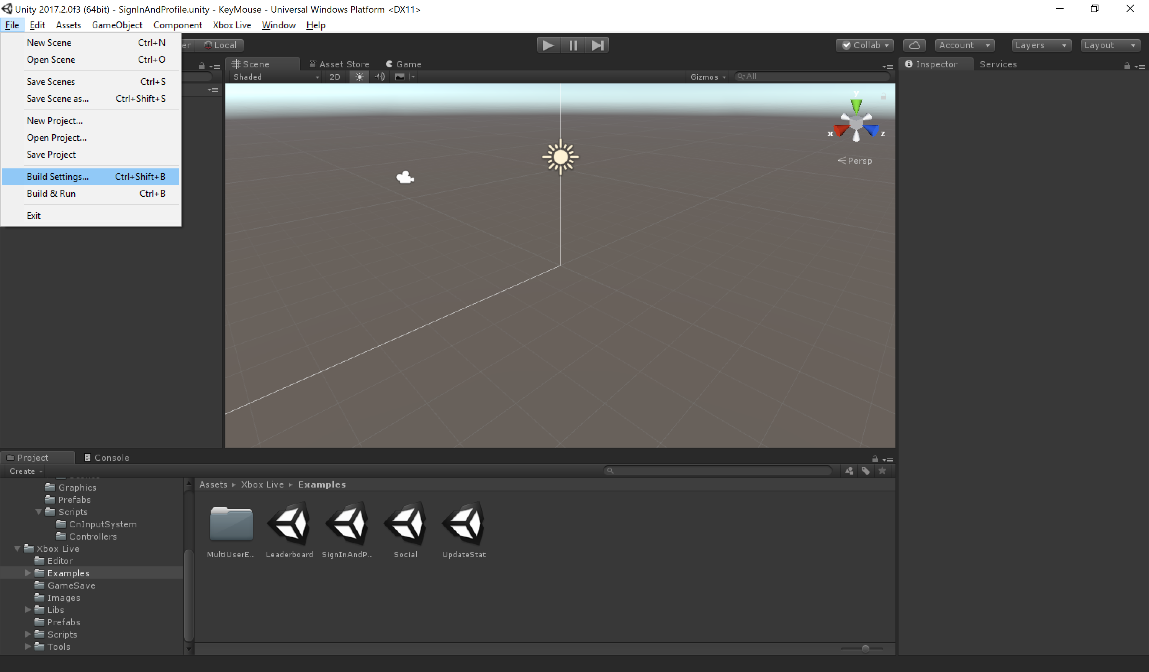
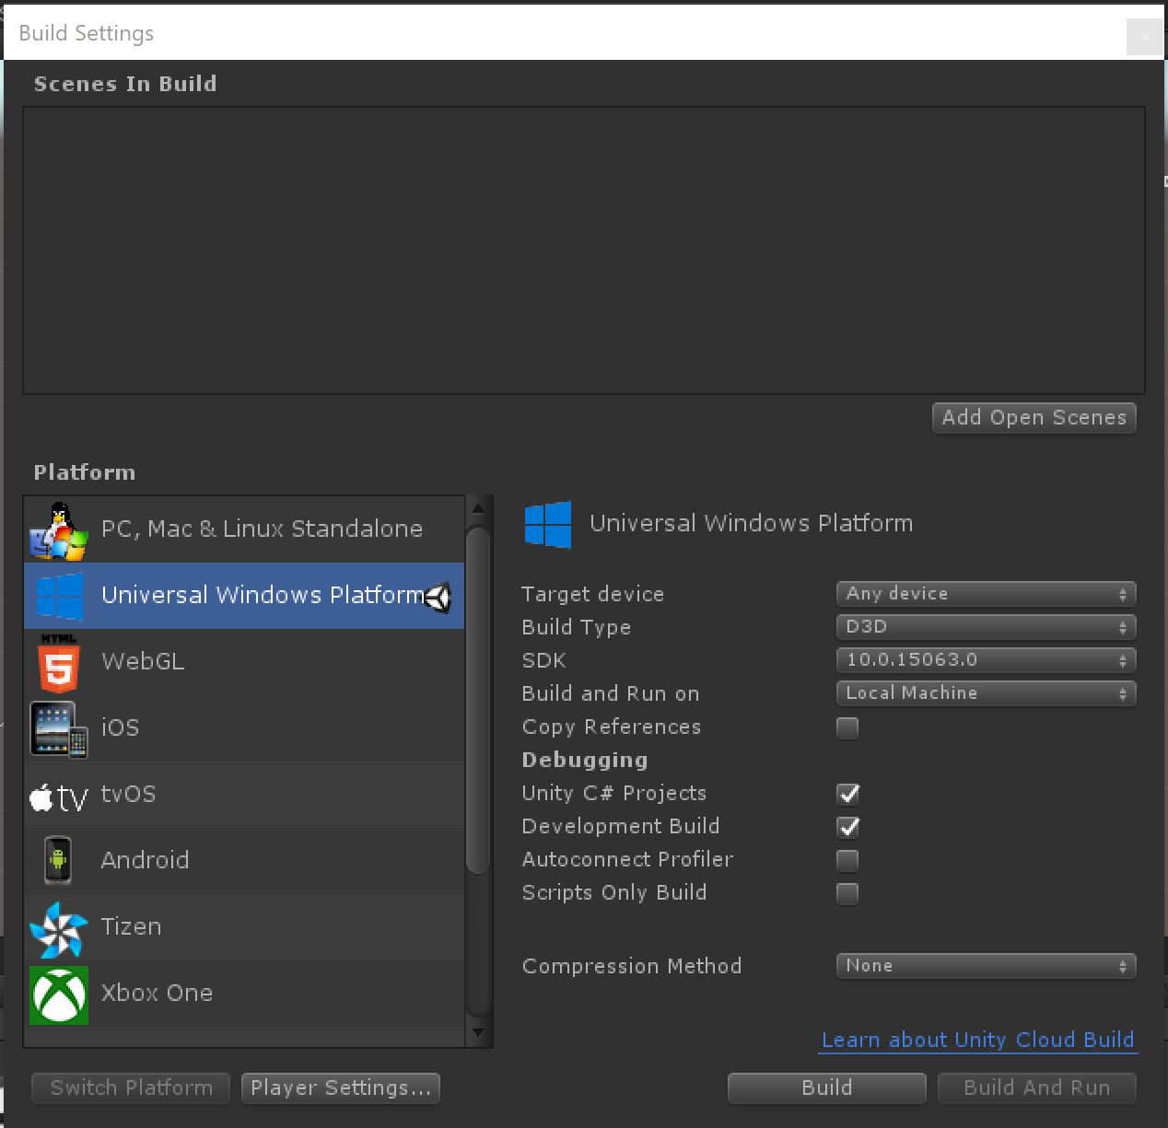
http://unity3d.com
Unity (for 2D & 3D games)
Unity
Notes:
Speaker notes:
Deliver video content or stream video to audiences large or small to any device(Web or Mobile) anywhere reliably and in scale.
Helps you create versatile media workflows for ingesting, encoding, protecting and streaming content to audiences on-demand or broadcast live.
Powerful and extensible platform with broad set of first and third-party capabilities to support complete end-to-end media workflows.
Integration with Office 365 empowers organizations of all sizes helps to use videos to enhance sharing, collaboration and communication.
Azure Media Player, an automated online player solution, supports all the usual industry standards like HTML5 video, Media Source Extensions and rights management through Encrypted Media Extensions. The focus here is on open standards, but on older browsers, the player can fall back on Flash or Silverlight.

Slide 30
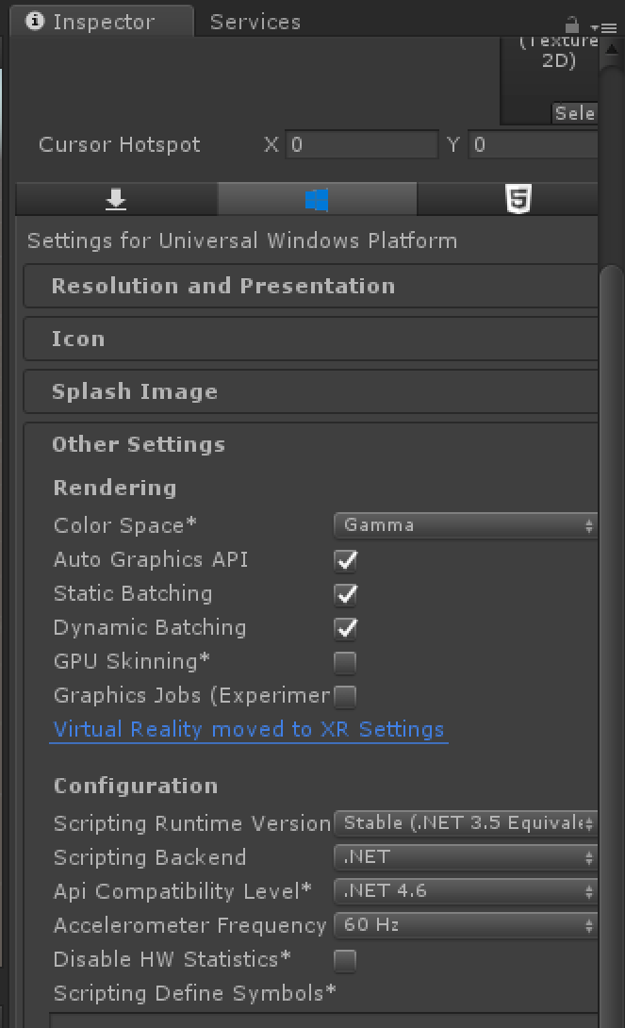
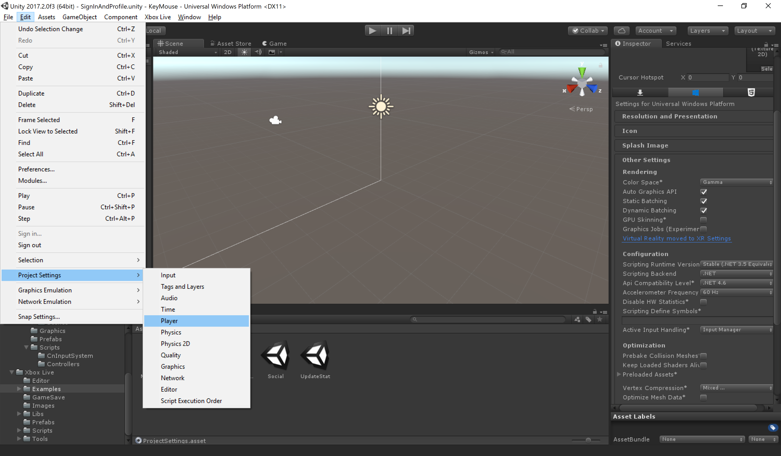
Player Settings: UWP Config
Notes:
Speaker notes:
Deliver video content or stream video to audiences large or small to any device(Web or Mobile) anywhere reliably and in scale.
Helps you create versatile media workflows for ingesting, encoding, protecting and streaming content to audiences on-demand or broadcast live.
Powerful and extensible platform with broad set of first and third-party capabilities to support complete end-to-end media workflows.
Integration with Office 365 empowers organizations of all sizes helps to use videos to enhance sharing, collaboration and communication.
Azure Media Player, an automated online player solution, supports all the usual industry standards like HTML5 video, Media Source Extensions and rights management through Encrypted Media Extensions. The focus here is on open standards, but on older browsers, the player can fall back on Flash or Silverlight.

Slide 31
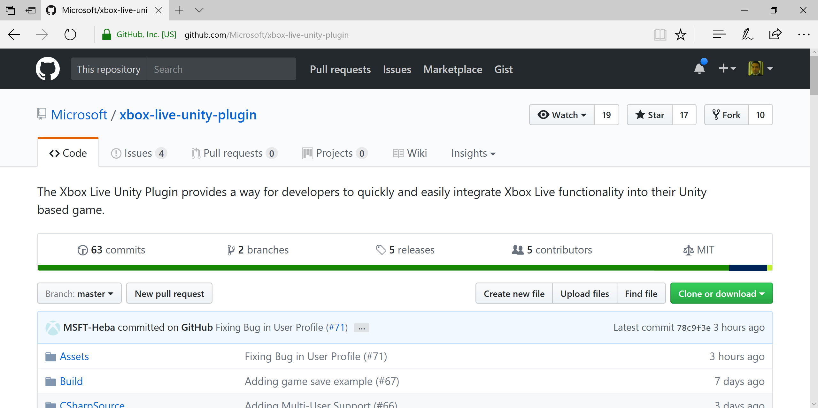
Xbox Live Unity Plugin
https://github.com/Microsoft/xbox-live-unity-plugin
Notes:
Speaker notes:
Deliver video content or stream video to audiences large or small to any device(Web or Mobile) anywhere reliably and in scale.
Helps you create versatile media workflows for ingesting, encoding, protecting and streaming content to audiences on-demand or broadcast live.
Powerful and extensible platform with broad set of first and third-party capabilities to support complete end-to-end media workflows.
Integration with Office 365 empowers organizations of all sizes helps to use videos to enhance sharing, collaboration and communication.
Azure Media Player, an automated online player solution, supports all the usual industry standards like HTML5 video, Media Source Extensions and rights management through Encrypted Media Extensions. The focus here is on open standards, but on older browsers, the player can fall back on Flash or Silverlight.

Slide 32
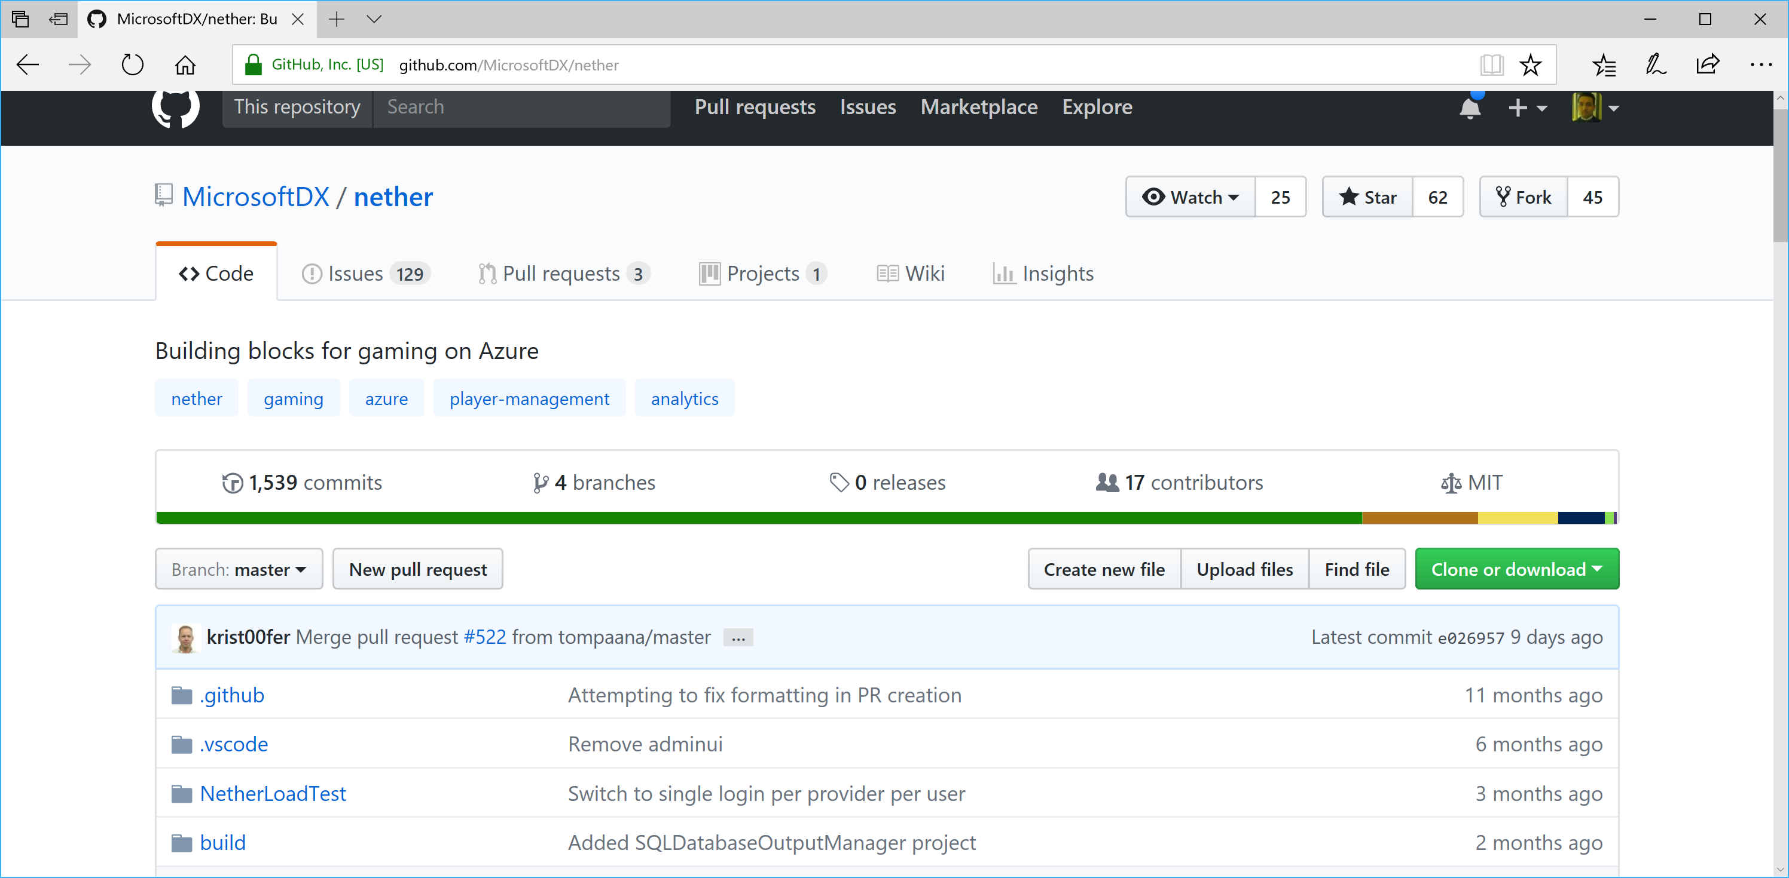
nether for Azure Gaming Services
https://github.com/MicrosoftDX/nether
Notes:
Speaker notes:
Deliver video content or stream video to audiences large or small to any device(Web or Mobile) anywhere reliably and in scale.
Helps you create versatile media workflows for ingesting, encoding, protecting and streaming content to audiences on-demand or broadcast live.
Powerful and extensible platform with broad set of first and third-party capabilities to support complete end-to-end media workflows.
Integration with Office 365 empowers organizations of all sizes helps to use videos to enhance sharing, collaboration and communication.
Azure Media Player, an automated online player solution, supports all the usual industry standards like HTML5 video, Media Source Extensions and rights management through Encrypted Media Extensions. The focus here is on open standards, but on older browsers, the player can fall back on Flash or Silverlight.

Slide 33
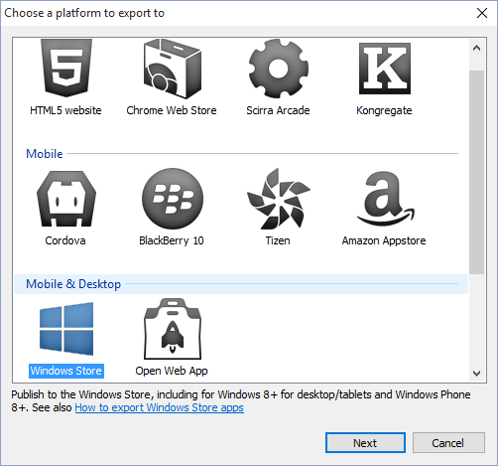
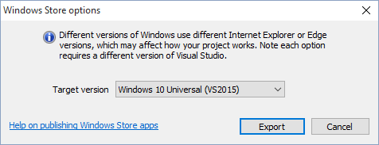
Construct 2, by Scirra (for 2D games)
http://scirra.com
Construct 2 for Windows
Notes:
Speaker notes:
Deliver video content or stream video to audiences large or small to any device(Web or Mobile) anywhere reliably and in scale.
Helps you create versatile media workflows for ingesting, encoding, protecting and streaming content to audiences on-demand or broadcast live.
Powerful and extensible platform with broad set of first and third-party capabilities to support complete end-to-end media workflows.
Integration with Office 365 empowers organizations of all sizes helps to use videos to enhance sharing, collaboration and communication.
Azure Media Player, an automated online player solution, supports all the usual industry standards like HTML5 video, Media Source Extensions and rights management through Encrypted Media Extensions. The focus here is on open standards, but on older browsers, the player can fall back on Flash or Silverlight.

Slide 34
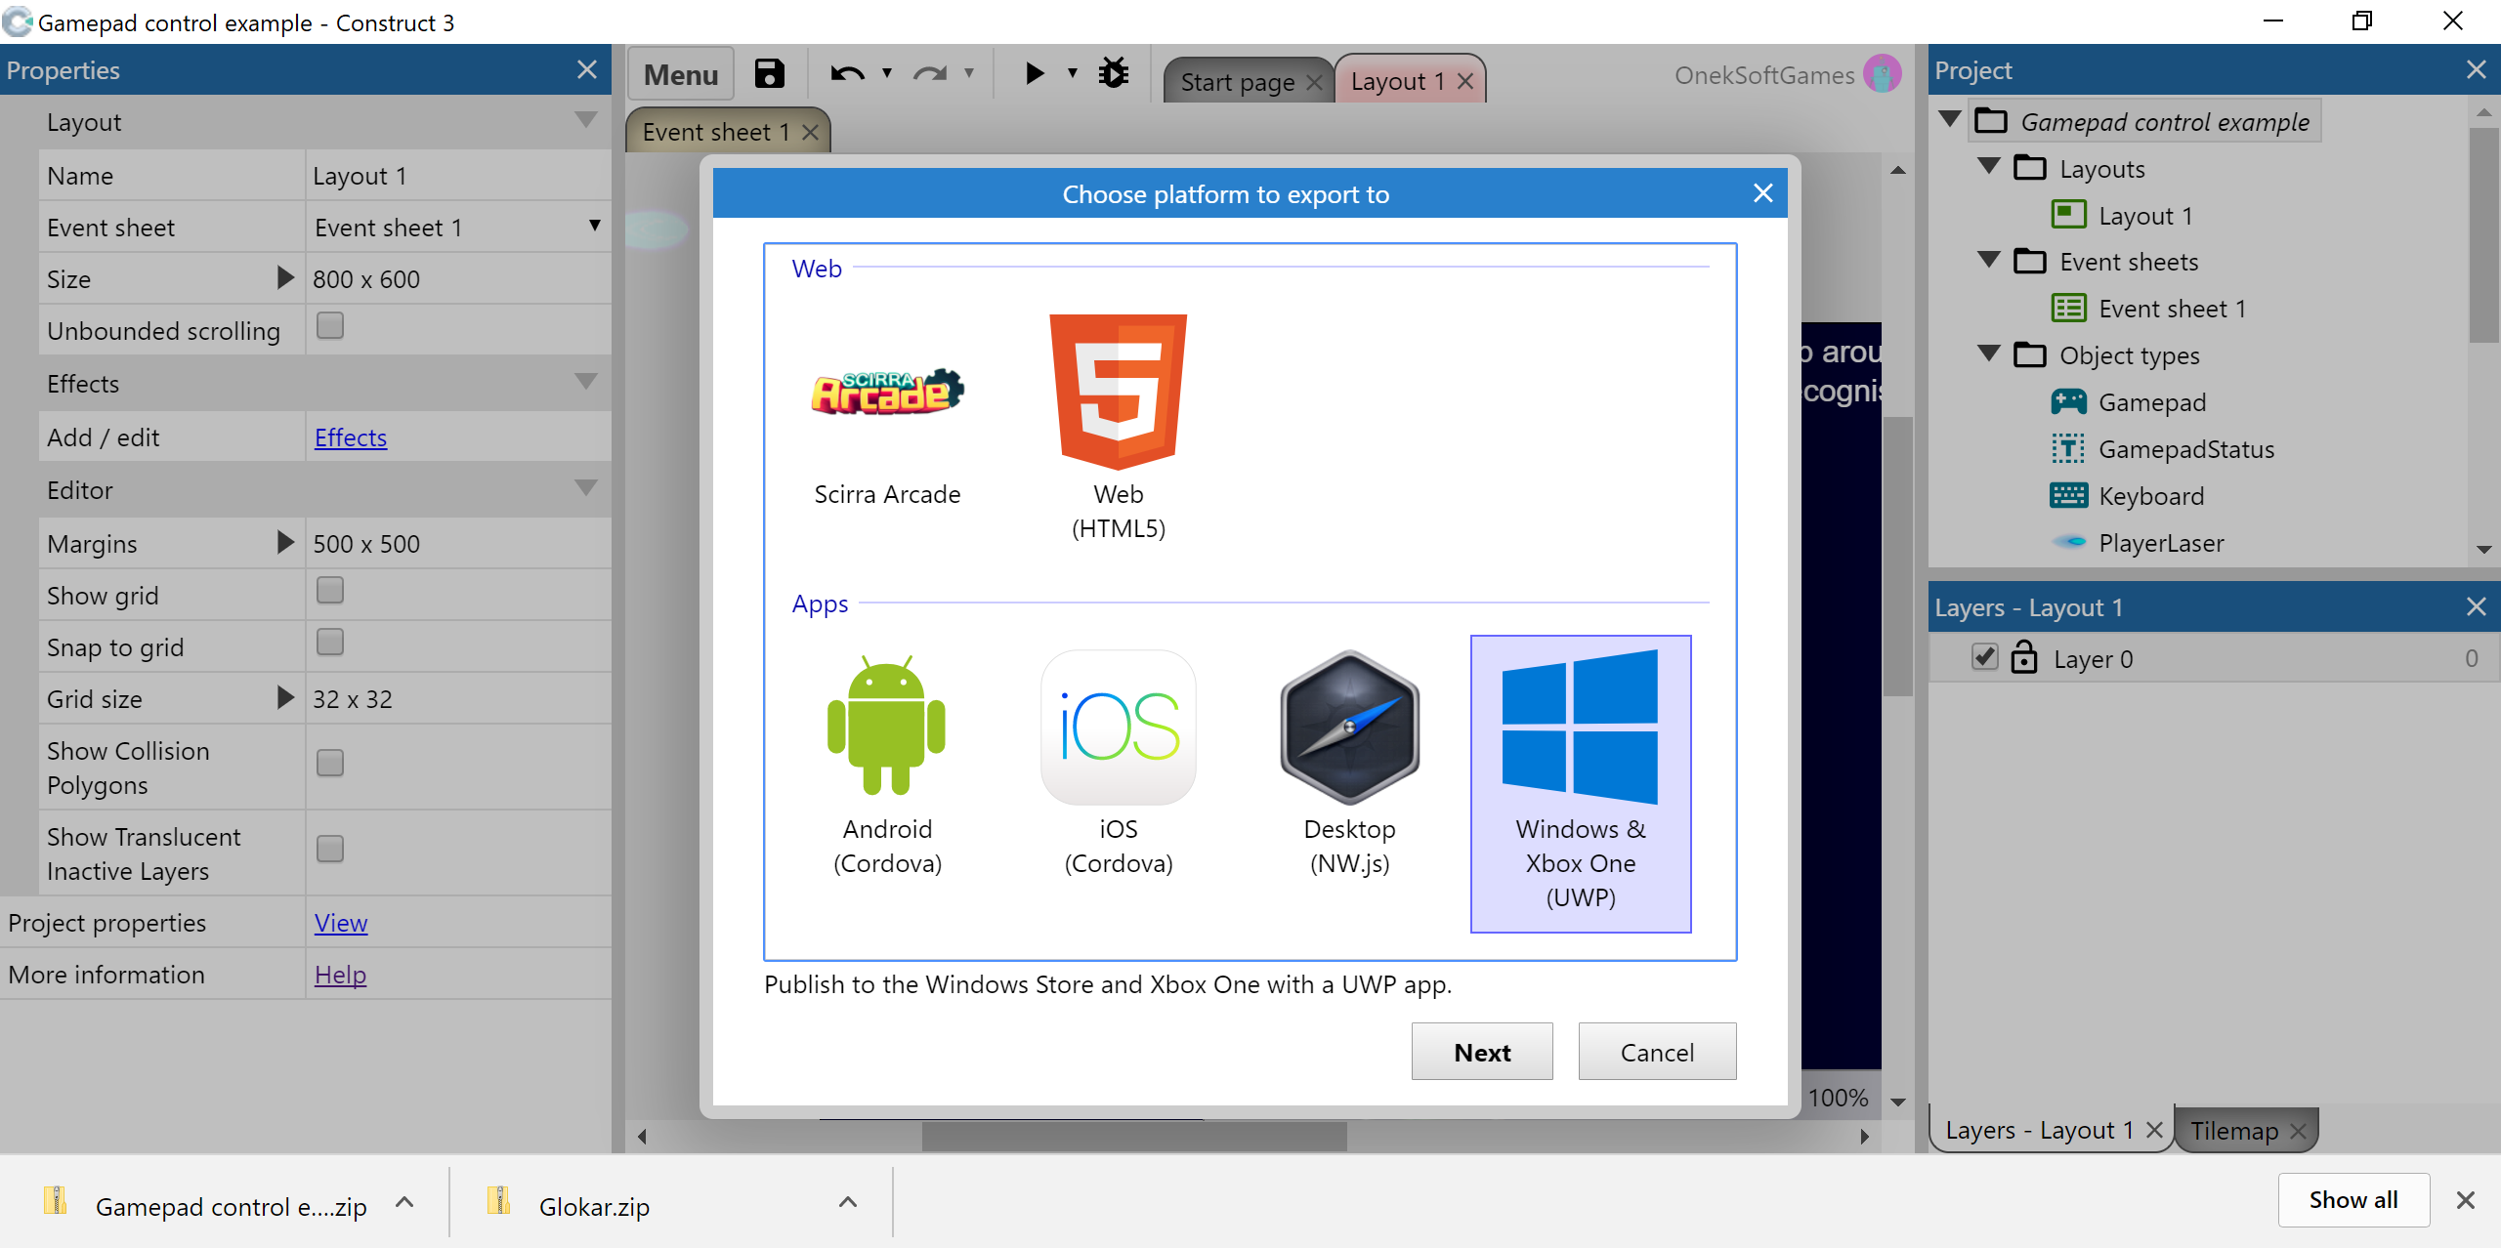
Construct 3: PC/Mac/Linux
https://editor.construct.net/
Notes:
Speaker notes:
Deliver video content or stream video to audiences large or small to any device(Web or Mobile) anywhere reliably and in scale.
Helps you create versatile media workflows for ingesting, encoding, protecting and streaming content to audiences on-demand or broadcast live.
Powerful and extensible platform with broad set of first and third-party capabilities to support complete end-to-end media workflows.
Integration with Office 365 empowers organizations of all sizes helps to use videos to enhance sharing, collaboration and communication.
Azure Media Player, an automated online player solution, supports all the usual industry standards like HTML5 video, Media Source Extensions and rights management through Encrypted Media Extensions. The focus here is on open standards, but on older browsers, the player can fall back on Flash or Silverlight.

Slide 35
Xbox One
Dev Mode
Notes:
Speaker notes:
Deliver video content or stream video to audiences large or small to any device(Web or Mobile) anywhere reliably and in scale.
Helps you create versatile media workflows for ingesting, encoding, protecting and streaming content to audiences on-demand or broadcast live.
Powerful and extensible platform with broad set of first and third-party capabilities to support complete end-to-end media workflows.
Integration with Office 365 empowers organizations of all sizes helps to use videos to enhance sharing, collaboration and communication.
Azure Media Player, an automated online player solution, supports all the usual industry standards like HTML5 video, Media Source Extensions and rights management through Encrypted Media Extensions. The focus here is on open standards, but on older browsers, the player can fall back on Flash or Silverlight.

Slide 36
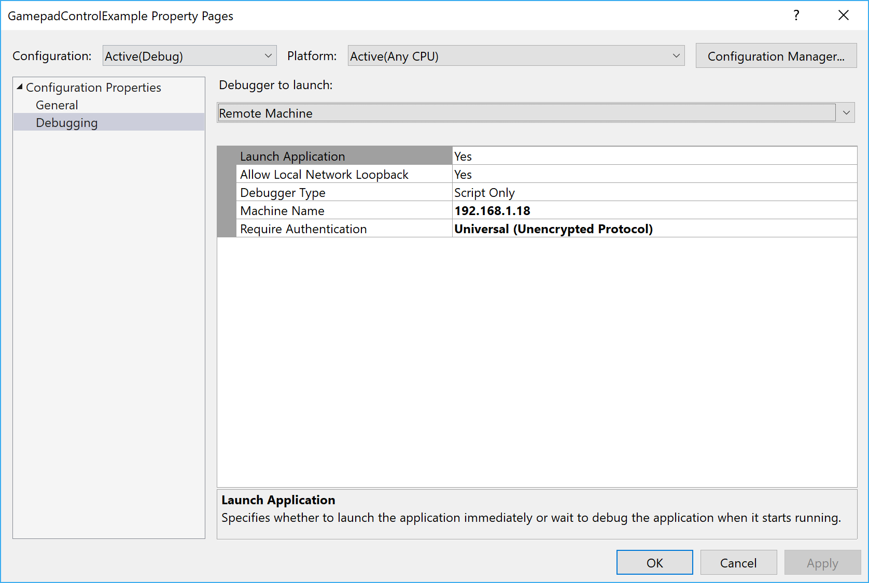
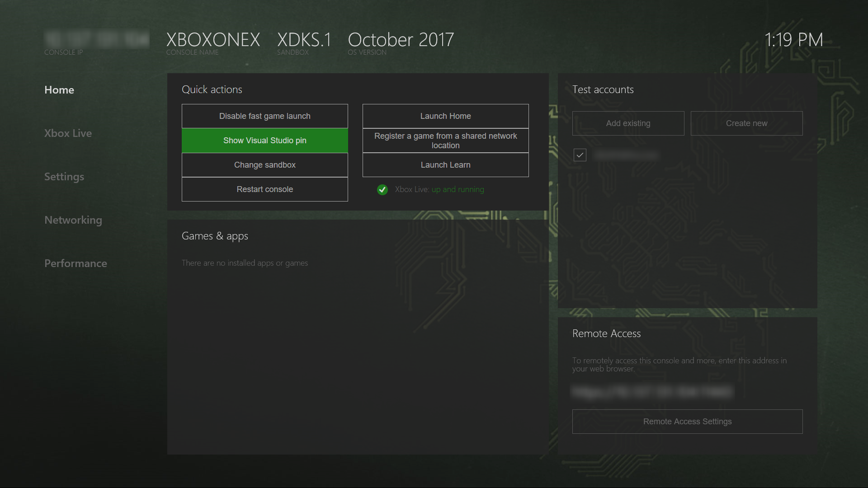
Setting Up Dev Mode…
https://msdn.microsoft.com/en-us/windows/uwp/xbox-apps/development-environment-setup
Notes:
Speaker notes:
Deliver video content or stream video to audiences large or small to any device(Web or Mobile) anywhere reliably and in scale.
Helps you create versatile media workflows for ingesting, encoding, protecting and streaming content to audiences on-demand or broadcast live.
Powerful and extensible platform with broad set of first and third-party capabilities to support complete end-to-end media workflows.
Integration with Office 365 empowers organizations of all sizes helps to use videos to enhance sharing, collaboration and communication.
Azure Media Player, an automated online player solution, supports all the usual industry standards like HTML5 video, Media Source Extensions and rights management through Encrypted Media Extensions. The focus here is on open standards, but on older browsers, the player can fall back on Flash or Silverlight.

Slide 37
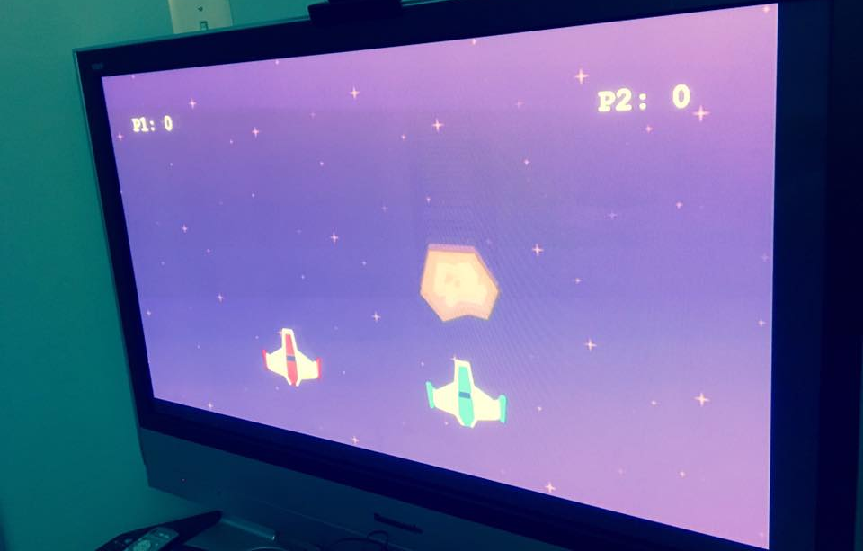
Running in Dev Mode!
Notes:
Speaker notes:
Deliver video content or stream video to audiences large or small to any device(Web or Mobile) anywhere reliably and in scale.
Helps you create versatile media workflows for ingesting, encoding, protecting and streaming content to audiences on-demand or broadcast live.
Powerful and extensible platform with broad set of first and third-party capabilities to support complete end-to-end media workflows.
Integration with Office 365 empowers organizations of all sizes helps to use videos to enhance sharing, collaboration and communication.
Azure Media Player, an automated online player solution, supports all the usual industry standards like HTML5 video, Media Source Extensions and rights management through Encrypted Media Extensions. The focus here is on open standards, but on older browsers, the player can fall back on Flash or Silverlight.

Slide 39
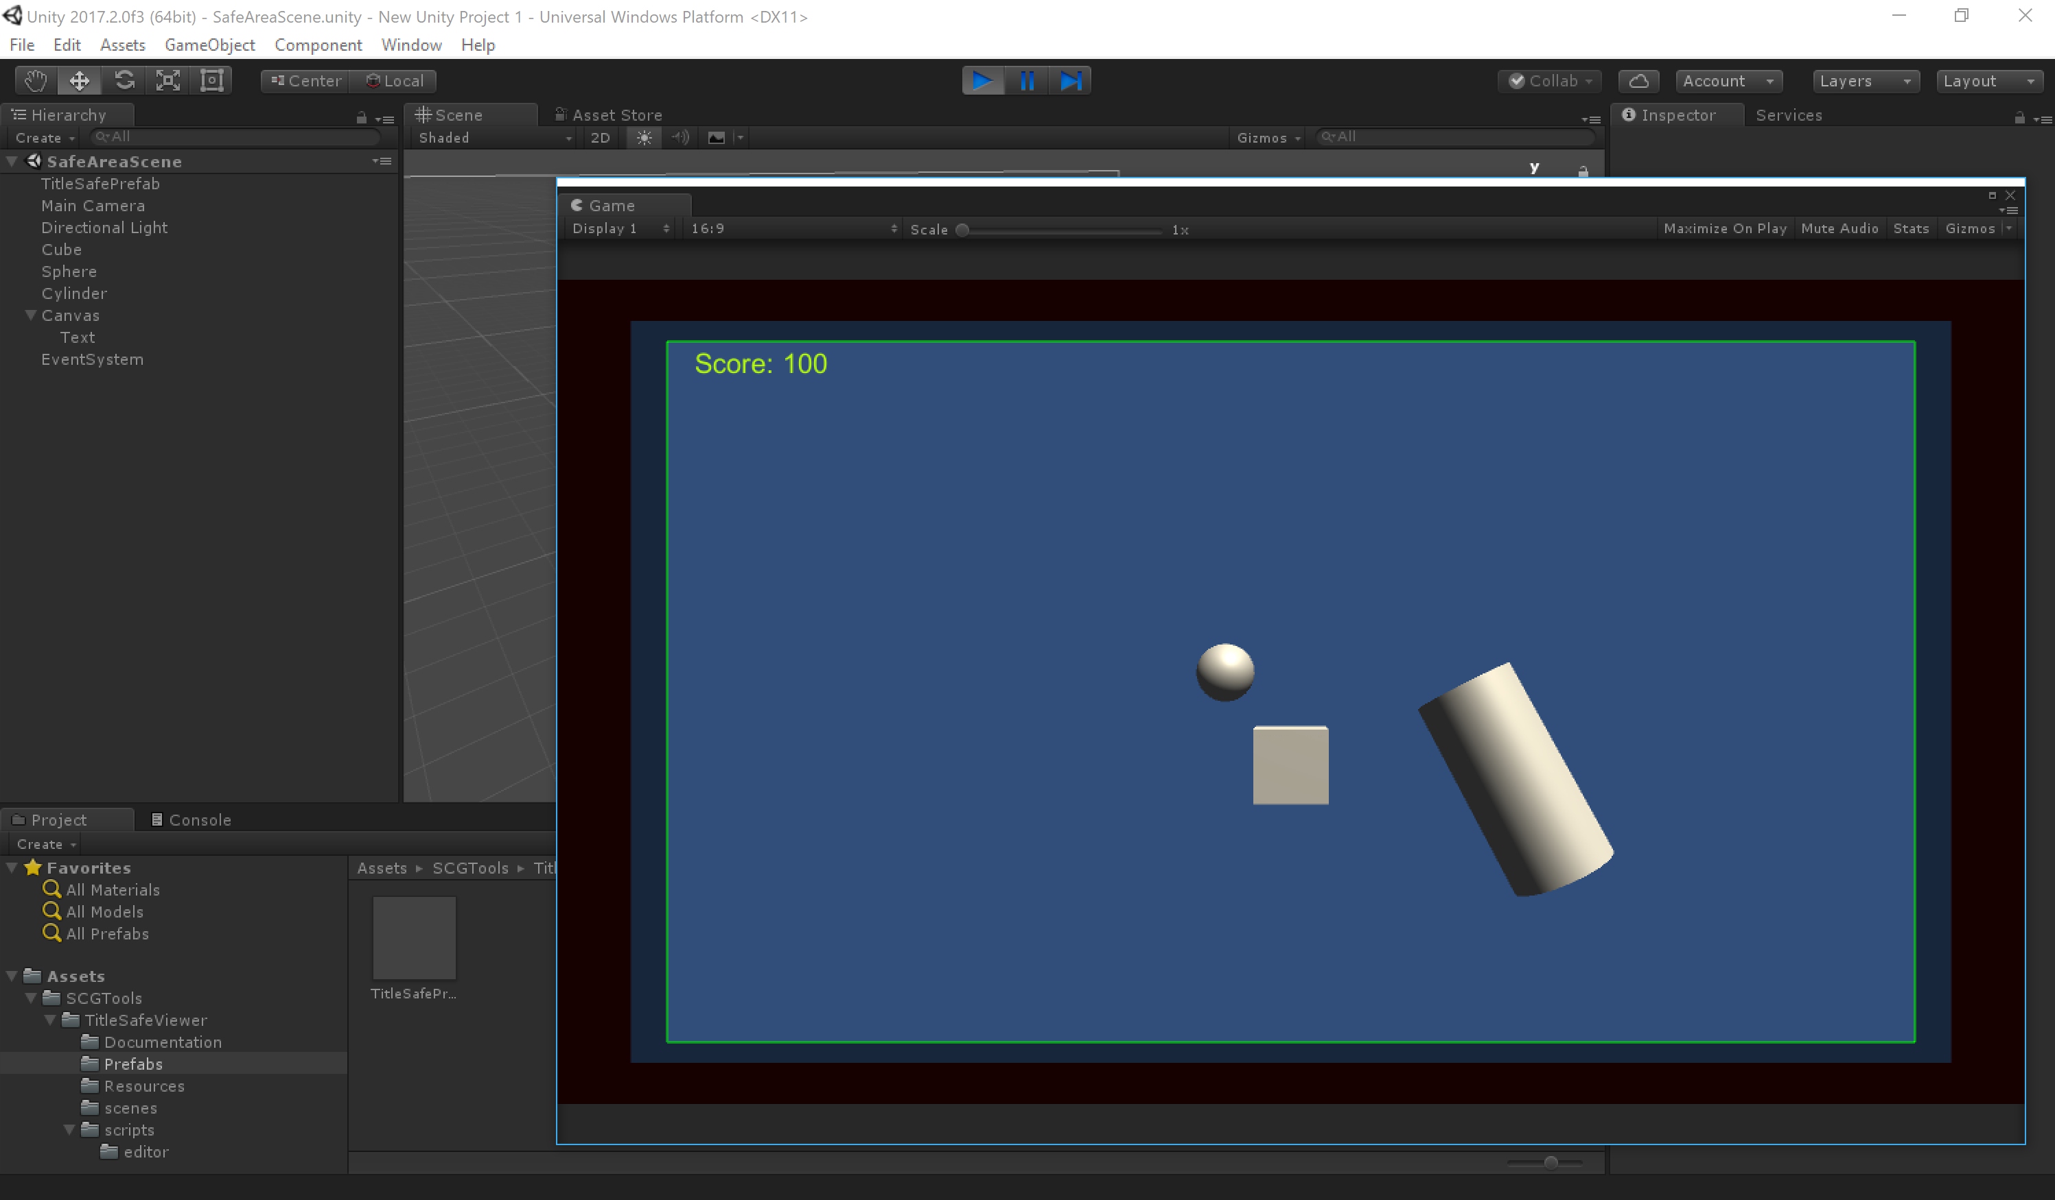
Safe Area Considerations
https://assetstore.unity.com/packages/tools/gui/title-safe-area-viewer-16583

Slide 40
Directional Support (Keyboard, Gamepad)
void FixedUpdate()
{
float moveHoriz = Input.GetAxis("Horizontal");
float moveVert = Input.GetAxis("Vertical");
Vector3 movement = new Vector3(moveHoriz, 0.0f, moveVert);
rigidBody.AddForce(movement * speed);
}
https://docs.unity3d.com/Manual/ConventionalGameInput.html
https://docs.unity3d.com/ScriptReference/Input.html

Slide 41
Button/Key Support (Gamepad, Keyboard, Mouse)
if (Input.GetButton("Fire1"))
{
// take action
}
https://docs.unity3d.com/ScriptReference/Input.GetButton.html

Slide 42

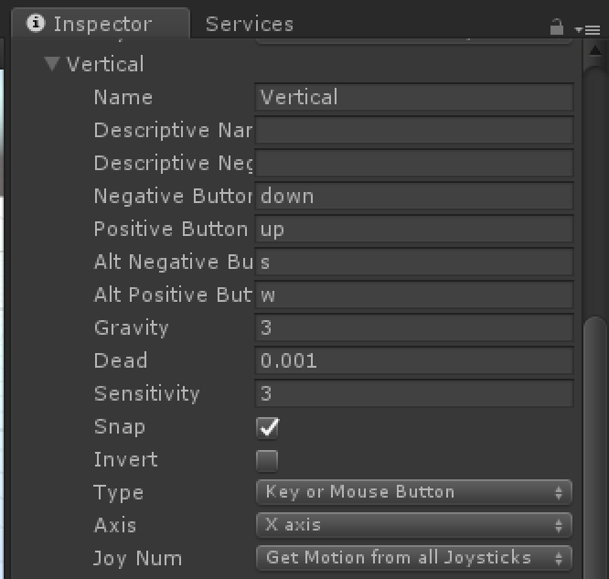
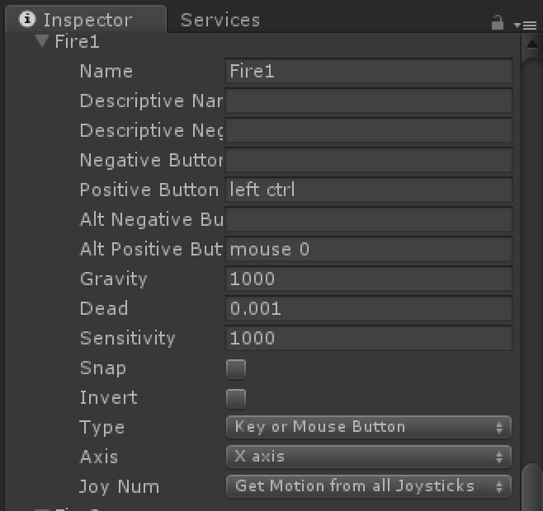
Default Input Settings (Mouse, Keyboard, Gamepad)

Slide 43

Controller Configuration
http://wiki.unity3d.com/index.php?title=Xbox360Controller

Slide 44
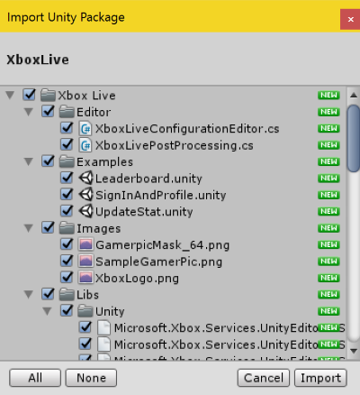
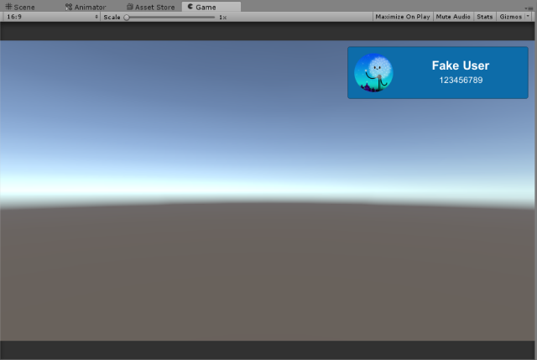
Xbox Live
https://docs.microsoft.com/en-us/windows/uwp/xbox-live/get-started-with-creators/develop-creators-title-with-unity
https://darkgenesis.zenithmoon.com/resolving-build-issues-for-uwp-packages-with-unity/

Slide 45
ID@Xbox
Notes:
Speaker notes:
Deliver video content or stream video to audiences large or small to any device(Web or Mobile) anywhere reliably and in scale.
Helps you create versatile media workflows for ingesting, encoding, protecting and streaming content to audiences on-demand or broadcast live.
Powerful and extensible platform with broad set of first and third-party capabilities to support complete end-to-end media workflows.
Integration with Office 365 empowers organizations of all sizes helps to use videos to enhance sharing, collaboration and communication.
Azure Media Player, an automated online player solution, supports all the usual industry standards like HTML5 video, Media Source Extensions and rights management through Encrypted Media Extensions. The focus here is on open standards, but on older browsers, the player can fall back on Flash or Silverlight.

Slide 46
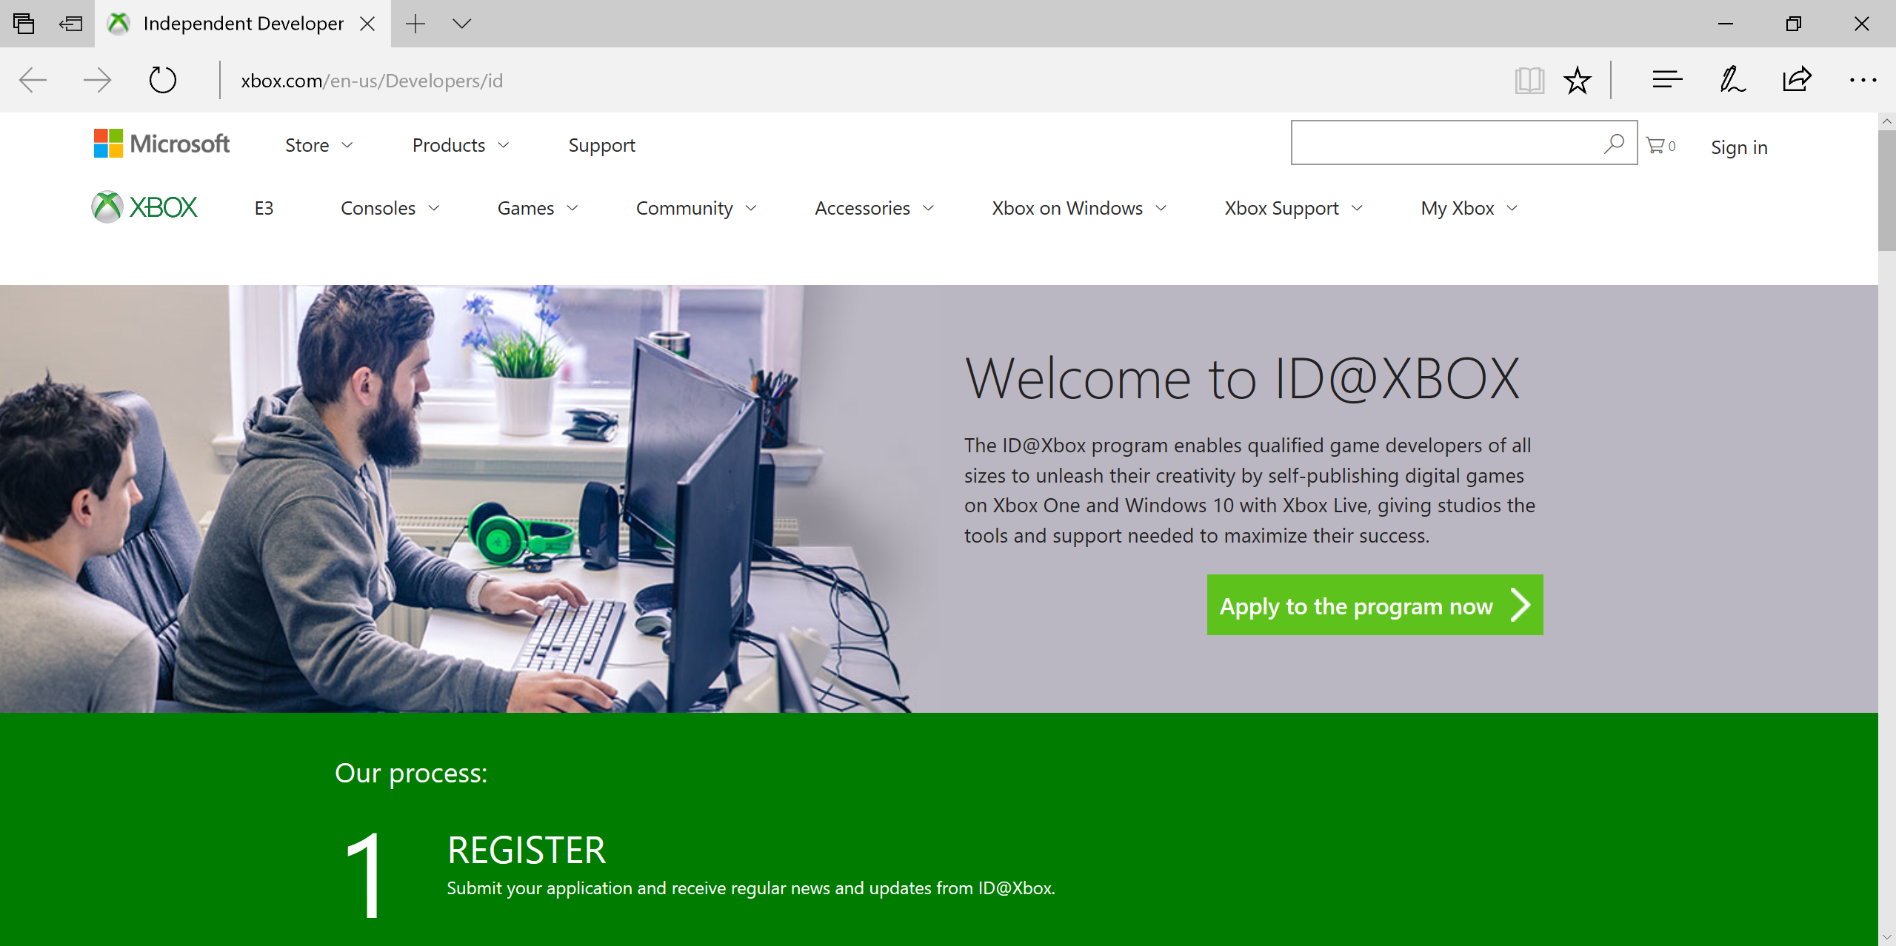
ID@Xbox
http://xbox.com/id
http://www.xbox.com/en-us/Developers/id
Notes:
Speaker notes:
Deliver video content or stream video to audiences large or small to any device(Web or Mobile) anywhere reliably and in scale.
Helps you create versatile media workflows for ingesting, encoding, protecting and streaming content to audiences on-demand or broadcast live.
Powerful and extensible platform with broad set of first and third-party capabilities to support complete end-to-end media workflows.
Integration with Office 365 empowers organizations of all sizes helps to use videos to enhance sharing, collaboration and communication.
Azure Media Player, an automated online player solution, supports all the usual industry standards like HTML5 video, Media Source Extensions and rights management through Encrypted Media Extensions. The focus here is on open standards, but on older browsers, the player can fall back on Flash or Silverlight.

Slide 47
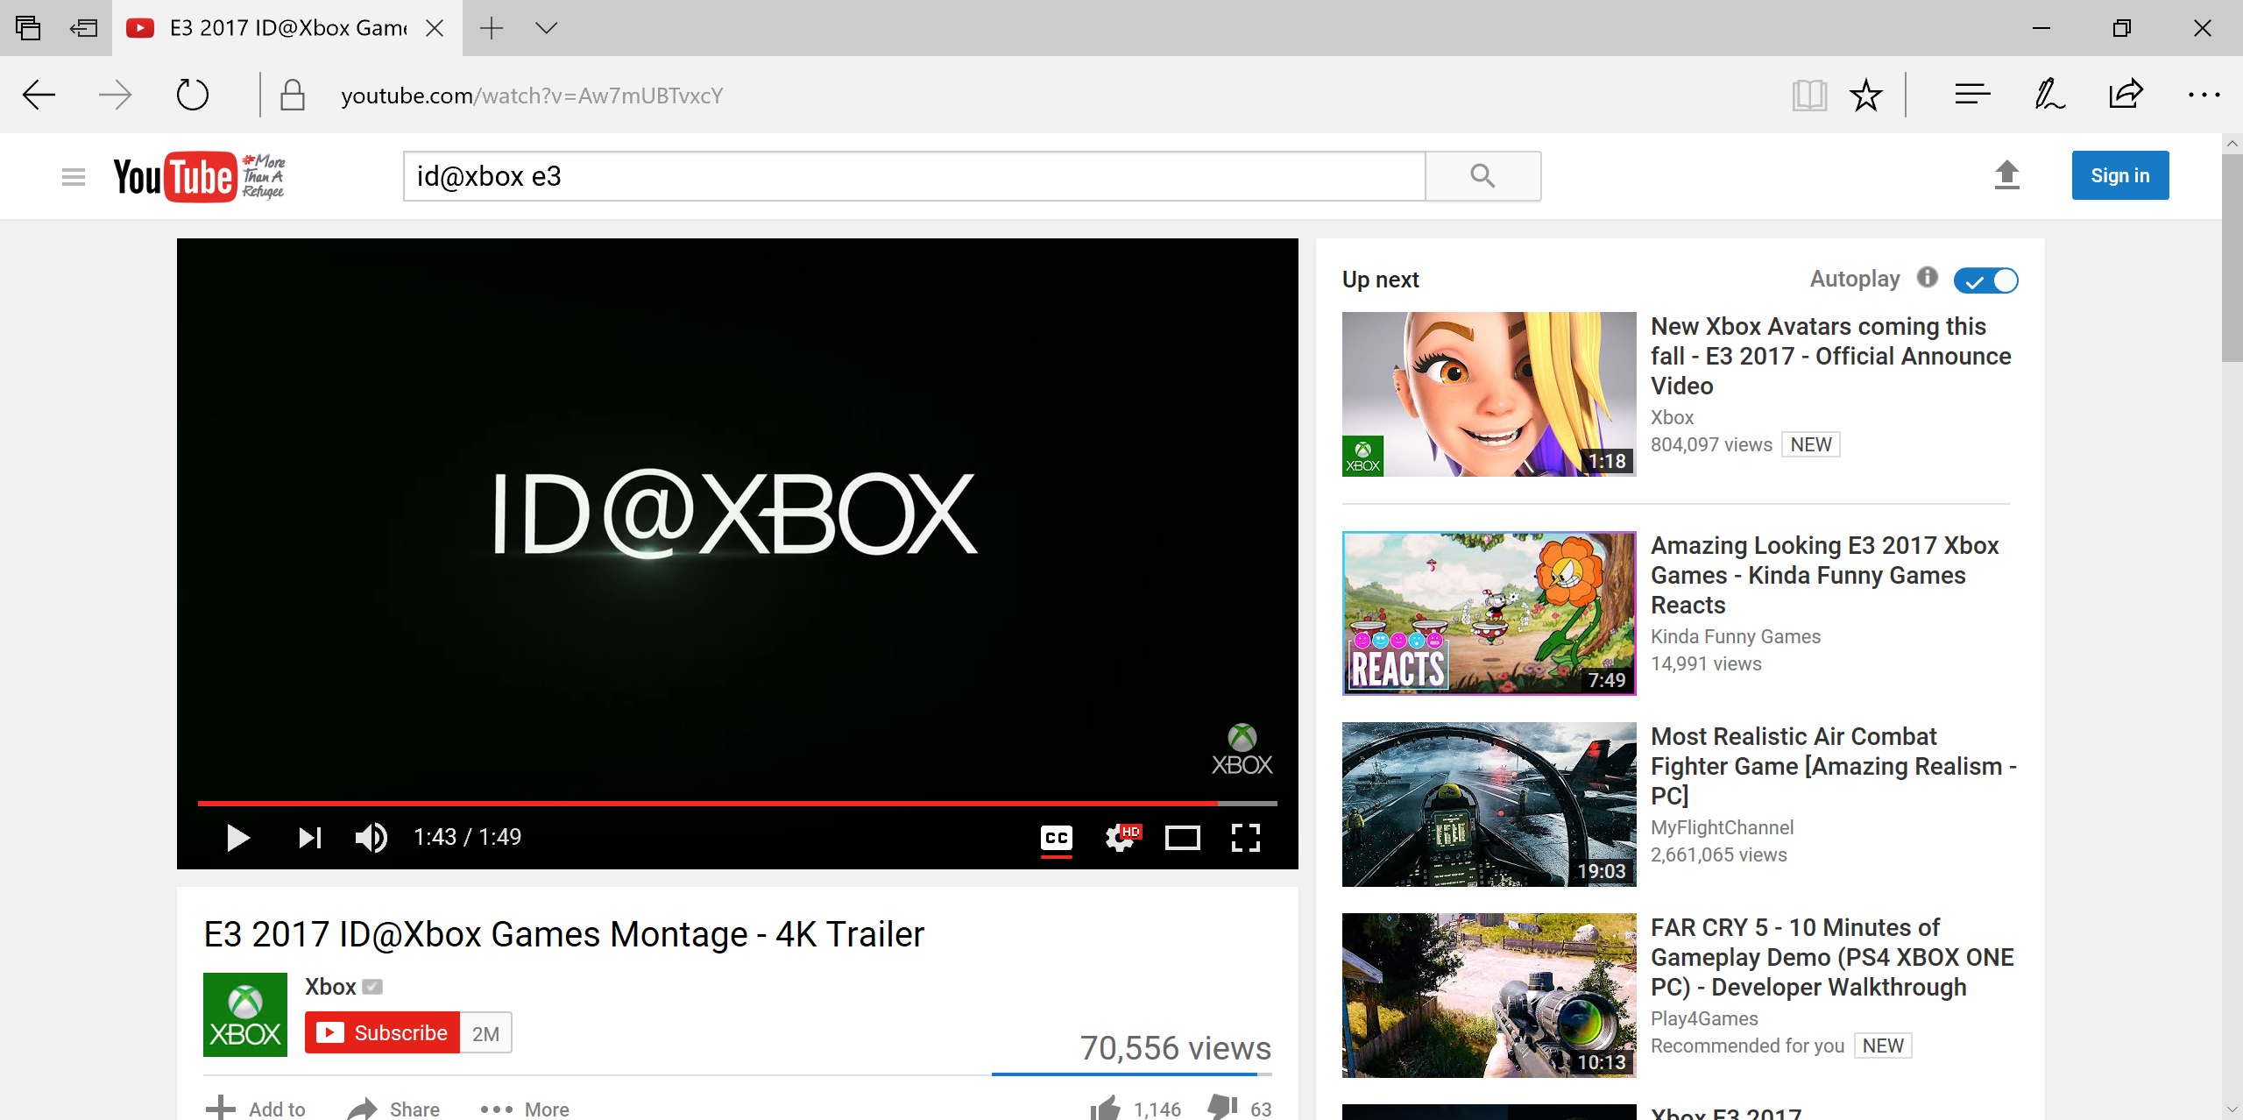
ID@Xbox Games at E3 2017
https://www.youtube.com/watch?v=Aw7mUBTvxcY
Notes:
Speaker notes:
Deliver video content or stream video to audiences large or small to any device(Web or Mobile) anywhere reliably and in scale.
Helps you create versatile media workflows for ingesting, encoding, protecting and streaming content to audiences on-demand or broadcast live.
Powerful and extensible platform with broad set of first and third-party capabilities to support complete end-to-end media workflows.
Integration with Office 365 empowers organizations of all sizes helps to use videos to enhance sharing, collaboration and communication.
Azure Media Player, an automated online player solution, supports all the usual industry standards like HTML5 video, Media Source Extensions and rights management through Encrypted Media Extensions. The focus here is on open standards, but on older browsers, the player can fall back on Flash or Silverlight.

Slide 48
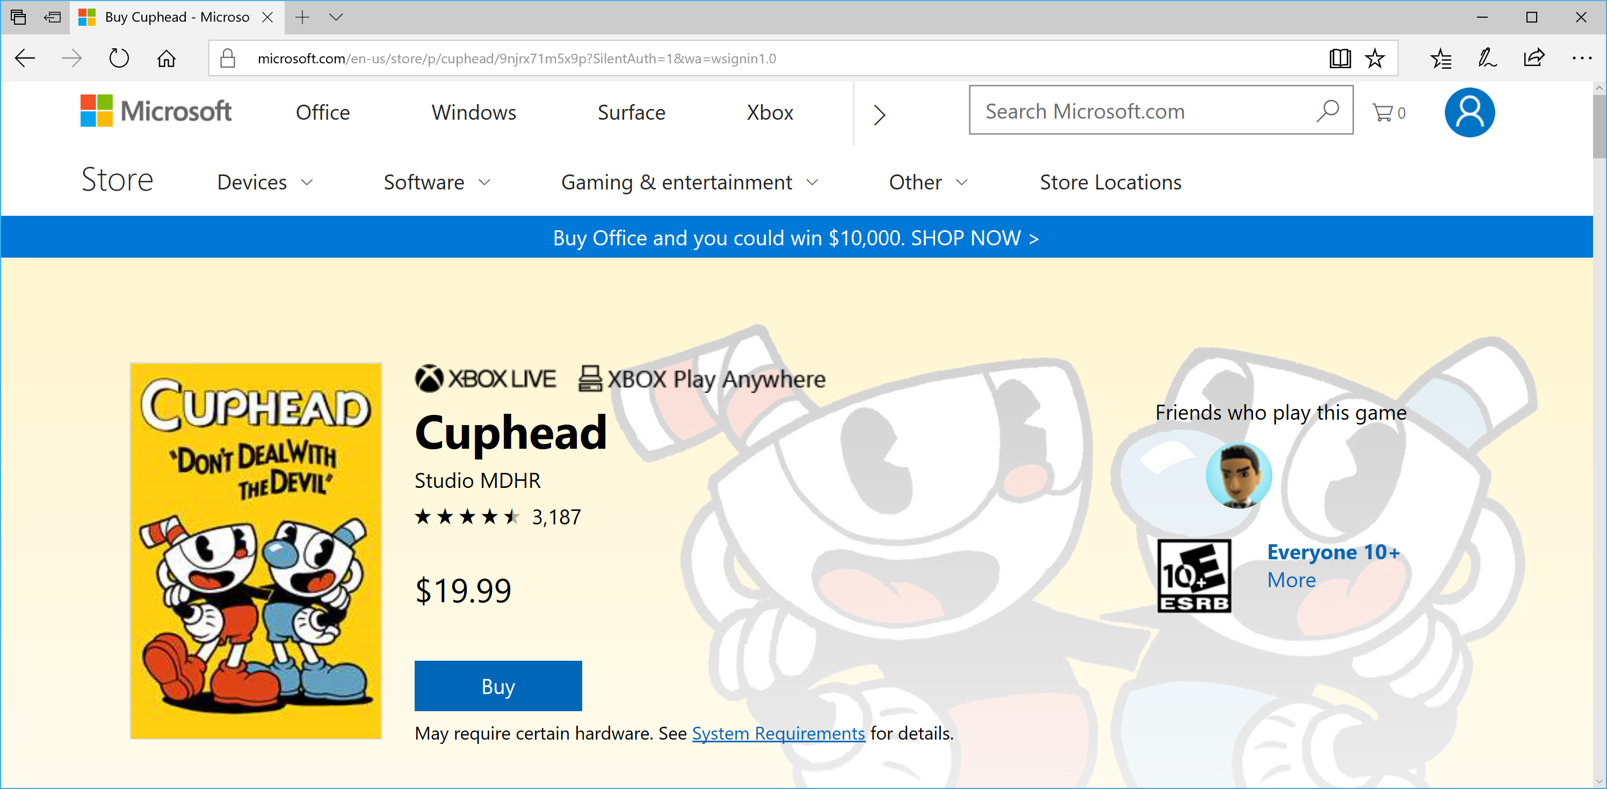
Cuphead!
https://www.youtube.com/watch?v=Aw7mUBTvxcY
Notes:
Speaker notes:
Deliver video content or stream video to audiences large or small to any device(Web or Mobile) anywhere reliably and in scale.
Helps you create versatile media workflows for ingesting, encoding, protecting and streaming content to audiences on-demand or broadcast live.
Powerful and extensible platform with broad set of first and third-party capabilities to support complete end-to-end media workflows.
Integration with Office 365 empowers organizations of all sizes helps to use videos to enhance sharing, collaboration and communication.
Azure Media Player, an automated online player solution, supports all the usual industry standards like HTML5 video, Media Source Extensions and rights management through Encrypted Media Extensions. The focus here is on open standards, but on older browsers, the player can fall back on Flash or Silverlight.

Slide 49
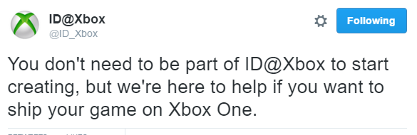
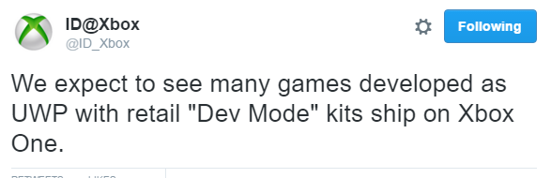
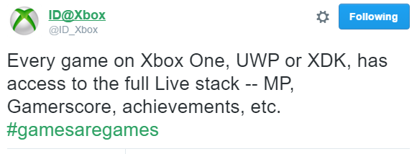
More Info from ID@Xbox
https://twitter.com/id_xbox/status/715218215945670656
https://twitter.com/id_xbox/status/715574259205033984
https://twitter.com/ID_Xbox/status/716785692487995392
Notes:
Speaker notes:
Deliver video content or stream video to audiences large or small to any device(Web or Mobile) anywhere reliably and in scale.
Helps you create versatile media workflows for ingesting, encoding, protecting and streaming content to audiences on-demand or broadcast live.
Powerful and extensible platform with broad set of first and third-party capabilities to support complete end-to-end media workflows.
Integration with Office 365 empowers organizations of all sizes helps to use videos to enhance sharing, collaboration and communication.
Azure Media Player, an automated online player solution, supports all the usual industry standards like HTML5 video, Media Source Extensions and rights management through Encrypted Media Extensions. The focus here is on open standards, but on older browsers, the player can fall back on Flash or Silverlight.

Slide 50

New Message from Chris Charla, ID@Xbox Director
https://twitter.com/iocat/status/923065606114390016
Notes:
Speaker notes:
Deliver video content or stream video to audiences large or small to any device(Web or Mobile) anywhere reliably and in scale.
Helps you create versatile media workflows for ingesting, encoding, protecting and streaming content to audiences on-demand or broadcast live.
Powerful and extensible platform with broad set of first and third-party capabilities to support complete end-to-end media workflows.
Integration with Office 365 empowers organizations of all sizes helps to use videos to enhance sharing, collaboration and communication.
Azure Media Player, an automated online player solution, supports all the usual industry standards like HTML5 video, Media Source Extensions and rights management through Encrypted Media Extensions. The focus here is on open standards, but on older browsers, the player can fall back on Flash or Silverlight.

Slide 51
Thanks, .NET Conf Uruguay!
Shahed Chowdhuri
Shahed.Chowdhuri@Microsoft.com
@shahedC
http://WakeUpAndCode.com

