Slide 1
lectures accompanying the book: Solid State Physics: An Introduction, by Philip Hofmann (3nd edition 2022, ISBN: 978-3-527-41410-9, Wiley-VCH Berlin.
www.philiphofmann.net

Slide 2
README
This is only the outline of a lecture, not a final product.
Many “fun parts” in the form of pictures, movies and examples have been removed for copyright reasons.
In some cases, www addresses are given for particularly good resources (but not always).
I have left some ‘presenter notes’ in the lectures. They are probably of very limited use only.
I do actually prefer to do give the lectures on a blackboard, using presentations as little as possible.

Slide 3
Bonds between atoms: contents
at the end of this lecture you should understand....
bonding in general, attractive and repulsive forces, cohesive energy
ionic bonding
covalent bonding
metallic bonding
hydrogen bonding and van der Waals bonding
relationship between bonding type and some physical properties of a solid (in particular melting point)
Notes:
overview over each lecture, key-headings
there must be two sorts of forces: no attractive, no solid, no repulsive, total collapse and no solid either;
attractive forces long range (we shall see), repulsive at short range

Slide 4
Bonding in solids: the general idea
valence electrons (of the outer shell) achieve bonding (like in chemistry)
decrease in total energy stabilises the solid (the solid’s energy is lower than that of sum of atoms it is made of)
so the energy gain by the bonding must be higher than the energy it costs to promote electrons from the atomic orbitals to the electronic states of the solid.
this energy difference is a measure for the strength of the bond. It is called the cohesive energy.
cohesive energy = energy of atoms - energy of solid
Notes:
the latter is certainly the case for ionic bonding which we discuss now
in any case, two type of forces: one to hold the atoms together, one to keep them from crashing into each other.

Slide 5
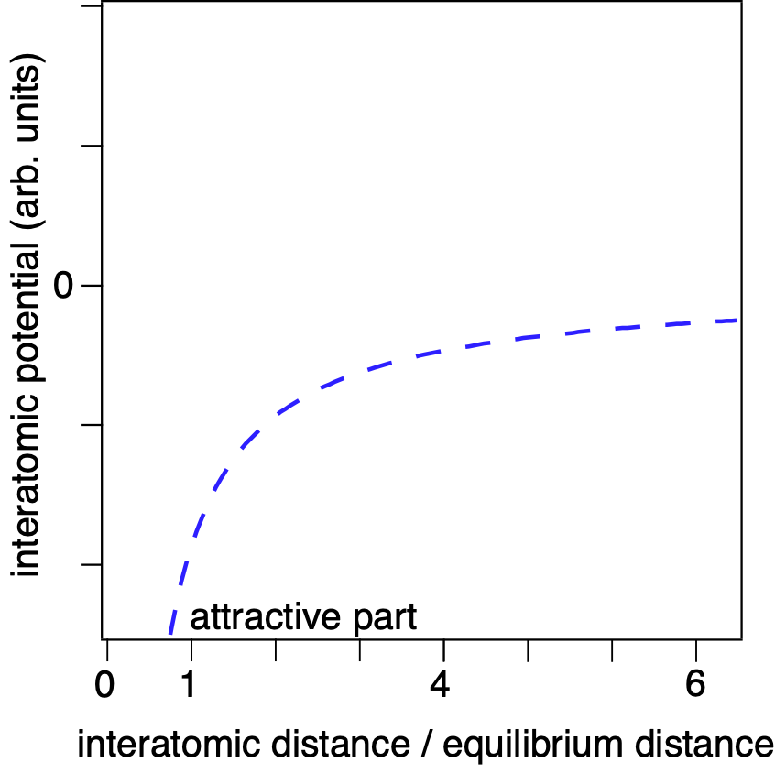
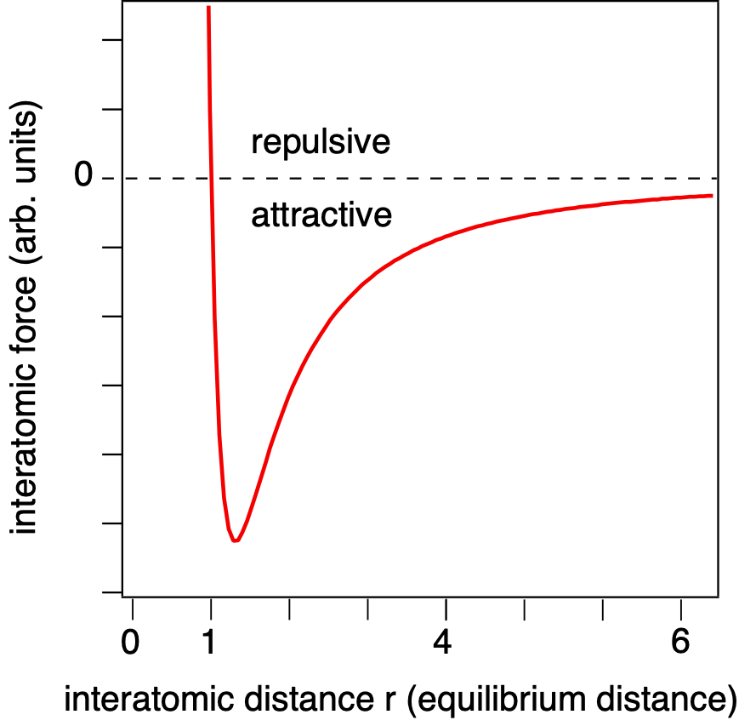
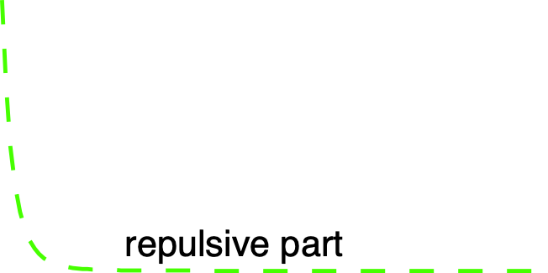
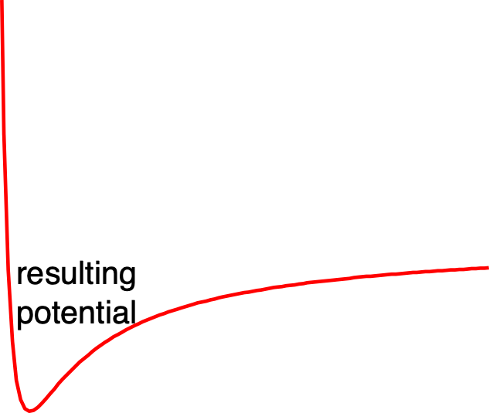
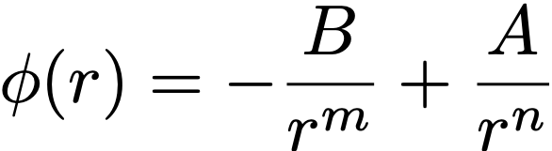

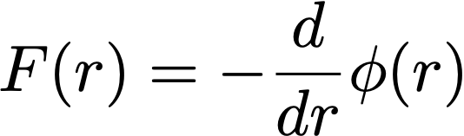

Repulsive force
Notes:
m would usually be 1 of course, n would be at least 6
Why so hard to get them closer and why does it happen at these distances?
Pauli principle: all states already occupied.
We can push more in but if we want to do this, we have to push ALL states to higher energies!
It is not the Coulomb repulsion between the nuclei
This is essentially the same for all atoms
But now we look at the attractive part.

Slide 6
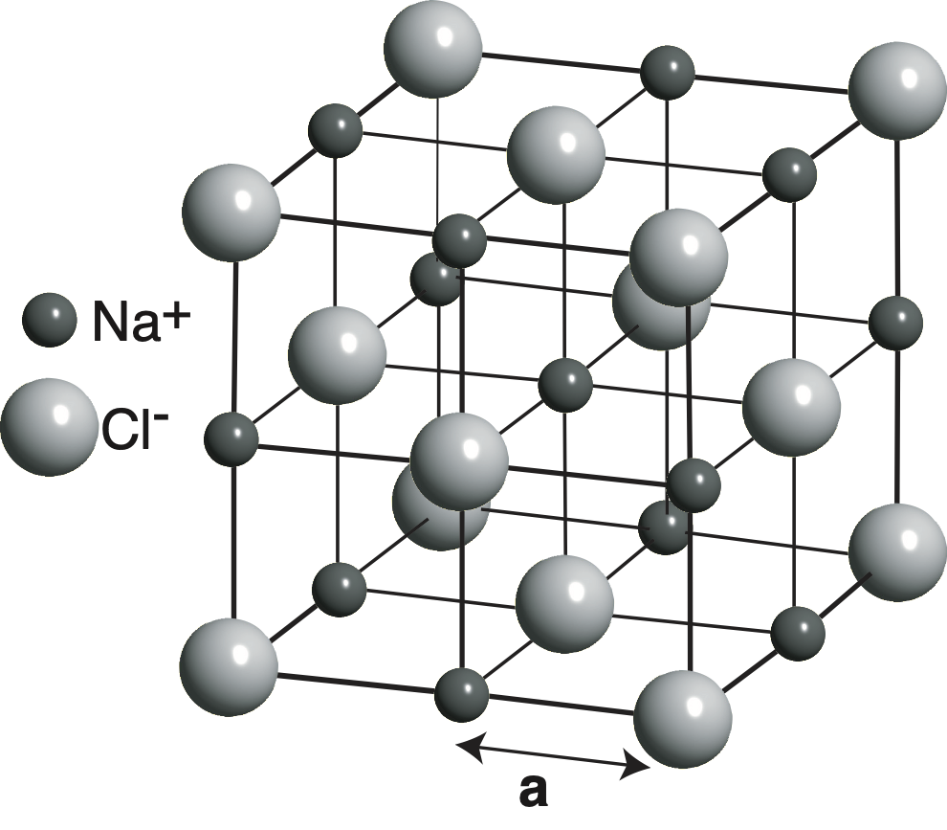
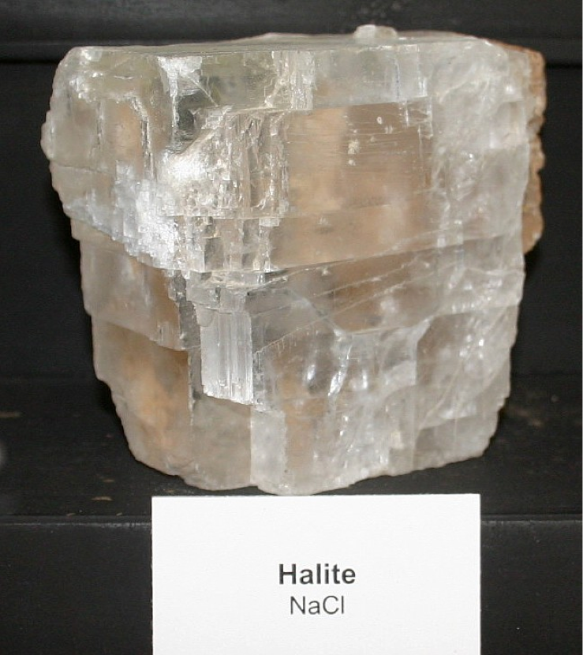
Ionic bonding
form positive and negative ions (here Na⁺ and Cl⁻)
bonding is achieved by electrostatic force and a classical treatment is (partially) meaningful.
example NaCl (rock salt): cubic structure
Notes:
First type we discuss: simple and we can use simple tools to give a reasonable prediction of the energy balance
typical: Na only one 1 electron which is cheap to remove
Cl has 7 valence electrons (2s and 5p) and needs one more to achieve the special closed-shell configuration.
discuss structure. Knowing the structure we can actually calculate the relevant energies. How we know the structure is a different matter...

Slide 7
Turning Atoms in Ions
example: NaCl
how much energy does it cost?
ionization energy Na: 5.1 eV
electron affinity Cl: 3.6 eV
net energy cost: (5.1 eV - 3.6 eV) = 1.5 eV per pair
Notes:
energy balance:
We have Na and Cl atoms and want to produce ions
ionization energy is energy it takes to remove one electron. We know this already for Na
electron affinity is the energy gain when we add an extra electron to the neutral atom. Positive means actual gain. This is 3.6 eV for Cl
So the net cost is the difference

Slide 8
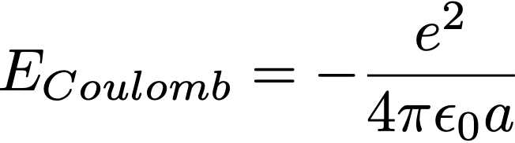
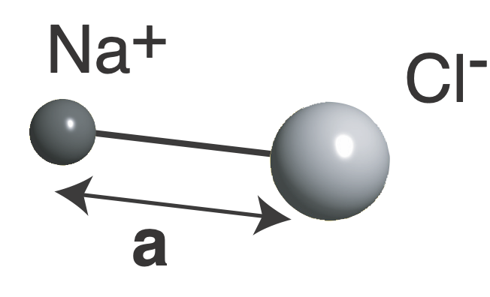
Ionic bonding
example: NaCl
what is the energy gain?
potential energy:
this amounts to 5.1 eV per pair
= 2.8 Å
so the total gain is
5.1 eV - 1.5 eV = 3.6 eV
Notes:
we want to do all classical but we are cheating a little because a (2.8 AA) falls out of the sky!
So this is the total energy for one molecule. It must be higher for a solid....

Slide 9
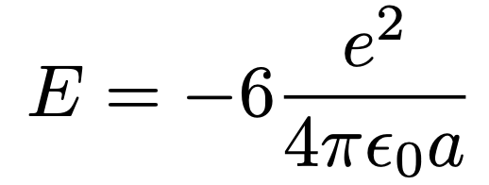
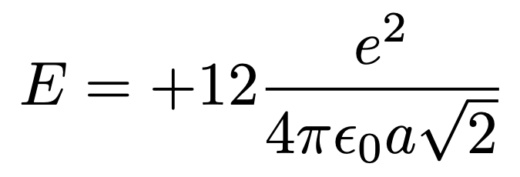
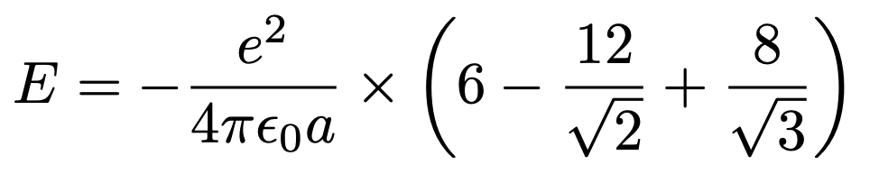
Ionic bonding
example: NaCl
but this was just a molecule: what about the electrostatic energy gain in the solid?
consider the centre Na ion
energy gain from next 6 Cl:
energy loss from next 12 Na:
next we get 8 more Cl ions and the total becomes
Notes:
alternating negative and positive terms in a series.
factor for the series is the normal Coulomb attraction for a pair

Slide 10
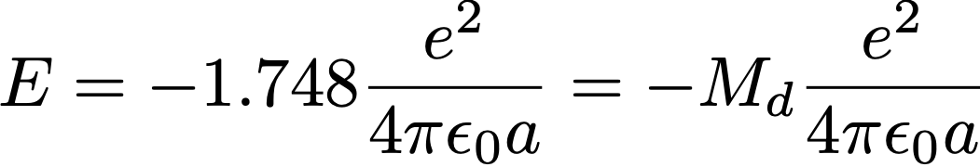
Ionic bonding
example: NaCl
eventually the series converges
and we get (for one ion)
M_{d} is called the Madelung constant.
It is specific for a given structure.
Notes:
it is good that this is higher that 1 because otherwise salt would come in molecules, not in crystals
point out the difference between lattice and cohesive energy
cohesive energy is total energy for forming solid from atoms
it is also the more relevant thing to look at.

Slide 11
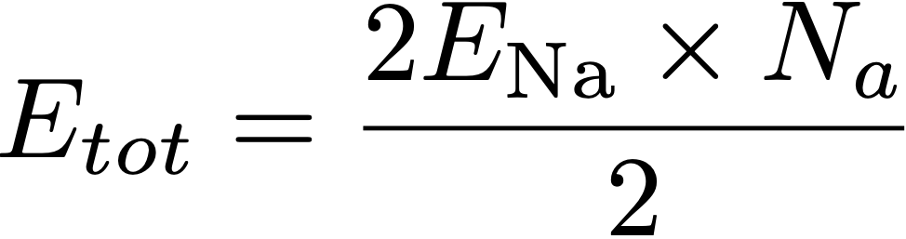
Ionic bonding
so the total lattice energy for one mole of NaCl
because there are Na and Cl ions
to count every
pair only once
This gives 861 kJmol⁻¹. The experiment gives 776 kJmol⁻¹
Note: this is the lattice energy, not the cohesive energy (the lattice energy minus the energy to turn atoms into ions).
Notes:
Total energy:
we considered only 1 Na ion but we also need the Cl ion (same energy)
we calculate the binding with every other atom but in this way, we count every bond twice. So divide again by two
In the end it’s just Avogadro’s number times E!
a few eV (exercise)
BUT: there is a big problem in all this: We have been cheating a bit because we can gain ever more energy by making a smaller!
NOTE the energies given are actually the lattice energies. How to measure? Dissolve?

Slide 12
Repulsive force
10%
The existence of a (non-classical) repulsive force causes the real cohesive energy to be slightly smaller (10%) than the value calculated by the Coulomb potential.
Notes:
our cheating has another consequence
in agreement with the experiment
bottom line (also seen in exercise): cohesive energy a few eV.

Slide 13
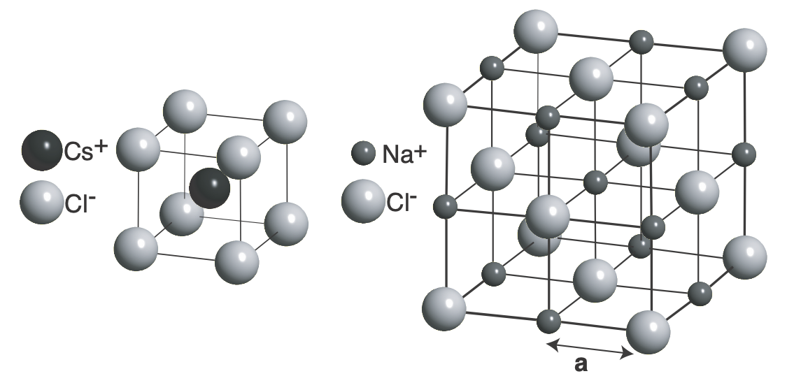
Bottom line ionic bonding
Cohesive energies in the eV range (per bond / pair of atoms).
Likely to happen between elements that easily form positive / negative ions.
Simple and characteristic crystal structures.

Slide 14
Which one is easiest to dissolve in water?
substance | cohesive energy | lattice energy
LiF | 9.01 | 11.00
NaCl | 6.70 | 8.24
KCl | 6.75 | 7.48
KF | 7.70 | 8.65
Notes:
The lattice energy is needed to split the crystal into ions. The ions are then surrounded by water molecules. The implicit assumption in here is that the energy gain for making the water / molecule complexes is always the same.

Slide 15
Covalent bonding
A detailed view on the hydrogen molecule, identical particles (later in connection with magnetism, see online note on www.philiphofmann.net).
A simple view on other covalent bonds.
Notes:
more complex bonding: true electron sharing
and highly directional

Slide 16
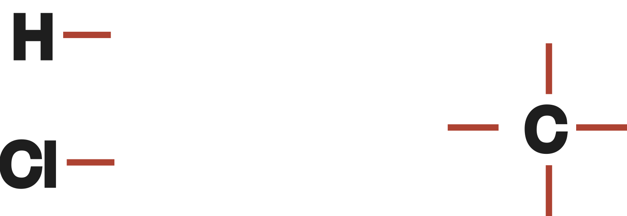
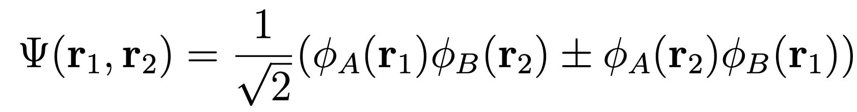
The covalent bond: simple picture
The covalent bond: less simple picture
(hydrogen molecule)
(see note on www.philiphofmann.net)
Notes:
so simple that you might be intellectually offended....
number of “additional” or “missing” valence electrons as arms
more complex bonding: true electron sharing
and highly directional

Slide 17
The covalent bond: simple picture
Notes:
number of “additional” or “missing” valence electrons as arms
H and alkalis have one “arm”. Halogens have only one “arm”
carbon has 4 “arms” (this can only carry us so far but....)
Ga has 3, As has 5...
The arms have directions!

Slide 18
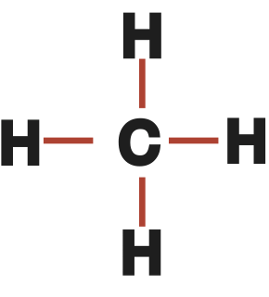
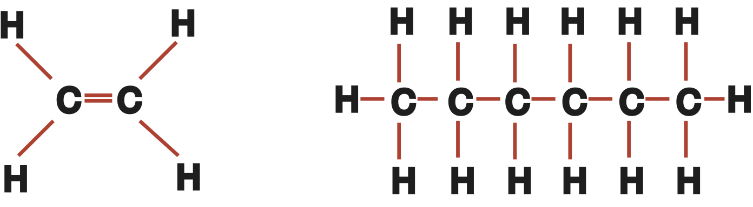
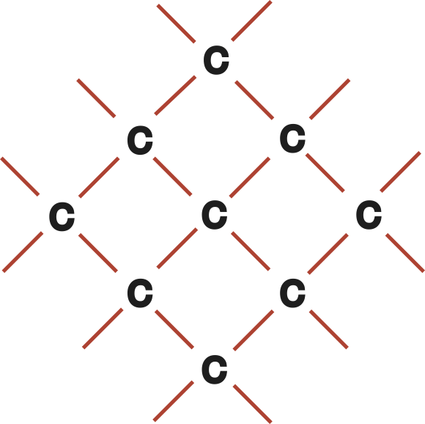
The covalent bond: simple picture
methane
hydrocarbons
C-based solid
Notes:
but take a closer look at these “arms”
one building block, ethylene and polyethylene
(its called polyethylene because it stems from the polymerization of ethylene, even though it does not have double cc bonds)
important how these bonds look: directional

Slide 19
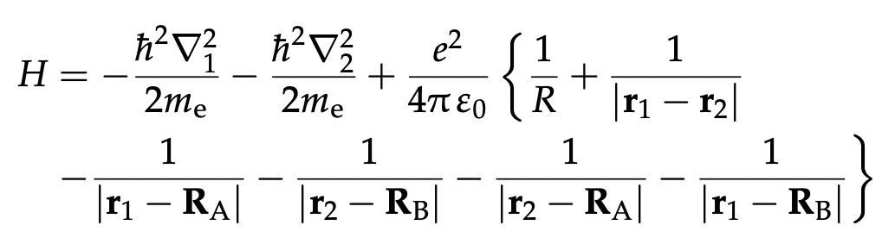
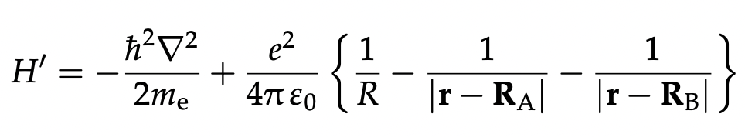
The covalent bond: simple model
H2 molecule
H2⁺ molecular ion
Ansatz: Linear Combination of Atomic Orbitals (LCA):
Notes:
Molecule has the problem with the electron-electron interaction.
Molecular ion simplifies this.
The phi_A and _B are just atomic wave functions for the electrons sitting on their own nuclei.
Can turn this into a system of algebraic equations

Slide 20
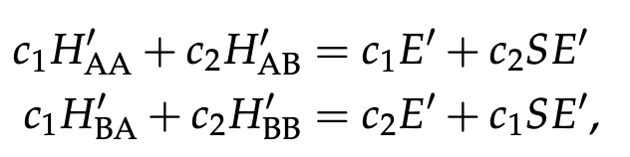
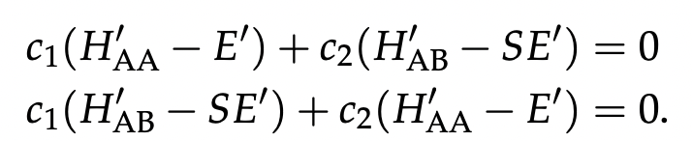
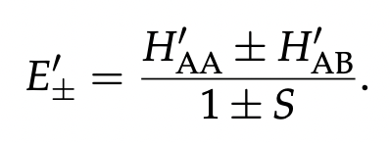
or
two energy solutions
Notes:
multiply from left with either phi_A* or phi_B* and integrate. Gives two equations.

Slide 21
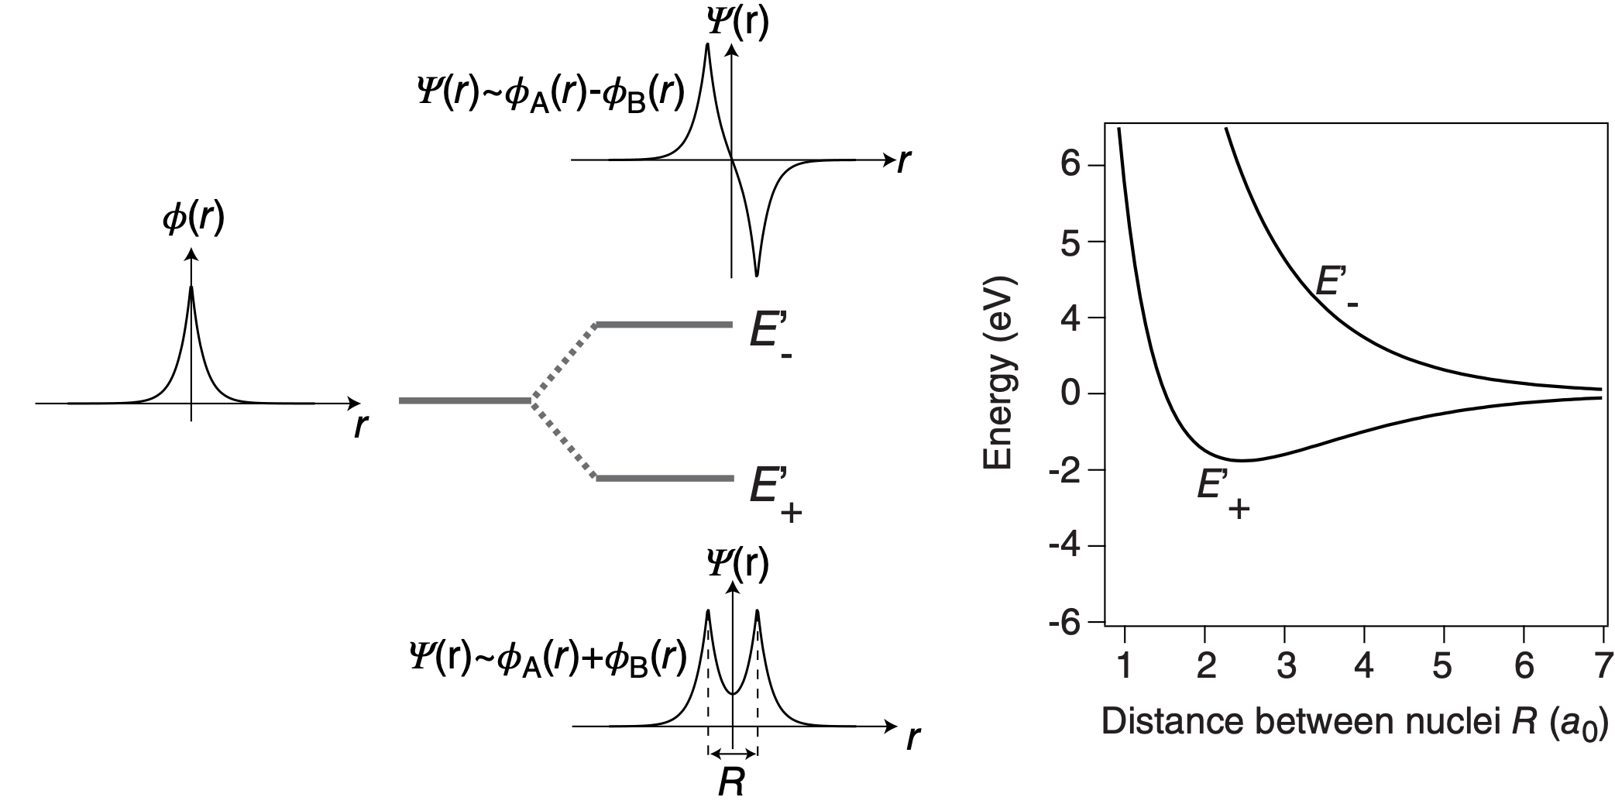
Notes:
bonding and anti-bonding orbitals

Slide 22
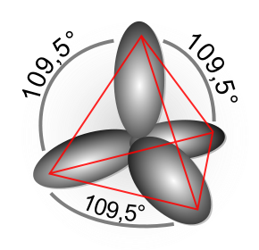
The covalent bond: a closer look at C
electron configuration: 2 s and 2 p electrons
formation of four sp³ hybrid orbitals as linear combination between the s and three p orbitals
directional character of p orbitals is also found in sp³ orbitals.
Notes:
typical tetrahedral configuration, 109.5 deg between each bond
directional bonding characteristic for covalent bonding!

Slide 23
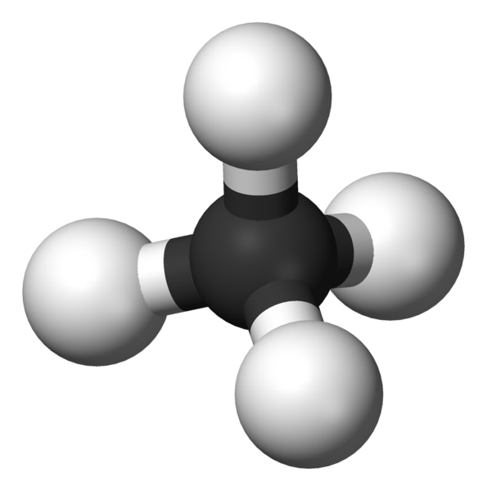
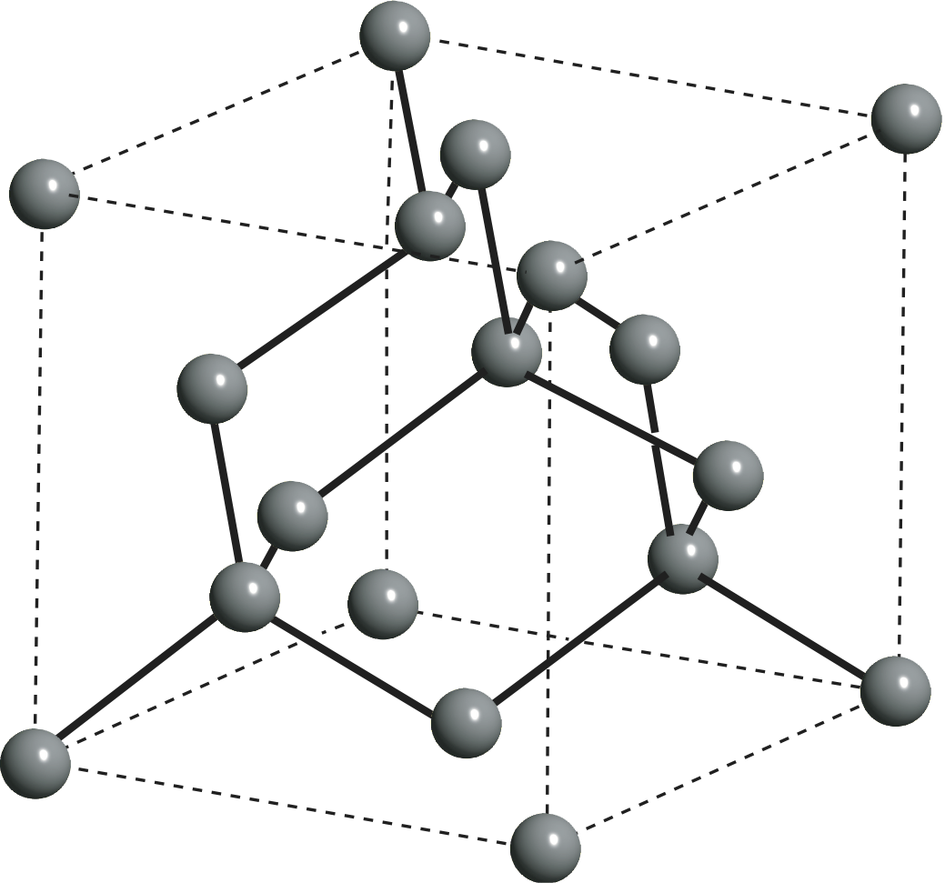
The covalent bond: sp³ bonding
methane
diamond
Notes:
directional character is maintained and important: it is found in all solids and molecules of sp3 bonding

Slide 24
Bonding in most semiconductors
Tetrahedral (sp³) configuration almost ubiquitous: diamond, Si, Ge, III-V (GaAs, AlAs, InP), II-VI (CdS, CdTe)
Notes:
but the situation is more complicated than in diamond because of the other kind of p orbitals.
Si: 3p not 2p so there are nodes in the radial wave functions. sp3 is formed but not the whole other carbon chemistry
Also, Si and the II/VI or III/V semiconductors may be isoelectronic but in the latter the bonding is not purely covalent anymore. It is partly ionic.

Slide 25
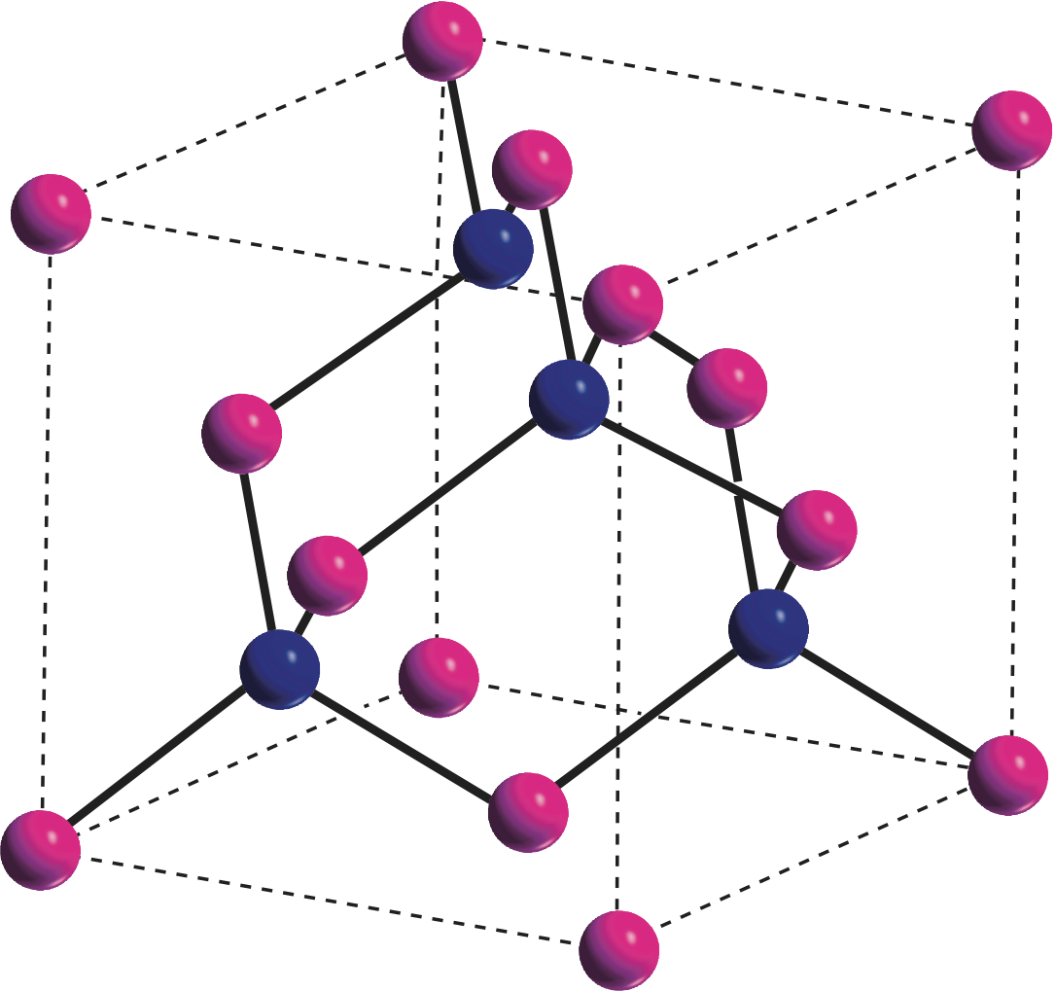
Bonding in most semiconductors
Tetrahedral (sp³) configuration almost ubiquitous: diamond, Si, Ge, III-V (GaAs, AlAs, InP), II-VI (CdS, CdTe)
Notes:
but the situation is more complicated than in diamond because of the other kind of p orbitals.
Si: 3p not 2p so there are nodes in the radial wave functions. sp3 is formed but not the whole other carbon chemistry
Also, Si and the II/VI or III/V semiconductors may be isoelectronic but in the latter the bonding is not purely covalent anymore. It is partly ionic.

Slide 26
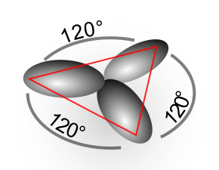
The covalent bond: sp² bonding
formation of three sp² hybrid orbitals as linear combination between the s and two p orbitals. One p-orbital remains
Notes:
other type of hybridization possible: combine s orbital with only two p orbitals and keep one p orbital

Slide 27
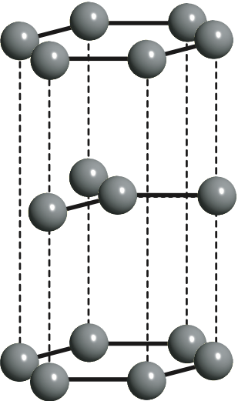
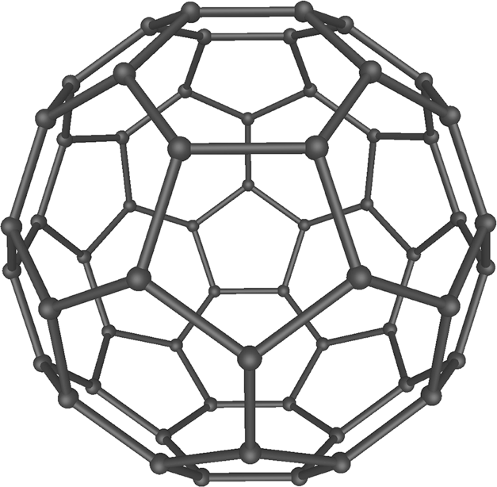
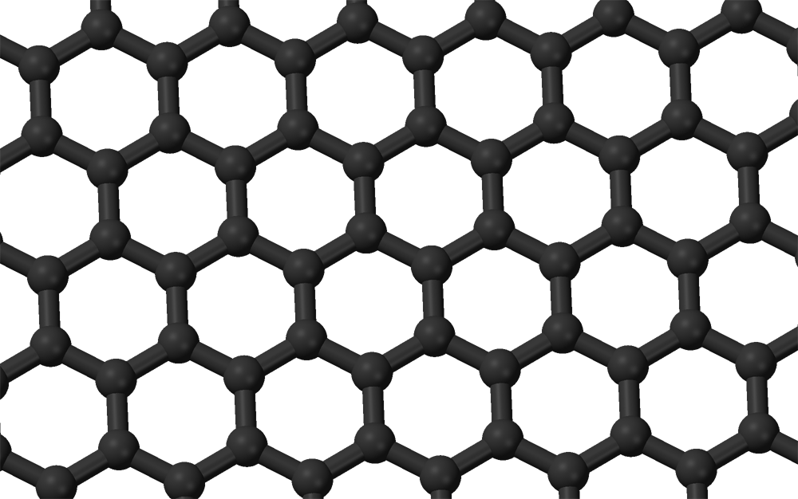
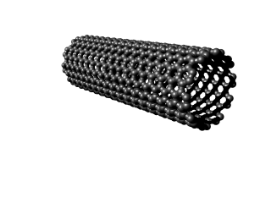
The covalent bond: sp² bonding
graphene / graphite
bucky-balls
carbon nanotubes
(rolled-up graphene)
Notes:
graphite good conductor unlike diamond,
explain what graphene is and how to get it
nanotubes conductors or not depending on how they are rolled up
C60 can be made into a solid. Insulator
graphene fascinating stuff: get back to this several times later!

Slide 28
Covalent bonding
Cohesive energies similar to ionic bonding, in the eV range.
Very directional bonding.

Slide 29
Metallic bonding
Notes:
seemingly high-school texbook physics
but in reality quite complicated. Come back to this over again through the course

Slide 30
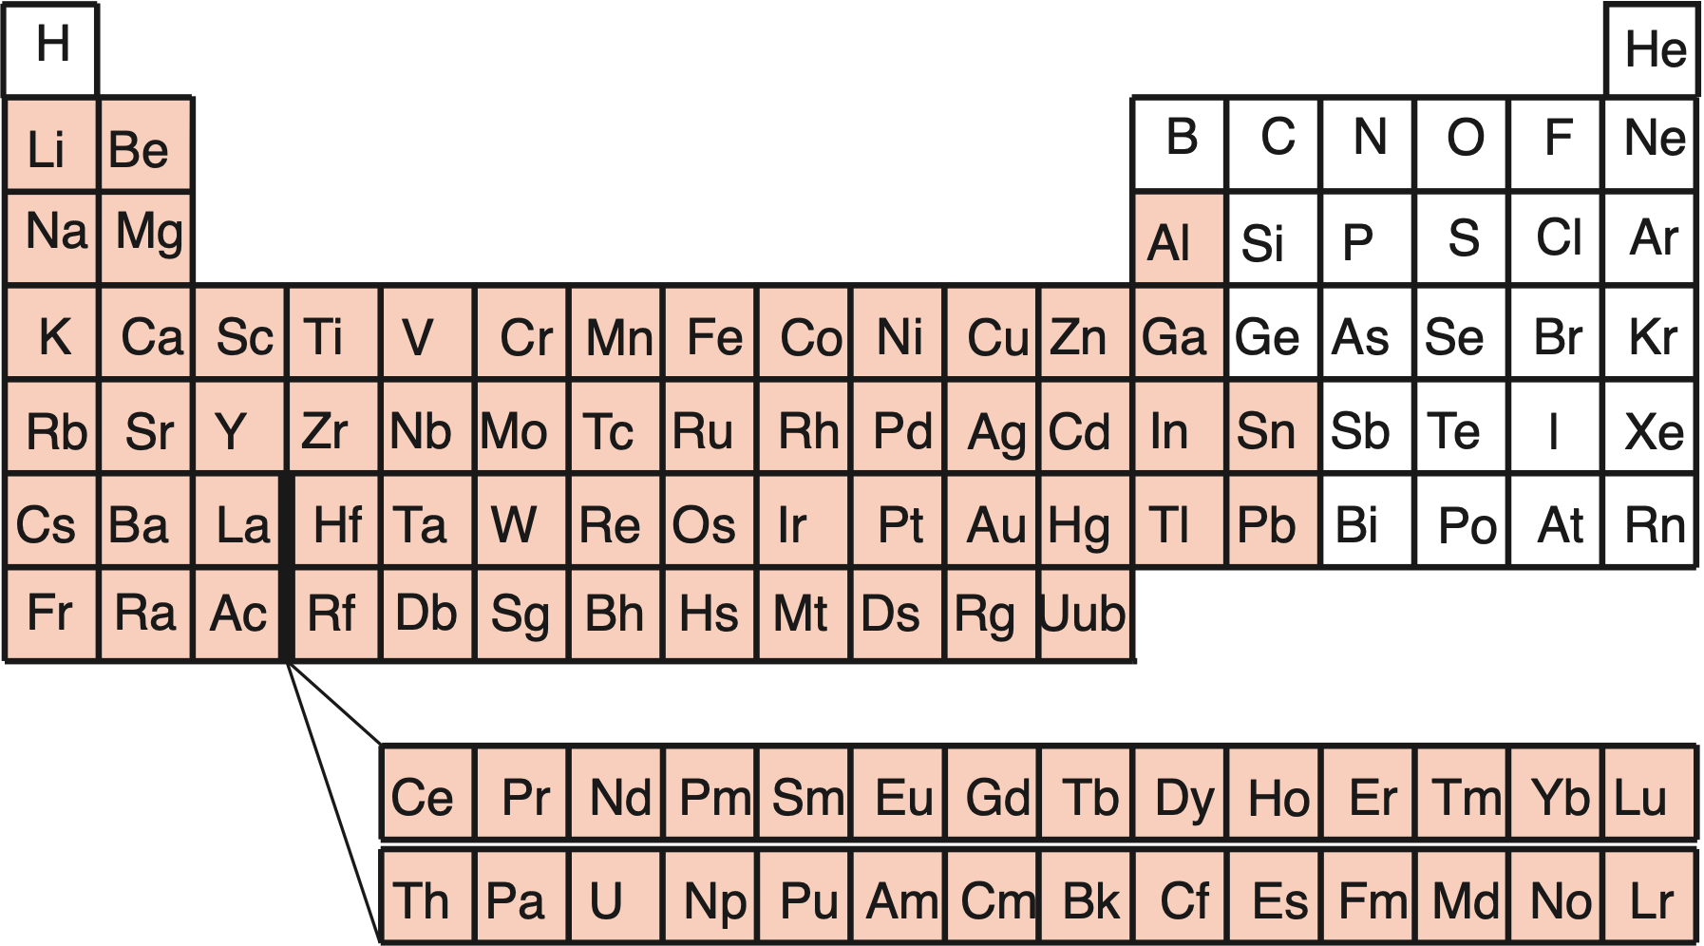
metals / non-metals
the boundaries can be disputed
simple metals, transition metals, noble metals
Notes:
some of these may be disputed
Bi is more of a semimetal than As and Sb
C could be said to be a semimetal, As, Sb and Bi could be metals
However, the metallic state is obviously really important!

Slide 31
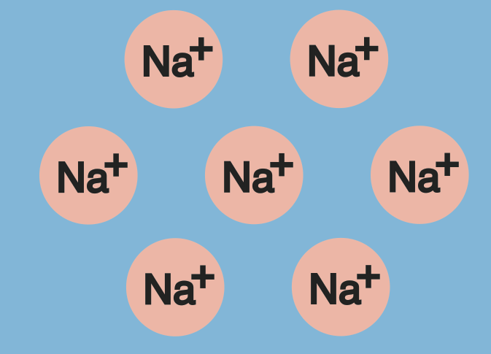
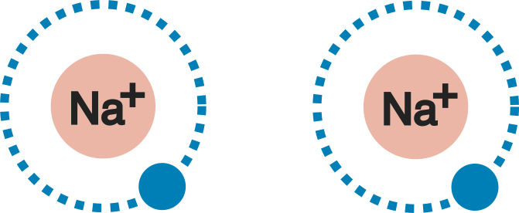
Metallic bonding (simple metals)
outer electrons are delocalized and act as “glue” between positively charged ion cores
generally found for elements with one, two or three valence electrons.
cohesive energies in the eV range
Notes:
high-school texbook physics.
but: where does the energy gain come from? It will still cost energy to take the electrons away from the ions (and we know how much, 5.1 eV for one Na electron!)
Really it is quite complicated. Learn a lot about this in the course of the lectures
some rough ideas now

Slide 32
Metallic bonding (simple metals):
more characteristics
smaller cohesive energies than in ionic crystals
larger ionic radii, e.g. for Na: 3.82 Å (metal) and 1.94 Å (NaCl)
bonding has no directional preference
closed-packed atomic configurations are preferred: best possible overlap between the orbitals, no “holes” in the potential
Notes:
ionic: each ion is strongly attracted by its neighbours (at least by the nearest neighbours)
here: all ions repel each other (but they are of course still embedded in average one valence electron). It is not nearly as clear where the energy gain comes from in the first place
closed pack configurations are good: no holes in the potential.

Slide 33
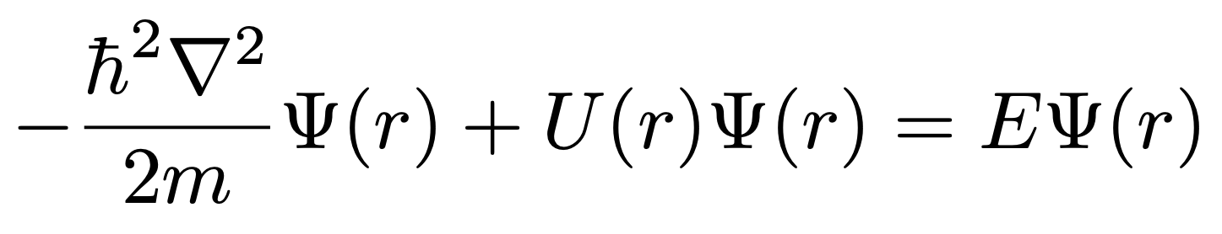
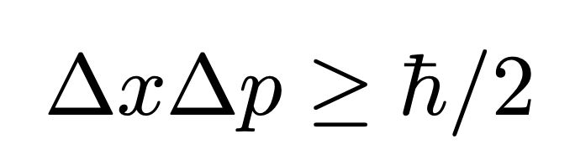
Metallic bonding: why is this so favorable?
kinetic energy (or Hamiltonian for a free particle)
∝ (negative) average curvature of wave function
“flatter” wave function -> lower energy
less localization -> smaller p variation
Notes:
let’s look at the stationary Schr-equ.
two terms in the Hamiltonian: kinetic energy and potential energy. Kinetic energy is something like the negative average curvature of the wave. We know it’s always positive so let’s don’t worry about the sign. The thing is, the higher the curvature, the higher the energy.
So if we force the electron to be localized in a small orbit around a single atom the curvature is high. If we de-localize the electron over the whole solid (or at least some larger fraction), the average curvature is smaller and we gain energy
also consistent with a hole-free potential
This is a bit loosely spoken because the wave function is of course complex and so the curvature is not so well defined...
Exercise: just use the “biggest” p to calculate the energy. Maybe not so satisfying because p could also be 0.

Slide 34
Metallic bonding: why is this so favorable?
image source: wikipedia
Notes:
Alternative exercise:
If I decrease L I push up all the eigenvalues. How do they depend on L (obviously 1/L^2)?

Slide 35
Transition metals
4s and 3d have very similar energies
4s electrons form delocalized metallic bonds
3d electrons form more local (covalent-like) bonds
higher cohesive energies
Notes:
so the d electrons are also valence electrons
two types of valence electrons s and d
it is a bit of a mixture between the metallic state discussed previously and the covalent bonds same of course for 4d

Slide 36
Bonding types
In which material is the bonding most covalent?
lead
diamond
GaAs
KF

Slide 37
Bonds between molecules
molecular solids are very common (but not at RT)
ice
plastic
DNA
what makes molecules bond to each other?
Notes:
until now cohesive energies always quite similar, a few eV per atom
We know this: kT at room T only 25 meV. Cohesive energy of most solids must be much higher otherwise they would melt. Or at least entropy effects would be important.
But not ice. Not DNA otherwise no replication.
two mechanisms. H-bonding, van der Waals bonding

Slide 38
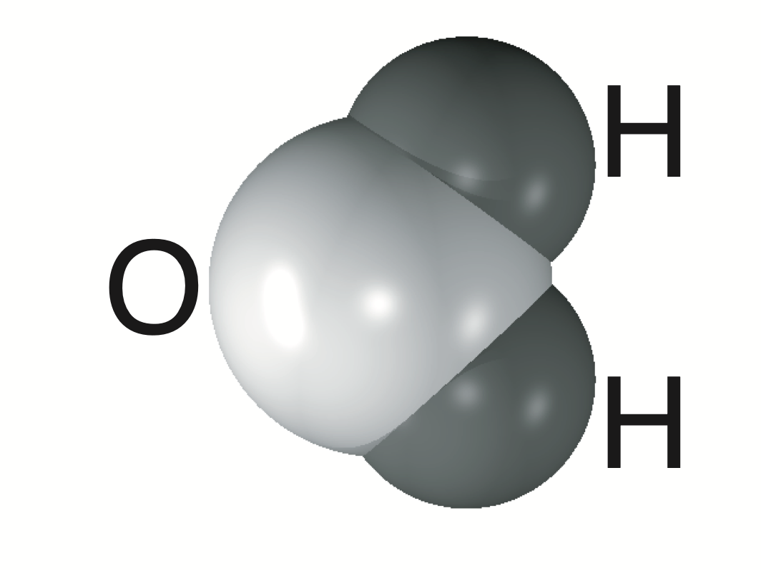
Bonds between molecules: hydrogen bonds
permanent dipole

Slide 39
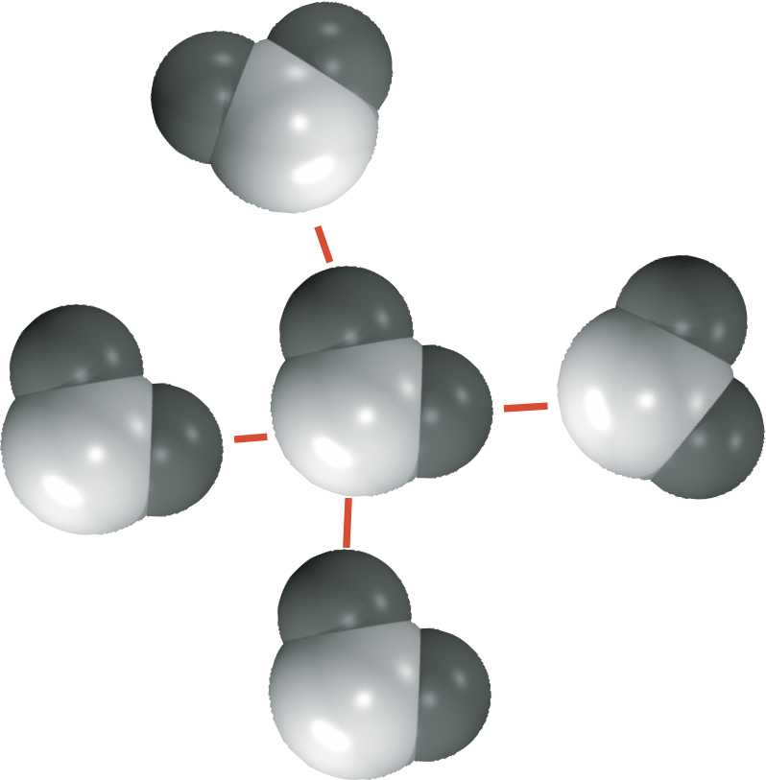
Bonds between molecules: hydrogen bonds
H is positively charged but also very small: another “real” bond cannot be established without overlap of electron clouds (in this sense it is too big in this drawing).
H bonding is important in ice, DNA... but not very strong
Notes:
don’t confuse it with the chemical bond of the H atom
is responsible for the high melting point of ice (many other molecules are already in the gas phase at this temperature)
makes the double helix bond
but these things break at RT unlike other solids. Quite important for life.
What is kT at room temperature?

Slide 40
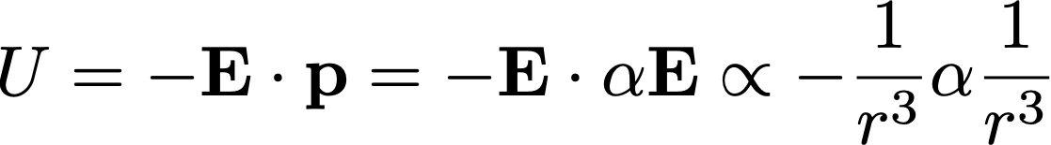
Bonds between molecules: van der Waals force
E
p=αE
attract
dipole moment caused by fluctuations
this is always present as an attractive force (even between He atoms as in this case)
it is very weak and depends on the distance as r⁻⁶
Notes:
usually important at much lower temperatures.

Slide 41
Bond type and physical properties
How does the bond type affect the properties of a solid such as:
mechanical strength / melting point
electrical conductivity
thermal conductivity
optical properties
Notes:
we look at the melting point here briefly and in more detail later, other properties also later
el conduct: some free electrons
th conduct: quite similar to el conduct: metals are better. But some insulators are also ok and superconductors are not, so there is more to this!
optical properties: metals are shiny and opaque, insulators can be coloured and / or transparent

Slide 42
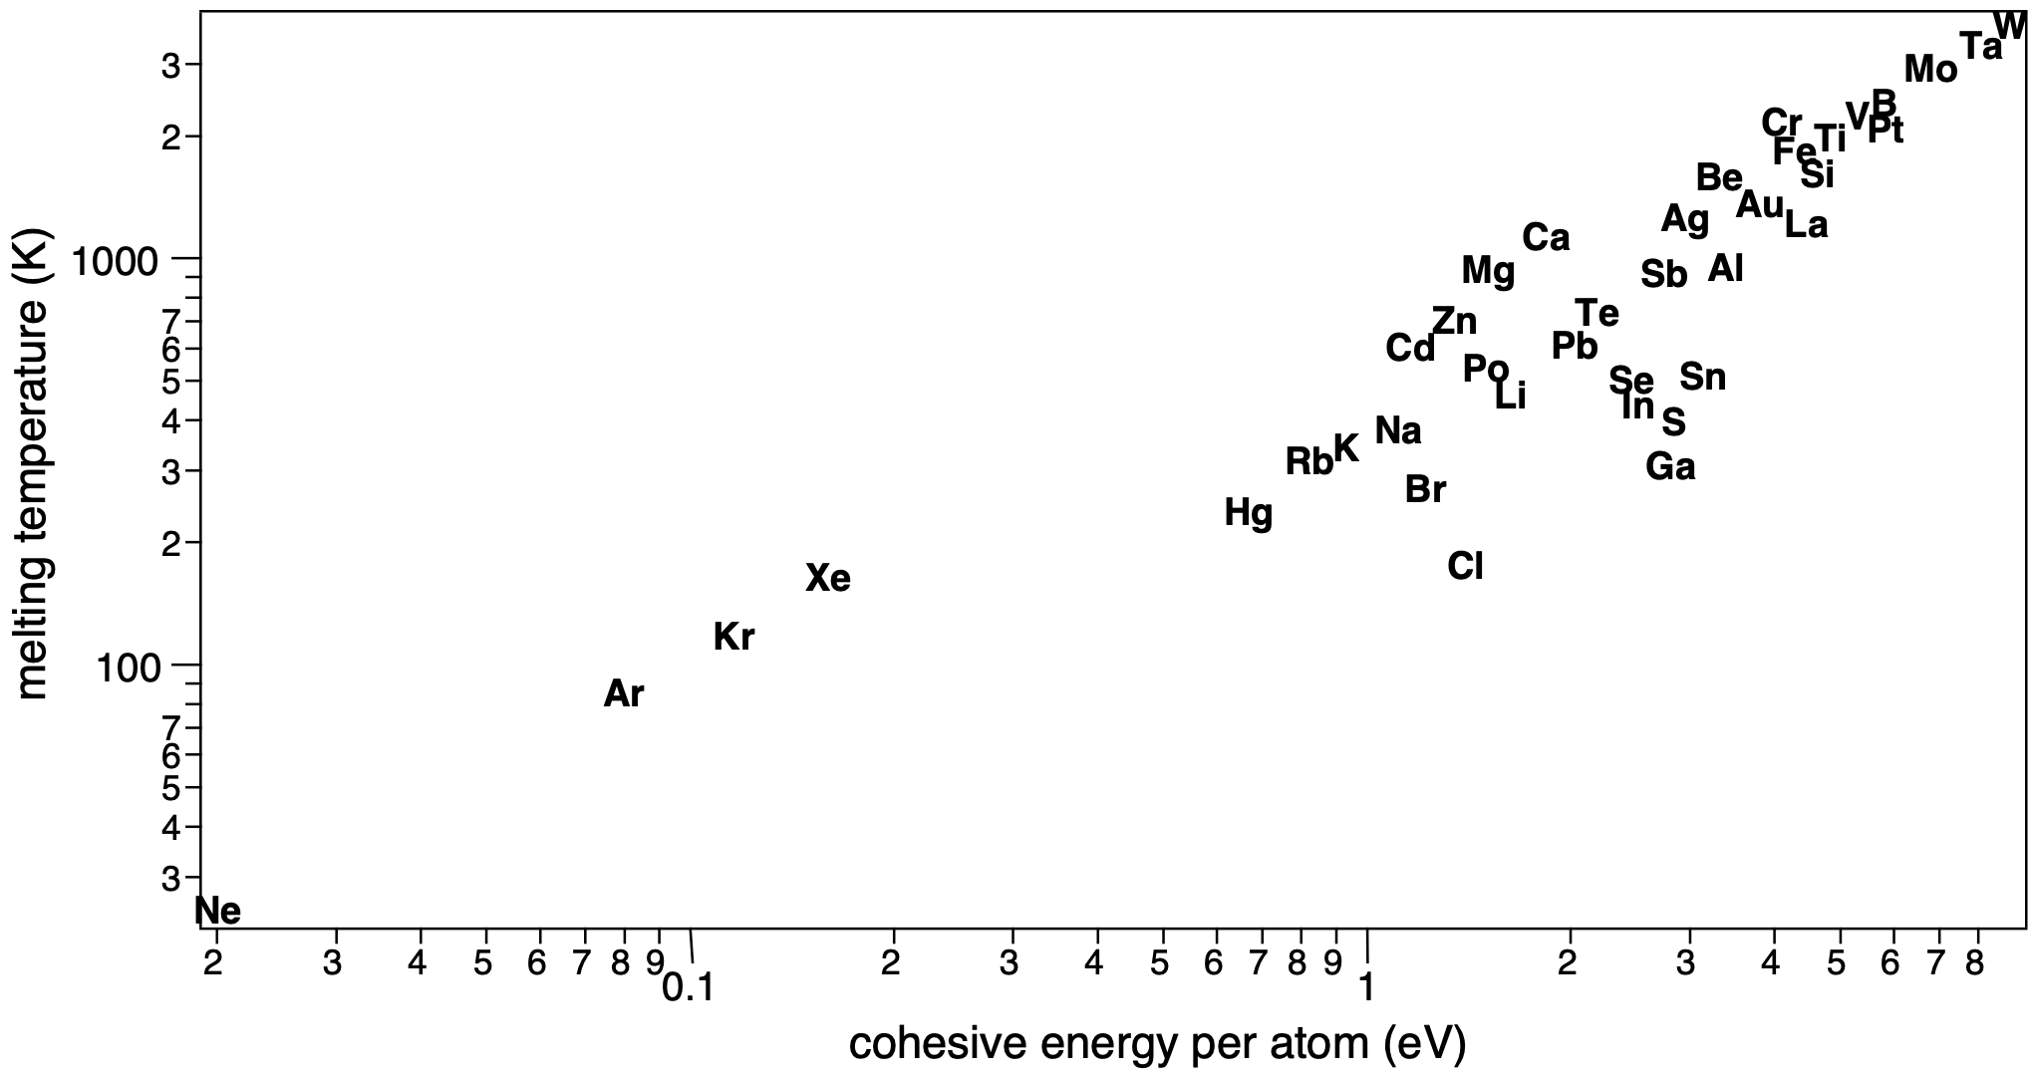
Bond type and physical properties
Notes:
rare-gas solids: only van der Waals bonding, less than RT in any case
molecular solids are missing
simple metals and noble metals
and finally, transition metals (covalently bonded solids and ionic crystals)
energy scale and temperature scales don’t correspond: RT is 25 meV, 4*25 meV = 100 meV would be 4*300=1200 K and 1 eV thus 12000 K.
high cohesive energy should melt at much higher T so it’s a bit more subtle than this here.

Slide 43
Summary
We have looked at different types of bonding: ionic, metallic, covalent, H-bonds, van der Waals bonds.
In reality, intermediate bonding scenarios are often found.
We have some ideas about the relation between between the bonding type and the physical properties (at least for the melting point).
Notes:
drastic mixes of properties, for example alpha gallium

