Slide 1
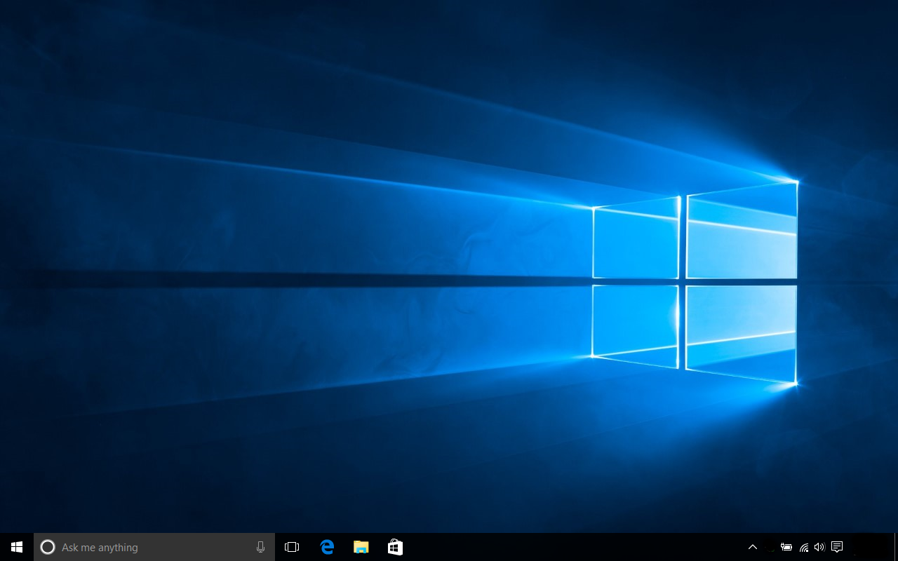
Windows 10

Slide 2
Windows 10 is a personal computer operating system released by Microsoft as part of the Windows NT family of operating systems. The first version of the operating system entered a public beta testing process in October 2014, leading up to its consumer release on July 29, 2015.
To encourage the transition to Windows 10, Microsoft announced that during its first year of availability, upgrades to the operating system would be made available free of charge to users of genuine copies of eligible editions of Windows 7, and Windows 8, after update to Windows 8.1.
Windows 10 introduces what Microsoft described as a "universal" application architecture; these apps can be designed to run across multiple Microsoft product families with nearly identical code‍—‌including PCs, tablets, Smartphone, embedded systems, Xbox One, Surface Hub and HoloLens.
The Windows user interface was revised to handle transitions between a mouse-oriented interface and a touchscreen-optimized interface based on available input devices‍—‌particularly on 2-in-1 PCs; both interfaces include an updated Start menu that blends elements of Windows 7's traditional Start menu with the Tiles of Windows 8. Windows 10 also introduces the Microsoft Edge web browser, Cortana and other features.

Slide 3
Desktop/Laptop Operating System Browsing Statistics
Desktop operating system market share according to StatCounter for February, 2016. Android desktops and laptops are not included in these data.

Slide 4
Should I Upgrade to Windows 10?
If you have a computer provided to you by PRC running Windows 7, then you may try to upgrade. You may or may not be successful.
If you own your own desktop or laptop computer, then you should consider upgrading to Windows 10. (Some features found in Windows 7, 8 and 8.1 are not available in Windows 10.)
Be advised, that even if your upgrade to Windows 10 is successful, some hardware or software might not function as before, e.g., printers, pointing devices, scanners, sound cards, etc.

Slide 5
Key Dates
July 29, 2015-Consumer release of Windows 10
July 29, 2016-Free Windows 10 upgrade offer from Microsoft expires. *
January 14, 2020-End of Windows 7 Extended Support
January 10, 2023-End of Windows 8, 8.1 Extended Support
* Microsoft hasn’t said what it intends to do after July 29, 2016, relative to the free Windows 10 upgrade offer.

Slide 6
Let’s Look At Six Windows 10 Features

Slide 7
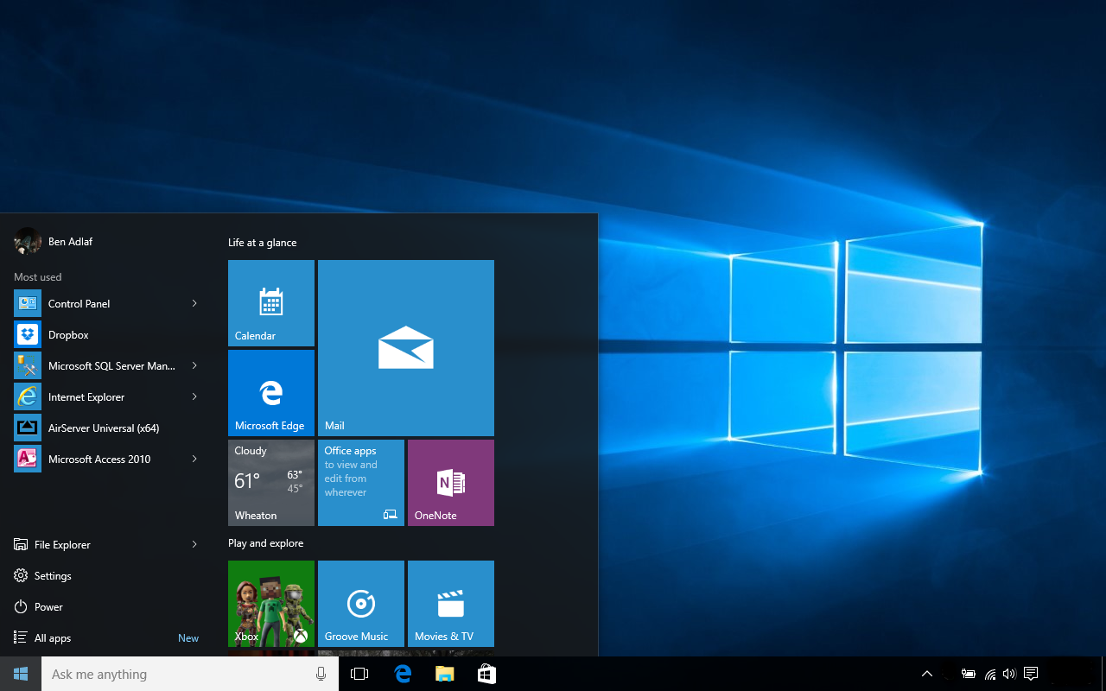
Start Menu

Slide 8
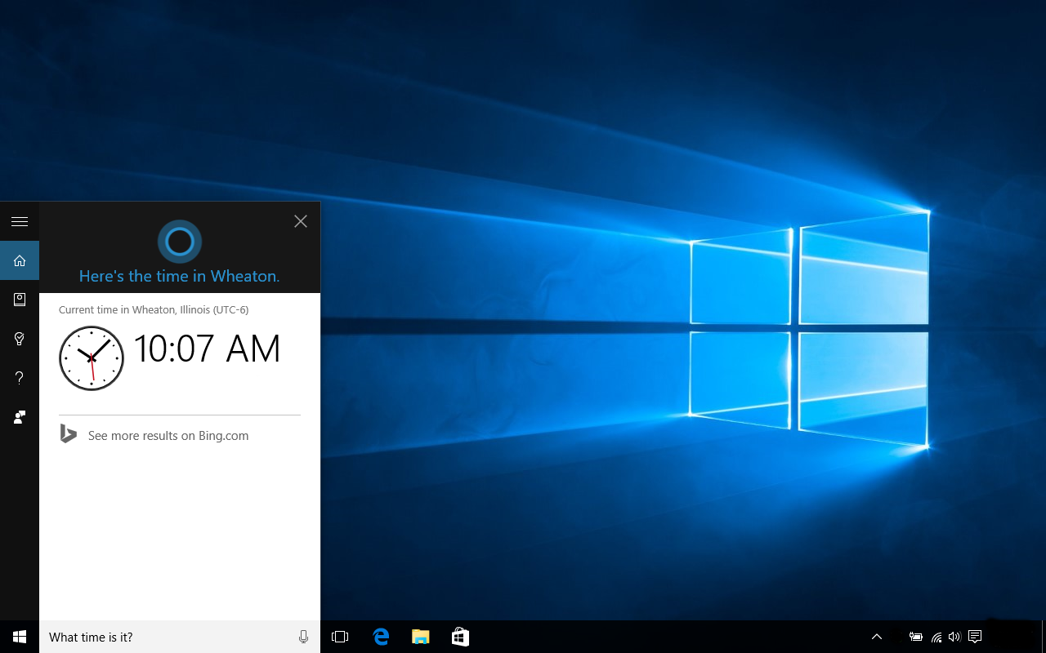
Cortana Personal Assistant

Slide 9
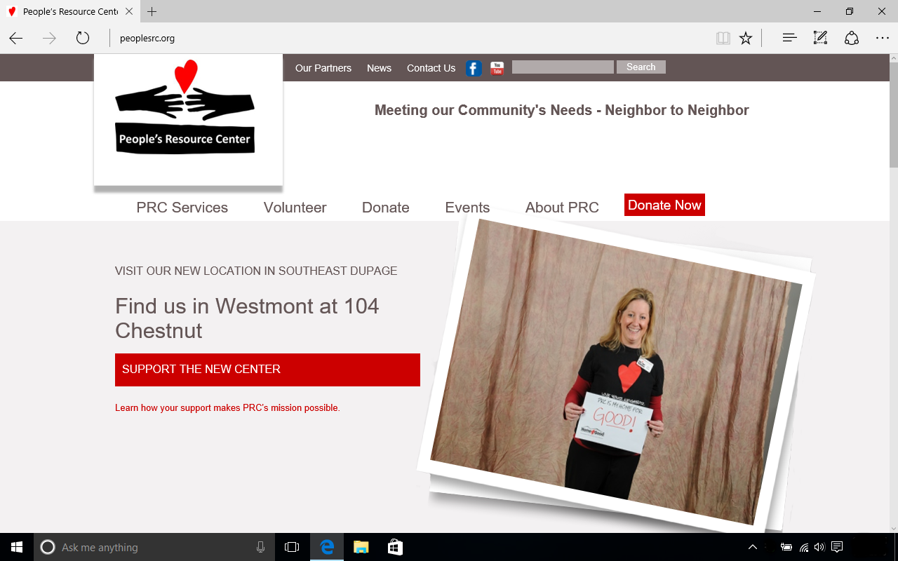
Edge Web Browser

Slide 10
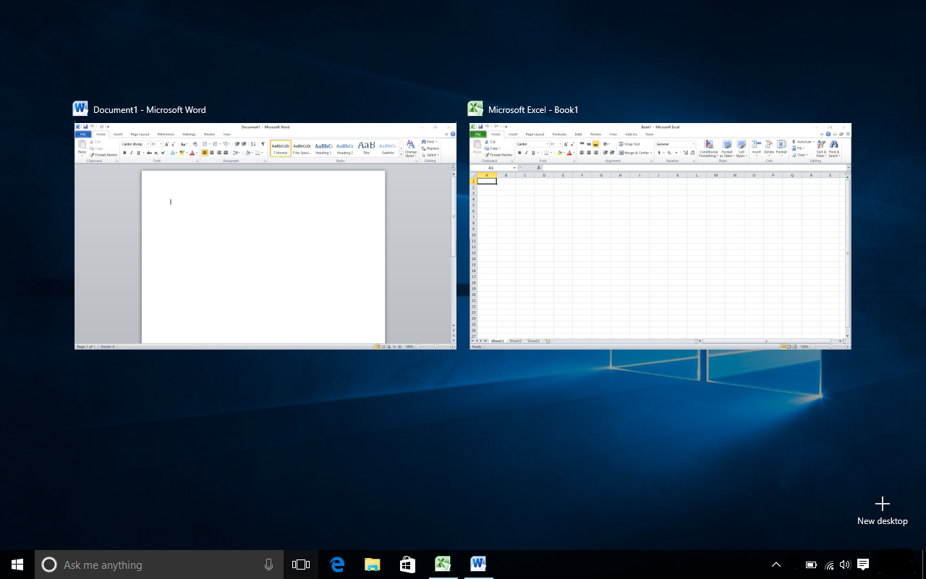
Task View

Slide 11
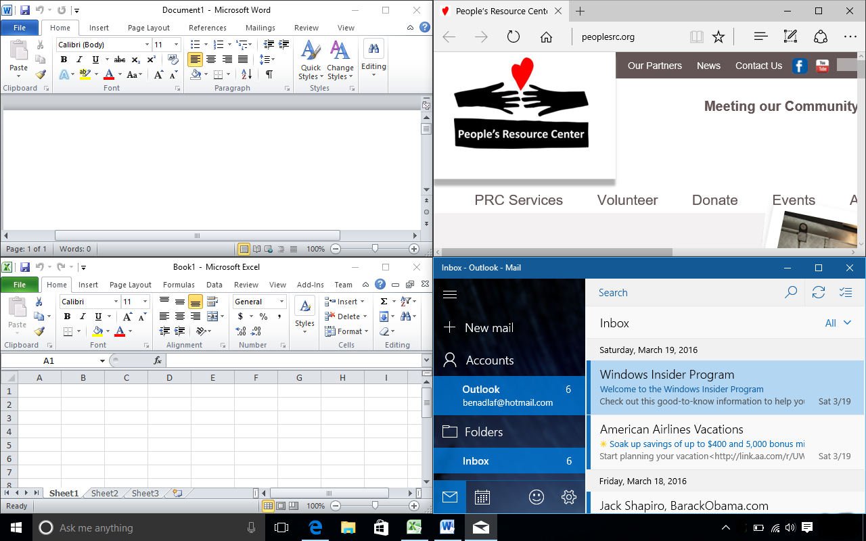
Snap Assist

Slide 12
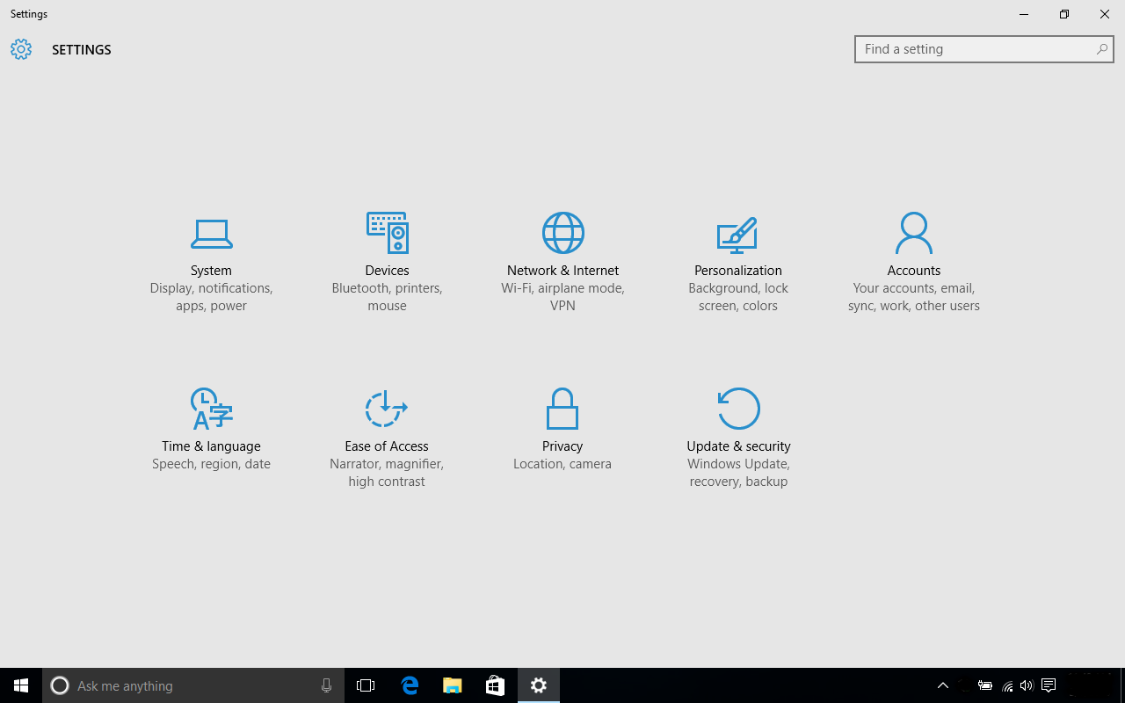
Privacy Settings
https://privacy.microsoft.com/en-US/

