Slide 1

Pinterest
Julie Wachowski
Literacy Coordinator

Slide 2

Also Known as:
Social Media CAN be fun!
Crowd Source Your Visual Hobbies

Slide 3

also known as:
“Time flies!”
Notes:
Remember there’s another form of online learning: the Crowd Source Model. Now, we’re going to take a look at Pintrest, which is a social media platform, that is also a place that has evolved into a learning environment. I have this cartoon here because, I find Pintrest to be a dangerous time suck. But if you stay focused you can find some great stuff.

Slide 4

What Can You Do With It?
See anything you
can picture

Slide 5
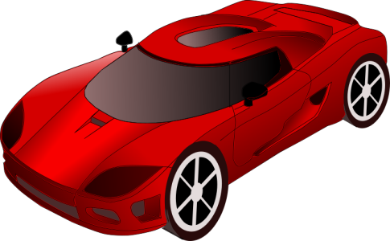
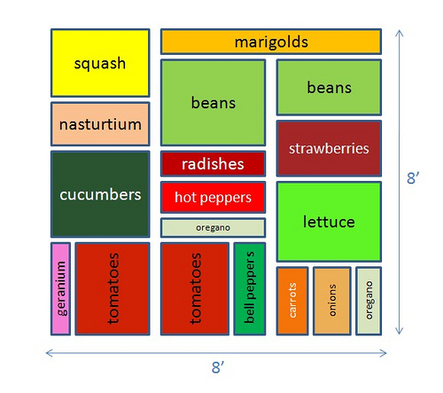


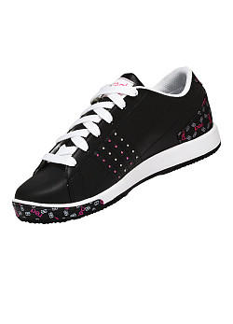

What Can You Do With It?

Slide 6





Create the magazine that’s perfect for you.

Slide 7
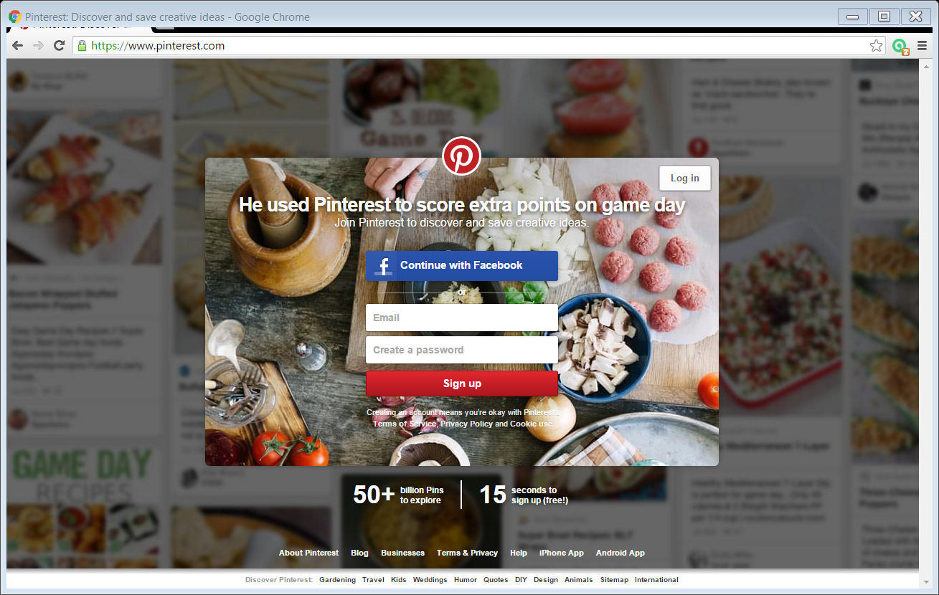
Notes:
Here’s a screenshot of the basic landing page. Pintrest is a free website that launched in 2010. The developer called it a “catalogue of ideas”; other people have described it as a “photo sharing” network. I think it’s like a visual catalog to the web. People save photos and links, using a “pin”. You may have seen the P icon for pinning on tool bars?

Slide 8
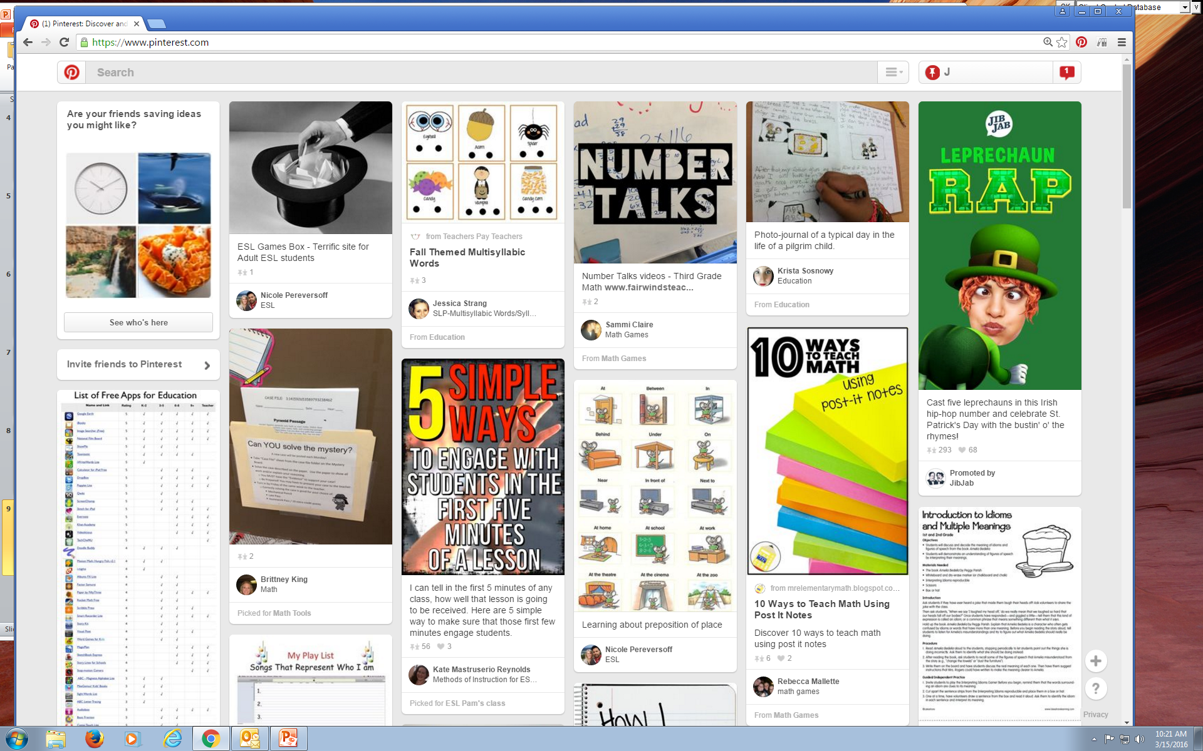

Slide 9
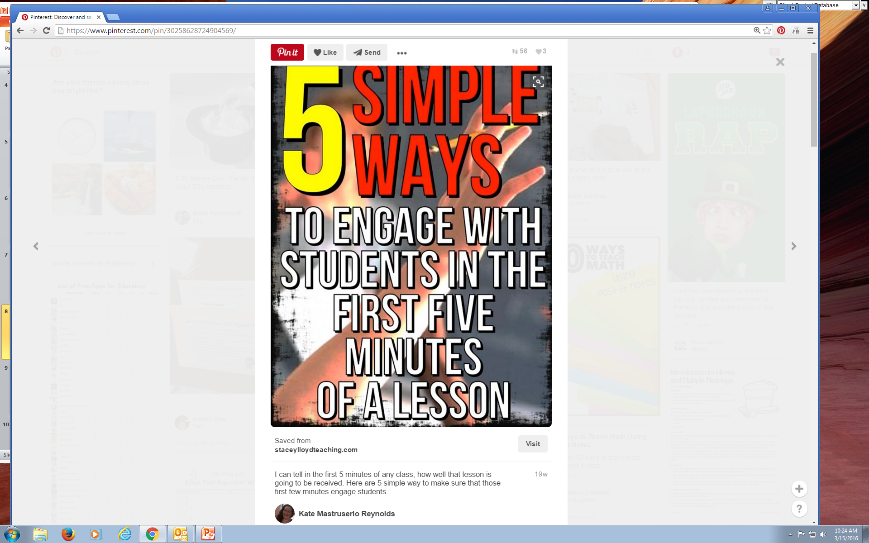

Slide 10
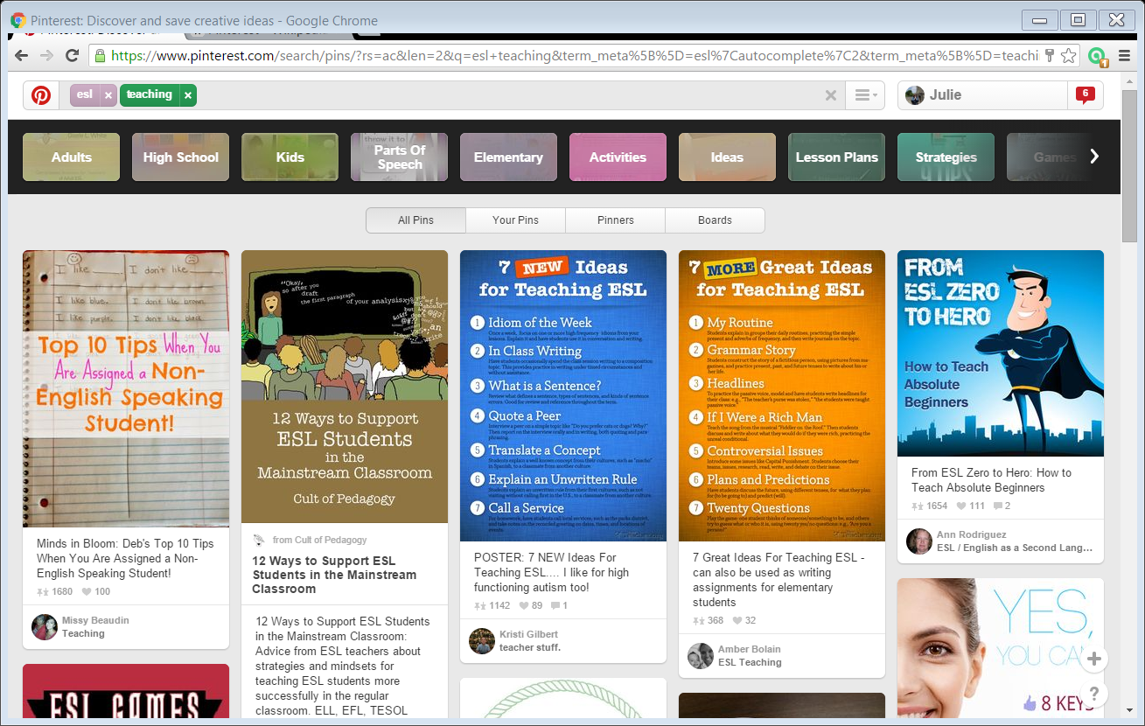
My search terms
Suggested/
Search Terms
Notes:
OK—Here I’m logged in—you can see my name up there? And I have done a subject search for two topics: ESL and teaching and the boxes below are pins other people have added related to these topics.

Slide 11
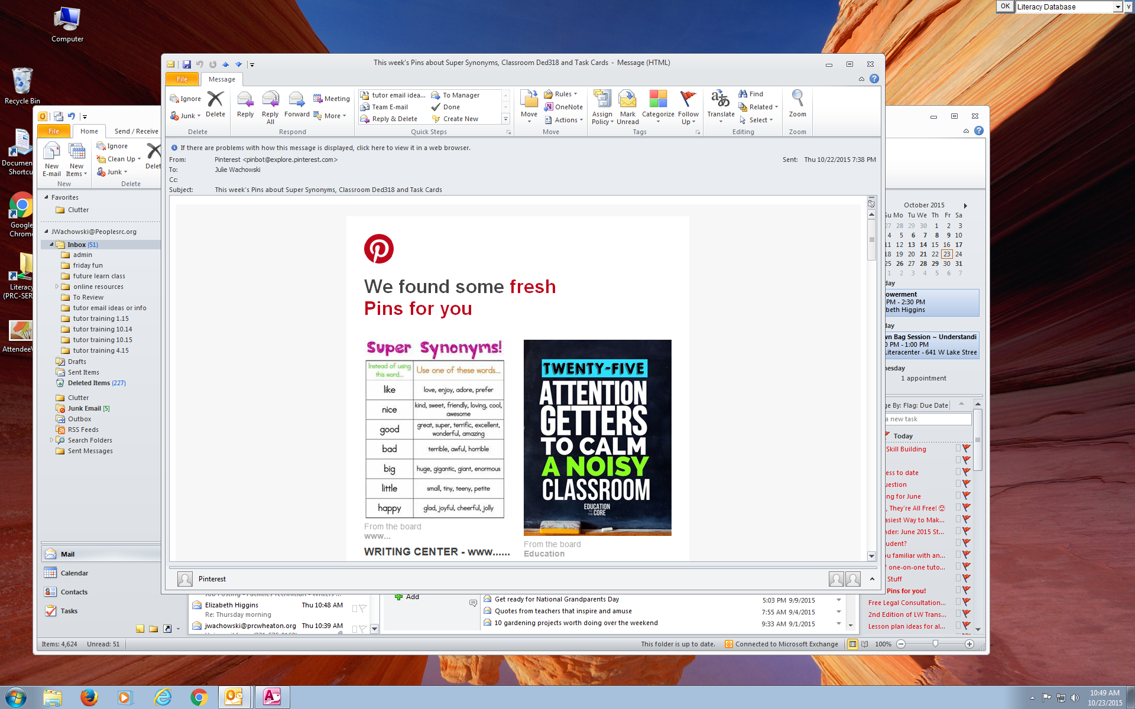
Notes:
I log into Pintrest with my email, so I also get emails every day or two related to things I’ve search. This is great for inspiration! But beware the time suck!

