Slide 1

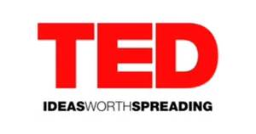

Online Learning #2

Slide 2
Life Long Learning!
More Liberal Arts for Everyone!

Slide 3



Traditional teaching model:
A student
a teacher
Notes:
Similar to a classroom, a student is directed by a teacher to learn new information or skills.

Slide 4


& are more like:
many teachers
A student
Notes:
In the late 1990’s educators began to talk about the potential for what was called at the time “distance learning.” At first distance learning, happened as a transaction driven by the student via email and listserve groups. It was slow and had high drop out rates. Very few students completed a course. As internet speed improved the ability to work real time, teachers began to see new potential. Universities all over the world began to develop courses which could include real time participation AND stored for future review.
We are still discovering how online learning can happen.
It is has unknown potential because this type (both teachers and tools) of resource has never been accessible to so many people.

Slide 5
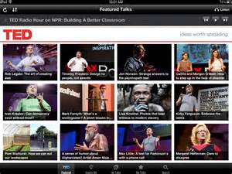
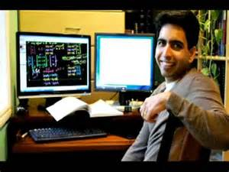
Traditional Instruction Model
Instruction
Lesson/Lecture
Instructor Driven
Similar to Classroom Instruction
Notes:
Right now, there are two standard models for how online learning happens: Traditional and Crowd Sourced. Traditional is a lot like the schools we are used to. A student signs up to watch a video of an instructor or you read and watch a mix of things, but basically—it feels very similar to what we’ve done in school. You might decide, in general what you want to learn about, then a teacher guides you through the material. Both Khan and TED follow this model. TED is a lecture. Khan offers lecture with problem solving.

Slide 6
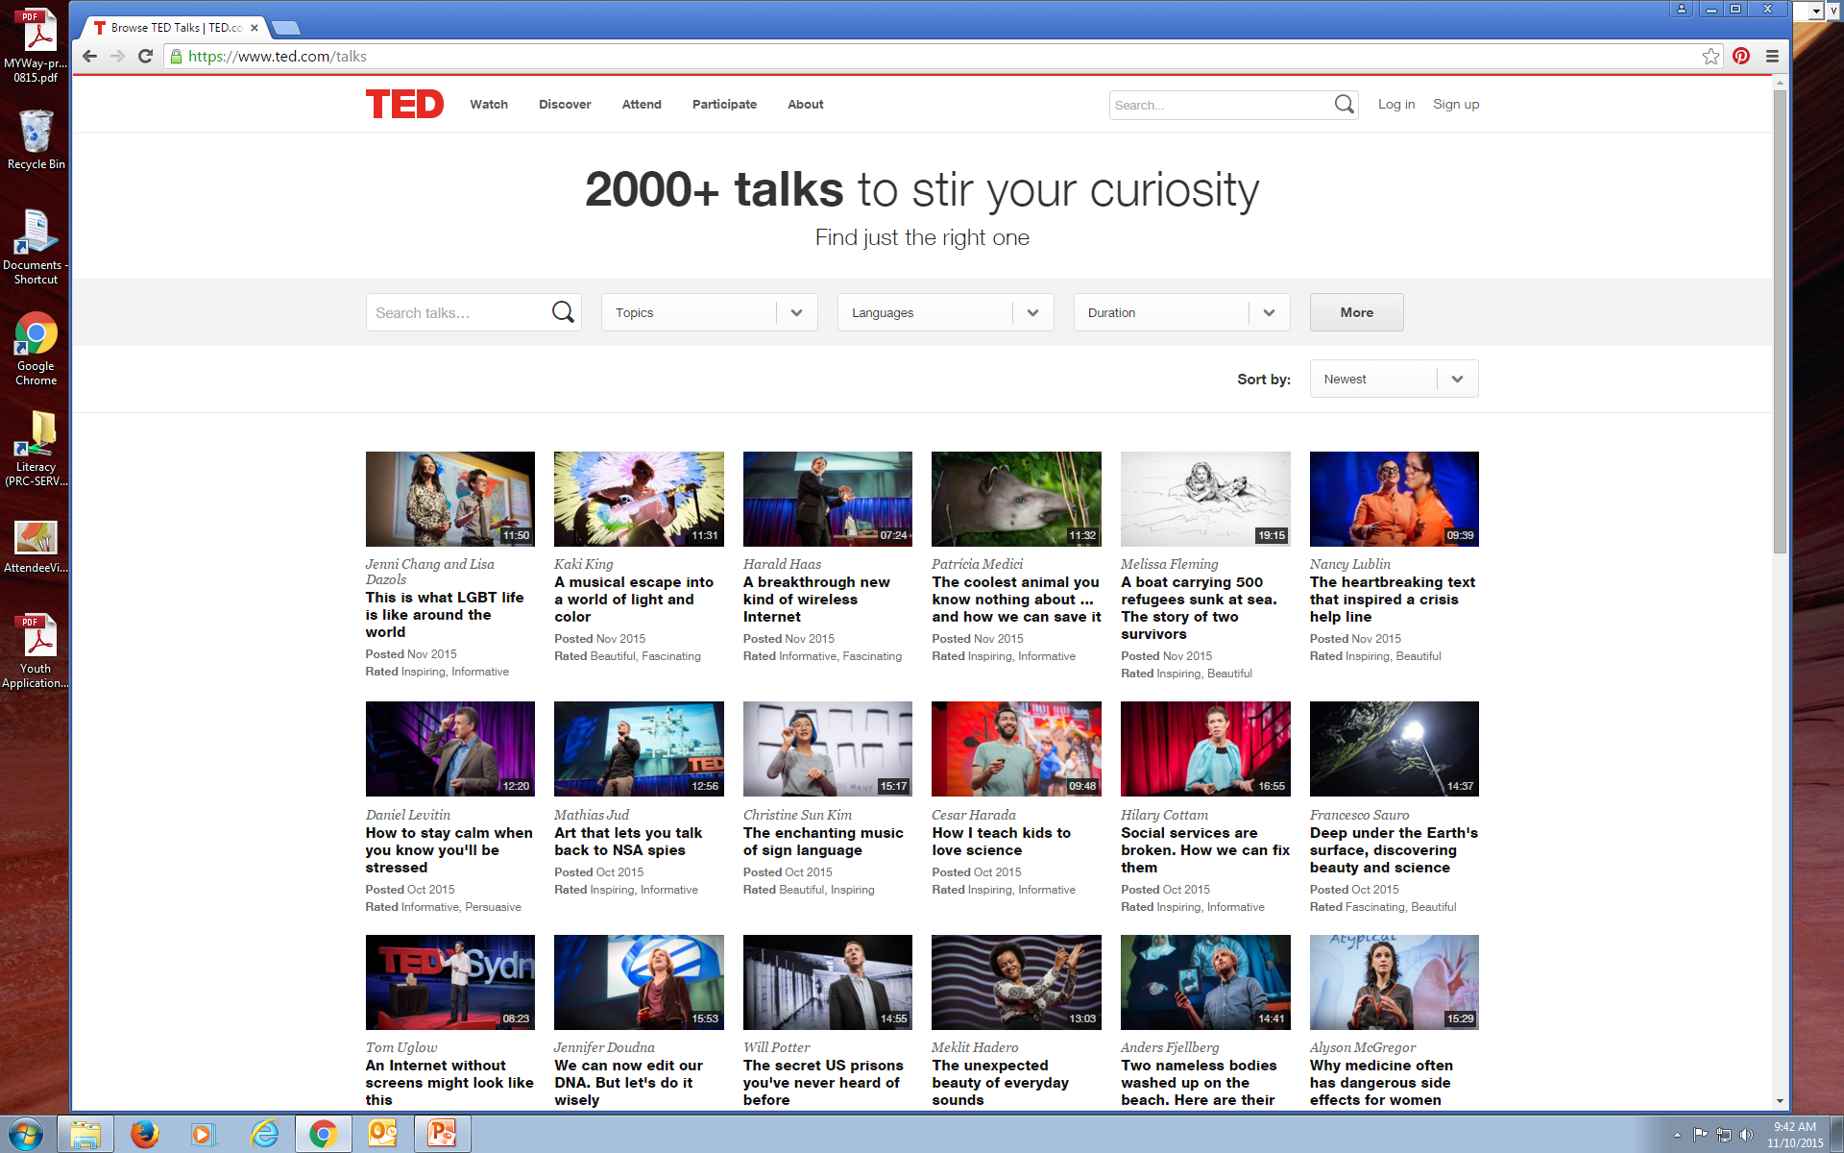
Notes:
What is TED? (Technology, Entertainment & Design-originally tech entertainment & design people; now philosophers, politicians, etc.) “Ideas worth spreading.” Conference began in 1990. When it started is was held in So Cal, $6000 to attend. Exclusive Prom for nerds. 18 minute maximum. Now run as a non-profit using Creative Commons copyright. Headquarters in US & Canada. British newspaper magnate Chris Anderson runs it as a “curator.” This is a word worth noting—lots of people who work with the internet/web think of curating as the next important step in making use of the mass of info available.
Over 200 talks available. In 2012 views reached 1 billion.

Slide 7
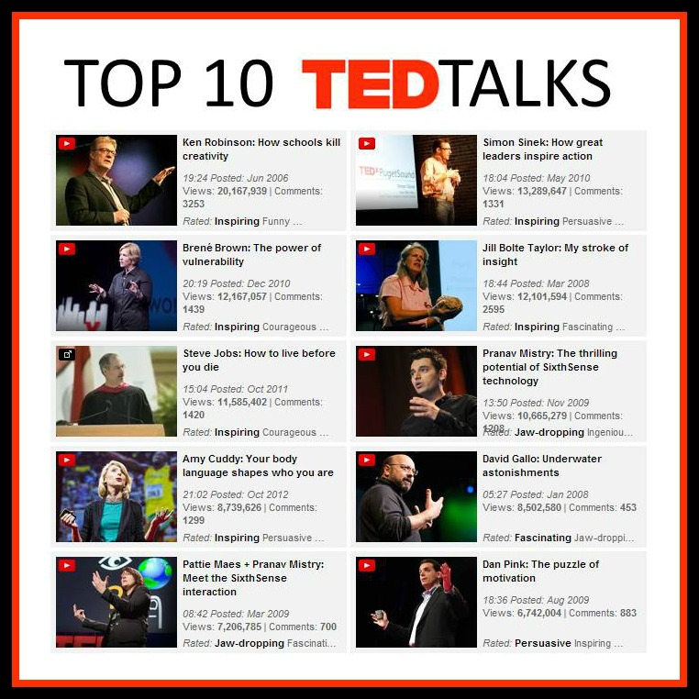
Notes:
Where to start? With 2000 talks, we need to curate a bit. I recommend looking at the most popular first—because they are usually very well done. Even if you aren’t interested in the subject matter. They are fun to listen to!

Slide 8
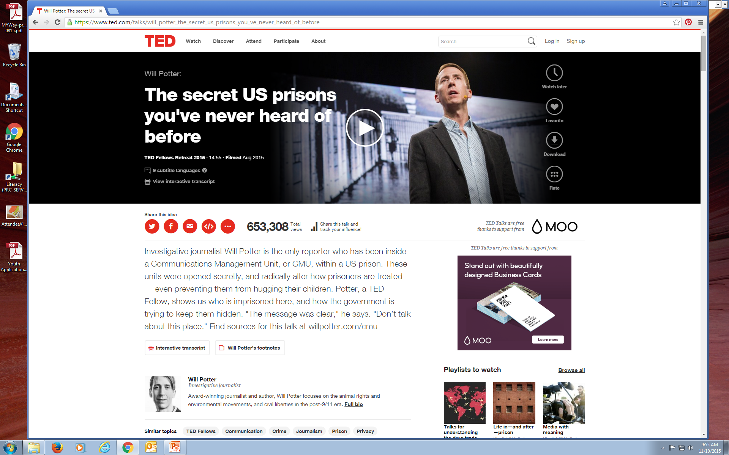
Notes:
Two ways to listen to TED talks. You can register at the website. Create a login. Or you can google the person/ talk you are intreested in and go directly to the talk through You Tube.

Slide 9
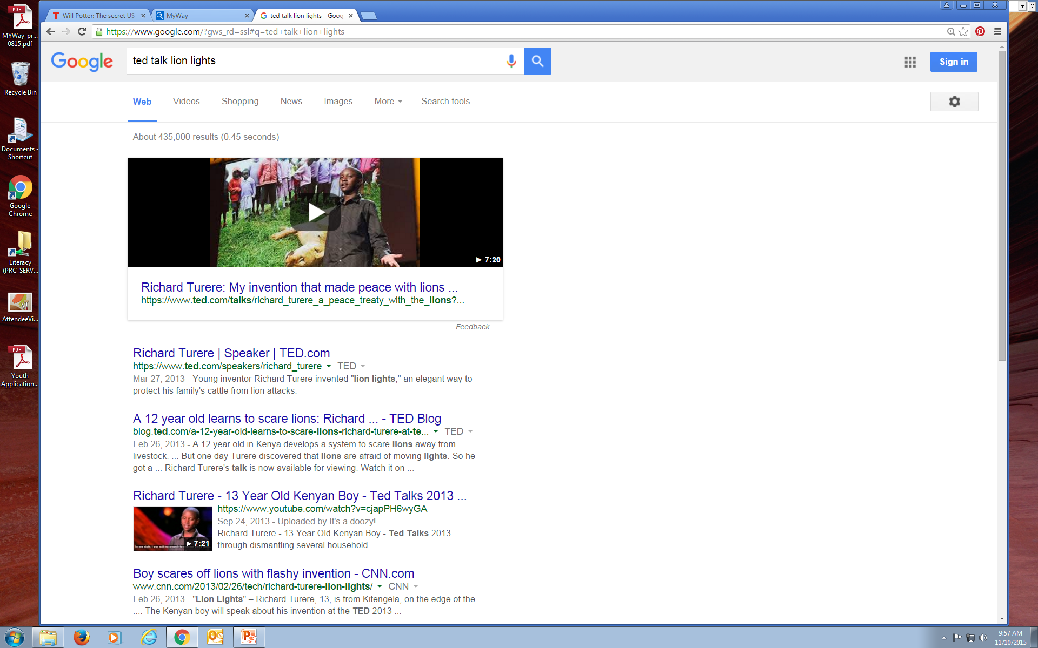
Some of My Favorites
Karen Armstrong: Charter for Compassion
Sugata Mitra: School in the Cloud
Amy Cuddy: Your Body Shapes Who You Are
Dan Gilbert: Happiness
Notes:
So you can also google to see if someone you are interested in has DONE a TED talk. Of if you’ve vaguely heard of a talk, here ‘s the way I find them. This is a great one! Now it has spread to TEDx—which are additional local conferences held all over the US. TEDmed, TEDed…etcetera…

Slide 10
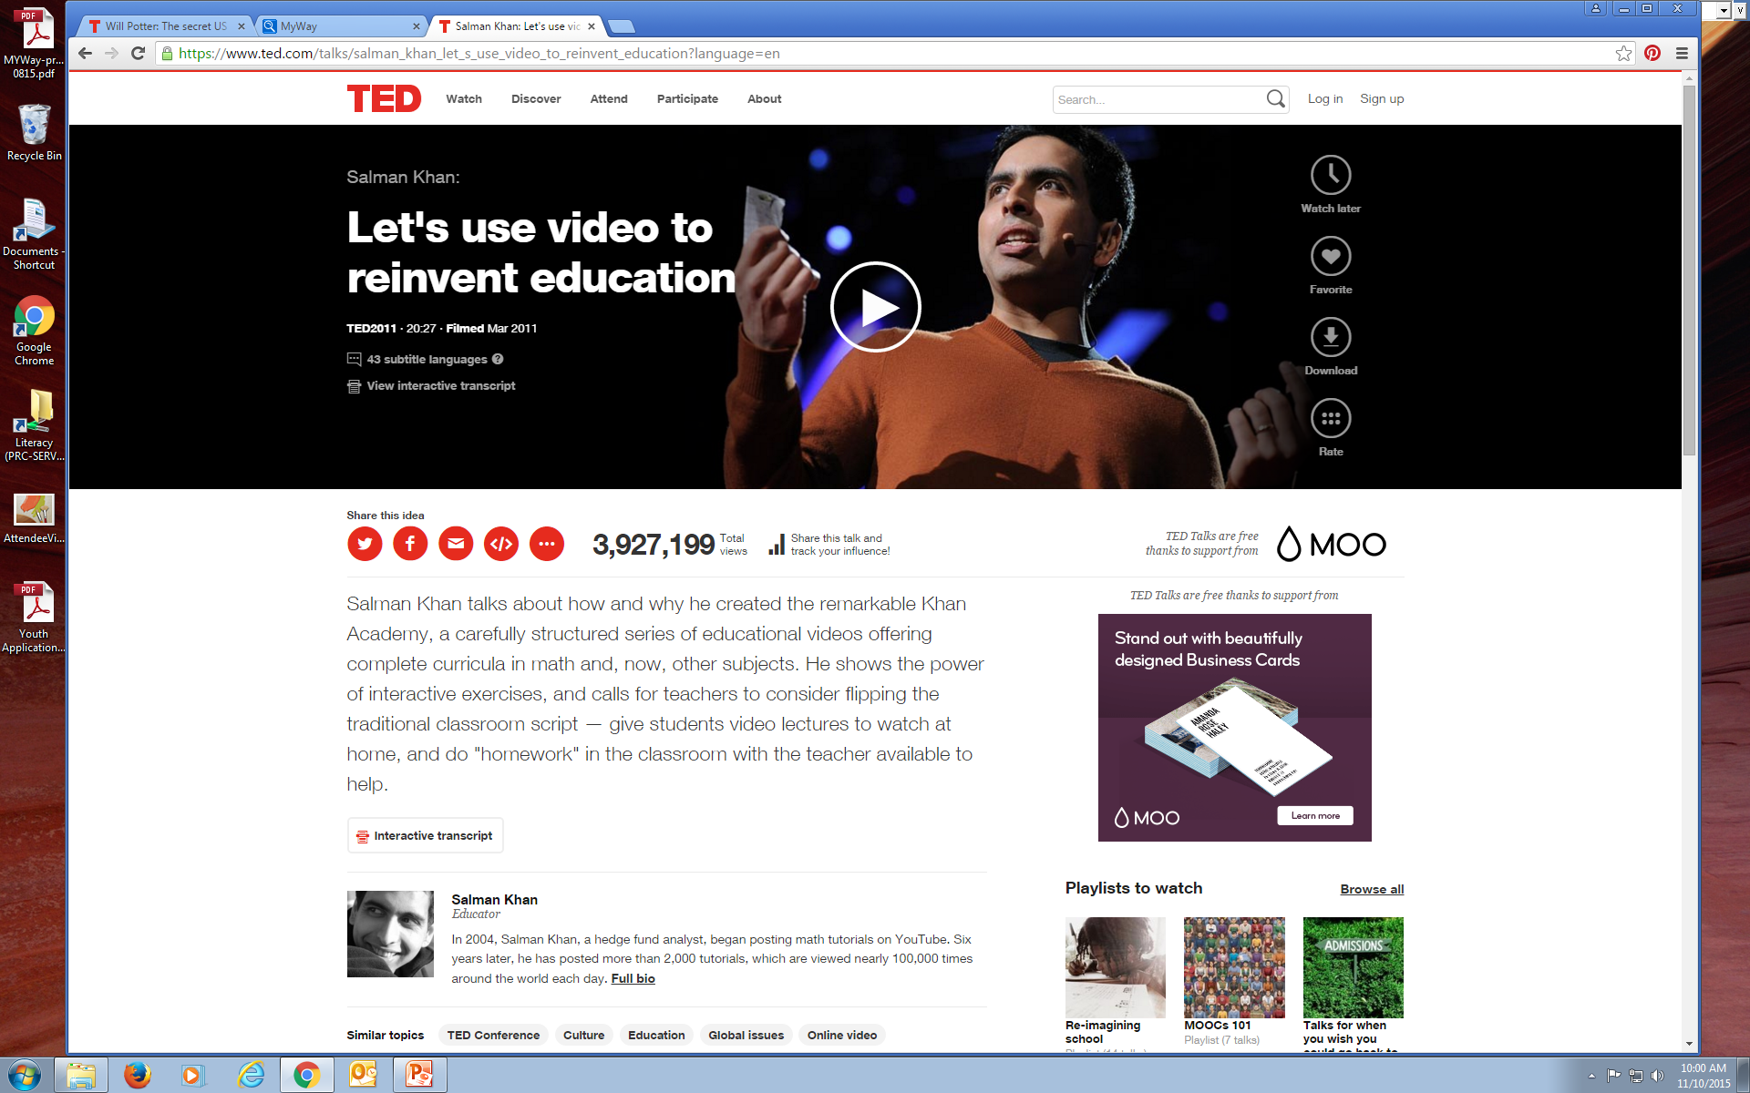
Notes:
Which leads us to –check it out—the guy who invented KHAN academy! What is Khan? It’s online lessons –it started with math and science. This guys was tutoring his cousins, and recording it on YouTube, and it caught on big time. It is a FREE service.

Slide 11
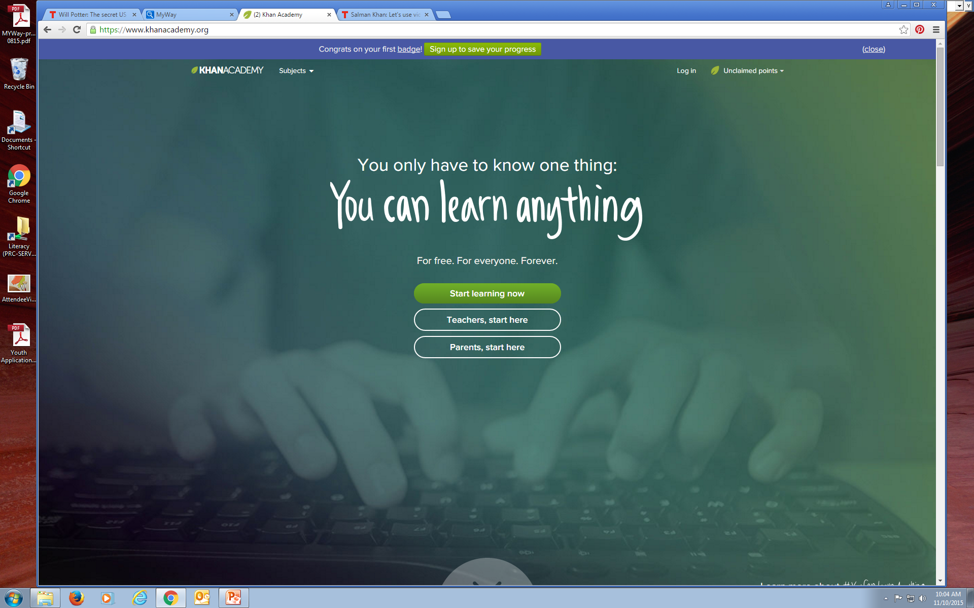
TED Talk on KHAN
Notes:
Now it’s a huge website with many topics. Still strongest in the hard sciences, but they are expanding. I’ll let you here him tell the story of the start.

Slide 12
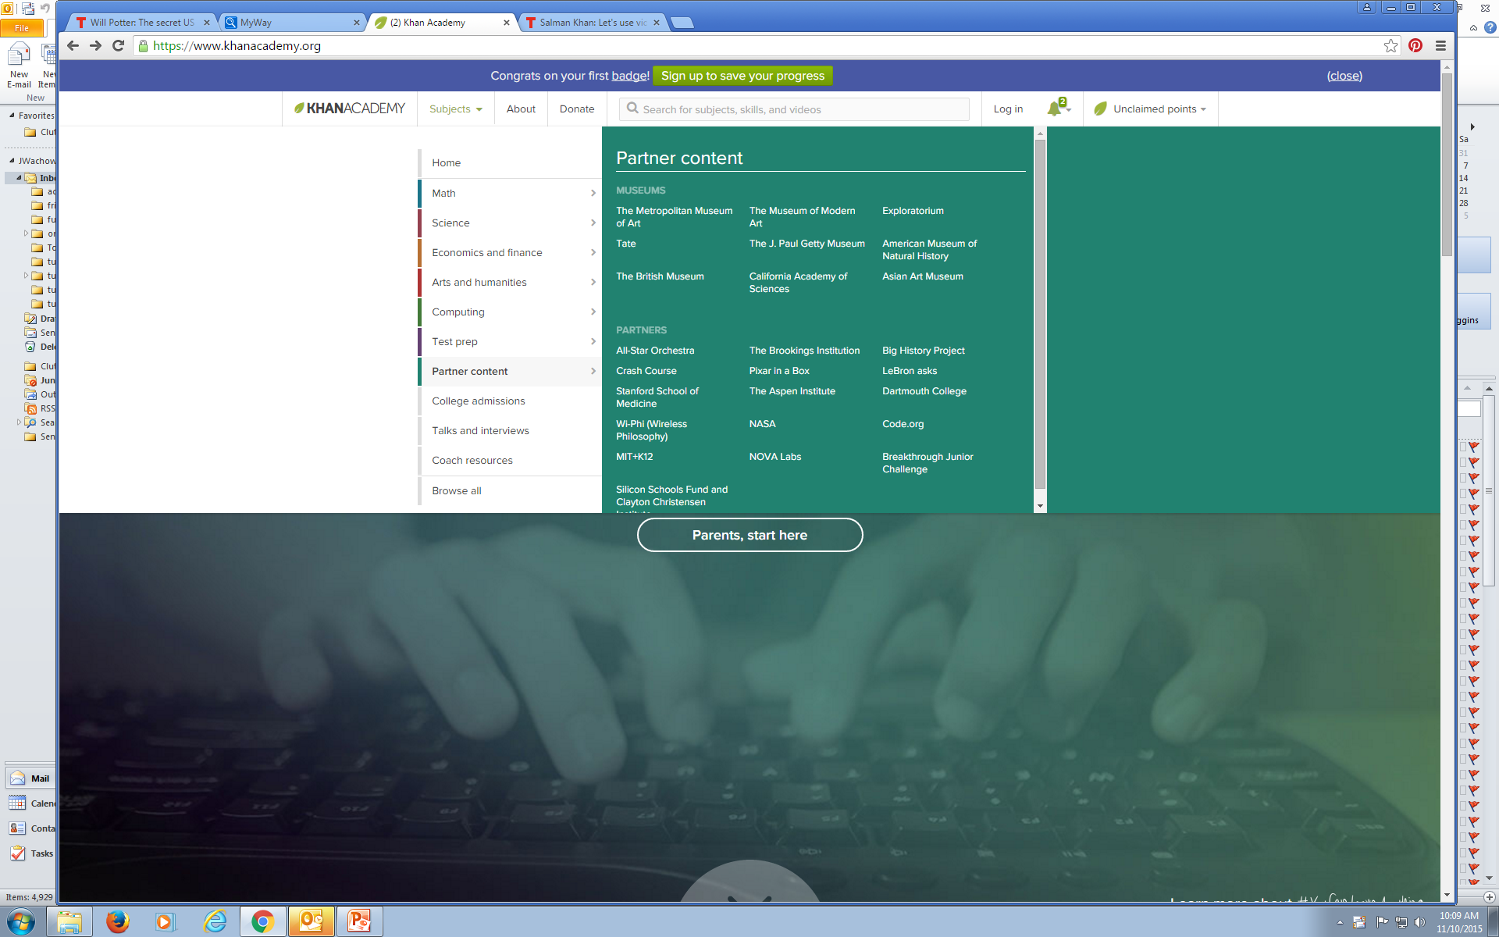
Notes:
The ribbon or bar above can be clicked without logging on. You can browse the subjects and investigate.

Slide 13
Questions?
Let’s experiment!

