Slide 1

An Introduction

Slide 2
Database Basics
What is a Database?
  A database is a tool for collecting and organizing information.
Why use a Database?
  A database would be used when the information being collected is voluminous, repetitive or changing on an on-going basis.

Slide 3
Objects in a Database
Tables
  This is the main way that data is stored in your database. Tables can be compared to spreadsheets in Excel: the data is organized in rows and columns.
Forms
  Forms are the way that data is added to your database. While you can enter the data into the database directly into the tables, using forms allows for quicker and more visual data entry.
Queries
  A query allows you to retrieve information from one or more tables based on a set of search conditions you define using the table fields.
Reports
  These summarize and display the data in your database. Reports are for analyzing data and returning answers to specific questions, such as how much profit was made, or where customers are located. These are usually designed to be printed out.

Slide 4
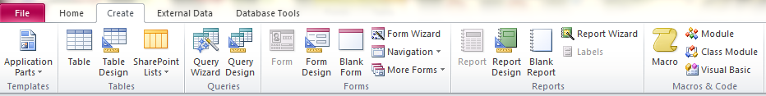
Create

Slide 5
Database Design
Purpose of the database
  Bookstore – Track Books; Track Customers; Track Orders
Planning database tables
    Books; Customers; Orders
Planning database fields
  Books: Title, Author, Price, Category
  Customer: First Name, Last Name, Address, City, State, Zip, Email
  Orders: Customer, Book, Date

Slide 6
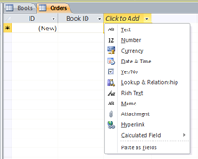
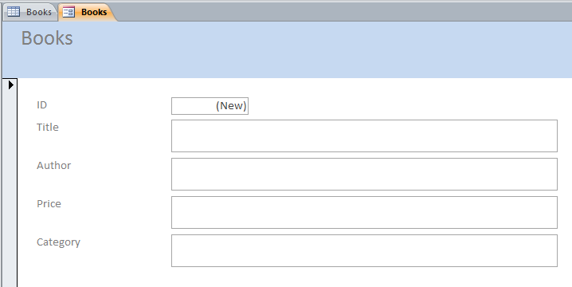
Setting Up Tables
Datasheet
Forms

Slide 7
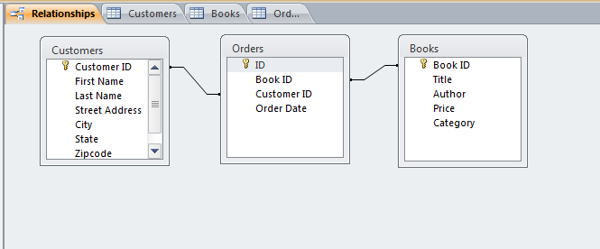
Relationships

Slide 8
Queries
The real power of an Access 2007 database lies in its ability to pull data for quick analysis, which is what happens when you run a query. Queries allow you to retrieve information from one or more tables based on a set of search conditions you define.

Slide 9
Query Questions
What do you want the results to look like? Identify every bit of information—or field—you want included in the results.
Where is the information stored in the database? List which tables hold the information you want to see.
What conditions do you want the data to meet? This helps determine how to set the criteria so Access can search the records properly.

Slide 10
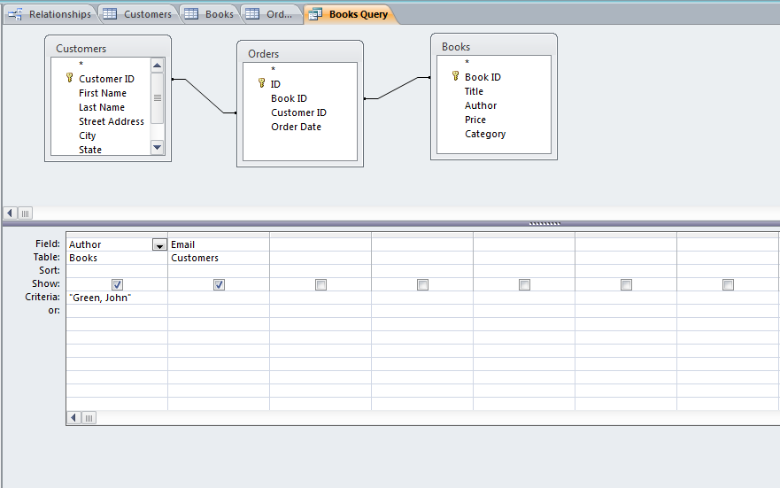
Query

Slide 11
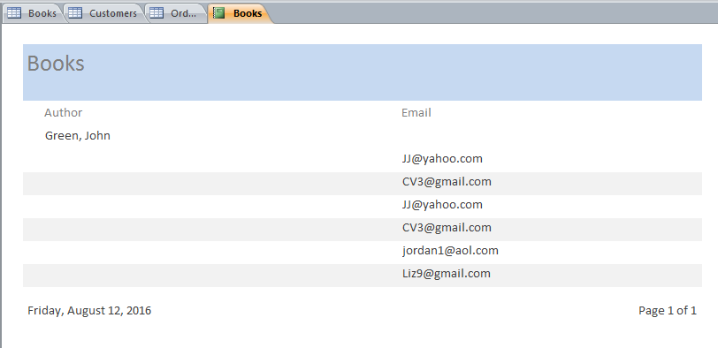
Report

Slide 12

Questions

