Slide 1

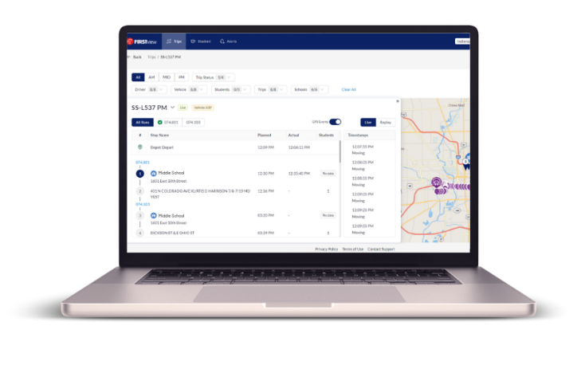

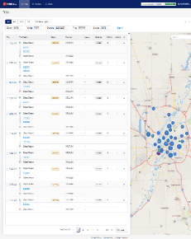
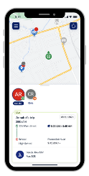
What is firstview?
FirstView is First Student’s vehicle tracking product suite:
A comprehensive real-time dashboard to monitor the entire fleet at an operational, district admin, or school personnel level
A mobile app for parents/caregivers to track all vehicle types for individual student trips
FirstAlt, powered by First Student, provides districts with a safe and reliable transportation option for students with special needs, students experiencing homelessness, out of district students, and hard to serve trips.
With FirstView, districts and their communities now have more transparency and peace of mind into the transportation services provided by First Student.
Document not intended for general distribution or publication.

Slide 2
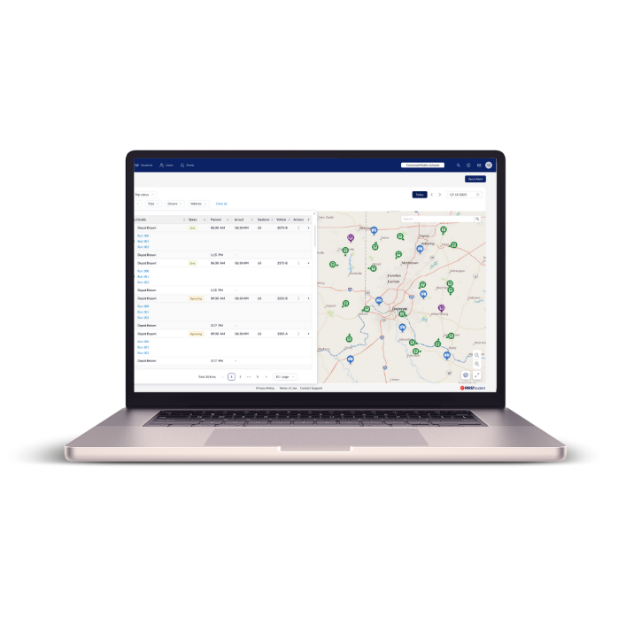
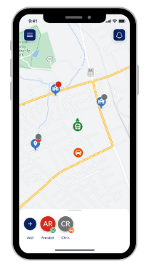
The future of firstview
FirstView Classic
FirstView launched in 2017 with a mobile application for parents/guardians to track their student’s journey to and from school. Shortly after, a district dashboard for district and school staff to monitor all vehicles servicing their school district was introduced.
New & Enhanced FirstView 1.0
The new version features a fresh look, simplified tech environment and advanced tracking capabilities for our traditional home-to-school trips and now our alternative transportation service, FirstAlt.
Mobile application for parents/caregivers to track all vehicle types.
District dashboard for district and school level personnel.
A NEW internal operations view for comprehensive real-time monitoring of your entire fleet.
Dec 2023
Development
Launched
May 2024
UAT
Launched
Aug 2024
FirstAlt
First Release
Sept 2024
Yellow Bus Pilot
Oct 2024
Yellow Bus
First Release
Dec 2024
Yellow Bus
Customer Migration 1
Mar 2025
Yellow Bus
Customer Migration 2
May 2025
Yellow Bus
Customer Migration 3
June 2025
Fully Mature Product
Continuous UAT
Staggered Development/Release
Document not intended for general distribution or publication.

Slide 3
Data & Operational Requirements
Student/Trip Information
Data Management Tool
Driver App
FirstView
Student information that is maintained in an electronic SIS or manually by the district and provided to the FirstAlt team via the transportation request form or spreadsheet
Proprietary software the FirstAlt team uses to maintain data including:
Districts
Schools
Student Trips
Driver Assignments
Drivers use the app to receive their assigned student trip and confirm the start/end actions for tracking the vehicle
Displays student trip and driver assignments from Data Management Tool, trip activity from the Driver App, and tracks the vehicle to alerts parents when bus is near and has arrived
Document not intended for general distribution or publication.

Slide 4
FirstView dashboard
FirstView 1.0 for Districts and Schools
Securely monitor student trips via a real-time dashboard – view current and previous day’s trips.
Detailed trip information at a district and/or school level view.
View vehicle and driver details for clearer transparency in the trip details and on the map.
Review the driver’s completed route path and GPS data collected for each trip.
Dashboard Tracking Disclaimer: The FirstView Dashboard is a web-based tool available via desktop browser only and is not accessible on mobile devices via the web browser or the downloadable FirstView Parent App. The dashboard should be used as a tool to aid parents with bus tracking questions and should not be used for route performance analysis or reporting.
Document not intended for general distribution or publication.

Slide 5
Firstview dashboard
Training, Marketing Collateral & Communications
Our standard materials are available in English, French Canadian and Spanish on FirstStudentInc.com
Launch the dashboard in 4 easy steps:
Attend your implementation kick-off call to receive access to the dashboard
Share information about FirstView, including the training schedule, with your district and school staff
Invite additional district or school staff as users to your dashboard
Begin using the dashboard to answer parent questions and track student trips
Document not intended for general distribution or publication.

Slide 6
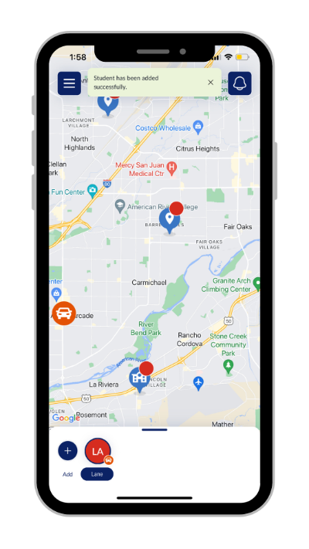
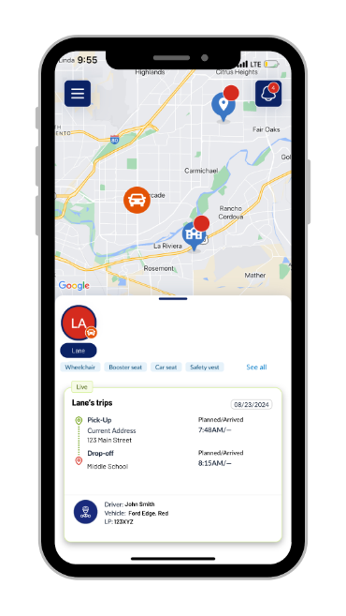
FirstView Parent App
FirstView 1.0 for Parents and Caregivers
Securely monitor your student(s) daily trips.
View real-time vehicle location via GPS and track its progress.
Easy access to vehicle and driver details as well as updates regarding changes.
Set family members and caregivers up to receive trip email alerts.
Dedicated customer support at your fingertips.
Document not intended for general distribution or publication.

Slide 7
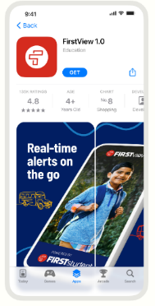
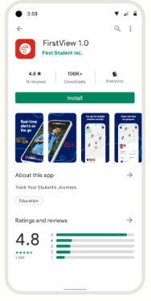
Firstview parent app
Parents/Caregivers Communications
Each user will need the district’s FirstView generated 5-digit district code, their student’s date of birth, and the primary guardian phone number that was provided to FirstAlt to access their student’s trip in the app.
Our standard marketing materials are available in English, French Canadian and Spanish on FirstStudentInc.com
Launch the app in 4 easy steps:
Work with the FirstView team to finalize a launch date for the app
Gather and customize marketing materials provided by the FirstView team in preparation for launch
Update your website, social media, and parent portal with information about FirstView
Send information to parents with instructions on how to download the app and track with FirstView
Document not intended for general distribution or publication.

Slide 8
Implementation Overview
Reach out to implementation@myfirstview.com to be added to our deployment calendar.
Discovery
Onboarding
Deployment
Support
FirstAlt team hands off customer to FirstView Implementation team after data and operational sign-off
Implementation connects with customer for kick-off/implementation call
Account is configured and call scheduled
Customer is provided a product overview, dashboard access/training, and marketing toolkit
Launch timeline is confirmed with customer
Customer prepares for deployment
Additional dashboard users invited and trained
Customer launches app to parent community
Implementation monitors dashboard & app usage and user feedback
Implementation hands off customer to FirstView Support for ongoing maintenance
Customer may receive periodic FirstView newsletters or surveys from Marketing
Step 1
Step 2
Step 3
Step 4
The implementation timeline may vary during different stages of the process and is subject to change due to data challenges and/or deployment capacity. Customers new to FirstView are not onboarded during school start months, August - September.
Document not intended for general distribution or publication.

