Slide 1


Best Refuted Causal Claims from
Observational Studies
Slides at https://bit.ly/CODE2018Kohavi
Oct 26-27, 2018
Ron Kohavi, Technical Fellow and Vice President,
Analysis & Experimentation, Microsoft
In narrative form with references at https://bit.ly/ExPAdvanced -> #6
Thanks to Tommy Guy and Jonathan Litz for feedback
Notes:
Metrics are at the heart of controlled experiments, from the Overall Evaluation Criterion to guardrail metrics to debugging metrics. We share several real examples from experiments, where the "obvious" or initial interpretation of a metric movement leads to the wrong (e.g., opposite) conclusion of the tested treatment's value.
We share guidelines that can help detect such pitfalls and thus improve the trustworthiness of results gleaned from experiments.

Slide 2
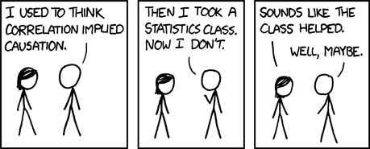
Randal Monroe’s XKCD 552
The hover text is key here (as in many of Randal Monroe’s figures):
  Correlation doesn’t imply causation, but it does waggle its eyebrows suggestively
  and gesture furtively while mouthing ‘look over there.’
Notes:
See https://xkcd.com/license.html
You can use them freely (with some kind of link) in not-for-profit publications, and I'm also okay with people reprinting occasional comics (with clear attribution) in publications like books, blogs, newsletters, and presentations.

Slide 3
Motivation
In large organizations, it is common to see reports showing a correlation and claiming a causal effect
People have heard that correlation does not imply causation
Some have even seen the example that carrying umbrellas is an excellent predictor of rain
… and they laugh when you suggest that we ban umbrellas in Seattle to reduce precipitation
But when an observational study shows that users of their new feature have lower attrition, they celebrate
An interesting “problem” is that we trained groups working with us to trust the results of our experimentation platform and encourage data-driven decision making
When someone shares an observational study, alarm bells don’t go off.
They’re not used to asking: was it a randomized controlled experiment?
As Randal Monroe claimed: correlations are reasonable hypotheses.
It is hard to show that they are not causal, which is what this deck is about: great examples of incorrect claims

Slide 4
My Feature Reduces Churn! – Real Examples
Two presentations in Microsoft Office 365, each made the following key claim
    New users who use my cool feature are half as likely to churn when compared to new users that do not use it
    (churn means stop using the product 30 days later)
[Wrong] Conclusion: feature reduces churn and thus critical for retention
The feature may improve or degrade retention:
the data above is insufficient for any causal conclusion
Example: Users that see error messages in Office 365 also churn less.
This does NOT mean we should show more error messages.
They are just heavier users of Office 365
See more error messages
Heavy Users
Have higher retention rates

Slide 5
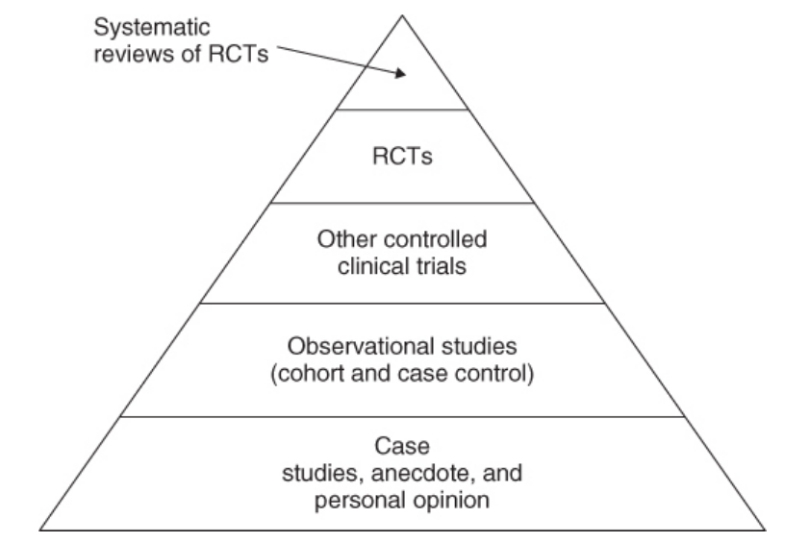
Hierarchy of Evidence
All studies are not created equally
Be very skeptical about unsystematic studies or single observational studies
The hierarchy of evidence (e.g., Greenhalgh 2014) helps assign levels of trust.
There are Quality Assessment Tools (QATs) that ask multiple questions (Stegenga 2014)
Key point: at the top are the most trustworthy
  Controlled Experiments (e.g., RCT randomized clinical trials)
  Even higher: multiple RCTs—replicated results
Notes:
See also GRADE
Series intro: http://www.jclinepi.com/article/S0895-4356(10)00329-X/fulltext
http://www.jclinepi.com/article/S0895-4356(10)00330-6/fulltext
http://www.jclinepi.com/article/S0895-4356(10)00332-X/fulltext
In 1995 Guyatt etal. published the first hierarchy as a way to grade recommendations in the medical literature (Guyatt, et al., 1995). Greenhalgh published a paper (1997), that has evolved into a book in its 5th edition (Greenhalgh, 2014). Figure ‎1.6 shows a simple hierarchy of evidence, where multiple RCTs (Randomized Control Trials , the term used in medical domains for controlled experiments) are at the top, followed by single RCT, followed by non-randomized controlled trials, followed by observational studies, and finally Case Studies (analysis of a person or group), anecdotes, and personal (often expert) opinion. Bailar summarized this well: “No other method for studying the merits of clinical treatment regimens can approach the precision of estimating effects and the strength of inference permitted by sound RCTs ” (Bailar, 1983).
More complex models, such as the Levels of Evidence by the Oxford Centre for Evidence-based Medicine are available (2009), and it is important to note that other factors need to be considered, such as the quality of the study itself. Quality Assessment Tools (QATs) allow the user to answer multiple questions to assess the quality of the study; Stegenga (2014) shares a critique of hierarchies and a preference for QATs, but the key point is that high quality randomized controlled experiments are trustworthy, whereas it is hard to assess the reliability of studies lower in the hierarchy.

Slide 6
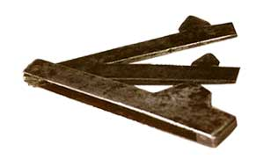
Doctors Mistaken for Centuries
In Bad Medicine, Wootton wrote: “for 2,400 years patients have believed that doctors were doing them good; for 2,300 years they were wrong.”
From 1st century BC to 1800s, the main therapy used by doctors was bloodletting—opening a vein in the arm with a special knife called a lancet
Doctors and researchers were fooled by correlation: bloodletting had
a calming effect, and thus doctors believed it was helpful
For many diseases, including hepatitis, pneumonitis, and ophtalmia,
bloodletting was deemed an efficient treatment
After years of using lancets, leeches were deemed a better way to suck the blood
In 1833 alone, France imported 42 million leeches for “medical use.”

Slide 7
Bloodletting is Actually… Bad for You
In 1799, President George Washington died after three different doctors each performed bloodletting, ultimately extracting more than half his blood volume when he was sick
It is now believed that this procedure led to “preterminal anemia, hypovolemia, and hypotension” and the premature death of the first US President
In 1836, Pierre-Charles-Alexandre Louis took 77 patients from a very homogeneous group with the same, well-characterized form of pneumonia
He analyzed the duration of the disease and the frequency of death by the timing of the first bloodletting (early in days 1-4, or later in days 5-9)
Result: 44% of the patients who had been bled early died compared to 25% of those bled late
Bloodletting, he concluded was really bad for you
Notes:
Louis promoted the “numerical method” [aka Statistics] of using aggregated data.
Today his study is considered the forerunner to epidemiology, clinical trials, and evidence-based medicine

Slide 8
Overestimates of Effects of Advertising
(Lewis, Rao, and Reiley, 2011)
Large study with 50 million users at Yahoo!
Question: Given a display ad, what is the lift to the number of users who
search using keywords related to the brand shown
Straight observational study: 1198%
Regression with some control variables: 894%
Regression with more control variables: 871%
Confidence intervals on above are about +/-10%
Randomized controlled experiment...
Wait…
Wait…
Guess…
5.4%
Users who actively visit Yahoo! on a given day are much more likely both to see the display ad and to do a Yahoo! search

Slide 9
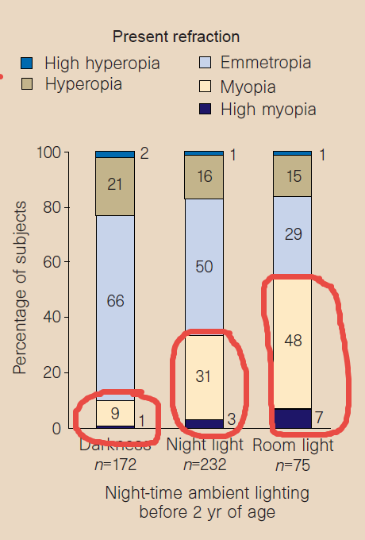
Night Light Causes Myopia?
May 1999: CBS News Health Consultant Dr. Bernadine Healy reports based on new study in the journal Nature that
      children who sleep with a night light … until the age of two have a higher incident of nearsightedness - also known as myopia
Sleeping condition | % of children developing myopia
Darkness | 10%
Night Light | 34%
Lamp on | 55%
Dr. Graham Quinn, the study's lead author… urged parents to provide sleeping infants and toddlers with a dark bedroom -- within reason
That last statement implies causality
p-value < 0.00001
Notes:
http://www.myopiaprevention.org/references_night_lights.html
http://www.nature.com/nature/journal/v399/n6732/full/399113a0.html
(Ronny copy at 1999NatureMyopiaAndAmbientLightingAtNight.pdf)
https://nei.nih.gov/news/statements/myopia
http://www.nature.com/nature/journal/v404/n6774/abs/404144a0.html
(Ronny copy at 2000 NatureMyopiaAndAmbientNightIsFalse.pdf)
https://www.ncbi.nlm.nih.gov/pubmed/12714399
https://en.wikipedia.org/wiki/Correlation_does_not_imply_causation

Slide 10
Night Light Causes Myopia? Probably Not
Two studies published in Nature a year later failed to replicate the result and saw no such correlation
Both made a crucial observation about a common cause they found:
  Myopic parents are more likely to employ night-time lighting aids for their children
  There is an association between myopia in parents and their children
Notes:
Three years later, another study showed that myopia occurred with approximately equal frequency in those who slept with and without light exposure at night
The study’s conclusion is that “night-time light exposure during infancy is not a major risk factor for myopia development in most population groups.”

Slide 11
Confounders
Observational study in The Lancet showed that
Vitamin C reduces Coronary Heart Disease (CHD)
An RCT study appeared later in the same journal showing
Vitamin C increases Coronary Heart Disease (CHD)
Which one do we trust?
The controlled experiment (higher on the hierarchy of evidence)
Nice paper analyzed the reasons:
Those confounded vitamins: what can we learn from the differences between observational versus randomised trial evidence?
The people who took Vitamin C are different on many attributes.
The following were stat-sig differences at the p<0.0001 level
  Socioeconomic indicators: Social class, number bathrooms in house, shared bedroom, car access
  Behavioral factors: current smoker, exercise, low fat diet, BMI >30 (obesity), alcohol consumption
  Biomarkers: adult height
If an observational study does not control for confounders, it is not trustworthy.
Problem: we may not know that we controlled for enough confounders

Slide 12
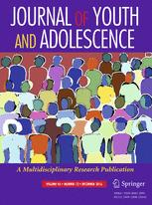
Causal Insufficiency: Twin Studies
Observational study claimed
    Youngsters who lose their virginity earlier than their peers are more likely to
    become juvenile delinquents
Considered a well-run study, which controlled for
    Gender, Race, Receipt of public assistance, Parental education, Family structure, Previous substance use and depression, Importance of religion, School GPA, Relative pubertal status, virginity pledge status
Paige Harden, a PhD student, used the same database and found 534 monozygotic twins
  Twins studies effectively control for many unknown factors
  Her publication showing the OPPOSITE result, was considered superior and accepted to the same journal
Causal Sufficiency (all common causes are observed) is impossible to prove
Summary from Washington Post 2007
Notes:
http://link.springer.com/article/10.1007%2Fs10964-006-9128-4
http://people.virginia.edu/~ent3c/papers2/Articles%20for%20Online%20CV/(1)Harden%20et%20al%20(in%20press).pdf

Slide 13
Time-Sensitive Confounder
Large observational study of over 50,000 women (Nurses’ Healthy Study)
followed-up for 16 years
Claim: Hormone Replacement Therapy (HRT) reduces risk of Coronary Heart Disease (CHD) among postmenopausal women
Results so convincing that many doctors prescribed Premarin
for HRT for many years
In 2001, it was the third most-prescribed drug in the United States!
Notes:
https://www.ncbi.nlm.nih.gov/pmc/articles/PMC3731075/
https://www.ncbi.nlm.nih.gov/pubmed/8672166
https://www.ncbi.nlm.nih.gov/pubmed/10840007
https://www.ncbi.nlm.nih.gov/pubmed/11119394

Slide 14
Time-Sensitive Confounder (Death)
Randomized Control Trial showed the opposite:
    HRT “does not confer cardiac protection and may increase the risk of CHD among generally healthy postmenopausal women
The RCT was planned for 8.5 years and terminated after 5.2 years because “the overall risks exceeded the benefits.”
Complex confounder: Time of usage of HRT
    The risk of CHD is highest when you start HRT
The problem with the observational study?
      The women who died early on were less likely to get into the study
Notes:
https://www.ncbi.nlm.nih.gov/pmc/articles/PMC3731075/
https://www.ncbi.nlm.nih.gov/pubmed/8672166
https://www.ncbi.nlm.nih.gov/pubmed/10840007
https://www.ncbi.nlm.nih.gov/pubmed/11119394

Slide 15
Systematic Studies of Observational Studies
Young and Carr looked at 52 claims made in medical observational studies, which were grouped into 12 claims of beneficial treatments (Vitamin E, beta-carotene, Low Fat, Vitamin D, Calcium, etc.)
These were not random observational studies, but ones that had follow-on controlled experiments (RCTs)
NONE (zero) of the claims replicated in RCTs, 5 claims were stat-sig in the opposite direction in the RCT
Their summary
Any claim coming from an observational study is most likely to be wrong

Slide 16
My Ask
I wrote an early version of this deck back in 2016
(https://twitter.com/ronnyk/status/800584797571514368)
and it’s available at http://bit.ly/refutedCausalClaims
I will merge these CODE talk to the above
If you know of other good examples, please tell me, and I’ll add to the deck and acknowledge

