Slide 1


Metric Pitfalls in Online Controlled Experiments
Slides at https://bit.ly/CODE2017Kohavi
Oct 27-28, 2017
Ron Kohavi, Distinguished Engineer, General Manager,
Analysis and Experimentation, Microsoft
Based on KDD 2017 paper by Pavel Dmitriev, Somit Gupta, Dong Woo Kim, and Garnet Vaz
A Dirty Dozen: Twelve Common Metric Interpretation Pitfalls in Online Controlled Experiments
Notes:
Metrics are at the heart of controlled experiments, from the Overall Evaluation Criterion to guardrail metrics to debugging metrics. We share several real examples from experiments, where the "obvious" or initial interpretation of a metric movement leads to the wrong (e.g., opposite) conclusion of the tested treatment's value.
We share guidelines that can help detect such pitfalls and thus improve the trustworthiness of results gleaned from experiments.

Slide 2

About the Team
Analysis and Experimentation team at Microsoft:
  Mission: Accelerate innovation through trustworthy analysis and experimentation.
  Empower the HiPPO (Highest Paid Person’s Opinion) with data
  About 90 people, software developers, data scientists, and PMs
We initially built the system for Bing, where about 1,200 controlled experiment treatments now run every month, with millions of users each
Last 3+ years, generalizing the system to a Microsoft-wide platform
  Platform in growing use at MSN, Office, OneNote, Xbox, Cortana, Skype, Outlook, Exchange, Windows, Edge browser, Web store, and more
  Summary at HBR article last month (with Thomke): http://bitly.com/HBR_AB
Pitfalls discussed are from diverse groups at Microsoft

Slide 3
Background: Session Metrics for Bing
Why session metrics are important for us(*)
Search engines (Bing, Google) are evaluated on query share (distinct queries) and revenue as long-term goals
Key Example
  A ranking bug in an experiment resulted in very poor search results
  Queries per user improved by 10% (hence query share is going up).
  Why? People had to reformulate queries several times
  Revenue went up over 30% (we’re making a lot more money!).
  Why? Ads (not impacted by the bug) became relatively more useful
We fired the relevance team, and
Bing’s US PC query share is up from 8% in 2009 to 23% in 2017, and is now profitable
(*) KDD 2012 Paper: Trustworthy Online Controlled Experiments: Five Puzzling Outcomes Explained

Slide 4
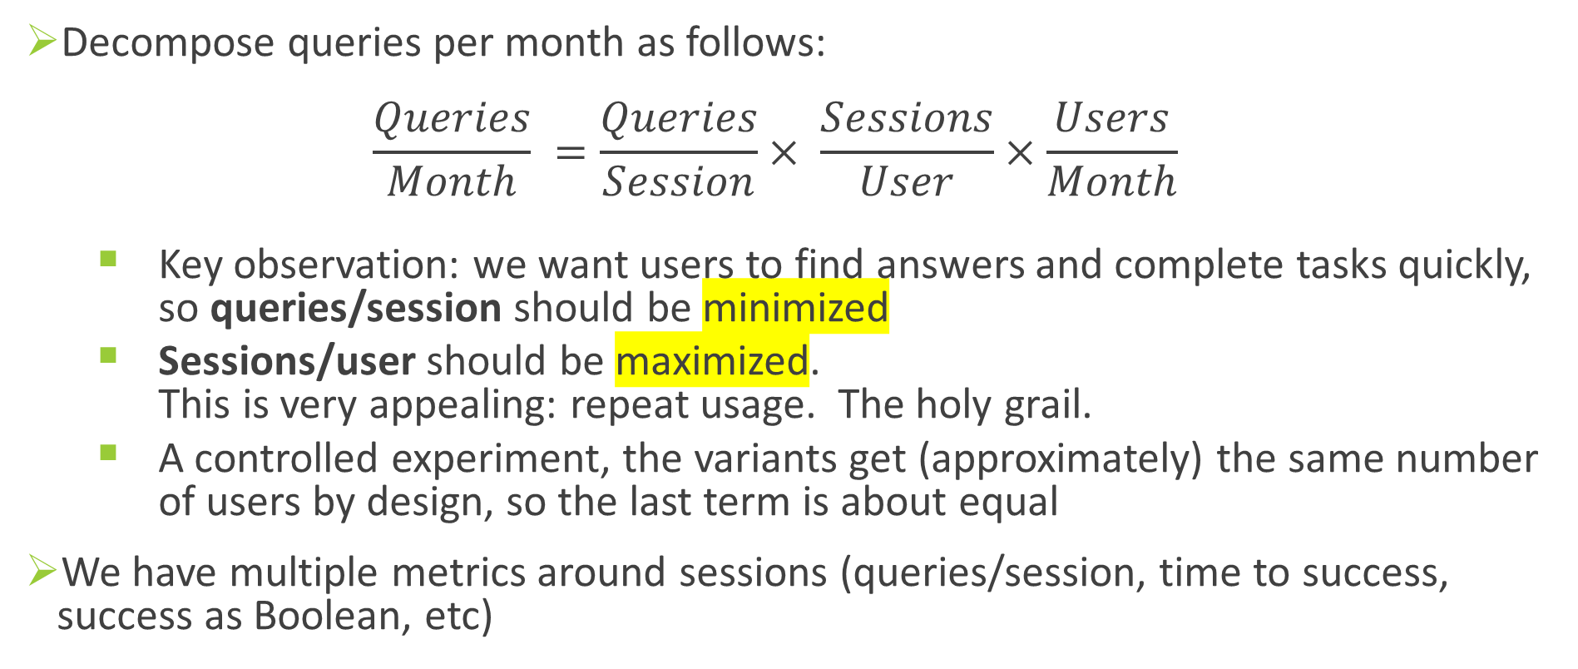
Key Insight: Sessions are Critical
Decompose queries per month as follows:
$\frac{Queries}{Month} =\frac{Queries}{Session}× \frac{Sessions}{User}×\frac{Users}{Month}$
  Key observation: we want users to find answers and complete tasks quickly, so queries/session should be minimized
  Sessions/user should be maximized.
  This is very appealing: repeat usage. The holy grail.
  A controlled experiment, the variants get (approximately) the same number of users by design, so the last term is about equal
We have multiple metrics around sessions (queries/session, time to success, success as Boolean, etc)

Slide 5
Pitfall #1 (a trivial observation really)
If the Sessions/user metric changes, session-level metrics may be invalid
  Example: suppose we sessionize by 20 minutes of inactivity in treatment instead of 30 minutes in control
  Empirically, Sessions/user is a REALLY hard metric to improve, so this rarely matters.
  In CODE 2015, I mentioned that two out of 10K experiments improve this metric
If Pages/user metric changes, then all click-through metrics may be invalid
  Example: MSN implemented auto-refresh of the home page every few minutes.
  Fresh news due to refresh is good for the users, but click-through rate is much much much lower
Detection: if the denominator changes between control and treatment for ratio metrics like click-through rates, it invalidates the ratio metrics

Slide 6
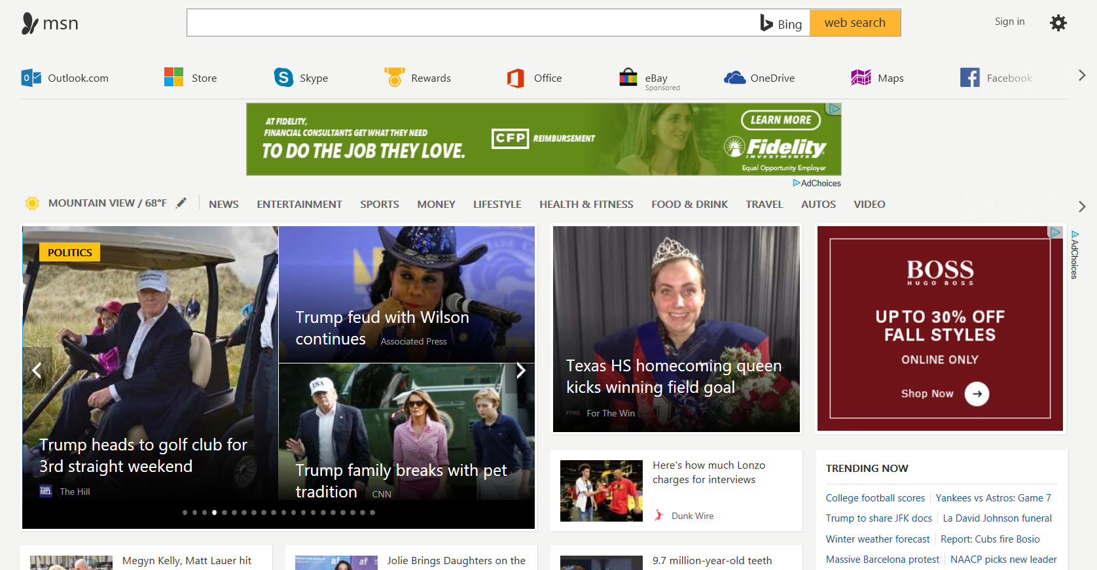
Puzzling Result: Opening Links in New Tab
In 2009 paper: opening Hotmail/Outlook.com link in a new tab at MSN showed significant benefits
Recent experiment opened news articles in new tab
Surprising result: 8% increase (degradation) in page load time (measured at 75th percentile)
Why? Similar to Clickthrough rate issue on prior slide, but less obvious
Fewer pages in treatment (8.4M vs. 9.2M)
Control: users hit back button to go back
from news to home page, which refreshes
Treatment: there is no back button. Users kill
the tab and see the previous tab with home page
Reloading the home page is faster than average
page due to caching effects (e.g., images cached),
and treatment has fewer of these loads, so
it looks …slower by metrics (it’s actually faster!)

Slide 7
Pitfall #2: Heterogenous Treatment Effects
The hot topic in last year’s CODE, many speakers (including me) mentioned that this is important and we’ve implemented algorithms to detect these
Puzzling experiment
  Two segments showed a stat-sig, positive, treatment effect to sessions/user.
  A huge cause for celebration, as such movements are very rare.
  These were complementary segments: mutually exclusive and exhaustive,
  and the treatment helped users in both segments. Wow!
  But… the overall average treatment effect for sessions/user was basically zero: far from stat-sig
What’s going on?

Slide 8
Pitfall #1
Famous story (hypothetical, no political motives):
When President X ended his presidency and went from Washington DC back to his home state, the average IQ in both DC and his home state went up
Nothing wrong here. It’s definitely possible. Variant of Simpson’s paradox.
His IQ has to be lower than the average in DC, and higher than in his home state.
  Remove a below-average-IQ person in DC, and the average goes up.
  Add an above-average-IQ person to the home-state, and it also goes up
In our experiment, users shifted from one segment to another
Prevention: don’t allow segments that could be impacted by treatment
(too restrictive for us)
Detection: alert if there is a ratio mismatch

Slide 9
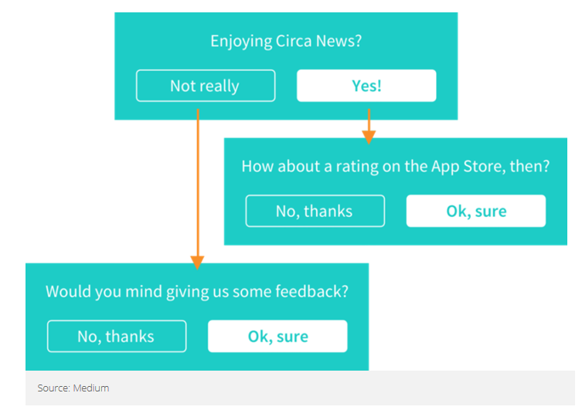
The App Store Rating Trick
A variant of this is now commonly used by mobile apps to improve their app-store rating
Think of three segments
  Users that rate the app high (4-5 stars)
  Users that rate the app low (1-3 stars)
  Users that don’t rate the app
What if instead of improving the product (really hard),
you could just shift users from #2 to #3?
It turns out it’s pretty easy.
Ask a question that correlates with high rating,
such as “Enjoying <product>?”
Notes:
See https://growthtower.com/how-to-get-more-positive-app-store-reviews/ #4 and https://blog.helpshift.com/rate-our-app-now-smarter-and-more-intuitive-through-helpshift/
The other option is to buy ratings. For example, http://buyappratings.com/faq says they “employ genuine users around the world to install your apps and then give 5-star ratings on App Store.”

Slide 10


Pitfall #3: Ignoring Twyman’s Law
Experiment changed Outlook.com link (left) to Mail app
Result: 28% increase in the number of clicks on the button.
Even better: 27% increase in the number of clicks on the button adjacent to the mail button.
Celebrate? NO! Remember Twyman
Twyman’s Law: Any figure that looks interesting or different is usually wrong

Slide 11
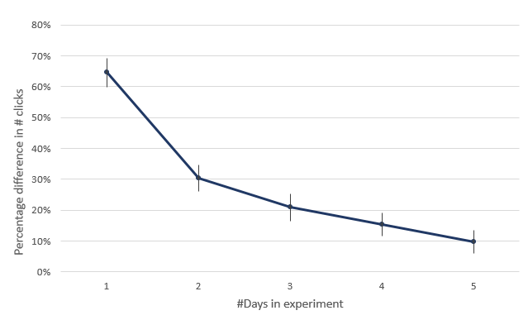
Pitfall #3 (continued)
Graph over time showed dramatically diminishing delta
Users were confused, repeatedly clicked on icon and nearby icon.
They were expecting outlook web site, and the mail app popped up.
Learned not to click: Proportion of users clicking on the whole stripe was down
Lesson:
  We are biased to celebrate good results and investigate
  bad results
  Remember Twyman’s law, especially if results look
  Too-Good-To-Be-True™

Slide 12
Summary
KDD 2017 paper by Pavel Dmitriev, Somit Gupta, Dong Woo Kim, and Garnet Vaz
A Dirty Dozen: Twelve Common Metric Interpretation Pitfalls in Online Controlled Experiments
Experimentation systems should be able to detect common
pitfalls and alert the experimenters
Best experimenters have healthy skepticism
  Triangulate a result through multiple data points
  Have good hypotheses about why metrics are moving and
  show support by diagnostic metrics
  Apply Twyman’s law
  Drill down into segments
Dirty Dozen:
Metric Sample Ratio Mismatch
Misinterpretation of Ratio Metrics
Telemetry Loss Bias
Assuming Underpowered Metrics had no Change
Claiming Success with a Borderline P value
Continuous Monitoring and Early Stopping
Assuming the Metric Movement is Homogeneous
Segment Interpretation
Impact of Outliers
Novelty and Primacy Effects
Incomplete Funnel Metrics
Failure to Apply Twyman’s Law
Slides at https://bit.ly/CODE2017Kohavi

Slide 13
Appendix

Slide 14
Background: Observations to Metrics
You ran a controlled experiments (e.g., A/B test) and collected observations:
page views, clicks, hovers, revenue events, add-to-cart, initiate checkout, submit,
timers (e.g., server start/end, time element displayed, click time)
Calculated / enriched observations
  Time to X (e.g., time to display key elements, server time to send HTML)
  Successful click (in search engines, user clicks and does not come back within 30 seconds)
  Session end (no user activity for at least 30 minutes)
Observations are aggregated to metrics at different levels: User, Session, Page
  User metrics: Page views/user, clicks/user, revenue/user, average page load time/user
  Session metrics: successful session (has successful click), time to success (capped), page views per session
  Page metrics: click-through rate, RPM (revenue per thousand impressions)

Slide 15
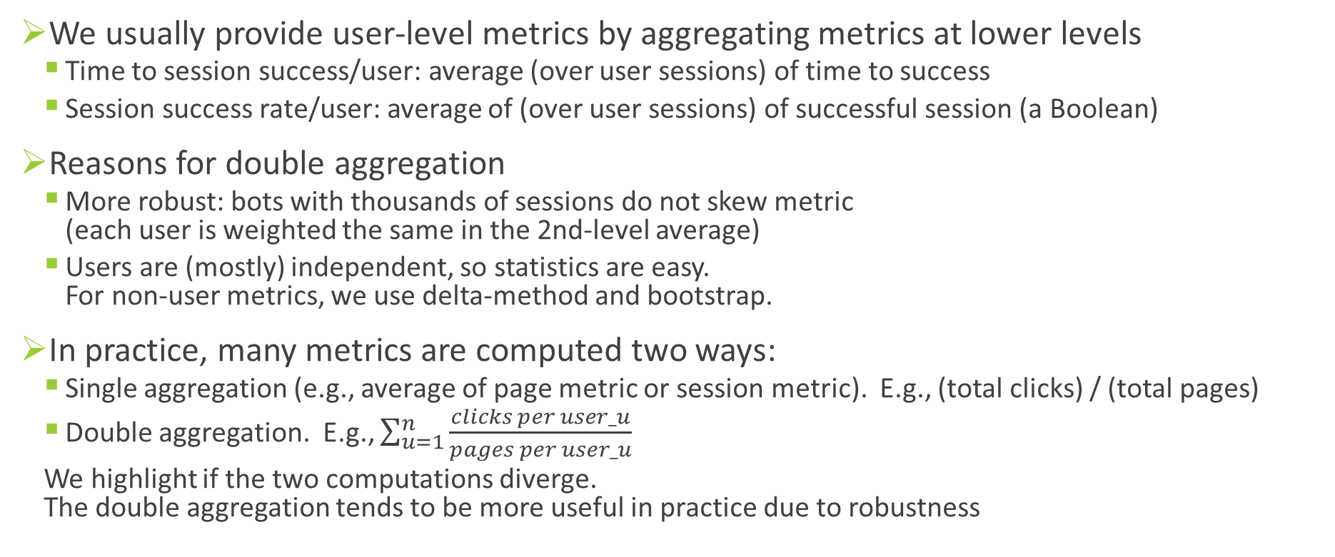
Double Aggregation to User Level
We usually provide user-level metrics by aggregating metrics at lower levels
  Time to session success/user: average (over user sessions) of time to success
  Session success rate/user: average of (over user sessions) of successful session (a Boolean)
Reasons for double aggregation
  More robust: bots with thousands of sessions do not skew metric
  (each user is weighted the same in the 2nd-level average)
  Users are (mostly) independent, so statistics are easy.
  For non-user metrics, we use delta-method and bootstrap.
In practice, many metrics are computed two ways:
  Single aggregation (e.g., average of page metric or session metric). E.g., (total clicks) / (total pages)
  Double aggregation. E.g., $\sum_{u=1}^{n}{\frac{clicks per user_u}{pages per user_u}}$
  We highlight if the two computations diverge.
  The double aggregation tends to be more useful in practice due to robustness

