Slide 1

Your feedback is important!
What other content do you want to see?
Please take our 2 minute survey!
  Anonymous
  All answers optional
https://aka.ms/skills-feedback

Slide 2
Microsoft Teams
Foundations – Core components of Microsoft Teams

Slide 3
Changelog
Revision
June 2018 | Initial version
September 2018 | Clarification on Yammer not creating a shared calendar Clarification on Teams inbox and calendar being hidden by default
January 2019 | Added/updated architecture slides Added dynamic membership support Updated SPO slides (lack of license, subsites are available, but flat is preferred) Updated Exchange matrix slide, removed voicemail – added workaround bullet

Slide 4
About this module
Additional resources
  More modules can be found at https://aka.ms/TeamsAcademy
Feedback
  Feedback for this session: http://aka.ms/teamscommunity adding the “IT Pro Training” label
  Feedback for features: https://aka.ms/TeamsFeedback
Teams and Office 365 evolves constantly!
  Stay up-to-date with https://aka.ms/Teamsblog
January 2019 version of this presentation

Slide 5
Agenda
Architecture of Microsoft Teams
Azure Active Directory
Office 365 Groups
SharePoint and OneDrive for Business
Exchange

Slide 6
Architecture

Slide 7
Teams logical architecture
Teams
Chats
Voice
Apps
Tabs
Chat
Modern Group
Team
Apps
OneDrive
Contacts
SharePoint
Channel
Folder
Meetings
Tabs
Calling
Images, Emojis, Stickers, Giphy, Recordings
Activity Feed
Message
Reply Chain

Slide 8

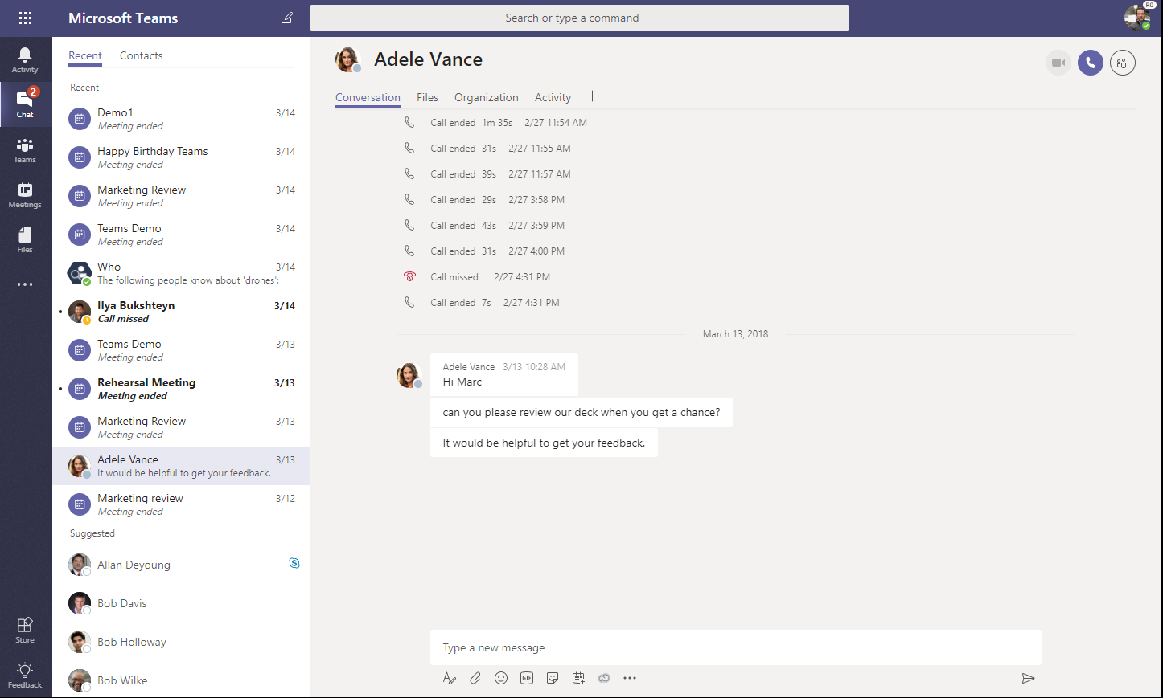
Conversation storage
Where are conversations stored?
Chat service
In memory processing for speed
Leverages Azure storage (moving to Cosmos DB)
Exchange
Chat and channel messages are also stored in Exchange for information protection
Conversation images & media
Inline Images/Stickers are stored in a
media store, Giphys are not stored.

Slide 9
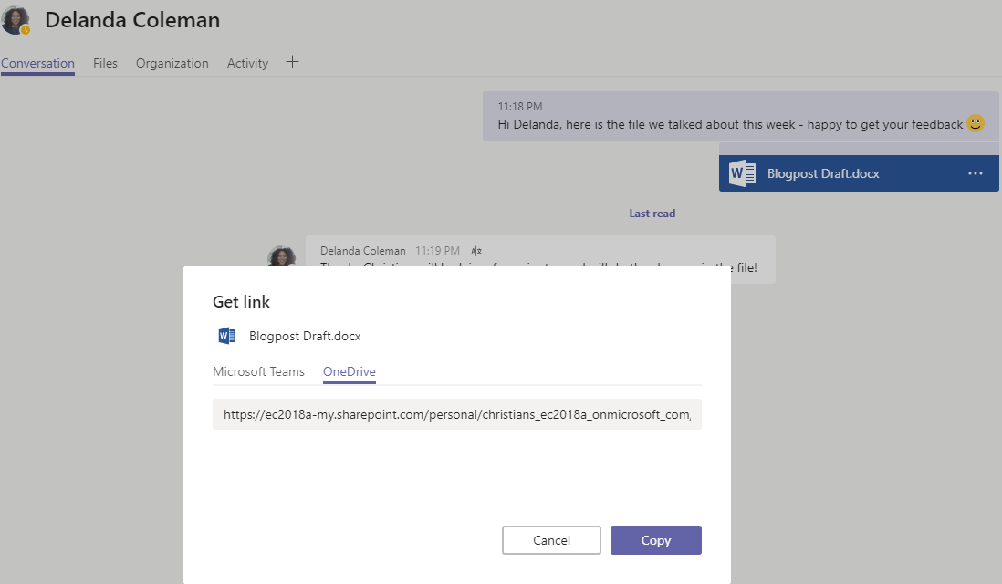
File storage
Where are files stored?
1:N chats
Files are uploaded to OneDrive for Business and permissions are set for the members of the chat
Team conversations
Files are uploaded to SharePoint. A folder is associated with each channel in the team
Cloud storage
Dropbox, Box, Citrix ShareFile, Google Drive

Slide 10
Data Entity Storage
Key data entities and location where data is stored at rest
Entity
Storage
Storage
Message
Chat service table storage (moving to Cosmos DB)
Ingested to Exchange to enable compliance
Image
Media service on Azure (using Blob storage)
Ingested to Exchange to enable compliance
Files
Team files → SharePoint
Chat files → OneDrive for Business
Voicemail
Individual mailbox in Exchange
Recording
Media service on Azure (using Blob storage) (<24 hours)
Encoded to Stream
Calendar meeting
Individual mailbox in Exchange
Contacts
Exchange
Telemetry
Microsoft Data warehouse (No customer content)

Slide 11
Azure Active Directory

Slide 12
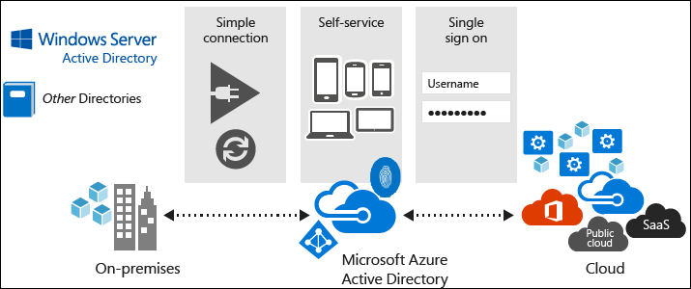
What is Azure Active Directory (AAD)?
Microsoft’s multi-tenant, cloud-based directory, and identity management service
Combines core directory services, application access management, and identity protection into a single solution

Slide 13
Azure Active Directory (AAD) Editions
AAD Free: included with an Azure subscription
AAD Basic: designed for task workers with cloud-first needs
  Group-based access management
  Self-service password reset for cloud applications
  AAD Application Proxy (publish on-premises web applications using AAD)
AAD Premium P1: adds enterprise-level identity management capabilities
  Dynamic groups
  Self-service group management
AAD Premium P2: adds Identity Protection and Privileged Identity Management (includes all P1 features)
Feature matrix: https://aka.ms/azure-features

Slide 14
Identity Models used with Microsoft Teams
Cloud Identity: user is created and managed in Office 365 and stored in Azure Active Directory, and the password is verified by Azure Active Directory
Synchronized Identity: user identity is managed in an on-premises server, and the accounts and password hashes are synchronized to the cloud
Federated Identity: requires a synchronized identity where the user password is verified by the on-premises identity provider (such as Active Directory Federation Services (ADFS))

Slide 15

Identity Models
Cloud identity
Synchronized identity
Federated identity
On-premises
directory
On-premises
directory
Zero on-premises
servers
Directory sync with
password sync
Federation
Directory
sync
On-premises
identity
On-premises
identity
Single Sign On Experience
Two directories to maintain
Between 0 and 3 servers on-premises
Single Sign On
One directory to maintain
Between 2 and 8 servers on-premises

Slide 16
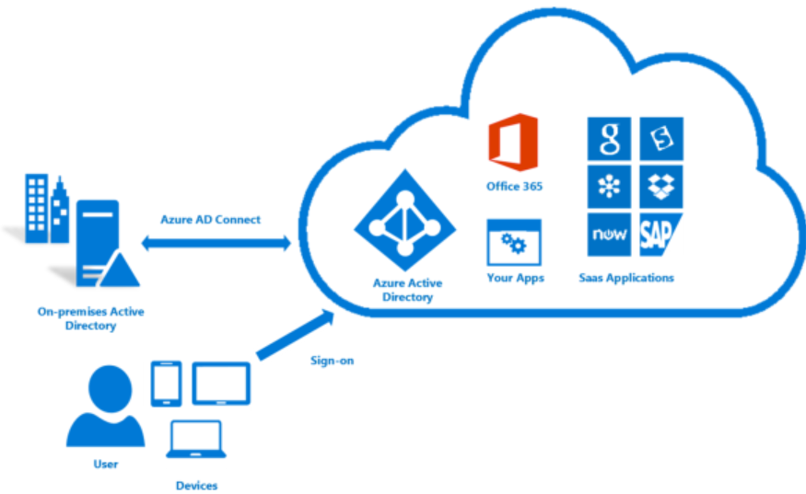
Syncing Identities to the Cloud
Tool: Azure AD connect
  Enables common identities between on-premises and online
  Works over the Internet
  Start simple with Express Settings setup
  Custom setup for complex scenarios
    Multi forest topologies, filtering, Sign on using federation, Azure AD Premium features, customer attributes and more
  User sign-in using either Password Synchronization or Federation with ADFS

Slide 17
Synchronized identities with Password Sync User and Administrative Experience
User Experience
  Sign in with one identity
  Authentication happens in the cloud or on-premises (depending on svc)
  Users have two IDs but one username/password combination
Administrator Experience
  If synchronization happens properly, normally nothing to maintain in the cloud for identity

Slide 18
Federated identities
User and Administrative Experience
User Experience
  Users Sign in with corporate ID
  Authentication happens on premises via claim based system
  Users have a single credential to provide SSO to on premises and Online services
  Users get true SSO experience
Administrator Experience
  Manage password policy on premises only
  Password reset for on premises IDs only
  Requires additional servers to enable identity federation so there will be an additional upfront cost

Slide 19
How does Teams leverage AAD?
Identity – Single Sign On (SSO) with Office 365 applications
  Multi-Factor Authentication (MFA) for increased security
  Conditional Access (based on group, location, and device state)
  Access Reviews [Preview]
Advanced Modern Group Features
  Naming policies [P1 feature]
  Group Expiration [P1 feature]

Slide 20
Office 365 Groups

Slide 21

Office 365 Groups is a membership service
2
Group identity created in Azure Active Directory
1
User creates new group for collaboration
3
Group experience populated in app of choice
Office 365 Application
Azure Active Directory
Office 365 Application
Identity, Resource URLs, Owners, Members
One Identity
Azure Active Directory (AAD) is the master for group identity and membership across Office 365 (Exchange, SharePoint, etc.)
Federated Resources
O365 services extend with their data (e.g. Group messaging, SharePoint Team Site, OneNote, Planner)
Loose coupling
Services notify each other of changes to a group (e.g., creation, deletion, updates).

Slide 22
Provisioning Office 365 Groups
By default, anyone can create a new Office 365 Group
  From Outlook 2016, OWA, or the Outlook Groups app
  From PowerShell (New-UnifiedGroup)
  From SharePoint Online when you create a new team site
  From Microsoft Teams when you create a new team
  From Planner, Power BI, StaffHub and Stream integrations

Slide 23
Resources in Office 365 Groups
Resources available when the Group is created
  Shared Inbox
  Shared Calendar
  SharePoint Document Library
  Shared OneNote Notebook
  SharePoint Team Site
  Yammer Group
Adding members to the group automatically gives them the permissions they need to the resources your group provides
Outlook
Yammer

Slide 24
Office 365 Groups: Roles
Owners: act as moderators
  Add/Remove Members from the Group
  Ability to delete conversations from the shared inbox, change group settings, rename the group, etc.
Members: regular users in the organization that use the group to collaborate
  Can access everything in the group, but cannot change group settings.
  Are site members for the corresponding SharePoint site.
Guests: similar to Members, but outside your organization
  Admins can control if Guests are permitted in Groups

Slide 25
Office 365 Groups: Privacy levels
Public: group can be seen by anybody in your organization, and anybody in your organization is able to join the group
Private: group content can only be seen by the members of the group; people who want to join a private group have to be approved by a group owner
Neither Public nor Private groups can be accessed by people outside of the organization, unless specifically invited as Guests.

Slide 26
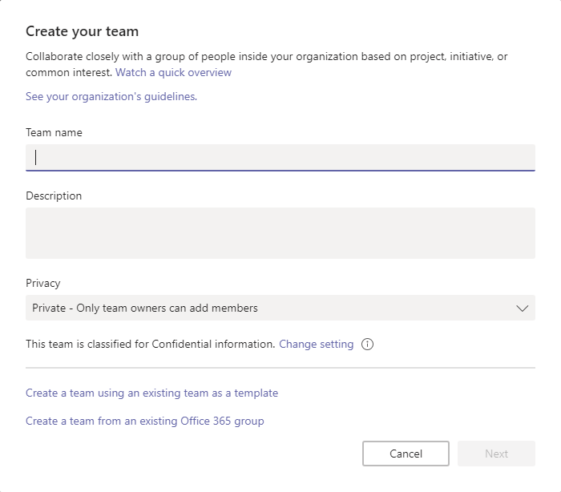
What about Teams?
Creating a new Team creates a new Group with:
  (Hidden) Shared Inbox
  (Hidden) Shared Calendar
  SharePoint Document Library
  Shared OneNote Notebook
  SharePoint Team Site
  Persistent chat-based workspace
Membership is sync’d between the underlying Group and Teams
  Adding a member to the underlying group replicates to Teams
  Adding a Distribution List to the team performs a one-time expansion, and invites individual members
  Dynamic membership is also supported: https://aka.ms/TeamsDM

Slide 27
How does Teams leverage Groups?
Microsoft Teams uses group membership as the access control list to Files and Notes tabs
Owners of existing Groups can move them over to Microsoft Teams
Team creation settings are controlled through the admin portal where you control group creation settings.

Slide 28
Considerations for Planning Teams and Groups
Teams leverages settings from the underlying Group
  Membership
  Naming Policies [AAD P1 needed for each unique user that is a member of one or more Office 365 groups]
  Group Expiration [AAD P1 needed for all users that are members of groups to which the expiration policy is applied]
Administration of Groups
  Admin Center (basic management [owners, members])
  Azure AD Portal (Self Service config, expiration, auditing)
  PowerShell (naming policies currently [Preview])
Exchange considerations:
  Configure Office 365 Groups with on-premises Exchange hybrid: https://aka.ms/groups-exchange-hybrid
  Choose the domain to use when creating Office 365 Groups: https://aka.ms/groups-domain

Slide 29
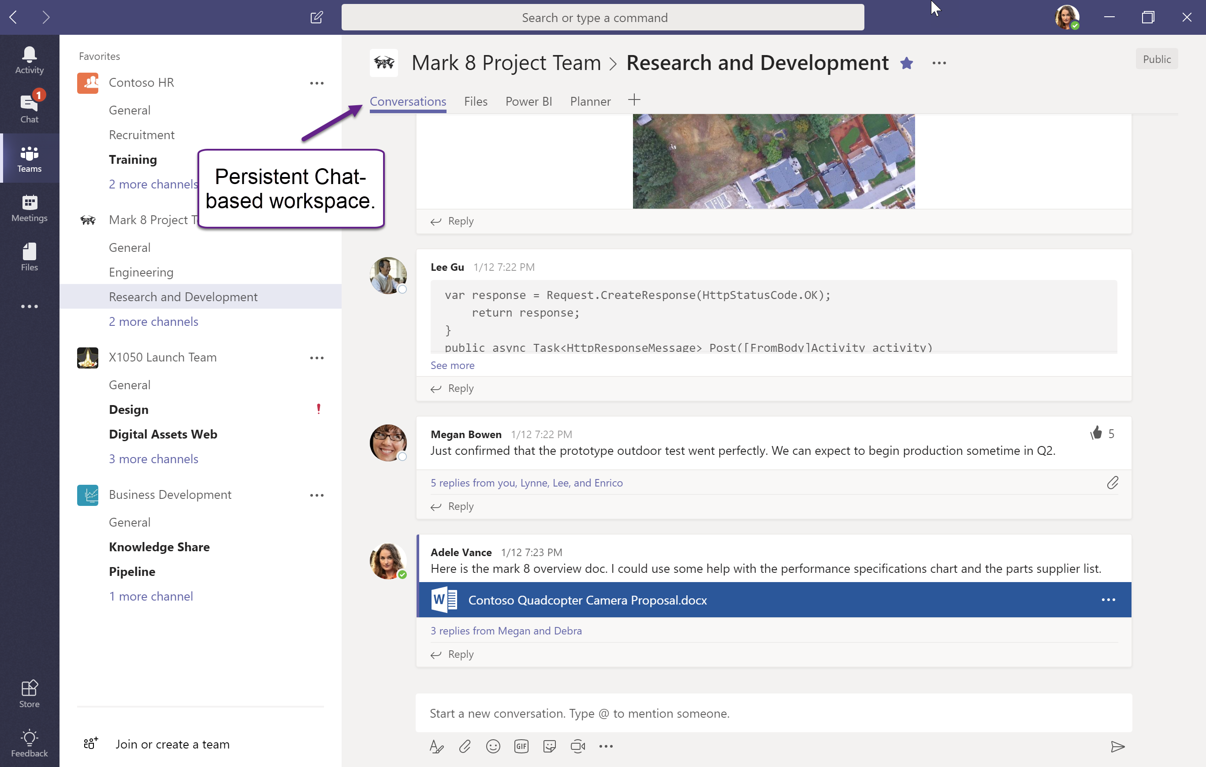

Slide 30
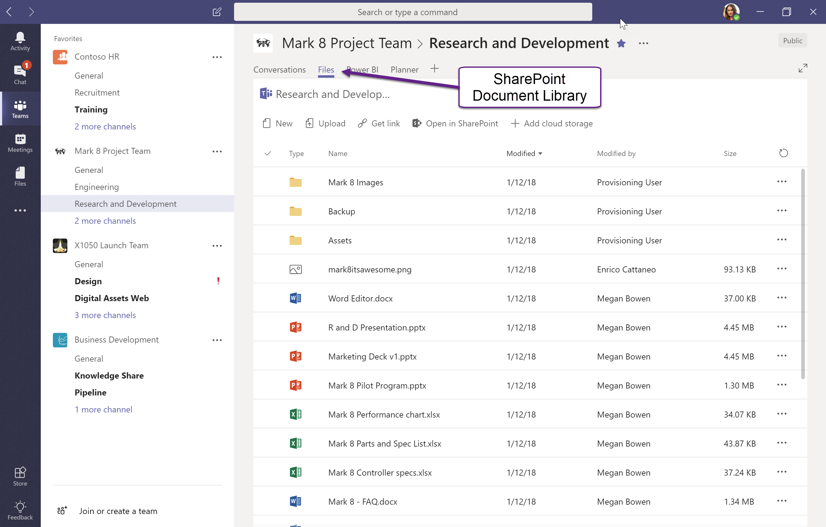


Slide 31
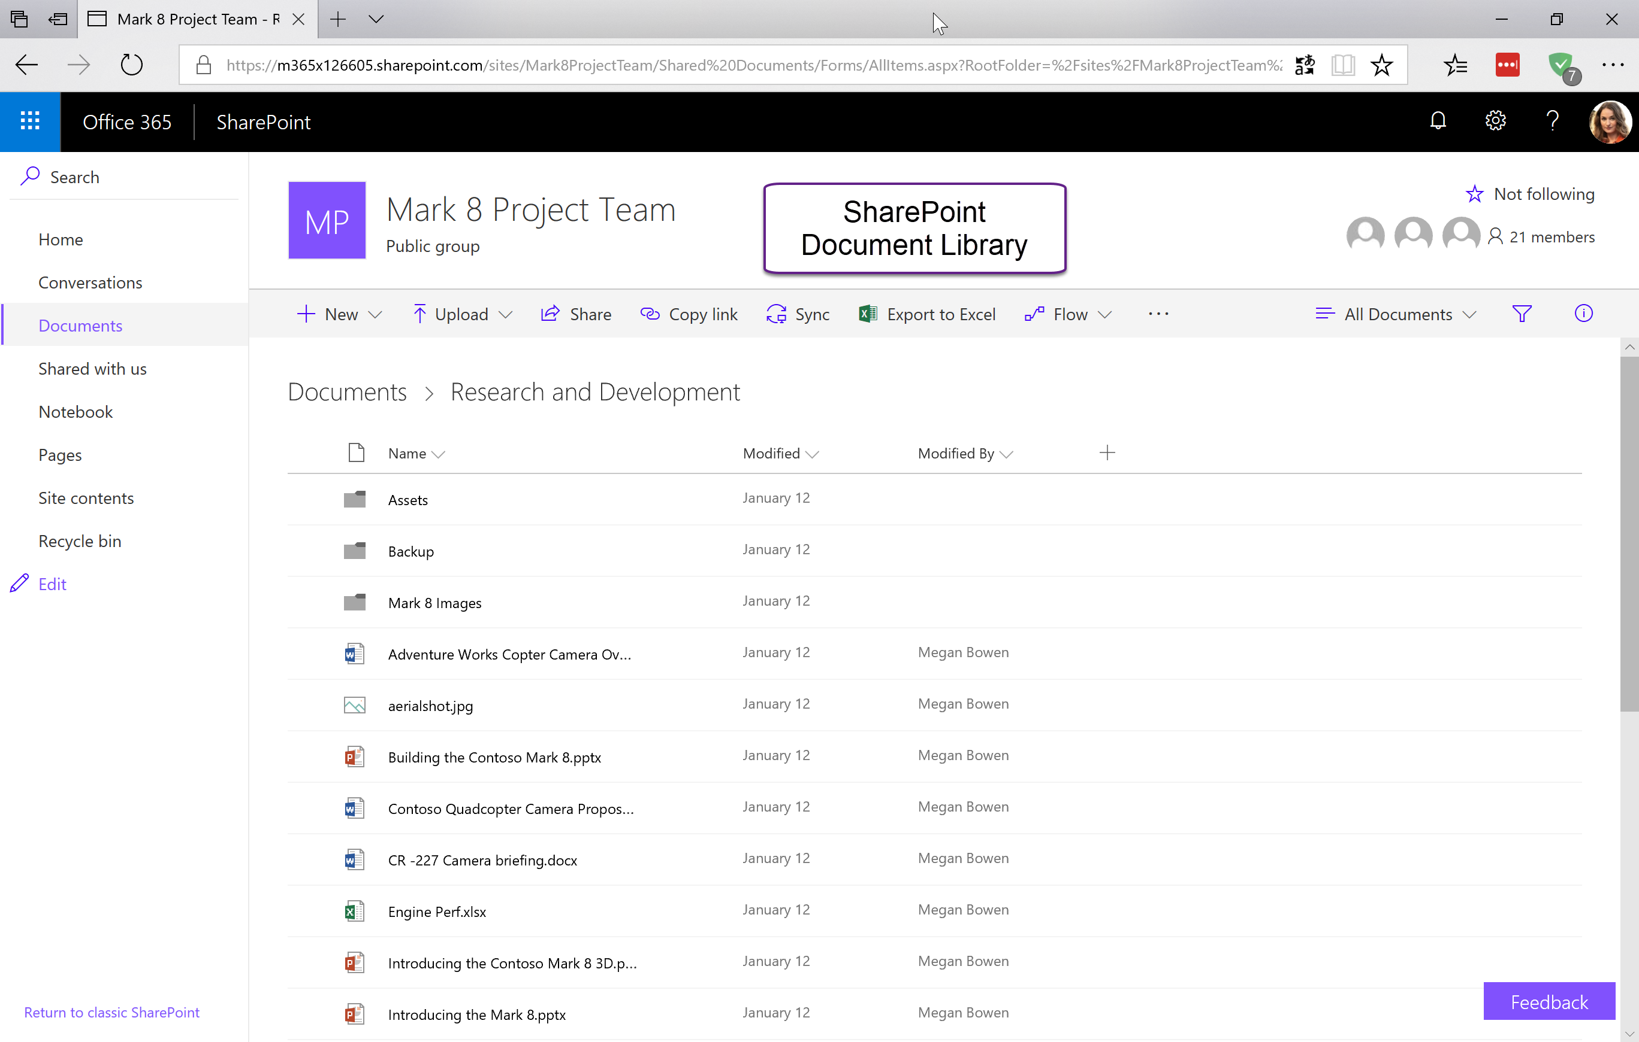

Slide 32
SharePoint Online & OneDrive for Business

Slide 33
How Teams uses SharePoint Online and OneDrive for Business
SharePoint Online and OneDrive for Business are used to store files that users share in Teams
Every Team gets a modern SharePoint Team site as part of its O365 group
  If team with same name already exists, the SharePoint URL will include a GUID
Team OneNote is stored in SharePoint Online
Add tabs for any: SharePoint page, list, news, single document
News connector posts news articles within Teams channels

Slide 34
Advantages of storing files in
SharePoint Online and OneDrive for Business
Use co-authoring and online versions of Office applications
Available data governance and compliance features
  Automatic classification, labelling
  Data loss prevention
  Document retention policies, disposition review, events-based retention
  eDiscovery, legal holds
  Encryption, customer lockbox, Azure Information Protection
Best in class mobile experiences with Microsoft Teams, SharePoint & Office apps for iOS & Android
Previews for 270+ file types
Files are discoverable in Delve and SharePoint search – respecting file permissions
OneDrive sync client for Windows or Mac; easily sync all the files for a team
Will respect tenant SharePoint and OneDrive for Business settings and locations

Slide 35
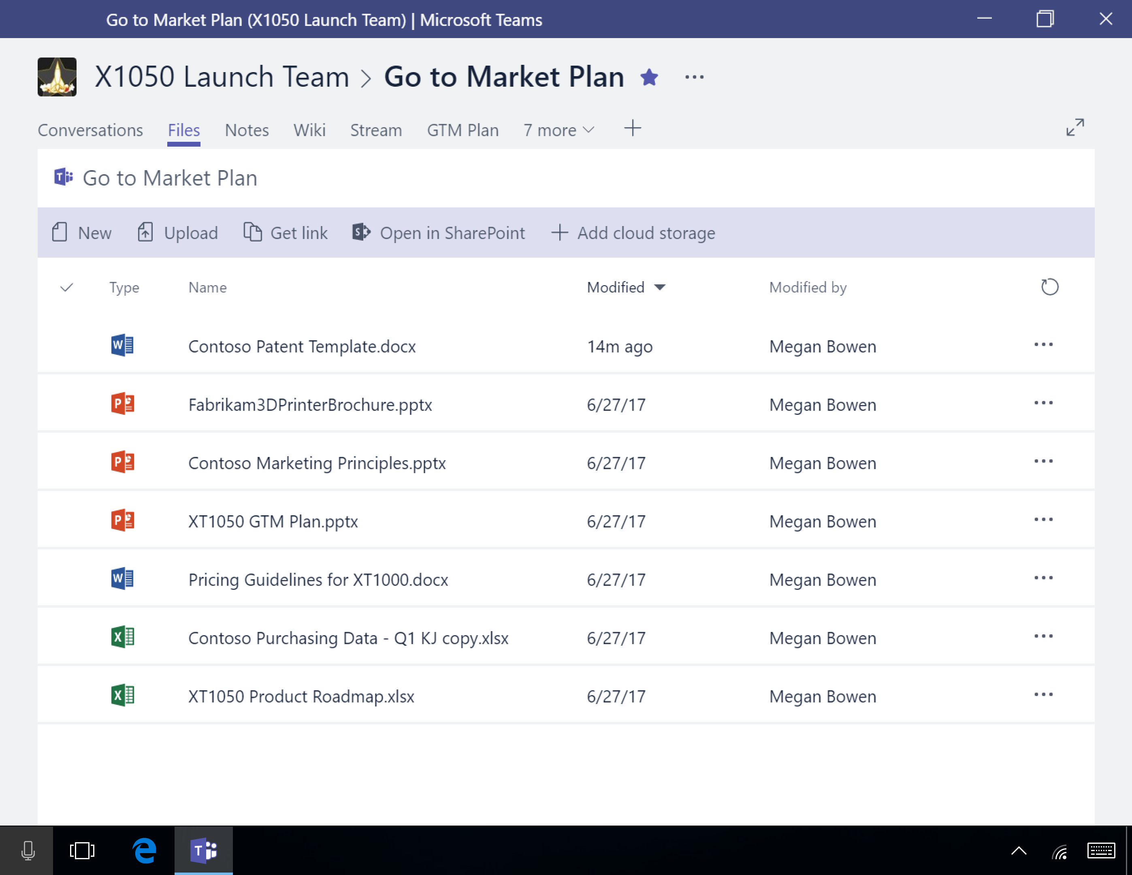
Files in Teams
Purpose
  Files tab displayed in every channel
  Files in channels are stored in the SharePoint Online site associated with the team’s O365 Group
  Files shared in chat are located in the sender’s OneDrive for Business
End user does not need to see or know about SharePoint Online or OneDrive for Business
Click “View in SharePoint” to open the SharePoint site

Slide 36
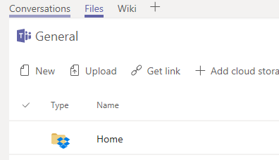
Additional Cloud Storage Providers
Additional Cloud Storage providers can be added in channels
  Dropbox
  Box
  ShareFile
  Google Drive
  Additional SharePoint Online Library
Process
  Sign-in to cloud provider and select folder to share
Will be displayed as Folders in file view
  Icon will indicate where data stored
Cannot substitute SharePoint or OneDrive for Business

Slide 37
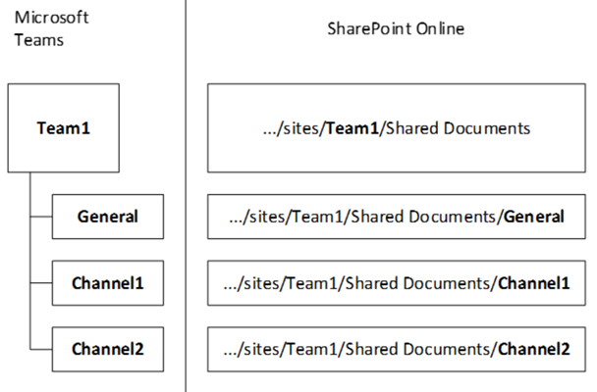
File Structure
SharePoint
  Modern Team site is created as part of creating Office 365 group
  Document library has a folder for each channel
  By default, all channels/folders inherit the permissions of the underlying O365 Group
  You can change them in SharePoint and Teams will respect them
OneDrive for Business
  Files are in a folder called “Microsoft Teams Chat Files”
  Uploaded to the OneDrive of the person sharing a file
  Each file has unique permissions granted based on the person or people in the chat
Team channel files in SharePoint

Slide 38
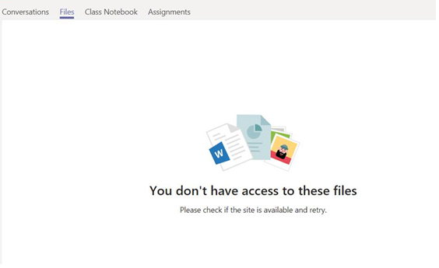
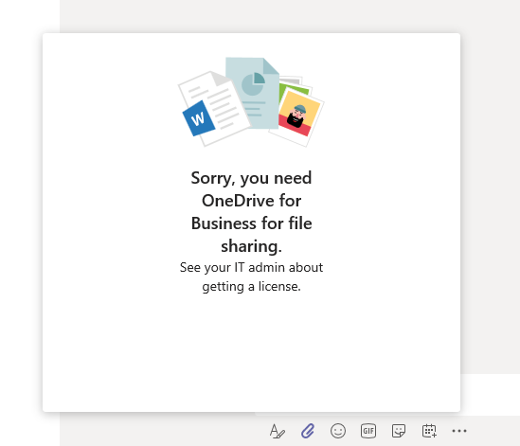
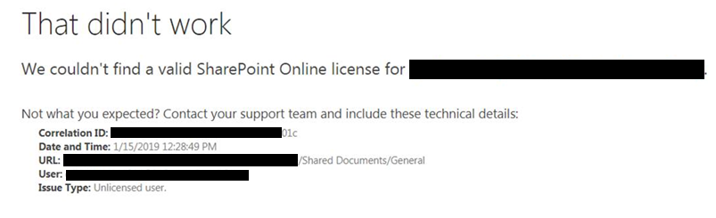
Experience without SharePoint Online or OneDrive for Business
SharePoint Online prerequisite for OneDrive for Business
Without SharePoint Online and/or OneDrive for Business you cannot:
  Store and share files in channels
  Perform private file sharing
  Access the team SharePoint site

Slide 39
Customer without SharePoint Online
A Teams implementation respects your investment in SharePoint Online. Some considerations are:
  Should content be migrated from SharePoint on-premises?
  How will sites and documents be classified and secured?
  How will we govern compliance, and configure the Security and Compliance center?
  How will external access be managed?
  Who can create SharePoint sites, and what kinds?
  Will you have custom site designs?
Reach out to FastTrack or partner resources to assist you in making these service decisions

Slide 40
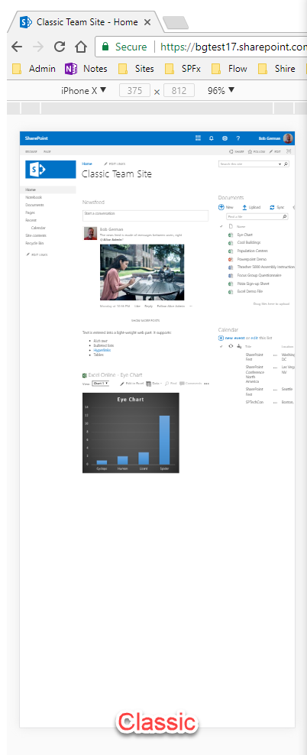
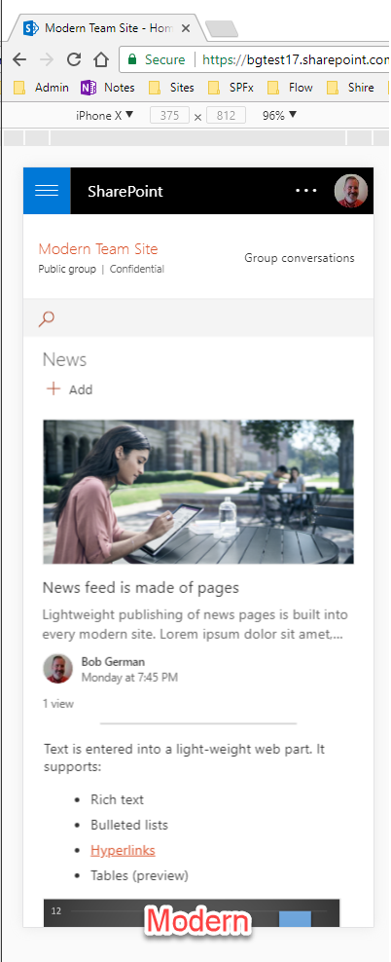
Classic Sites
Architecture is showing its age
Pages aren’t mobile friendly without custom development
Team site
The classic team site evolved from SharePoint 2003
Publishing site
Allows deep branding
Still the most capable for web content management
Modern Sites
All new client-side architecture
Modern Team Site
Designed for collaboration
This is what you get with each O365 Group/Microsoft Team
Communication Site
Designed for broader communication
“Modernize” existing team sites!
Lists and libraries modern by default
Add modern home (and other) pages
Attach site to a new O365 Group

Slide 41
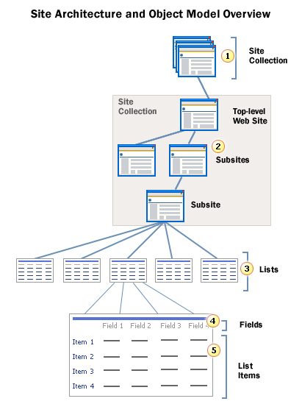
The World of Modern
SharePoint is Flat
In Classic SharePoint, sites are arranged in a hierarchy within each site collection
  It’s difficult to move a site to a new collection
  Pain point during reorgs, acquisitions, etc.
Modern SharePoint Online prefers flat architecture
  Each site collection has a single site
  “Hub sites” are used to organize site collections and can provide hierarchy

Slide 42
SharePoint Online Storage
OneDrive for Business: 1TB per user
SharePoint: 1TB for organization + 10GB for each licensed user*
Additional storage can be purchased
Quotas can be configured to limit size per SharePoint site
* License F1 does not include storage per user

Slide 43
What to configure where
 | In Teams | In Group/SharePoint
Adding members | Will take effect in Group and Teams | Will take effect in Group and Teams
Promoting members to owners | Will take effect in Group and Teams | Will take effect in Group and Teams
Changing channel/folder name | Will change channel name but keep folder name | Will change folder name but will break Teams integration
Change file permissions for members | You can’t configure file permissions in Teams, but Teams will respect permissions set in SharePoint | Will take effect in Group and Teams

Slide 44
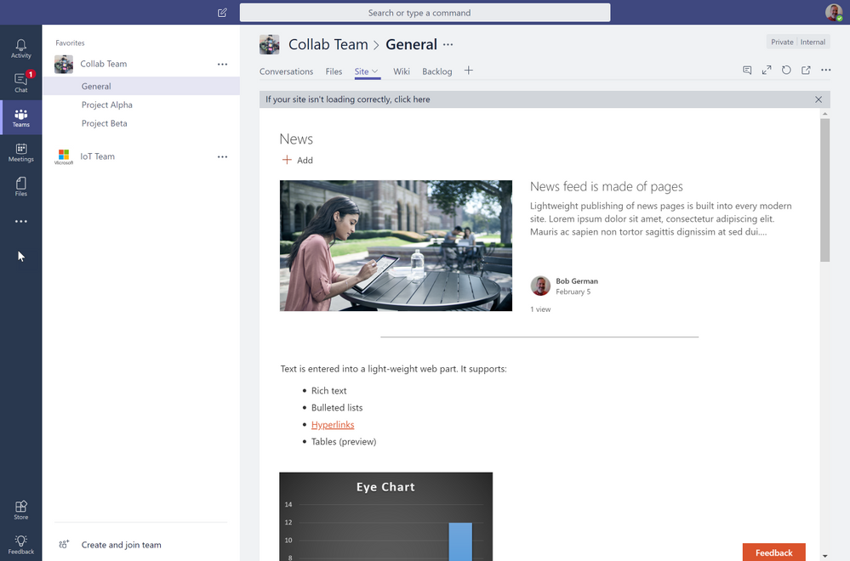
Use SharePoint pages in Teams
Works with modern pages, lists,
news, whole documents
  Content pages
  Lists
  News
Existing team sites can be used
as basis for Teams
  SharePoint Online site administrators see option when creating a new Teams team to use existing site
  Files section will be empty, as Teams uses specific folder per channel
  You can add your files as Document Library via “add a tab”

Slide 45
Integrating SharePoint Online Classic site pages
Need to connect SharePoint classic site with new Office 365 Group
  Use “SharePoint Modernization scanner” to verify if site can be connected to Office 365 Group
    Checks for things like site alias not already used, not including space, blocked word list etc.
  Currently PowerShell only: Set-SPOSiteOffice365Group
  Site collection Administrator to create new group via Settings menu in classic team site

Slide 46
Exchange

Slide 47
How Teams uses Exchange
Compliance features
  Chat stored in Exchange Online mailbox
Meeting information
Changing user profile picture
Call History and Voicemail
Connector configuration
Fully supported with Exchange Online
  Limitations with Exchange Server or Exchange Online Dedicated – Legacy
Exchange On-premises homed users
  Limited features supported with Exchange Hybrid for on-premises homed users
  Exchange on-premises without hybrid not supported

Slide 48
Microsoft Teams and Exchange
For the full Microsoft Teams experience, every user should be enabled for Exchange Online, SharePoint Online, OneDrive for Business and Office 365 Group creation.
eDiscovery
(messages, files)
Modify user profile picture
Legal hold
(messages, files)
Retention
(messages, files)
eDiscovery
(calling / meeting)
Team and Channel management
Add and configure connectors
Create and view meetings
Manage contacts
Add and configure bots
Call History
Voicemail
Access Outlook contacts
Add and configure tabs
Exchange Online | ✓ | ✓ | ✓ | ✓ | ✓ | ✓ | ✓ | ✓ | ✓ | ✓ | ✓ | ✓ | ✓ | ✓
Exchange Online Dedicated vNext | ✓ | ✓ | ✓ | ✓ | ✓ | ✓ | ✓ | ✓ | ✓ | ✓ | ✓ | ✓ | ✓ | ✓
Exchange Online Dedicated – Legacy | Yes¹ | Yes^{1,2} | ✕ | Yes (must be on allowed list) | ✓ | ✕ | ✕ | ✓ | ✓ | ✕ | ✕ | ✕ | ✓ | ✓
Exchange on-premises | Yes¹ | Yes^{1,2} | ✕ | Yes (must be on allowed list) | ✓ | Exchange 2016 CU3 or later | ✕ | ✓ | ✓ | ✕ | ✕ | ✕ | ✕ | ✓
¹ eDiscovery and Legal Hold for compliance on channel messages is supported for all hosting options.
² Teams private chat messages are not yet supported for Legal Hold for this hosting option.
https://aka.ms/teams-exchange

Slide 49
Exchange Hybrid requirements
AAD Connect with writeback is required
  In order to make Groups available for on-premises users
Prerequisites
  AAD premium license required for writeback
  Exchange hybrid configured
  One of the minimum version of
    Exchange 2013 with CU11
    Exchange 2016 with CU1
    Exchange Hybrid requires the latest or prior to latest CU

Slide 50
Exchange Server and eDiscovery
eDiscovery is always done against Exchange Online
  Channel messages are stored in group mailbox which is always online
  Chat messages need to be stored in a user mailbox
Enabling eDiscovery for Teams users with Exchange on-premises mailbox
  Users need cloud equivalent of mailbox for chat eDiscovery
  Feature can be enabled via support process
  Once enabled, Teams will create cloud equivalent mailbox and use for chat
  Content will remain intact if mailbox is migrated from on-premises to online

Slide 51
Workaround for unsupported features
Teams meetings
  On Windows PCs can be scheduled with Teams add-in for Outlook
  Meeting invites will be on calendar across platforms
Voicemail
  Voicemail can be retrieved from Outlook
Profile picture
  Can be changed in Office 365 portal
Connectors
  Can still be used, just not configured by user with on-premises mailbox

Slide 52
Summary

Slide 53
Summary
Teams builds on Office 365
For optimal user experience AAD sync, SharePoint Online, OneDrive for Business and Exchange Online required
Limited functionality still available for other environments

Slide 54
Thank you.

