Slide 1

Your feedback is important!
What other content do you want to see?
Please take our 2 minute survey!
  Anonymous
  All answers optional
https://aka.ms/skills-feedback

Slide 2



Coffee in the Cloud
Get more from Azure & Office 365
Teams IT Pro Academy:
Teams Windows Desktop Client
@CITCTV
https://aka.ms/CoffeeintheCloud

Slide 3
Teams Windows Desktop Client

Slide 4
Changelog
Revision
September 2018 | Initial version
March 2019 | Added information on OfficePro Plus, MSI without autostart

Slide 5
About this module
Additional resources
  PowerPoints and recordings for this and more topics: https://aka.ms/TeamsAcademy
Feedback
  Feedback for this session: https://aka.ms/teamscommunity adding the “IT Pro Training” label
  Feedback for features: https://aka.ms/TeamsFeedback
Teams and Office 365 evolves constantly!
  Stay up-to-date with https://aka.ms/Teamsblog
March 2019 version of this presentation

Slide 6
Key learnings
Desktop Client increases reachability and productivity
Can be installed individually by users or rolled out by IT
Updates fully automated

Slide 7
Agenda
Benefits of Windows Desktop Client
Planning and deploying the Windows Desktop Client
Managing the Windows Desktop Client

Slide 8
Benefits of the Windows Desktop Client

Slide 9













Alice, the information worker
I ♥ T..
Alice and her coworkers recently started to use Teams. She likes it a lot.
Alice uses the web client directly from her browser.
Sometimes Alice forgets to open Teams in her browser. Is she missing an important notification?
She realizes, Teams can also be installed on her computer!
Now she is not missing any messages, also there are additional features!
But what about her coworkers? Will they install Teams?

Slide 10




Carol, the IT administrator
Carol works at Contoso’s IT department.
Contoso recently decided to use Teams for collaboration.
Carol wants to get sure that users have the best experience when using Microsoft Teams.
She and her team roll out the Teams client to all users to provide auto-start, more features and better management.

Slide 11
Benefits of the Windows desktop client
Improved productivity
  Auto-starts and users’ staying signed in means users are always reachable
  Users will stay connected and will be better informed
Offers the richest Teams experience
  Calling
  Meeting experience with full audio, video, and sharing
  Outlook add-in
  Presence integration in Office
Management
  Auto-update (just like all other clients)
  Allows for mass deployment
  Allows QoS tagging

Slide 12
Planning and deploying the Windows Desktop Client

Slide 13

PC desktop client lifecycle
Installation
  One time activity (per user)
  User- or admin-driven
Updates
  Evergreen client
    Bugfixes, improvements, features
    No version sprawl
  Fully automated
once
automated

Slide 14
Installation options for PC
Standalone (exe) installer for user installation
MSI for IT-driven installation
As part of Office 365 ProPlus
  Depending on Office Update Channel: https://aka.ms/teams-proplus

Slide 15
Hardware and software requirements
Component | Requirement
Computer and processor | Minimum 1.6 GHz (or higher) (32-bit or 64-bit)
Memory | 2.0 GB RAM
Hard disk | 3.0 GB of available disk space
Display | 1024 x 768 screen resolution
Graphics hardware | Minimum of 128 MB graphics memory
Operating system | Windows 10, Windows 8.1, Windows 8, or Windows 7 Service Pack 1 in 32-bit and 64-bit. For the best experience, use the latest version of any operating system.
.NET version | Requires .NET 4.5 CLR or later
Video | USB 2.0 video camera
Devices | Standard laptop camera, microphone, and speakers
Video calls and meetings | For better experience with video calls and online meetings, we recommend using a computer that has a 2.0 GHz processor and 4.0 GB RAM (or higher). The optional blur my background video effect requires a processor with Advanced Vector Extensions 2 (AVX2) support.

Slide 16
Installation considerations
Permissions
  The Teams client can be installed without admin permissions
32-bit and 64-bit available
  Teams is agnostic to the architecture of Office that is installed
  64-bit version recommended
Office 2013 or higher

Slide 17
Installation details
Installed per user
Directories
  Teams application itself
    %LocalAppData%\Microsoft\Teams
    %LocalAppData%\Microsoft\TeamsMeetingsAddin
    %AppData%\Microsoft\Teams
  Update directories
    %LocalAppData%\SquirrelTemp

Slide 18
MSI deployment
Allows broad, IT-driven deployment
  Follow your standard deployment processes (Group Policy, System Center Configuration Manager (SCCM), Intune or third-party tools)
  Consider existing machines and standard build for new machines
How MSI works
  Can be used to deploy Teams, but not to deploy updates
  Places installer in Program Files
  Whenever a new user signs in, Teams will be installed and auto-started
    After Teams starts, the user is signed in and the update process begins
    If the Teams version is new enough, the user will be able to use Teams (the update happens in the background)
    If the Teams version is too old, the user waits for the update to be completed

Slide 19
MIS installer: disable autostart
Disables initial auto launch of Teams when using MSI installer
Teams shortcut placed on user desktop
Once user manually starts client, it will autostart at startup
Disable autostart
  For the 32-bit version
    msiexec /i Teams_windows.msi OPTIONS="noAutoStart=true"
  For the 64-bit version
    msiexec /i Teams_windows_x64.msi OPTIONS="noAutoStart=true"
  Note: If you run the MSI manually, be sure to run it with elevated permissions. Even if you run it as an administrator, without running it with elevated permissions, the installer will not be able to configure the option to disable auto start.

Slide 20
Managing the Windows Desktop Client

Slide 21
Uninstall the Teams client
If Teams was installed and later uninstalled, MSI won’t install again unless Teams has been completely uninstalled
For a complete uninstall
  The PC needs to be cleaned up
    Uninstall the Teams app that was installed for every user profile
    After uninstall, delete the directory recursively under %localappdata%\Microsoft\Teams
  Microsoft provides a clean-up script for these steps for SCCM
    https://aka.ms/AA2jisb

Slide 22
Updates
Teams is updated automatically
  Users will always have latest bug fixes, improvements, and features
Currently, updates can’t be controlled or managed
Update process
  If version is too old to sign-in
    Teams updates before signing-in
  If version is not too old to sign-in
    Check for update 15 minutes after sign-in
    Download if available (the full client package will be downloaded)
    Install when the Teams app has been idle for 30 minutes
    The Teams client will restart and send the user a notification
Update rhythm
  Updates expected every two weeks
  Exception: Hotfixes might be deployed when required

Slide 23
Client-side configurations
Client behavior is controlled via policies managed in the admin portal and PowerShell
There are no options to manage the Teams client via Group Policy or the registry

Slide 24
Troubleshoot: Outlook add-in installation
To initialize the add-in
  For the first time only, initialization is required
  Outlook must run before Teams is started
    Stop Teams (“Quit Teams”)
    Start Outlook
    Start Teams
    Restart Outlook
The add-in will be disabled depending on the Teams upgrade coexistence mode
The add-in can be disabled via Meeting Policy

Slide 25
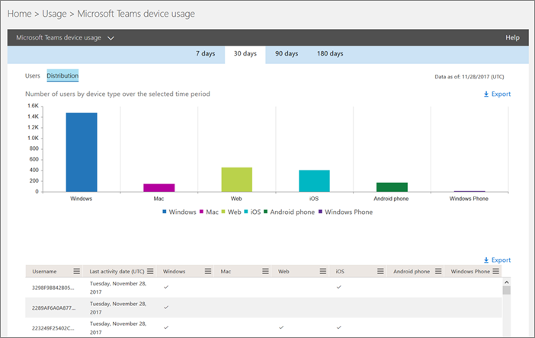
Report client usage
The admin portal client report:
Can be used to check overall client usage
Also allows you to receive reports per user

Slide 26
Summary

Slide 27
Key learnings
Desktop Client increases reachability and productivity
Can be installed individually by users or rolled out by IT
Updates fully automated

Slide 28
About this module
Additional resources
  PowerPoints and recordings for this and more topics: https://aka.ms/TeamsAcademy
Feedback
  Feedback for this session: https://aka.ms/teamscommunity adding the “IT Pro Training” label
  Feedback for features: https://aka.ms/TeamsFeedback
Teams and Office 365 evolves constantly!
  Stay up-to-date with https://aka.ms/Teamsblog
March 2019 version of this presentation

Slide 29
Thank You!

