Slide 1
Start here
At Microsoft, we are dedicated to your success with Microsoft 365 Copilot and our suite of cloud services. We have created the Copilot Success Kit for Small and Medium Business with the reference guidance we believe will help you to be successful. Combined with your own staff, this guidance will allow you to safely and successfully embark upon your journey to AI transformation. You are not alone – we are also here to help. For assistance you can:
  Ask questions in the Copilot for Small and Medium Business forum on the Microsoft Tech Community
  Leverage FastTrack if you have 150 licenses or more
  Engage a Microsoft Partner here
Start assembling your team, taking foundational training, and diving into both the User enablement and Technical readiness sections with our prepared materials. Additional templates, tools, and guidance for each phase of your initial journey are detailed throughout these primary resources. Slides labeled as “Shared Activity” in the top right indicate they are worksheets intended for you to use and modify as you plan your rollout and user enablement. These resources, compiled based upon our experience, research, and feedback from customers, can also be customized to meet your own unique situation.
Your AI journey will be an iterative experience with continuous improvement, learning, and discovery. Microsoft is only successful when you achieve your goals. Your feedback, both within our products and through our communities, help to shape the future of our services and is essential to our improvement. As you and your organization use Copilot, we encourage you to provide feedback and input using the thumbs up/down icons.

Slide 2
Microsoft 365 Copilot
Implementation Guide for Small and Medium Business
Creating the AI-powered organization
Apr 2025
© Copyright Microsoft Corporation. All rights reserved.

Slide 3
Table of contents
Get ready
Technical readiness
  Establish security policies
  Deploy Microsoft 365 apps and configure update channels
  Assign licenses
User enablement
  Driving successful change through leadership
  Identify target scenarios and Flight Crew team
  Share training content and onboard users
Measure success
Extend and optimize
Resources

Slide 4

Microsoft 365 Copilot implementation
Human change
Prepare organization and employees for the AI transformation journey through user enablement programs
Copilot
readiness checklist
You are here
Workstreams support each other for maximum value and ROI
Copilot implementation
Sponsor
Scenarios
Security
Get ready > Onboard & engage > Deliver impact > Extend & optimize
Technical readiness
Address technical deployment and optimization, including governance, security, compliance, and management
Leadership journey

Slide 5
Essentials for Copilot success
Nominate and activate your Copilot executive sponsors, in partnership with your AI Council
Define initial high value scenarios and target a critical mass of users for rapid value
Define your path to secure your data for compliance and peace of mind

Slide 6

Microsoft 365 Copilot
Implementation framework
Get ready
Onboard & engage
Deliver impact
Extend & optimize
1
2
3
4
Deploy training and Champion programs, engagement community
Make ongoing training the standard
Quantify impact including growth, cost savings and employee benefits
Build momentum with success stories and knowledge sharing
Identify new high value functional and cross-org scenarios
Recognize and reward success
Identify your success team
Be intentional with assignment and concentrate seats
User enablement
Address data security, governance, and data access questions
Build shared Copilot implementation plan with User Enablement team
Ensure appropriate Data Security controls are in place
If needed, deploy additional Microsoft 365 apps
Establish service management plan
Review Admin usage reports and the Copilot Dashboard to analyze user retention and engagement
Design, build, and publish plugins to deliver unique experiences
Build your own agents
Technical Readiness
Leadership guides AI transformation for business outcomes
Download our checklist for success: CopilotSMB/ChecklistforSuccess
Notes:
Use our implementation framework to help guide you through the high-level actions and outcomes in each phase across both user enablement and technical readiness.

Slide 7

Video
Notes:
This is a video on how Microsoft 365 Copilot works from Microsoft Mechanics.

Slide 8

Ensure appropriate Data Security controls are in place
Security and compliance for Microsoft 365 Copilot in SMB
Foundational security controls
Comprehensive security controls
Microsoft 365 Business Basic or Business Standard
+ Microsoft 365 Copilot
Microsoft 365 Business Premium
+ Microsoft 365 Copilot
Multi-factor authentication (MFA) for secure access to M365 applications with Copilot
Multi-factor authentication (MFA) with conditional access based on identity, device, location, and network
Search and export Copilot prompts and interactions
Search, export, eDiscovery case management, and legal hold for Copilot prompts and interactions
Audit logs for Copilot interactions
Audit logs for Copilot interactions
Retention or deletion policies for Copilot interactions and generated content
Retention or deletion policies for Copilot interactions and generated content
Restricted SharePoint Search for Copilot interactions and generated content
Manual sensitivity and retention labels for content processed by Copilot in files and emails
Data loss prevention policies to help protect sensitive data from Copilot in files and emails
Notes:
Microsoft 365 Copilot is an add-on available for Microsoft 365 for Business suites. The plan you choose determines the level of security and compliance controls available to your Microsoft 365 environment and Copilot—protecting your data, devices, and applications.
Microsoft 365 Business Basic and Business Standard provide foundational security controls, including multi-factor authentication via security defaults, to help safeguard your organization from identity-related attacks such as password spray, replay, and phishing.
They also include standard compliance controls, allowing users to search and export Copilot interactions, log user activities, and apply retention or deletion policies.
Microsoft 365 Business Premium offers comprehensive security controls which includes everything in Business Basic and Business Standard plus more. Conditional Access with Entra ID builds on MFA, case management and legal hold add more capabilities to searching and exporting Copilot interactions.
Business Premium also allows the use of Manual Sensitivity and Retention labels for files and emails. Users can protect access to sensitive data in Copilot interactions with Data Loss Prevention policies.
This slide provides a high-level overview of the controls, but there are additional add-on features and controls available with Office/Microsoft 365 for Copilot.

Slide 9
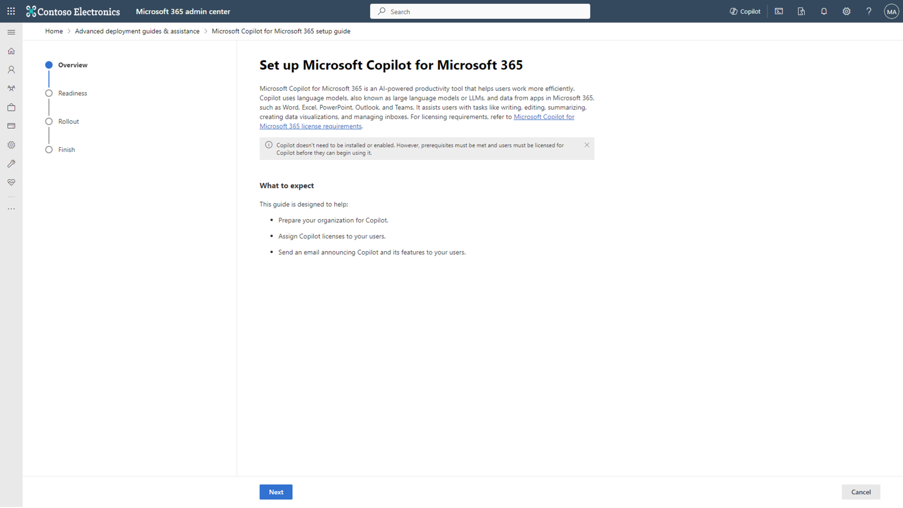
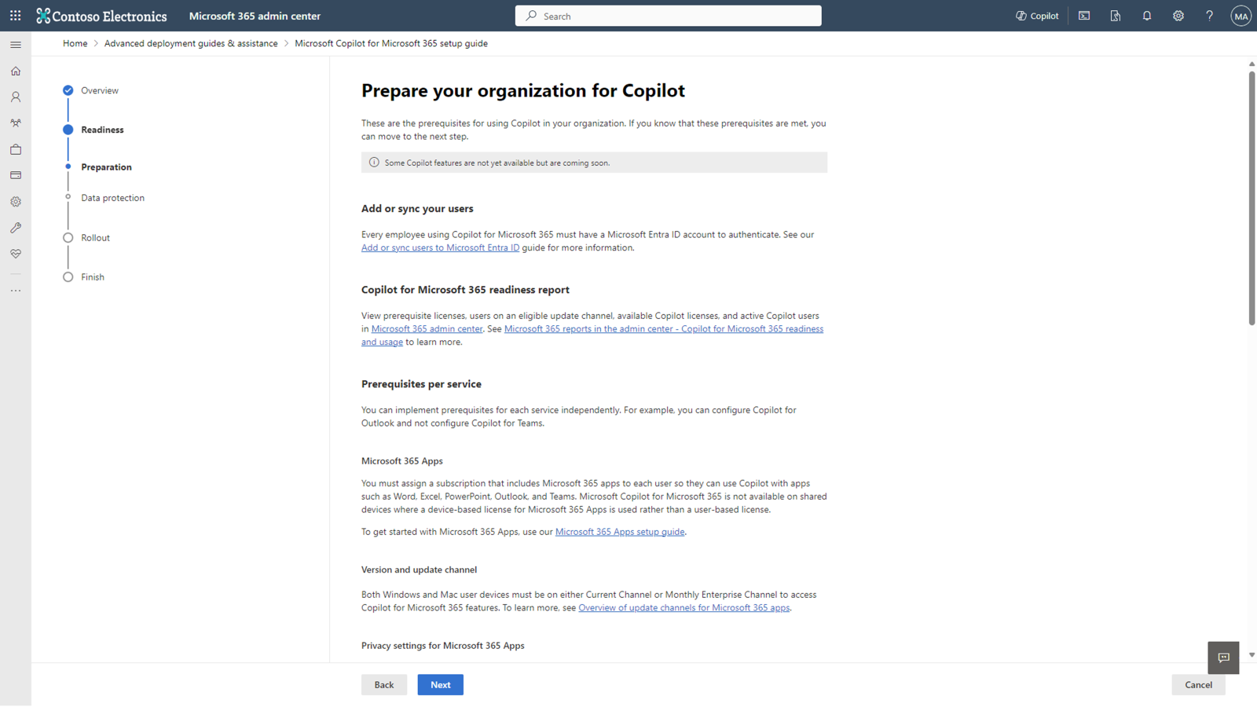
Setup guide
  Wizard-based guide covering deployment activities
  Use the new Microsoft 365 Copilot setup guide, a wizard-based experience in the Microsoft 365 admin center, to help prepare your organization for Copilot.
Find this wizard in the admin center > Home > Setup page >
Apps and Email > Get ready for Microsoft 365 Copilot.
Note: Do this in parallel with the steps in the User Enablement section to ensure you're driving effective change. Look for the “Shared activity” label.
Ensure you have the right prerequisites and apps deployed
Confirm that your user devices are on either the Current or Monthly Update Channels
Assign Microsoft 365 Copilot licenses to your users and initiate welcome email using templates provided to support onboarding

Slide 10
Reference: Ensure foundations are set with Microsoft 365 Copilot
  Here is a summary of security configurations to get ready for Microsoft 365 Copilot if you have Microsoft 365 Business Basic or Business Standard.
Product | Deployment outcomes | Get started activities
Microsoft 365 | Ensure security baselines are established | Sign in to the Microsoft Entra admin center as least a Security Administrator. Browse to Identity > Overview > Properties. Select Manage security defaults. Set Security defaults to Enabled. Select Save.
Microsoft SharePoint | If enabled, update Restricted SharePoint Search allow list | Use Restricted SharePoint Search to configure up to 100 sites to be on the allow list of sites. Extend to sites containing highly used, low risk content Note: Restricted SharePoint Search should be used as a temporary solution to secure data while you configure permissions. This feature affects modern search and Copilot experiences.
 | Evaluate sharing controls that govern who can share and how broadly | Ask site owners to manually review SharePoint site permissions and correct as needed Ask OneDrive for Business (ODB) owners to run sharing reports in their ODB and correct settings if needed Set default sharing link type on tenant, and optionally set the sharing link type on specific sites Set sharing link expiration on anyone links Set site owner sharing approval on sensitive sites
 | Identify inactive sites, restrict access, and move sites to Microsoft 365 Archive or deleted | Implement Inactive Site Policy
 | Identify potentially overshared content, restrict site access, initiate site owner review | Run Data Access Governance (DAG) reports Apply RAC on sites based on DAG reports Manually contact top shared site owners from DAG reports and ask them to attest to permissions and sharing configuration
 | Set restricted access control and block file download policies on business-critical sites | Apply the BlockDownloadPolicy on sensitive sites Apply the BlockDownloadPolicy on Teams Meeting Recordings

Slide 11
Reference: Maximize for comprehensive security
  Here is a summary of security configurations to get ready for Microsoft 365 Copilot if you have Microsoft 365 Business Premium or higher.
Product | Deployment outcomes | Core activities
Microsoft SharePoint* | If enabled, update Restricted SharePoint Search allow list | Configure up to 100 sites to be on the allow list of sites. Extend to sites containing highly used, low risk content Note: Restricted SharePoint Search should be used as a temporary solution to secure data while you configure permissions. This feature affects modern search and Copilot experiences.
 | Evaluate sharing controls that govern who can share and how broadly | Ask site owners to manually review SharePoint site permissions and correct as needed Ask OneDrive for Business (ODB) owners to run sharing reports in their ODB and correct settings if needed Set default sharing link type on tenant, and optionally set the sharing link type on specific sites Set sharing link expiration on anyone links Set site owner sharing approval on sensitive sites
 | Identify inactive sites, restrict access, and move sites to Microsoft 365 Archive or deleted | Implement Inactive Site Policy
 | Identify potentially overshared content, restrict site access, initiate site owner review | Run Data Access Governance (DAG) reports Apply RAC on sites based on DAG reports Manually contact top shared site owners from DAG reports and ask them to attest to permissions and sharing configuration
 | Set restricted access control and block file download policies on business-critical sites | Apply the BlockDownloadPolicy on sensitive sites Apply the BlockDownloadPolicy on Teams Meeting Recordings
Microsoft Purview | Gain visibility into how users are interacting with data in the organization and with Microsoft 365 Copilot | Confirm that Microsoft Purview Audit is enabled, if not enable it
 | Enable citations and protections for sensitive data access by Microsoft 365 Copilot | Manually Label emails and documents with out-of-the-box sensitivity labels using one-click or previously created policies
 | Protect sensitive information from being shared beyond its intended audience and reduce the risk of oversharing | Create and deploy Data Loss Prevention (DLP) policies for SharePoint, Exchange, and OneDrive for Business
 | Retain the data you need to keep and remove data that no longer has business value to reduce data surface for oversharing | Create and Configure retention policies to archive or delete content exceeding data retention guidelines or maximum retention date
 | Gain additional understanding of content used and shared in Copilot interactions | Use Microsoft Purview eDiscovery Content search to find email in search for in email, documents, and instant messaging conversations
*Note: If applicable, SharePoint Advanced Management capabilities can help you secure your environment in lieu of the manual configurations listed here.

Slide 12

3 essentials for user enablement
Leadership
Scenarios
Enablement
Develop leadership capabilities to leverage AI for business outcomes
Define business objectives, target scenarios, and measures of success
Leverage training and onboarding materials to upskill users
Executive sponsorship
Align AI to business strategy
Providing clarity and prioritization
Best practice: AI Council or Steering Committee
Identify Flight Crew team
Communications and community
Skilling and training
Best practice: Scenario Library, use case materials, planning worksheet
Provide onboarding materials
Check in regularly
Encourage peer-learning
Best practice: Prompt Gallery, onboarding email templates, Community of Practice
Responsible AI principles
Notes:
Beginning with 3 essentials for User Enablement,
You’ll need a strong sponsor, or leader, who can communicate the change within your company…be the figurehead for change and drive home the importance of it.
We’ve also found that identifying the right scenarios you want to address with Copilot, and getting specific with work or business outcomes, help measure and track success much more evidently, and creates much more concrete direction for change.
Lastly, ensure you consider training and onboarding for your users. We have a vast amount of resources available to you already through the SMB Success Kit and there are also tools integrated into Copilot, like Prompt Gallery, that help support habit-forming and familiarization with using Copilot.
We also have another masterclass on prompting fundamentals that hones in on how to craft prompts to get the most out of Copilot.

Slide 13


Who should be involved in your user enablement effort?
Transforming to this new way of working requires buy-in and support from across the business. We have identified four key groups who will bridge technology and business outcomes that matter to your organization
Each group has a specific role in implementation and should be engaged early and often. The next few pages will outline the specific role these Flight Crew members will play.
1
Executive Sponsors
Success Owner
Early Adopters
Champions
Technical team
2
Mott MacDonald developed a network of technology champions by engaging the employees who are most interested and enthusiastic about the new capabilities. The company made sure the champions were well trained and sent them out into the business to coach and communicate with colleagues.
3
4
5

Slide 14
Secure exec sponsorship
  Ensure they understand the ABCs:
  Executive Sponsors should:
Executive Sponsors may:
  Help the project team identify and prioritize their top business needs. Encourage shared planning between user enablement and technical implementation teams.
  Play a role in communicating the vision to leaders across the organization.
  Actively participate in and use the Copilot capabilities to help drive and reinforce enablement.
  Promote the enablement program. Studies show engaged employees are 2.6x¹ more likely to fully support a successful AI transformation.
  Lead or participate in the organizational AI Council.
  Have purchasing authority for licenses or services from supporting suppliers.
  Be directly accountable for Microsoft 365 or broader digital workplace initiatives.
A
Active, visible, and consistent participation
B
Build a coalition with their executive peers
C
Communicate directly with employees to support landing the change
¹The state of AI change readiness eBook, Microsoft Viva People Science

Slide 15

Identify Flight Crew team members
Shared activity
Key roles | Responsibilities | Department | Team member identified for role
Executive Sponsor | Send Microsoft Launch announcement. Help identify and prioritize top HR needs. Connect monthly with HR and IT leaders across the organization. Actively participate in and use the Microsoft 365 capabilities to help drive and reinforce adoption | VP, HR | [Name], [name], [name]
Success Owner
Program Manager
Champions
Training Lead
Department Leads (Stakeholders)
IT Specialists
Communication Lead
HR Manager
Community Manager
NOTE: These roles may be held by the same person on the Flight Crew

Slide 16
Keys to user enablement success
Research results below support suggested approach for building
your adoption plan.
Top reported activities for driving successful product adoption*:
% of respondents that rated activity as having above average importance
1
Define a vision and identify how target product will be used
2
Obtain proactive support from key roles to accelerate use of Copilot including senior leadership, legal, ITDMs, and key BDMs
3
Enable Champions and provide business relevant, snackable,
and on-demand training for business users
4
Raised awareness through launch event and omni-channel communications planning
*Results of a related Microsoft research study survey

Slide 17
Onboard & engage
Lay the foundation for continuous learning and an intelligent progression of AI skills
  Leverage additional resources in the
  User Onboarding Toolkit (direct download) to simplify user training and skilling.
3
Generate synergies across departments with extensibility
Streamline and automate cross-business process flows
For organization:
Org skills
2
Departmental skills
For teams:
Use role-specific and multi-step prompts
Extend usage to role-based processes
1
Start
here
Inspire quick wins to reach value tipping point
Master basic prompts (e.g., summarization, revision)
Individual skills
For users:
1
Start with top 10 generic skills from Prompt Gallery that deliver immediate success (e.g., summarize a meeting, email thread)​.
2
Use the Microsoft Scenario Library
to train users on new departmental use cases and process improvement to impact departmental KPIs.
3
Extend to line of business systems to streamline and automate for organizational level impacts on revenue and costs.
Prioritize peer-to-peer learning through community engagement and knowledge sharing.

Slide 18
Identify key scenarios and users
Shared activity
Department | Key scenarios you want to leverage Copilot for | Activities to use Copilot | Team member identified for role
Sales | Use Copilot to accelerate customer research and sales preparation | Use Copilot to draft customer outreach emails Prompt Copilot to search for information on a customer, pulling from their company website and annual reports Use Copilot to create meeting agendas with exploratory questions to identify customer needs, pain points, and possible solutions | [Name]
Marketing | Use Copilot to help accelerate marketing campaign conceptualization and content creation | Use Copilot to brainstorm a list of assets to support an upcoming announcement Prompt Copilot to come up with clever taglines and campaign concepts Jumpstart a messaging framework by using Copilot get start a draft by referencing key documents Summarize meetings with internal teams or customers to synthesize requirements | [Name]
Customer Service | Use Copilot to improve customer service and reduce customer response times | Use Copilot to review customer history by summarizing email threads and customer meetings, as well as past interactions. Gather product information from internal and external sources and historical resolutions to aid issue diagnosis Draft proposed responses to customers with Copilot Leverage Copilot to summarize meetings, compile notes and action items | [Name]
Use the Scenario Library to help identify target scenarios.

Slide 19
AI transformation roadmap
Example
 | Quick wins 0 to 1 month | 1 to 2 weeks | 2 to 3 weeks | 4 to 6 months | 12 months
Scenario 1 | Purchase 20 seats of Microsoft 365 Copilot, deploy to the first set of employees and send welcome email | Introduce Copilot-relevant Microsoft 365 apps and train employees on use case scenarios | Monitor progress and send regular communications to build new working habits | Expand scenario use cases and assign more licenses to rest of team | Build plugins or custom agents to personalize use cases
Scenario 2
Scenario 3
Notes:
Test this slide.

Slide 20
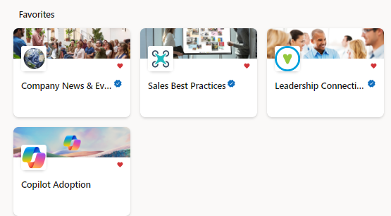
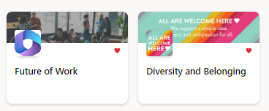
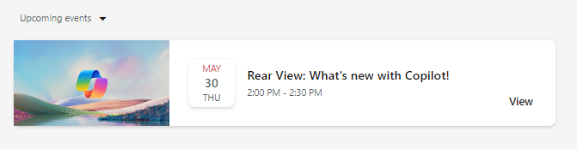
Build your Community of Practice
Connect and empower employees
Create a community in Microsoft Teams or other community chat tools to generate excitement, share learning, and support Copilot Champions and experts.
Give employees a place to:
Share best practices, such as prompts
Share success stories of Copilot saving time and driving productivity
Access company announcements on AI usage, direction, and mission
Facilitate peer to peer learning and Champion engagement
Get ready
Onboard & engage
Deliver impact
Extend & optimize
Notes:
NOTE: Building a Community of Practice in Viva Engage is recommended for customers already utilizing Viva Engage in their environment, but if you don’t have it, you may opt to hold this essential employee engagement in Microsoft Teams or other community chat tools.

Slide 21





Workday efficiencies with Copilot
Handout
Summarize a long PDF
Draft emails and social content
Generate
images
Learn new skills
Get answers for specific, complex questions
Turn a 20-page, jargon-filled PDF into 5 bullets using Copilot in Edge
Use it as your professional writer on call to draft emails, captions, and more
Leave behind stock images and text-only reports in favor of custom-generated images for emails, on social, and more
Ask questions tailored to your needs and interests to get consolidated key points from the internet for you
Get answers to questions that require multiple data points or a degree of analysis
Notes:
As mentioned earlier, seventy percent of employees are open to delegating some of their work to AI to lessen their workloads—and increase innovation. Employees and teams can leverage Copilot to help them complete tasks like summarizing PDFs quickly, drafting emails more efficiently, and getting answers to complex questions more with ease.
These are some of the common workday use cases we have seen. The potential to unlock productivity and unleash creative grows with Microsoft 365 Copilot.

Slide 22

Differentiating between chat experiences
Work vs. web
Handout
When signed in with your Entra ID, you’ll see a toggle at the top left of your screen.
Use Copilot to get answers from current web data
(e.g., latest news, announcements)
1
When the web toggle is selected, you’ll get GPT-4o plus web grounding plus Enterprise Data Protection – meaning your user and business data are protected and will not leak outside the organization.
Copilot’s web experience has no knowledge cut off and is ideal for finding answers to your questions, expanding your knowledge, creating images, and summarizing web pages in Edge.
2
When the work toggle is selected, you get graph grounding plus Enterprise Data Protection – which means that all your data stays inside the tenant boundary.
Copilot’s work experience is truly your personal AI assistant at work. This experience is ideal when working with meetings, emails, Microsoft 365 suite applications, and confidential work data.
Use Microsoft 365 Copilot to get answers from your internal work data
(e.g., your emails, meetings, files)
Start at copilot.microsoft.com

Slide 23
Prompt Ingredients
To get the best response, it’s important to focus on some of the key elements below when phrasing your Copilot prompts.
Goal
Context
What response do you want from Copilot?
Why do you need it and who is involved?
Generate 3-5 bullet points to prepare me for a meeting with Client X to discuss their “Phase 3+” brand campaign. Focus on Email and Teams chats since June. Please use simple language so I can get up to speed quickly.
Which information sources or samples should Copilot use?
How should Copilot respond
to best meet your expectations?
Source
Expectations
Notes:
Second, become familiar with the 4 ingredients that make up a successful prompt.
Your prompt should include a goal – what is it you ultimately want Copilot from Copilot?
Context – What’s the reason for needing this output, and who else might be involved
Source – Is there any reference material, like an existing deck or document that Copilot should refer to?
Finally expectations on how Copilot should best meet your expecations

Slide 24






Top 10 to "Try First"
Handout
with Microsoft 365 Copilot
Foundational skills for new users
1
2
3
4
5
Recap a meeting
– let Copilot keep track of key topics and action items so you can stay focused during the meeting and avoid listening to the recording after.
Summarize an
email thread
– get quickly caught up to a long, complex email thread.
Draft email
– personalize the tone and length.
Summarize a document
– get right down to business by summarizing long documents and focusing
on the relevant sections.
Tell me about a topic/project
– provide insights and analysis from across multiple sources to get up to speed quickly.
Draft an email to [name] that informs them that Project X is delayed two weeks. Make it short and casual in tone.
Draft an email with notes and action items from meeting
Click on the Summarize icon
Give me a bulleted list of key points from file
Tell me what's new about topic organized by emails, chats, and files?
6
7
8
9
10
Give me some ideas for …
– boost your creativity with ideas for your work such as agendas, product names, social media posts, etc.
Help me write …
– jumpstart creativity and write and edit like a pro by getting a first draft in seconds.
What did they say …
– when you vaguely remember someone mentioning a topic, have Copilot do the research.
Revise this content
– when you’ve got a rough draft of an idea, turn it into usable text and then vary the length and tone.
Translate a message
– with business becoming increasingly international, it’s important to be able to read or write messages in other languages.
Suggest 10 compelling taglines based on file
Generate three ways to say [x]
What did person say about topic
Rewrite with Copilot
Translate the following text into French:
For more prompts, visit the Prompt Gallery at: https://copilot.cloud.microsoft/prompts

Slide 25
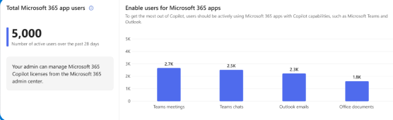
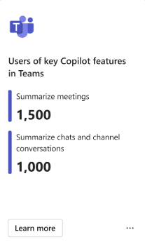
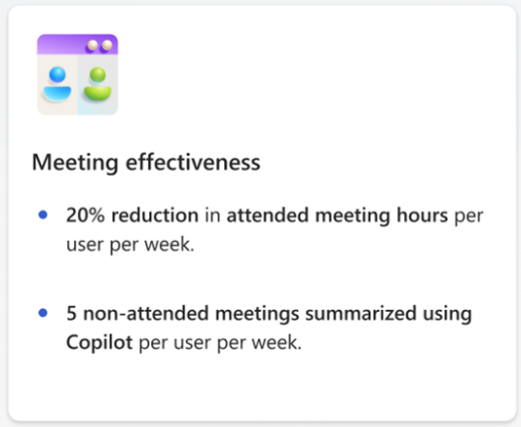
Deliver impact: Analyze usage reports
Shared activity
  Interpret the Microsoft Copilot Dashboard data
  In the Readiness tab, you assess your organization’s overall readiness for Copilot rollout based on technical eligibility requirements and overall Microsoft 365 app usage.
  In the Adoption tab, you track user adoption trends per Microsoft 365 app and understand how employees are using Copilot features.
  In the Impact tab, you gain visibility into total Copilot assisted hours, time savings and behavioral changes between active Copilot users and non-Copilot users.
  The Learning tab provides information research around the impacts of AI on workplace productivity.
Readiness
  Instruct users to access the Copilot Dashboard in Teams or web app
  to analyze the tabs
  Analyze Readiness, Adoption, and Impact tabs
  Follow the instructions on the Impact tab under Sentiment section to deliver a survey to users
  Upload the survey results through the Microsoft 365 admin center to have them displayed in the Microsoft Copilot Dashboard
  Analyze insights on how users feel about the AI assistance they receive from Copilot
Adoption
Impact

Slide 26
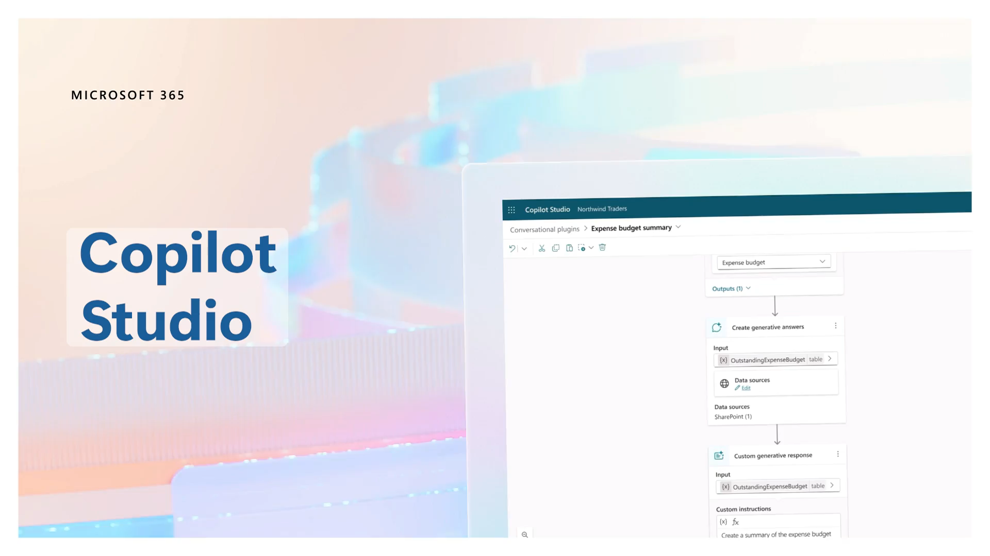
Extend & optimize: Design, build, and deploy custom agents
Shared activity
  Design and build custom agents
  To enhance the Microsoft 365 Copilot experience and cater to specific business requirements, you can create agents through connectors and plugins. Microsoft 365 Copilot Studio allows you to customize Copilot to work the way you need:
  Quickly and easily create your own conversational agents for customers or employees with an intuitive low-code tool
  Connect Copilot to your data in CRM, ERP, HCM, and more using 1,000+ Copilot connectors
  Ground Copilot in your business data by enabling pre-built agents from the store
  Configure Copilot responses to specific questions on topics like compliance, HR policies and more
  Determine the path forward for extensibility with our decision guide
  Try Teams toolkit with Teams AI Library at aka.ms/TryTeamsToolkit
  Don't miss a thing! Express your interest to receive an alert when extending Microsoft 365 Copilot with custom agents built with Microsoft Copilot Studio is in Public Preview and try it out yourself. Sign up here: aka.ms/TryCopilotAgents
  To learn more, go to Extend Microsoft Microsoft 365 Copilot | Microsoft Learn

Slide 27
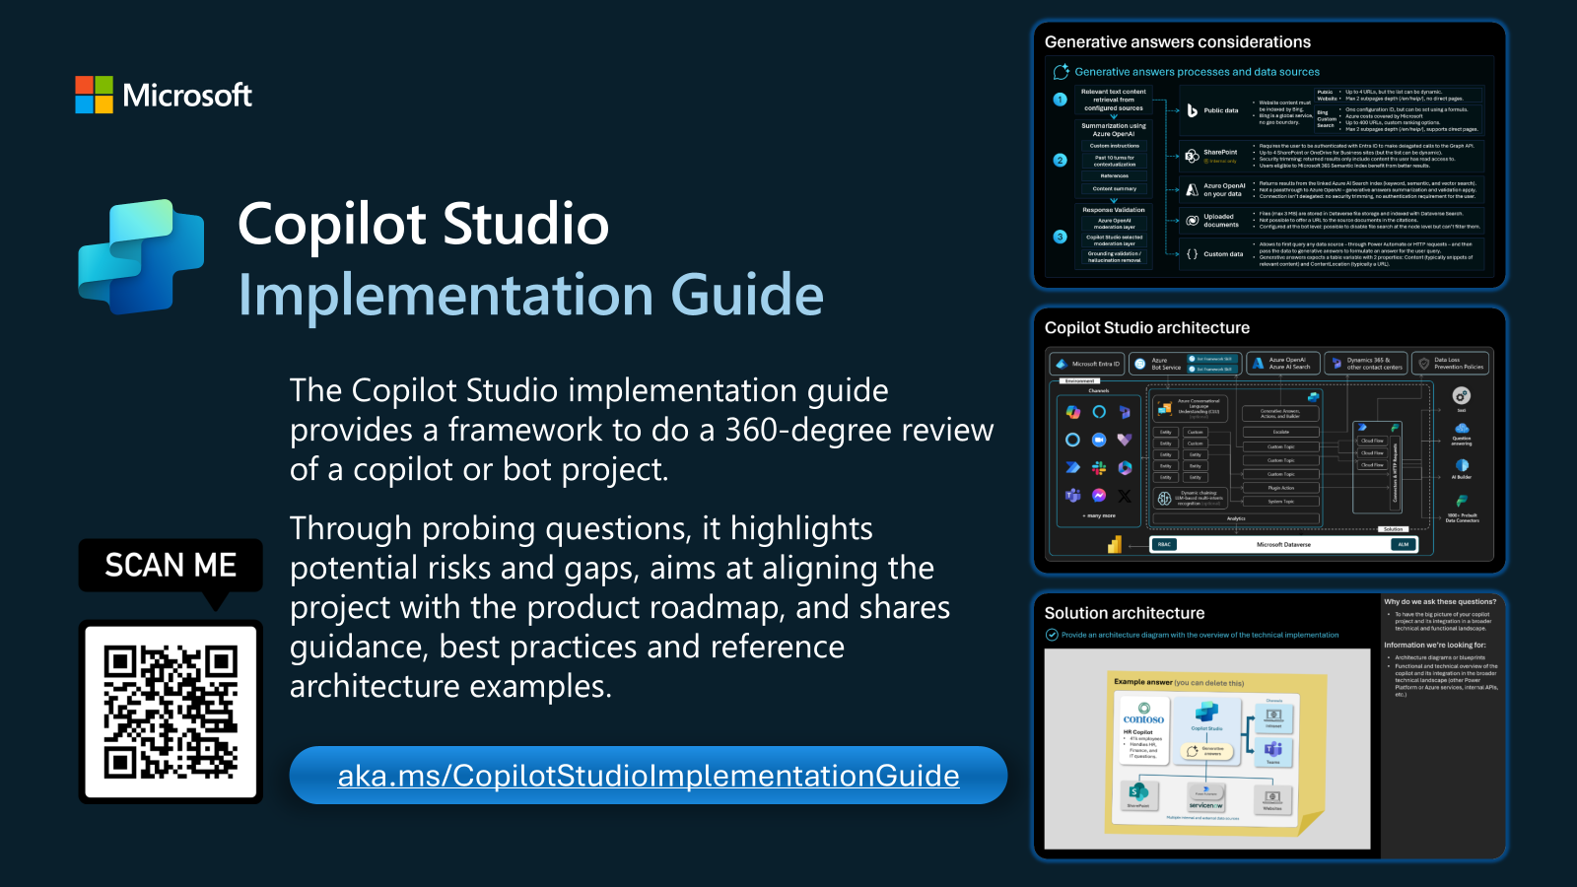
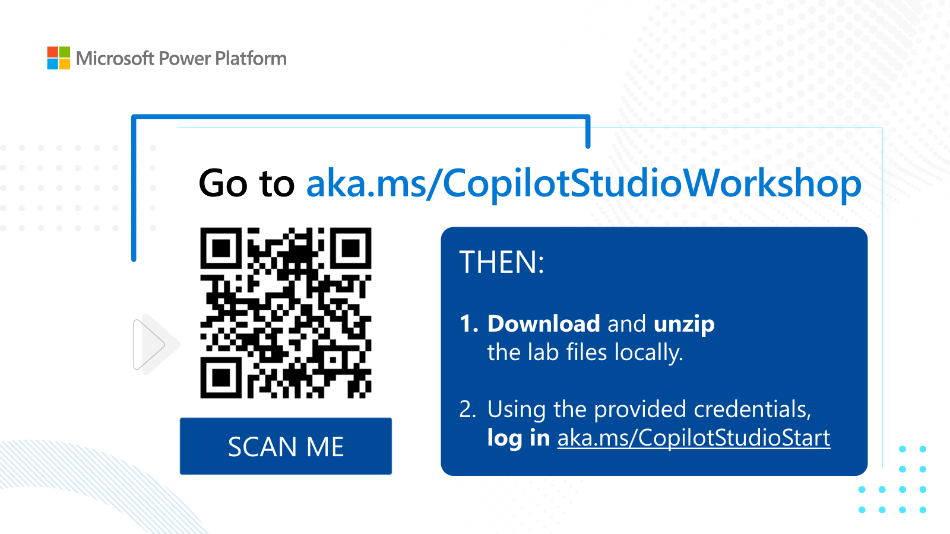
Extend & optimize: Build your own agents
  Copilot Studio
  Copilot Studio in a Day
  ½ day to 1 (one)-day hands-on workshop for subject matter experts and business users, covering the breadth of Microsoft Copilot Studio.
  The goal is for customers to:
  Have enough experience with the product to be able to understand the value and features currently in preview and how they could begin to use it
  Understand how Copilot Studio differentiates from the competition and become Copilot Studio advocates in their organization
  Know what the next steps are to learn more about Copilot Studio and become part of the community
  To develop your own copilot for high-value scenarios
  The latest workshop materials are published on GitHub at aka.ms/CopilotStudioWorkshop
  Access the learning path at aka.ms/CopilotStudioTraining
  Sign up and attend Copilot Studio in a day events at aka.ms/CopilotStudioInADay
  Check for latest content on Microsoft Power Platform Partner Hub

Slide 28
Security and compliance add-ons available for Business Premium
Microsoft 365 Business Premium meets the security and compliance needs for most SMBs when using Microsoft 365 Copilot. For those needing extra protection, additional add-ons can be purchased with a Business Premium license.
Information Protection
and Governance ($7pupm)
Insider Risk Management
($6pupm)
*Microsoft Defender for Cloud Apps assists in discovering SaaS apps and protects users from accessing risky ones
Insider risk management a helps minimize internal risks by responding to malicious activities
Communications DLP (Teams chat) blocks sensitive content when shared with Teams users
Communication compliance helps detect business code of conduct violations
Endpoint DLP a prevents data leaks of sensitive items stored on Windows 10/11 and macOS devices
Automatic sensitivity labels (client side) automatically discovers, classifies, labels, and protects sensitive data
eDiscovery and Audit
($6pupm)
Machine learning-based sensitivity labels uses trainable classifiers to identify items and assign labels
Records management helps manage legal obligations for businesses
eDiscovery (premium) end-to-end workflow for managing eDiscovery cases and investigations
Advanced message encryption helps to control sensitive emails shared outside the organization
Audit (premium) featuring longer record retention and intelligent insights policies
*Can be purchased as a standalone product
Note: This may not reflect the full set of features available in these packages. The features identified above are highly relevant when using Copilot for M365.
Notes:
While Business Premium provides data security controls suitable for most SMBs, we understand that some may require additional security to comply with strict regulations. If that is the case for your business, we identified three available add-ons for Business Premium to better meet your security requirements
Information Protect and Governance (IPG): This add-on, priced at $7pupm, includes additional capabilities like Microsoft Defender for Cloud Apps that helps you better understand the usage of AI apps across your environment and protect users from accessing risky apps. This product can also be purchased as a standalone for $3.50pupm. IPG also includes Data Loss Prevention (DLP) across Teams chat and endpoints, enhanced sensitivity labeling capabilities that automatically apply labels and use trainable classifiers to identify items and apply labels. Records Management provides features to help manage businesses legal obligations and Advanced Message Encryption adds an additional layer of security to have more control over sensitive emails shared outside your business.
eDiscovery and Audit: This add-on, priced at $6pupm, includes premium eDiscovery and Audit features that build on the existing capability in Business Premium. With this you have more robust and end-to-end workflow for managing eDiscovery cases and investigations and can get longer record retention and intelligent insight policies for audit logs.
Insider Risk Management: This add-on, priced at $6pupm, helps manages internal risks by responding to malicious activities and proactively detect business code of conduct violations.
The features listed under each available add-on are most directly relevant when using Copilot, but these do not reflect the entirety of the capabilities included in these add-ons.
These past two slides provide a high-level overview of the controls existing within M365 for Business and the add-ons available, but there are additional features and controls available with Office/Microsoft 365 Copilot.

Slide 29

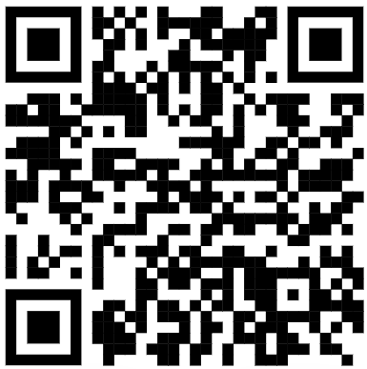
Copilot and Microsoft 365 SMB Community
The Copilot and Microsoft 365 SMB Community is for small and medium business members will get exclusive and direct access to Microsoft product teams.
Members' feedback will contribute to the prioritization of our engineering efforts this upcoming fiscal year
Attend our monthly calls, where we will share tips and tricks to help accelerate your business
Members are nominated to exclusive NDA insider programs within Microsoft and invited to experience features before they’re released to the public
Visit https://aka.ms/SMBCommunitySignUp or scan the QR code to
join the Copilot and Microsoft 365 SMB Community.

Slide 30
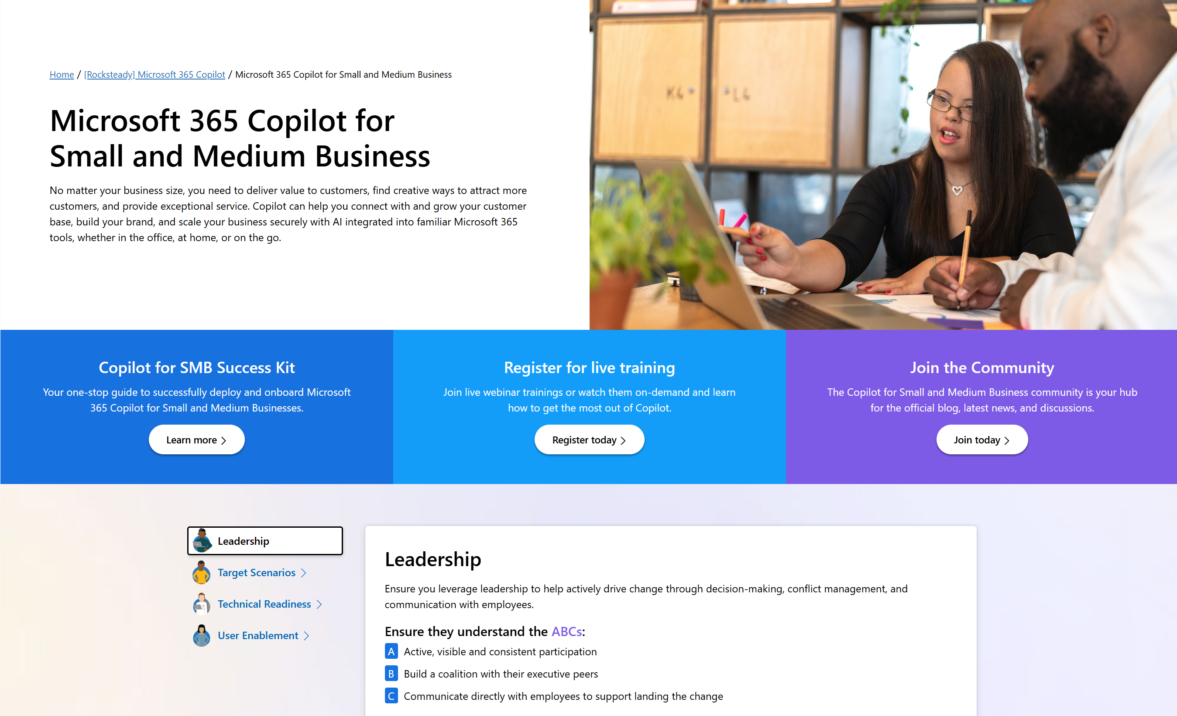
Copilot for Small and Medium Business resources on Microsoft Adoption
One site for all your Copilot needs
https://adoption.microsoft.com/copilot/smb
Resources by role
Product announcements and news
Links to all other Microsoft sites
Extended links for Microsoft Teams for SMB, Microsoft Viva, and more
Notes:
Provides resources by role/area, such as leader, user enablement, and technical readiness, to help them deploy, use, and scale Copilot for their needs.

