Slide 1
Copilot agents IT set up and controls
Sept 2025

Slide 2
Contents
1
Introduction to Copilot
2
Agents in Copilot
3
Agent management controls
4
Usage and value reports
5
FAQ

Slide 3
Introduction to Microsoft 365 Copilot

Slide 4

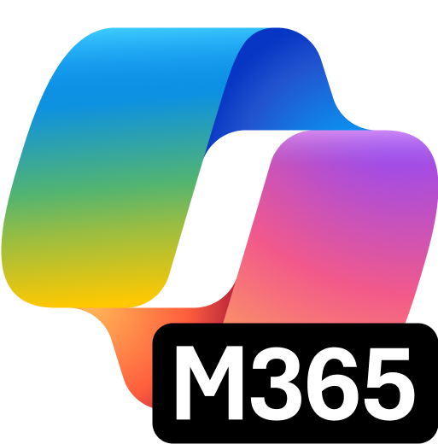
Copilot Control System
Copilot
Agents
Notes:
Just a few months ago, we introduced our vision and strategy for Copilot + Agents:
It all starts with people and human ingenuity.
We envision every employee having a Copilot – their trusted AI assistant. Copilot understands you and your work context, and it provides a consistent user experience to interact with AI.
Agents augment Copilot by adding skills and knowledge to automate tasks and business processes.
Just like everyone today has a smart phone with many apps, we envision of world in which everyone will have a Copilot with many Agents.

Slide 5
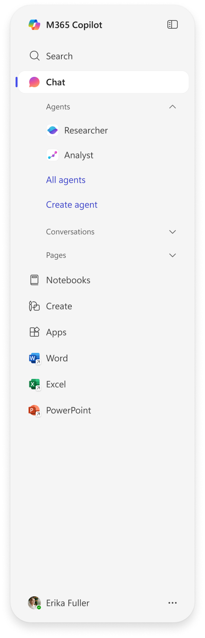

5 in 1 AI capabilities with Microsoft 365 Copilot
2
1
3
1
2
3
Chat
Search
Agents
Secure AI chat powered by the latest models available and grounded in web and work data.
AI-powered search that spans all your work data for fast and relevant results.
A broad ecosystem of pre-built agents available in the Agent Store and build your own agents in Copilot Studio.
4
5
4
5
Notebooks
Create
Copilot is grounded in your project’s diverse content types to provide targeted responses and engaging audio overviews.
AI-generated images, posters, banners, videos, and more that are aligned to your organization’s brand identity.
Notes:
Customers
Chat is the default experience, and it has significant updates including better quality and performance, as well as UX improvements and interactive charts. Copilot learns how you work and understands your needs and preferences through your chats, job profile, custom instructions, and more. Memory and personalization are private just to you, and if you’re ever working with sensitive information, you can control what Copilot remembers.
Copilot Search is an AI-powered enterprise search that helps you find what you need instantly with rich, context-aware answers from across your organization’s apps and data. It connects to first- and third-party apps—from ServiceNow to Google Drive, Confluence, Jira, and more—so you get fast, relevant results at work no matter where your data lives.
Agents are integrated into the app, including agents that come pre-built with Microsoft 365 Copilot along with a new Agent Store to discover agents from your organization and 3rd party agents.
Reasoning Work Agents like Analyst and Researcher, are pre-built agents where we customized advanced research models so they are optimized for specific work tasks and are similar to on-demand virtual employees
Studio is the copilot agent platform, enabling IT and users to create custom agents, offering tailored workflows, data integration, and conversational experiences which can boost productivity, automation, and user engagement.
Notebooks enables unified collaboration and content across Microsoft 365 with AI-powered assistance, real-time updates, and persistent chat to help avoid duplicative efforts and keep teams aligned,
Create module based on 4.o image generation, users can create high quality images, posters, banners, and even videos.
Previously, customers had to purchase the different capabilities from different AI vendors. We’ve brought them altogether into a single app providing that consistent UI for AI.

Slide 6
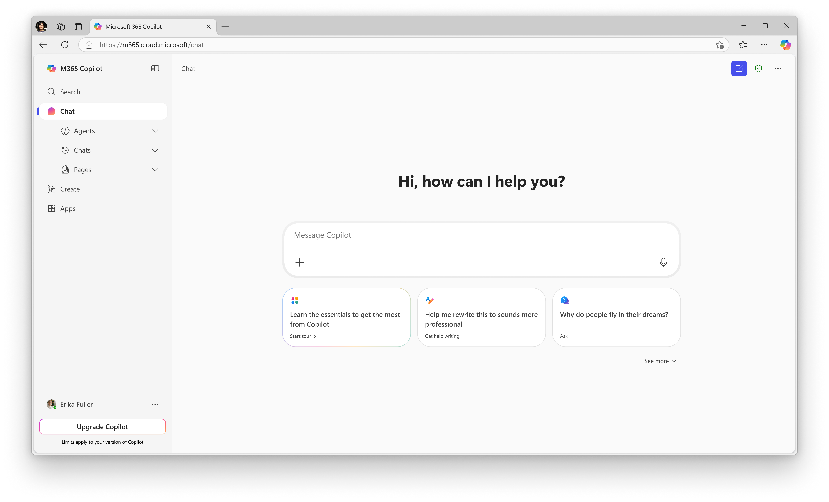
Get to know Copilot Chat
Start a new chat button
Clear your past chat and start a new conversation.
Agents
Use existing agents or create new ones
Prompt box
Start your conversation here
Chat history
View your past conversations
Dictation
Use dictation if you prefer to speak rather than type when you’re chatting with Copilot (coming soon)
Add content and agents
Expand to upload files, images or add an agent to chat
Suggested prompts
Get started with prompt suggestions
Copilot Prompt Gallery
Expand the suggested prompts to view the full Copilot Prompt Gallery, including saved prompts and prompts from your team

Slide 7
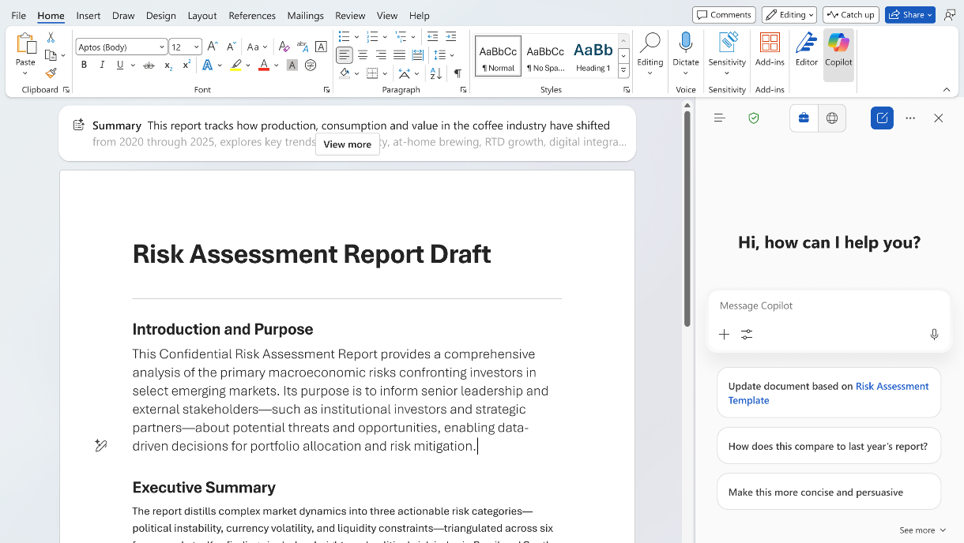

Copilot Chat in Microsoft 365 apps
Work data access
Use a secure chat with web & work data. Reason over open files and command with advanced app skills. Built-in access to agents and advanced reasoning AI like Researcher & Analyst across select Microsoft 365 apps.
Access reasoning agents
In-app editing
Work data prompts
Notes:
Use a secure chat with web &work data. Reason over open filesand command with advancedapp skills. Built-in access toagents, and priority access toadvanced reasoning AI likeResearcher & Analyst acrossselect Microsoft 365 apps.

Slide 8
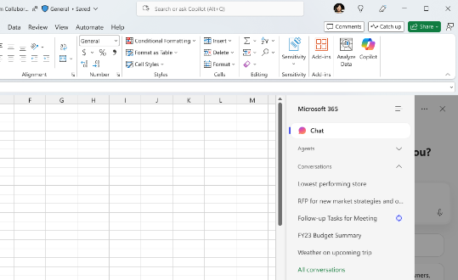
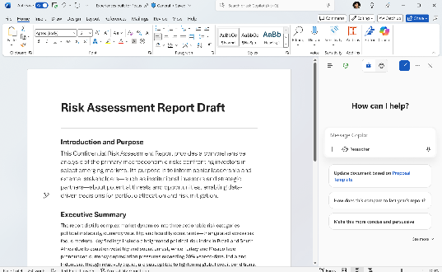
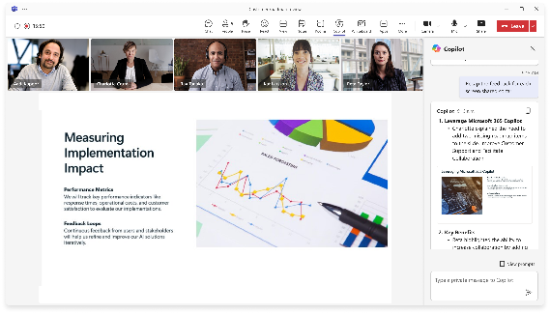
Copilot in Microsoft 365 Apps and Teams
Persistent conversations
Reason over content
Specialized AI functions
A unified Copilot Chat experience integrated in Teams and Microsoft 365 apps with conversations that follow you as you work.
Ask Copilot questions about
open files and invoke agents with specialized skills for faster, better results without leaving the app.
In-app editing and app specific skills perform specialized tasks within Teams, Outlook,
Word, Excel, PowerPoint and
other Microsoft 365 apps.
Notes:
We’re also bringing Copilot Chat into Microsoft 365 productivity apps. This provides a unified Copilot Chat experience across Microsoft 365, with the ability to reason over open files and persistent conversations that follow the user across applications. Copilot Chat is embedded in Word, Excel, and PowerPoint, users access to AI assistance without disrupting their workflow, which can enhance productivity and simplify everyday tasks.
Copilot licensed users also have access to the advanced Microsoft 365 Copilot capabilities.
Whether that’s drafting a whitepaper in Word ​
Analyzing data for you in Excel ​
Creating a presentation in .ppt ​
Summarizing emails in Outlook ​
Or transcribing meetings in Teams and sending meeting recaps ​
​
We continue to add new capabilities to Copilot in the Microsoft 365 apps. Let’s look at a few examples...

Slide 9
Agents in Copilot

Slide 10
Agents run on a secure and trusted platform
Data security
Access & cost controls
Measurement & reporting
Leverage sensitivity label inheritance and
data loss prevention policies
Control agent lifecycle, availability
and access
View core usage telemetry and track license utilization
Intelligent grounding
respects your permissions
and security controls
Control who can create and
share of agents
Track improvements in user productivity and compare impact across groups
Comprehensive visibility into user, data, and agent risks
Track and manage agent costs
and operational insights
Analyze Copilot & agents impact to business outcomes
Agent interactions stay in the Microsoft 365 and Azure Service Boundary and
your Microsoft 365 commitments and security, governance, compliance, and privacy policies apply

Slide 11
Spectrum of agents
Simple
Advanced
Retrieval
Retrieve information from grounding data, reason, summarize, and answer user questions
Task
Take actions when asked, automate workflows, and replace repetitive tasks
for users
Autonomous
Operate independently, dynamically plan, orchestrate other agents, learn and escalate
Generally available
Generally available
Generally Available
Agents vary in levels of complexity and capabilities depending on your need

Slide 12
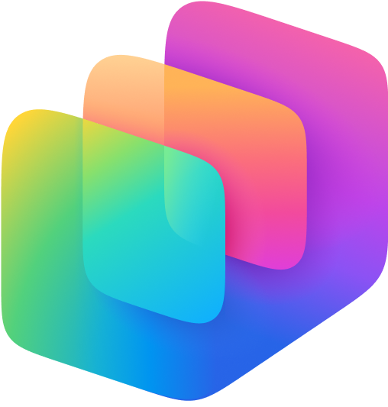

Tools to create agents
Simple
Advanced
Copilot Studio lite
Copilot Studio
Copilot Studio + Azure AI
For users
For makers
For developers
Declarative agents*
Declarative or custom-engine agents*
Custom-engine agents*
Knowledge
Microsoft Graph & connectors
Custom RAG on any data
Actions
Retrieval only
Task / autonomous
Channels
Microsoft 365 only
Multiple internal & external channels
* Declarative = prompts handled by Microsoft 365 Copilot; Custom-engine = prompts handled by custom AI engine (i.e., orchestrator and foundation models)

Slide 13
Agent management controls

Slide 14
Agent access and cost controls
Tenant-wide distribution & access, including 3P agents
Controls for user and maker created agents in the tenant
IT managed
Copilot Studio lite
Copilot Studio
SharePoint
Microsoft 365 admin center
Control agent creation* -
Microsoft 365 admin center
Assign M365 Copilot license
Power Platform admin center
Configure pay-as-you-go plan or prepaid message capacity
Microsoft 365 admin center
Assign Copilot Studio license
Power Platform admin center
Control access to Copilot Studio based on Security Groups
Microsoft 365 admin center
Assign M365 Copilot license
Microsoft 365 admin center
Configure pay-as-you-go plan or prepaid message capacity
Creation
Microsoft 365 admin center
Pin Copilot Chat
Control availability of agents* -enable or disable agents, deploy or remove individual agents
Microsoft 365 admin center
See IT managed options
Microsoft 365 admin center
See IT managed options
SharePoint Online
Use file permissions on the agent file to control who can access
Use
Microsoft 365 admin center
Control agent sharing* -
Power Platform admin center
Use “Manage sharing” to limit how broadly agents can be shared
Power Platform admin center
Use “Manage sharing” to limit how broadly agents can be shared
SharePoint Advanced Management
Restricted access control
Sharing
Costs
Azure portal
Control and track costs
Power Platform admin center
Manage and track costs
Power Platform admin center
Manage and track costs
Azure portal
Control and track costs
* Applies to Copilot Studio lite and Copilot Studio

Slide 15
Pin Copilot Chat to
Microsoft 365 apps

Slide 16
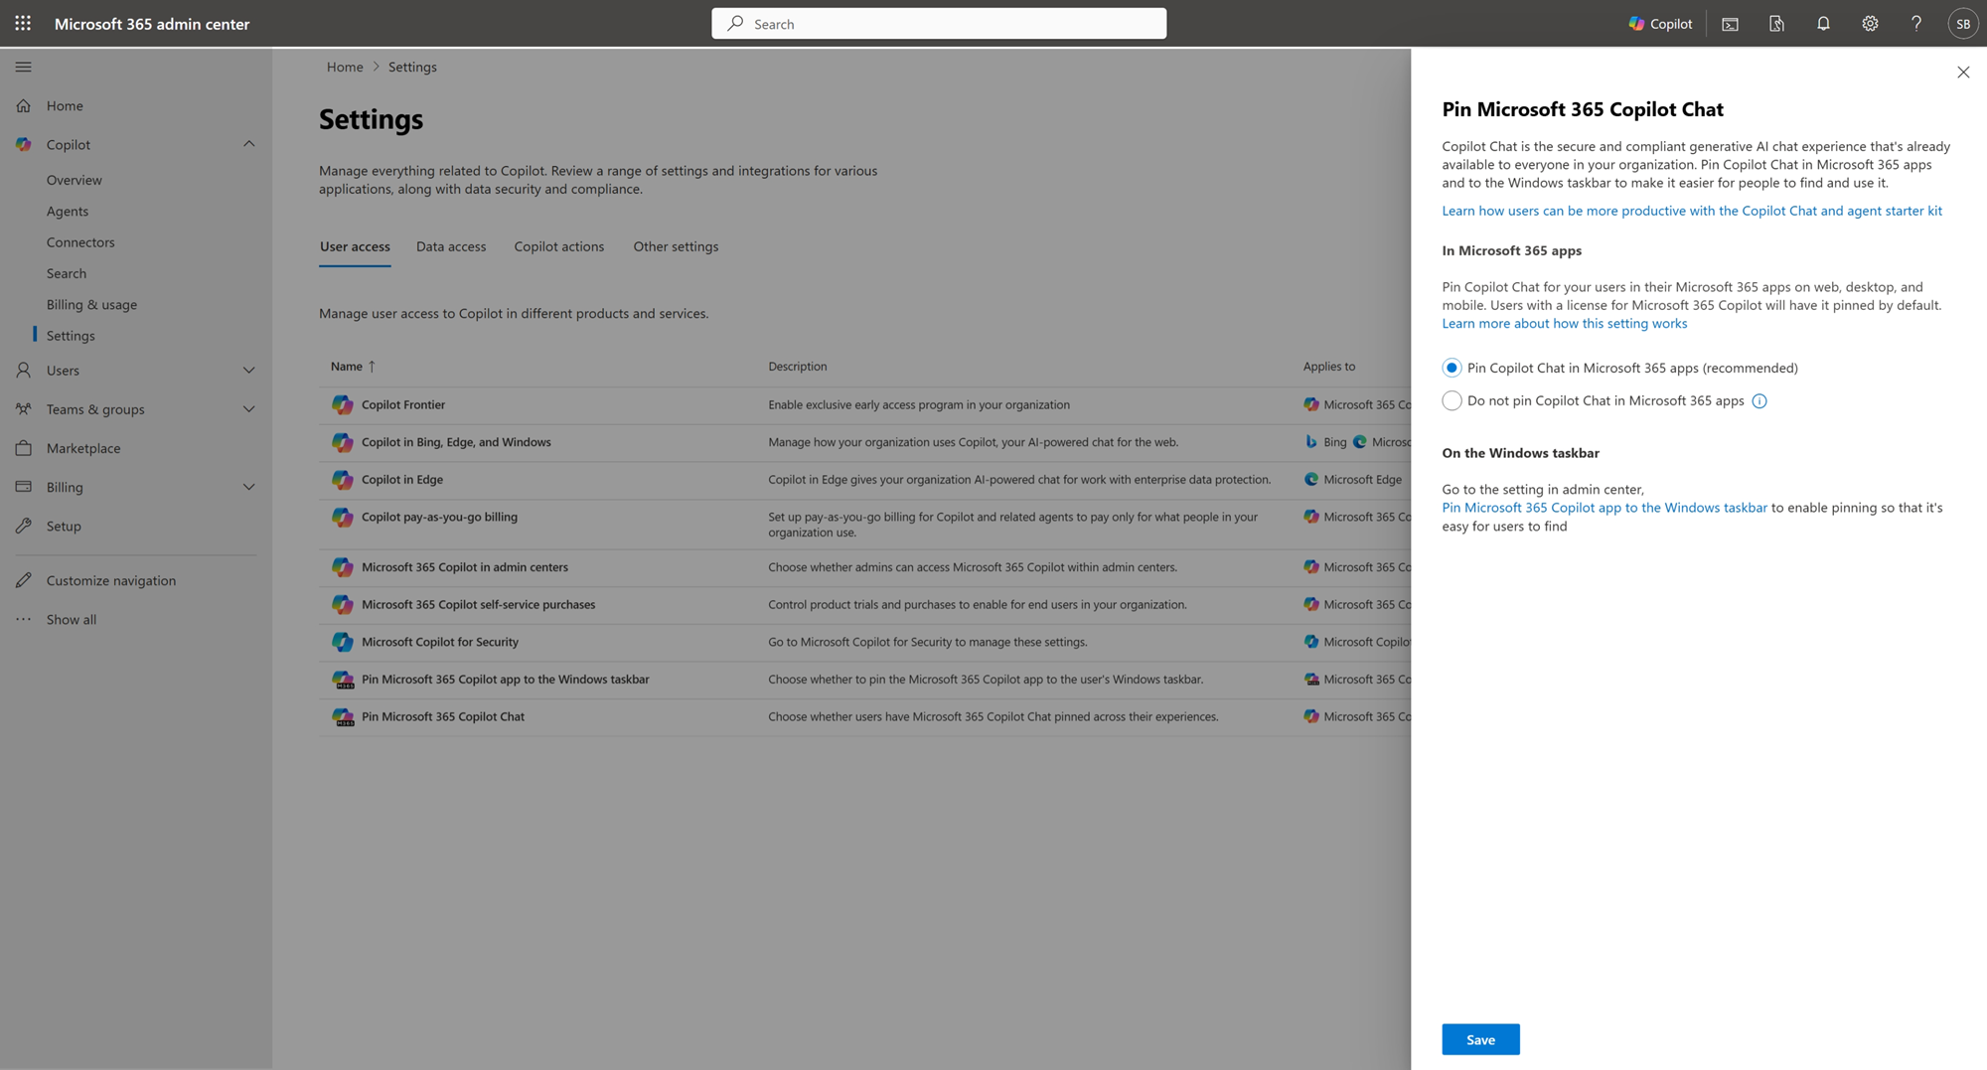
Pin Copilot Chat in Microsoft 365 apps
Pin Microsoft 365 Copilot Chat
Microsoft 365 admin center
Enable access to Copilot Chat from Microsoft 365 apps like Outlook, Teams, Word, Excel, PowerPoint and more.
Pinning Copilot Chat ensures it is always visible in the navigation bar and ribbon, allowing everyone to instantly access context-aware AI capabilities without switching apps.
As a global administrators or AI administrator, you can access this setting in the Microsoft 365 admin center by navigating to
Copilot > Settings > User access > Pin Microsoft 365 Copilot Chat.
Select Pin Microsoft Copilot (recommended by Microsoft).
Optionally, pin Copilot Chat for specific groups or users in the Microsoft 365 Apps admin center

Slide 17
Manage agents

Slide 18
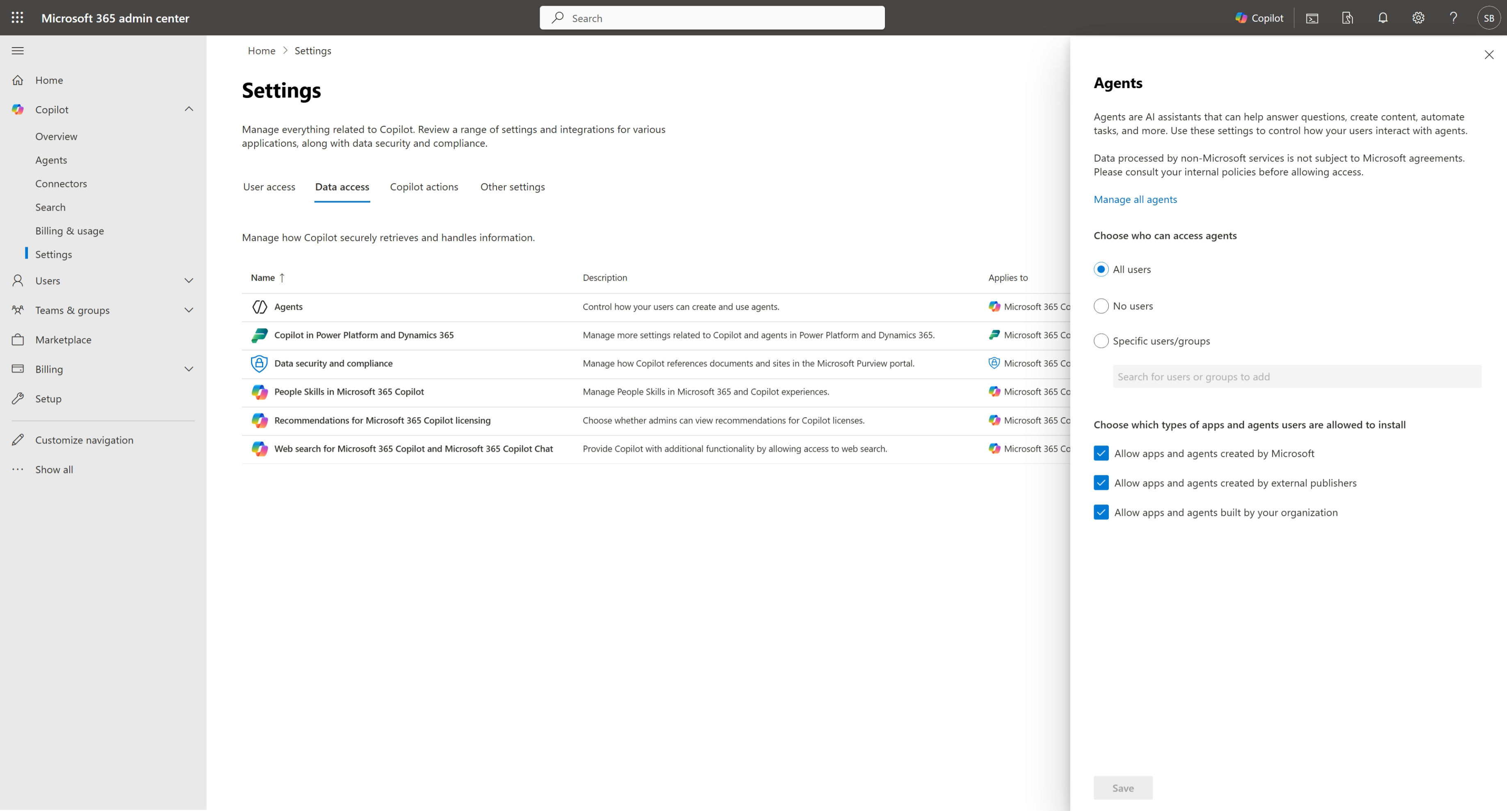
Manage who can create and use agents
Control how your users can create and use agents in M365 Copilot
Microsoft 365 admin center
AI admins can manage who can create and use agents* in M365 Copilot Chat
Options to enable agents for all users, no users, or specific users and groups
Enable agents by type e.g. created by Microsoft, external publishers, built by your organization
As a global administrators or AI administrator, you can access this setting in the Microsoft 365 admin center by navigating to
Copilot > Settings > User access > Pin Microsoft 365 Copilot Chat.
Select Pin Microsoft Copilot (recommended by Microsoft).
*This control doesn’t govern SharePoint agents

Slide 19
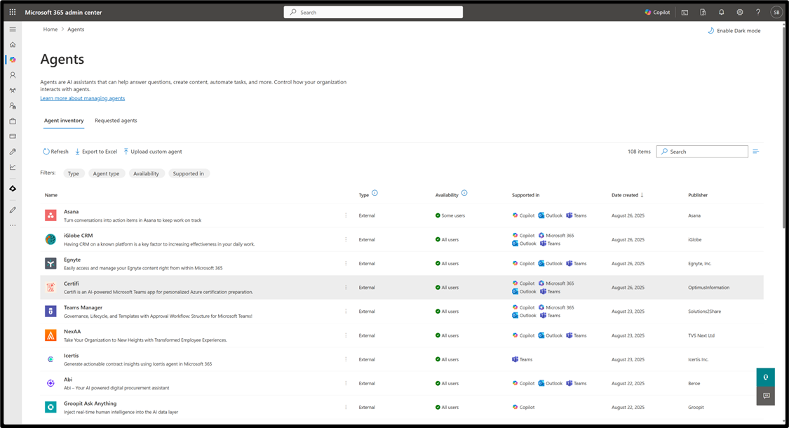
Central management of agents in Microsoft 365
Manage agents
Microsoft 365 admin center
Agent inventory - rich agent metadata, capabilities, data sources, custom actions, certification details and more
Deploy and block agents, review and approve requested agents
Manage per-agent user access by individual users or groups
Pin high-value agents for all users in the organization or function-specific agents for specific groups

Slide 20
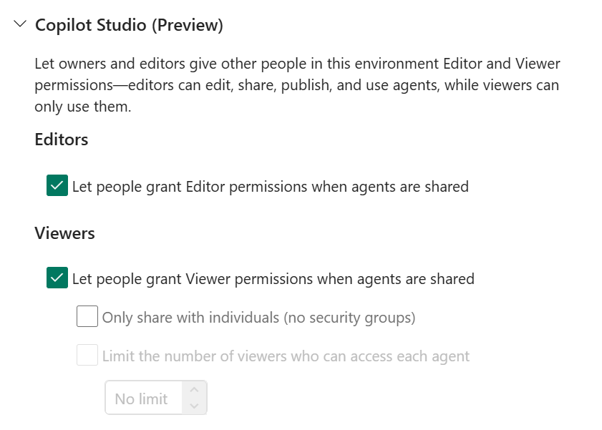
Control permissions and limit sharing
Control how agents are shared
Power Platform admin center
In Managed Environments, admins can limit how broadly users can share agents. To configure these rules, select a Managed Environment from the environments list in the Power Platform admin center. Then, select Edit Managed Environments in the command bar. The sharing rules are located in the Manage sharing section.

Slide 21
Manage access to
Copilot Studio

Slide 22
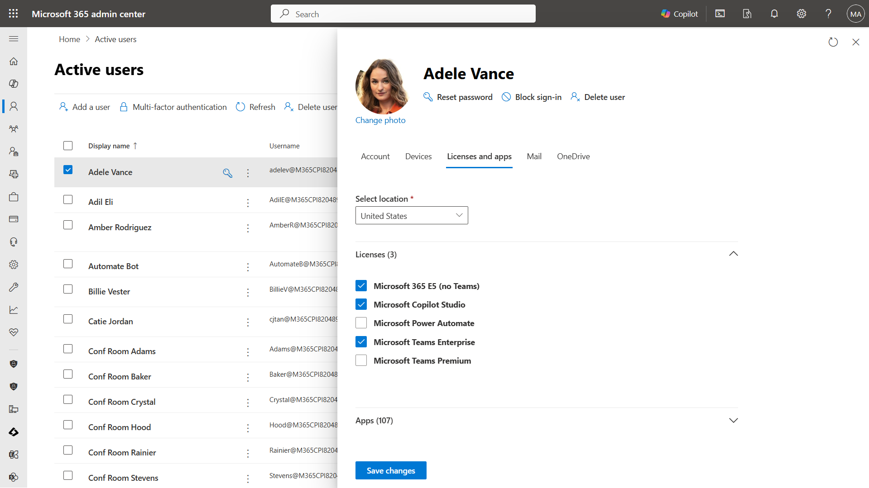
Set access permissions for Copilot Studio authors (option 1) Assign user licenses and manage access
Microsoft 365 admin center
For individual users who will need to create and manage agents, you will need:
A Copilot Studio tenant license for your organization, and
A Copilot Studio User License for individual users who need access to create and manage agents.
Copilot Studio licenses can be acquired through the Microsoft 365 admin center.

Slide 23
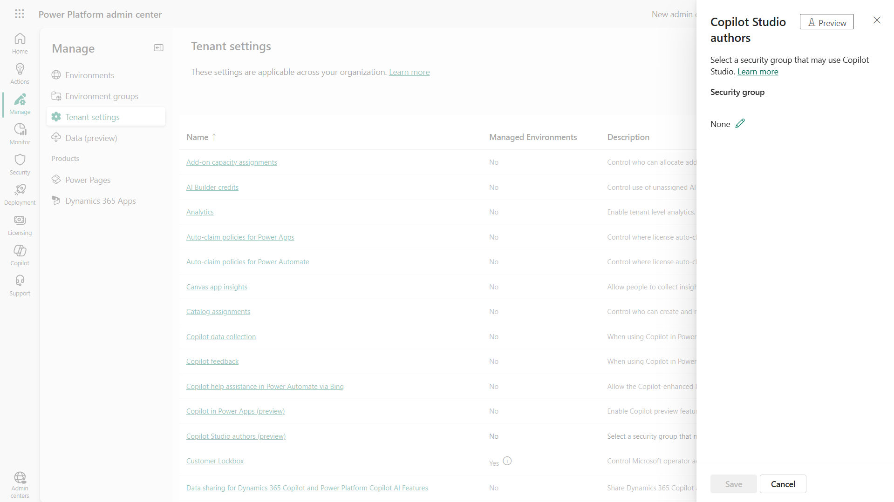
Set access permissions for Copilot Studio authors (option 2)
Power Platform admin center
In the Power Platform admin center, you can set permissions for Copilot Studio authors.
By default, all users in your Microsoft Entra tenant will have Copilot Studio authoring access.
If you need to restrict authoring access, under Manage > Tenant settings > Copilot Studio authors (preview), you can change the default permissions and choose a different Security Group.
This will restrict authoring access to only members in that group.

Slide 24
Create and manage pay-as-you-go billing plan for Copilot agents

Slide 25
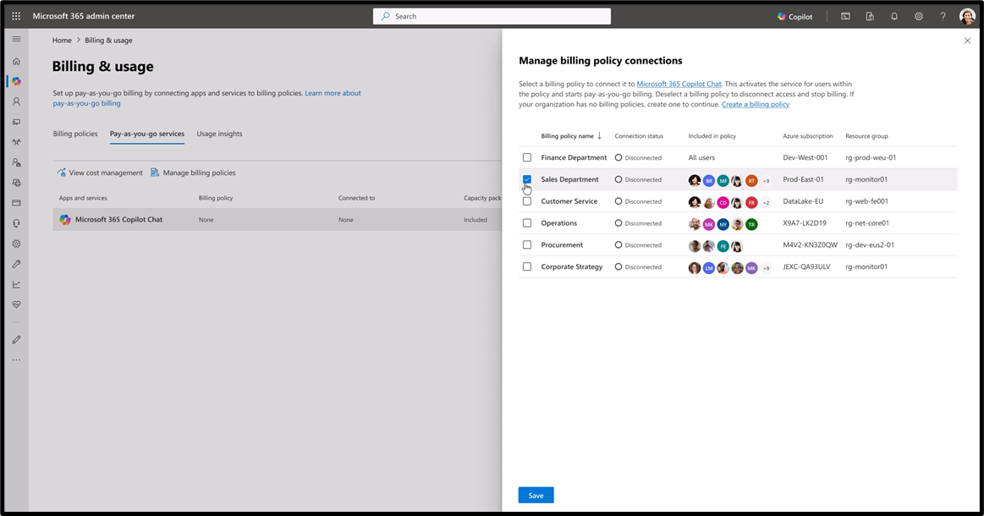
Enable pay-as-you-go billing for Microsoft 365 Copilot Chat
Microsoft 365 admin center
Create billing policies scoped to defined users and groups, and associated Azure subscription
Enables departmental billing and cross charges
Supports agent management decisions with group-level usage and cost insight

Slide 26
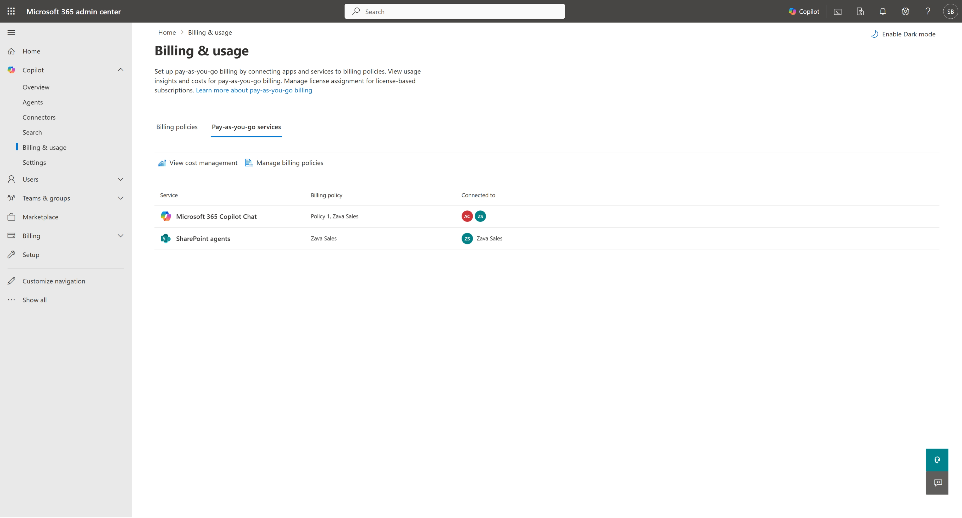
Configure Copilot agent consumption meter
Microsoft 365 admin center
After setting up pay-as-you-go billing you will see the link to the Cost Management page under the Pay-as-you-go services tab

Slide 27
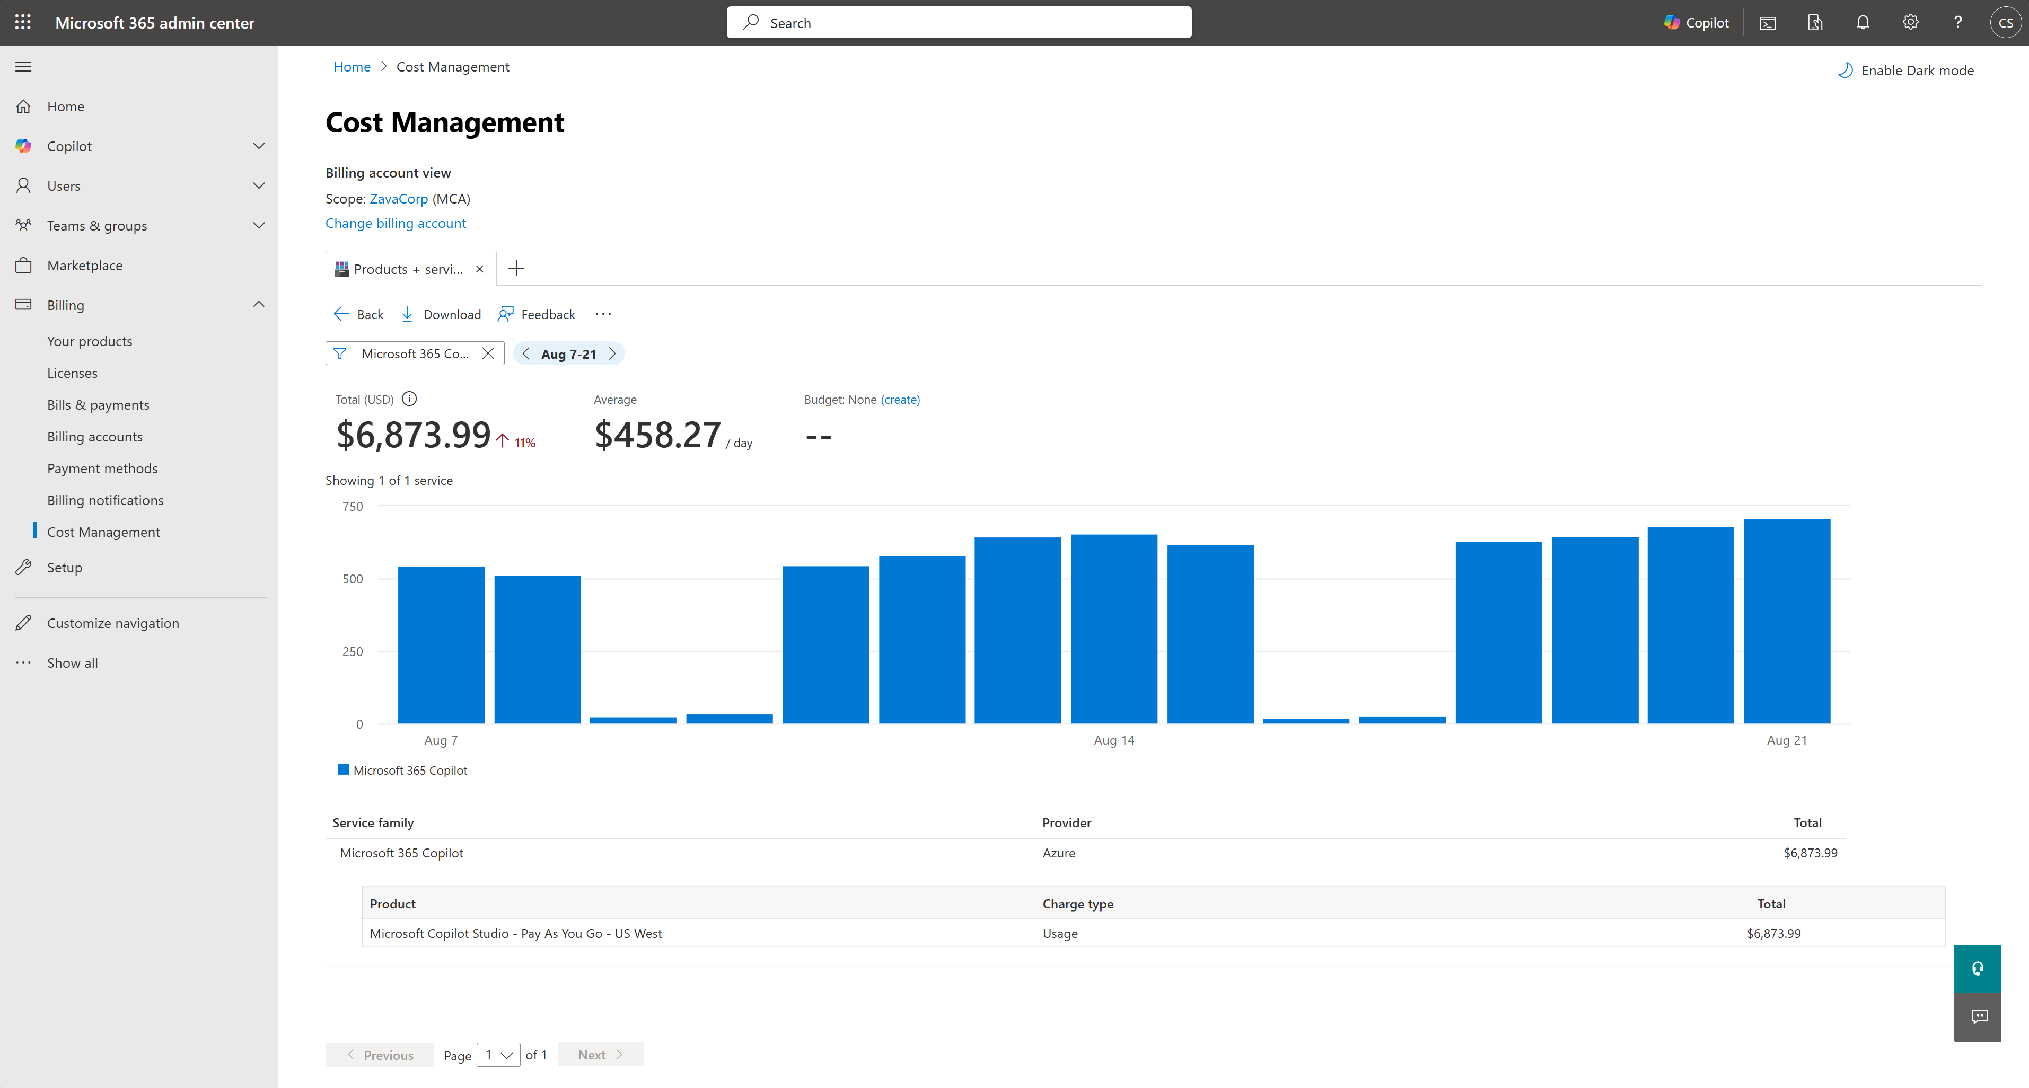
Configure Copilot agent consumption meter
Microsoft 365 admin center
Expand the Microsoft 365 Copilot section of the Cost Management tab to view Copilot Studio charges by region

Slide 28
Create pay-as-you-go billing plan for SharePoint agents

Slide 29
SharePoint agent licensing options
SharePoint agents
Microsoft 365 Copilot license
Unlimited usage of SharePoint agents
Pay-as-you-go
Pay-as-you-go with Azure subscription
for all other tenant users
https://learn.microsoft.com/sharepoint/sharepoint-agents-azure-billing

Slide 30
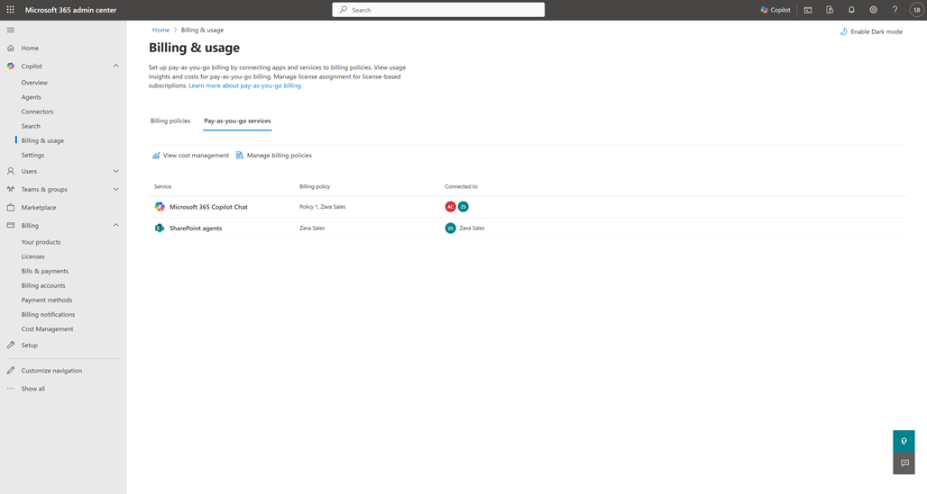
Setup PAYG for SharePoint agents in Microsoft 365 admin center
Set up SharePoint agents for pay-as-you-go billing
In the Microsoft 365 admin center:
Select Billing & usage
On the Pay-as-you-go services page, under Billing, select SharePoint agents.
Connect the billing policies for which you would like to enable SharePoint agents
Select Save.

Slide 31
Manage Copilot Studio prepaid message capacity

Slide 32
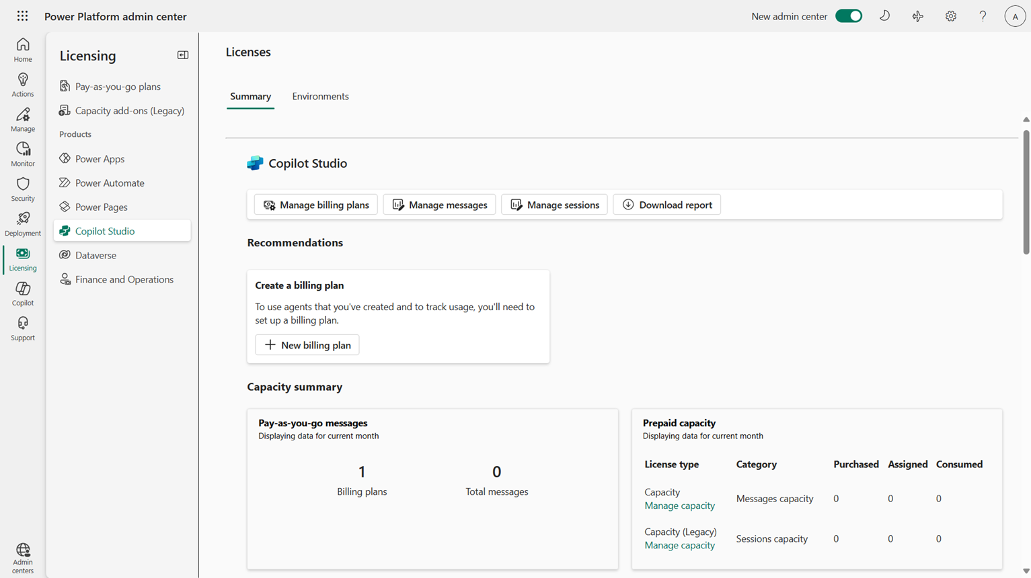

Configuring prepaid message capacity – Step 1
Manage Copilot Studio credits and capacity
Power Platform admin center
To manage prepaid message capacity:
In the Licensing pane, under Products, select Copilot Studio.
From the Summary tab, select Manage capacity from the Prepaid capacity card.

Slide 33
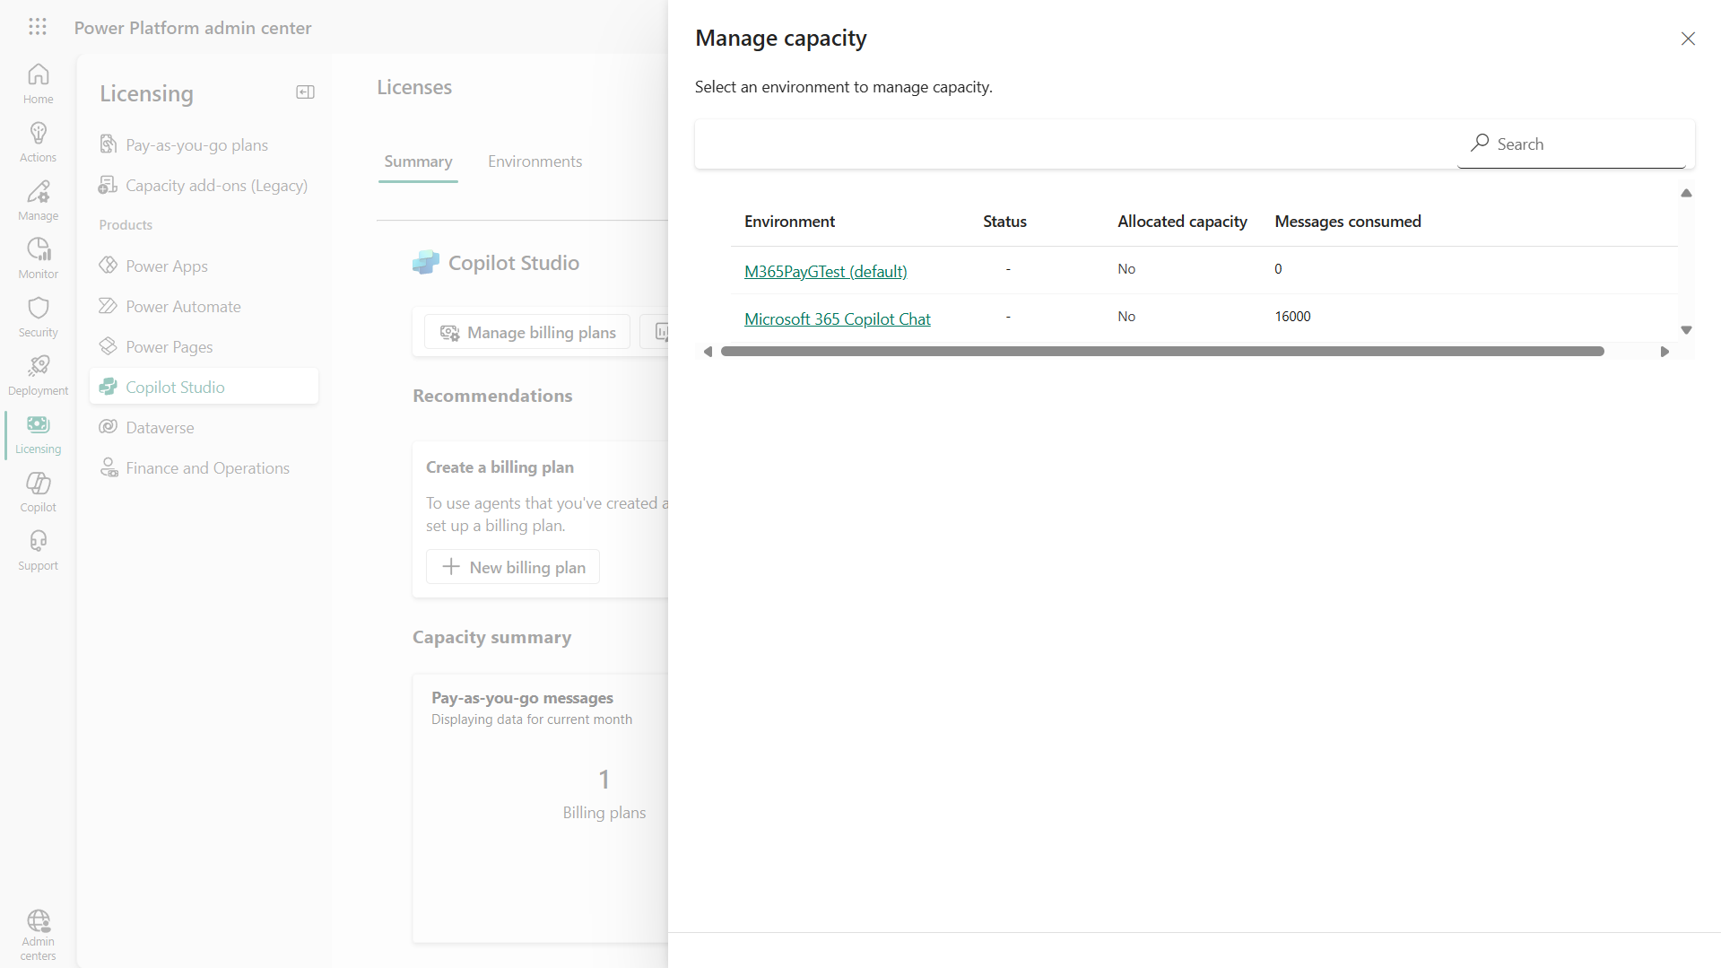
Configuring prepaid message capacity – Step 2
Power Platform admin center
Select the Microsoft 365 Copilot Chat environment.

Slide 34
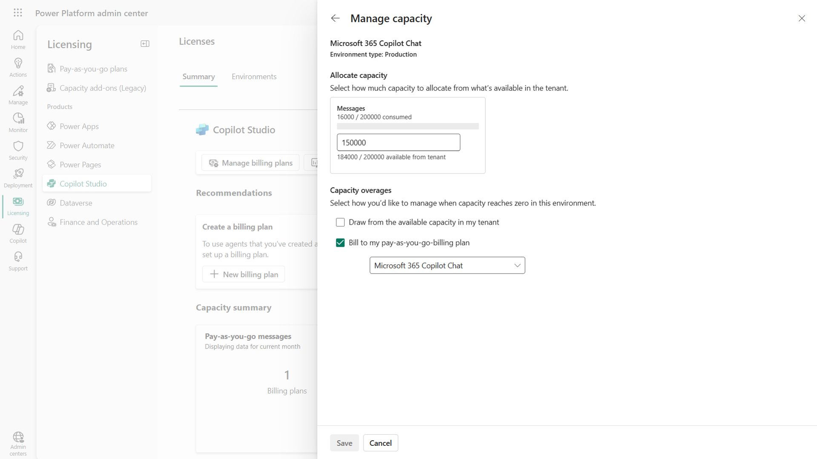
Configuring prepaid message capacity – Step 3
Power Platform admin center
Allocate the desired number of messages available for agents in Copilot Chat, configure capacity overages preferences and Save.

Slide 35
View message consumption

Slide 36
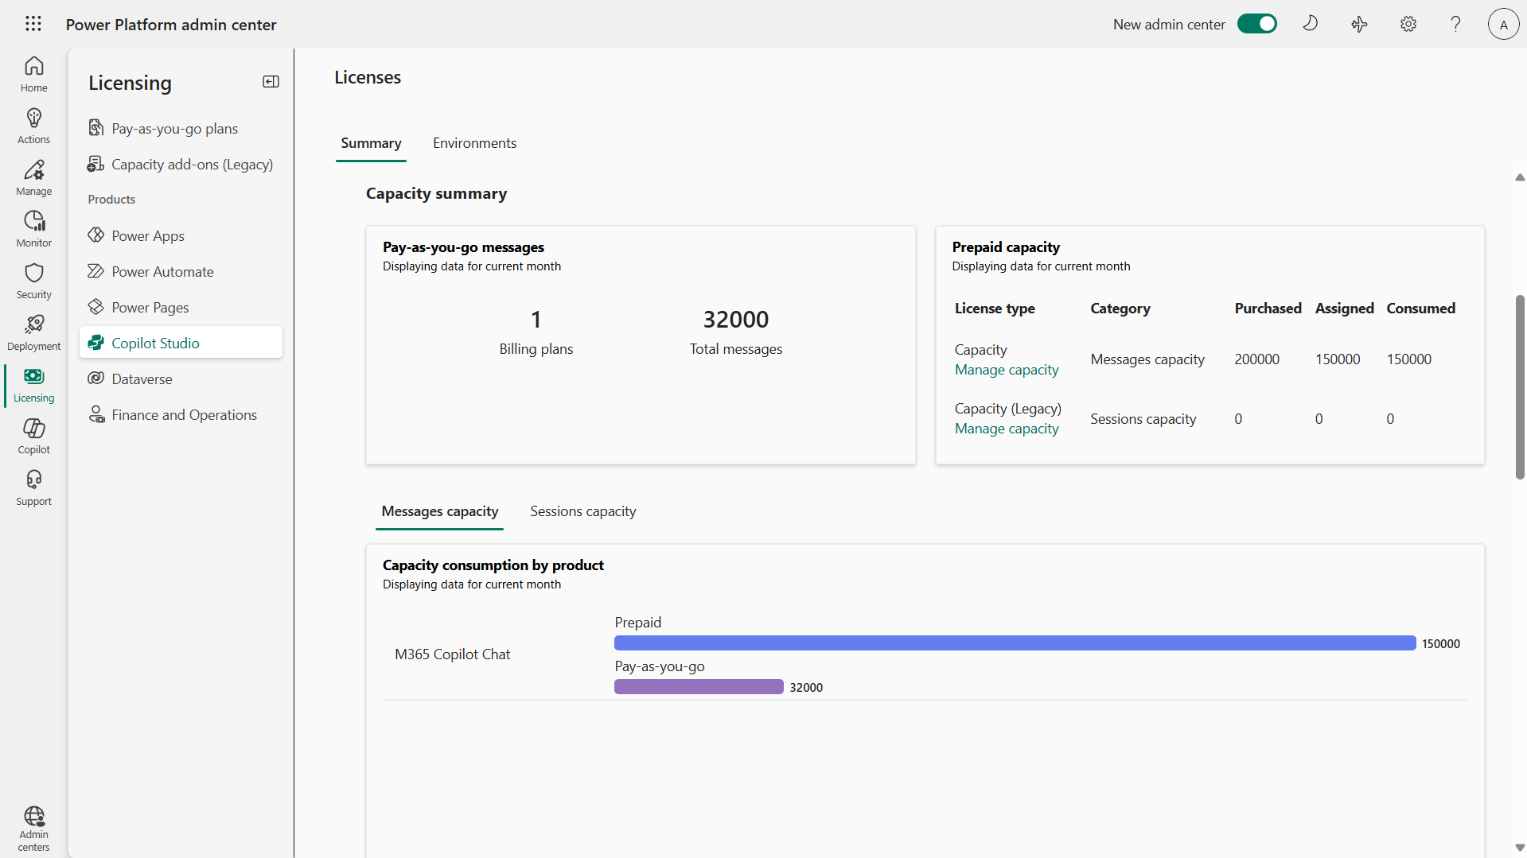
Review message capacity and consumption
Manage Copilot Studio messages and capacity
Power Platform admin center
You can monitor usage from the Licensing pane, under Products, and Copilot Studio, where you are provided with details in the Messages capacity tab for both prepaid as well as pay-as-you-go consumption for the current month.

Slide 37
Reports & analytics

Slide 38
Copilot Analytics in Microsoft 365 admin center

Slide 39
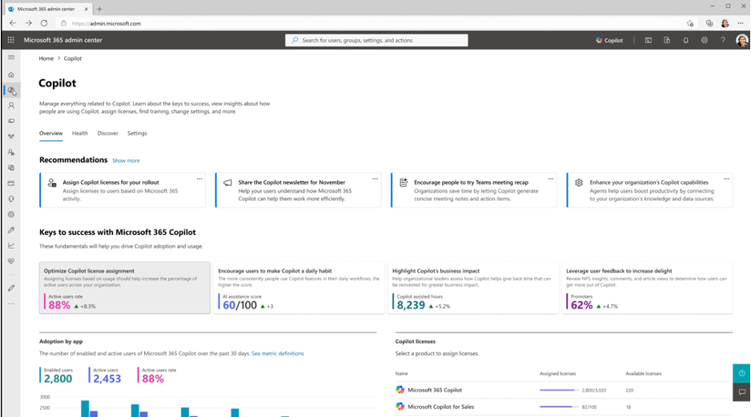
Microsoft 365 admin center
Microsoft 365 admin center
For IT users and administrators, the Microsoft 365 admin center offers robust reporting, covering readiness, usage and adoption of M365 Copilot, Copilot Chat, and agents.
The Microsoft 365 admin center helps IT pros to understand and drive Copilot usage and adoption, through reporting and messaging tools
This usage-level visibility into individual readiness and adoption allows admins to inform and optimize license assignment
Notes:
Additionally, you can use Viva Insights to better understand the ROI of your Copilot for Microsoft 365 investment. The new Microsoft Copilot Dashboard, powered by Viva Insights, providing privacy-protected insights across every stage of your AI transformation journey. The dashboard offers insights into Copilot usage metrics with organizational context and collaboration data, enabling deeper views of adoption and impact. Copilot customers will have the flexibility to filter by attributes like department, teams, or roles, understand differences between groups, and compare those same measures between users and non-users.
The Copilot Dashboard is available to all Copilot for Microsoft 365 customers at no additional cost.

Slide 40
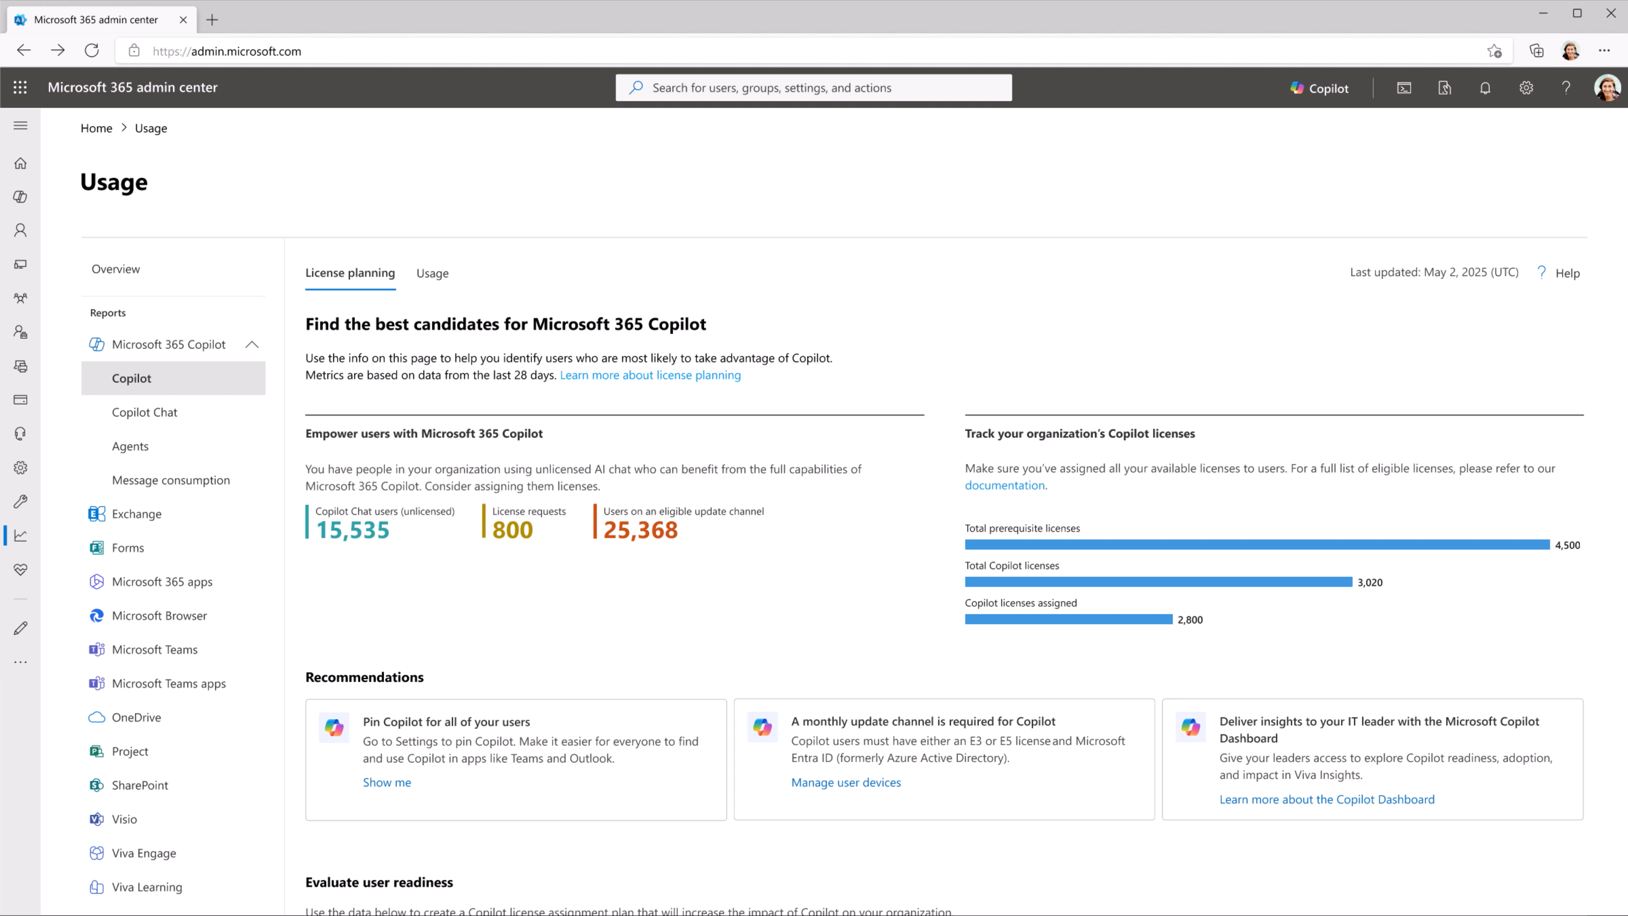
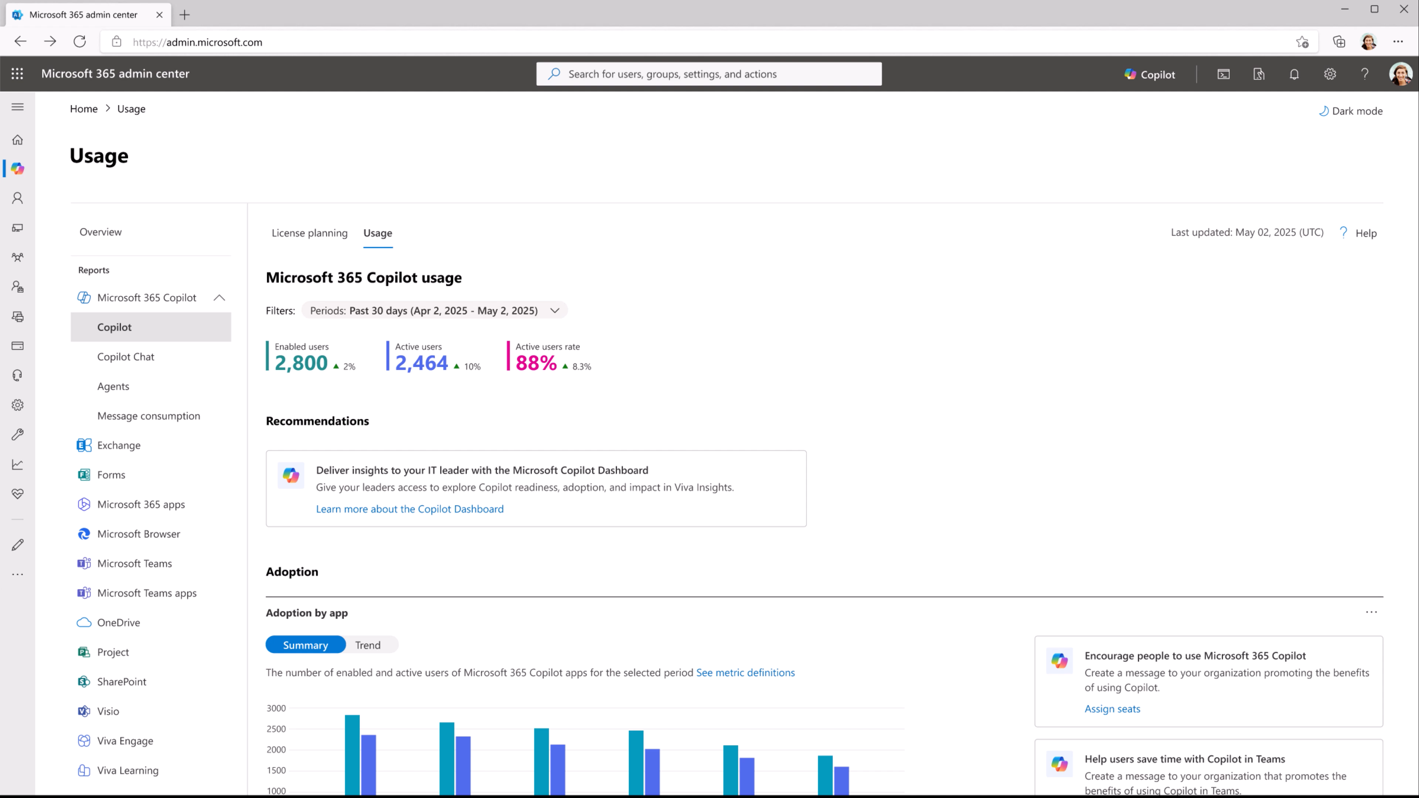
Usage reports for M365 Copilot and license planning
Copilot Control System – Microsoft 365 Copilot usage report
Review license planning and usage insights to right-size your license strategy and maximize adoption for M365 Copilot
Technical eligibility information, assigned and available licenses, suggested candidates for M365 Copilot licenses based on Microsoft 365 app usage
Usage insights including total enabled and active users, in aggregate and per app with user-level last activity dates
Generally Available
Product images subject to change

Slide 41
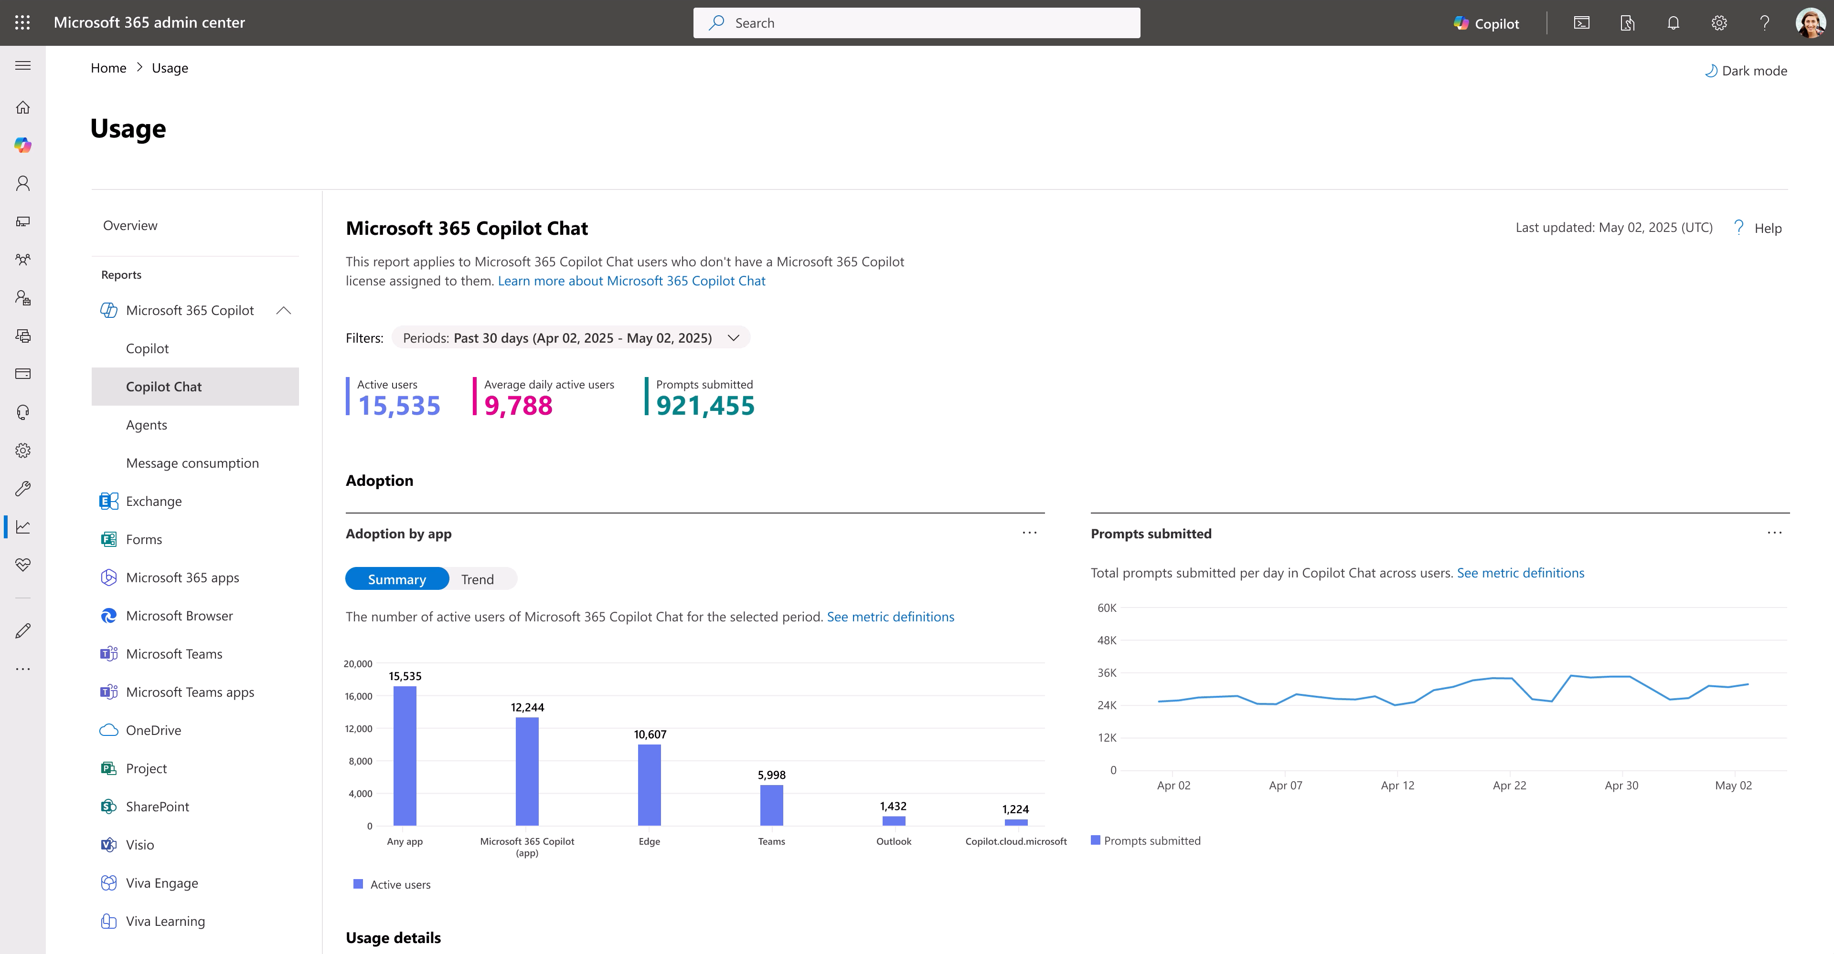
Track usage of Copilot Chat
Copilot Control System – Copilot Chat usage report
Understand Copilot Chat adoption patterns and support M365 Copilot licensing decisions with detailed usage metrics in totals and at the user level.
Review total active users, average daily active users, prompts submitted and usage by app entry-point e.g. M365 Copilot app, Microsoft Teams, Outlook, copilot.cloud.microsoft.
Generally Available
Product images subject to change

Slide 42


Agent usage report
Microsoft 365 admin center
Optimize agent strategy with detailed usage insights.
The Agent Usage Report helps organizations understand how agents are being used in Microsoft 365 Copilot —across licensed and unlicensed users, by publisher type (e.g., user-created, Microsoft-built, partner-built), and at the individual user-agent level.
With line-level data on users, agents, and user-agent pairs, plus near real-time updates, leaders can make informed decisions to optimize agent deployment, adoption, and ROI.
Public preview includes declarative agents. GA will support custom engine and SharePoint agents.
August 2025 Public Preview | October 2025 GA

Slide 43
Copilot page in Power Platform admin center

Slide 44
Copilot page
A centralized location for documents, insights, and controls
for Power Platform in Power Platform admin center
Readiness
Insights
Governance
Data and security guidance
Copilot FAQ
What’s new in Copilot
Getting started guides
Usage across Copilots
Apps created using Copilot
Makers using Copilot
Copilot ROI
Responsible AI insights
Visibility to Copilot enablement
Centralized Copilot settings

Slide 45
Resources

Slide 46
Resources
1
Microsoft Learn: Prepare security
and compliance to support Microsoft 365 Copilot
2
Microsoft Learn: Manage and Extend Microsoft 365 Copilot
3
Documentation: Manage Microsoft 365 Copilot Agents - Microsoft 365 admin
4
Documentation: Security and governance - Microsoft Copilot Studio

