Slide 1
Copilot agents IT set up and controls
April 2025

Slide 2
Copilot is the UI for AI
Our ambition is to empower every employee with a copilot and a transform every business process with agents
Copilot
Agents

Slide 3
Agents run on a secure and trusted platform
Data security
Access & cost controls
Measurement & Reporting
Leverage label inheritance and
data loss prevention policies
Control agent availability
and access
View core usage telemetry and track license utilization
Intelligent grounding
respects your permissions
and security controls
Control who can create and
sharing of agents
Track improvements in user productivity and compare impact across groups
Comprehensive visibility into user, data, and agent risks
Track and manage agent costs
and operational insights
Analyze Copilot & agents impact to business outcomes
Agent interactions stay in the Microsoft 365 and Azure Service Boundary and
your Microsoft 365 security, governance, compliance, and privacy policies apply

Slide 4
Spectrum of agents
Simple
Advanced
Retrieval
Retrieve information from grounding data, reason, summarize, and answer user questions
Task
Take actions when asked, automate workflows, and replace repetitive tasks
for users
Autonomous
Operate independently, dynamically plan, orchestrate other agents, learn and escalate
Generally available
Generally available
Preview
Agents vary in levels of complexity and capabilities depending on your need

Slide 5

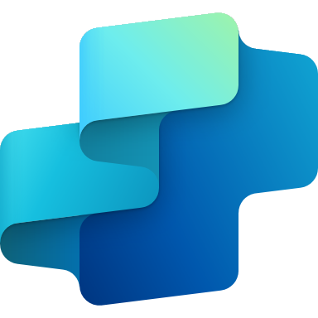

Tools to create agents
Simple
Advanced
Agent builder
Copilot Studio
Copilot Studio + Azure AI
For End Users
For Makers
For Developers
Declarative agents*
Declarative or custom-engine agents*
Custom-engine agents*
Knowledge
Microsoft Graph & connectors
Custom RAG on any data
Actions
Retrieval Only
Task / Autonomous
Channels
Microsoft 365 Only
Multiple Internal & External Channels
Agents can perform different functions and access different sources of data, including the public web, work data in the Microsoft Graph (SharePoint, OneDrive etc.), and data stored in other business apps and tools.
* Declarative = prompts handled by Microsoft 365 Copilot; Custom-engine = prompts handled by custom AI engine (i.e., orchestrator and foundation models)

Slide 6
Product capability details
● Included ▲ Included — Metered
 |  | Microsoft 365 Copilot Chat | Microsoft 365 Copilot
Chat | Copilot Chat – Web grounded (powered by GPT 4o) | ● | ●
 | Copilot Chat – Work grounded (work data in your tenant’s Microsoft Graph and 3rd party data via Graph connectors) |  | ●
 | Copilot Pages | ● | ●
 | File upload¹ | ● | ●
 | Code Interpreter¹ | ● | ●
 | Image generation¹ | ● | ●
Agents² | Create agents using Copilot Studio³, including SharePoint agents | ● | ●
 | Discover and pin agents | ● | ●
 | Use agents grounded on Web data | ● | ●
 | Use agents grounded in work data (work data in your tenant’s Microsoft Graph and 3rd party data via Graph connectors) | ▲ | ●
 | Use agents that act independently using autonomous actions | ▲ | ▲
Personal assistant | Copilot reasons over personal work data (e.g., Outlook, OneDrive, meeting transcripts) |  | ●
 | Copilot in Teams (Copilot in Meetings and Meeting Recap, insights from screen-shared content coming soon) |  | ●
 | Copilot in Outlook (Prioritize my inbox, schedule focus time and 1:1 meetings, draft agendas, summarize message threads) |  | ●
 | Copilot in Word (Suggestions for structure, flow, and tone, draft and summarize documents) |  | ●
 | Copilot in Excel (Python, getting started experience, create formulas and visualizations using natural language) |  | ●
 | Copilot in PowerPoint (Narrative builder, presentation translation, generate slides or images aligned to company branding ) |  | ●
 | Copilot Actions |  | In preview
 | Pre-built M365 agents (Interpreter, Facilitator, Project Manager, Employee Self-Service) |  | In preview
Copilot Control System | Enterprise Data Protection (EDP) | ● | ●
 | IT management controls | ● | ●
 | Agent management | ● | ●
 | SharePoint Advanced Management |  | ●
 | Copilot Analytics to measure usage and adoption⁴ |  | ●
 | Pre-built reports and advanced analytics to measure ROI |  | ●
1. Limits apply. 2. Applies to employee-facing agents only. 3. Learn more about the full capabilities of Copilot Studio: aka.ms/CopilotStudioCapabilities 4. Basic reporting in Microsoft Admin Center available for Copilot Chat.
Notes:
Let's go a bit deeper on the differences between Copilot Chat and M365 Copilot across four core elements: Chat , Agents, Personal assistant, and CCS
Let's start with Chat
Copilot Chat offers a secure web grounded chat experience, that includes additional value like- the ability to create and interact with Copilot Pages and images – and have the ability to generate code, analyze data and create visualizations with Code Interpreter.
In addition to that M365 Copilot provides the ability to ground any prompt on shared Graph data ,personal data (documents, emails, meetings) as well as any 3rd party data using Microsoft Graph Connectors.
Moving to Agents:
Regardless of the product - Users will be able to build, manage, discover, and pin agents.
They can use agents grounded on web data at no extra cost
The differences lay on: For Copilot Chat the usage of agents that are grounded on shared tenant Graph data or 3rd party data are metered and charged on a consumptive basis
Personal assistant:
All the value related to the integration of Copilot to the M365 apps as well as Pre-built M365 agents and additional context and personalization experiences will remain exclusive for M365 Copilot users
CCS: Lastly we are committed to provide a secure and trusted Chat experience for both Copilot Chat and M365 Copilot.
So our Copilot Chat experience offers Enterprise Data Protection as well as the IT admin controls that you expect from Microsoft
In addition to that M365 Copilot customers have access to advanced management and measuring tools like SharePoint Advance Management, Copilot Analytics, and Viva Insights.

Slide 7
Set up Agents for Success

Slide 8
Three steps to get setup for agents
1
2
3
Setup Billing Plan to use agents grounded, get licenses to Copilot Studio for users
Ensure users have the access to the right agents
Monitor and govern agent usage
Setup Azure Subscription:
1. In the Azure Portal:
Home > Subscriptions to create a subscription if you do not already have one.
Home > Resource groups to create a resource group if you do not already have one.
2. Once you’ve completed the steps above, go
to the Microsoft 365 admin center:
Copilot > Pay-as-you-go services > follow steps to assign Azure subscription and resource group.
Note: If you prefer more predictable billing, you can also consider purchasing message packs for your tenant.
Identify agent makers and acquire Copilot Studio User Licenses:
Determine who in your company would need to create agents with more advanced capabilities like automation.
Acquire Copilot Studio User Licenses from the Microsoft 365 admin center:
  Billing > Purchase services, look for Copilot Studio User License
Assign appropriate users these licenses.
Help your users find Copilot and agents easier by pinning Copilot:
In the Microsoft 365 admin center:
Copilot > Settings > Pin Copilot.
Select Pin Microsoft Copilot (recommended by Microsoft).
Ensure users have access to the agents they need by assign the right agent access:
From the Microsoft 365 admin center:
Integrated apps > Shared agent management
In this menu, admins can make agents available to specific users, block or unblock agents for a whole tenant or specific users. Learn more.
Track Microsoft 365 Copilot and agent usage in your tenant:
In the Microsoft 365 admin center:
Reports > Usage > Microsoft 365 Copilot
Review message consumption:
In the Power Platform admin center:
Licensing > Copilot Studio
Here, you can review message usage across both Pay-as-you-go and prepaid consumption.
Manage and track costs:
In the Azure Portal:
Cost Management + Billing > Reporting + analytics > Cost analysis

Slide 9
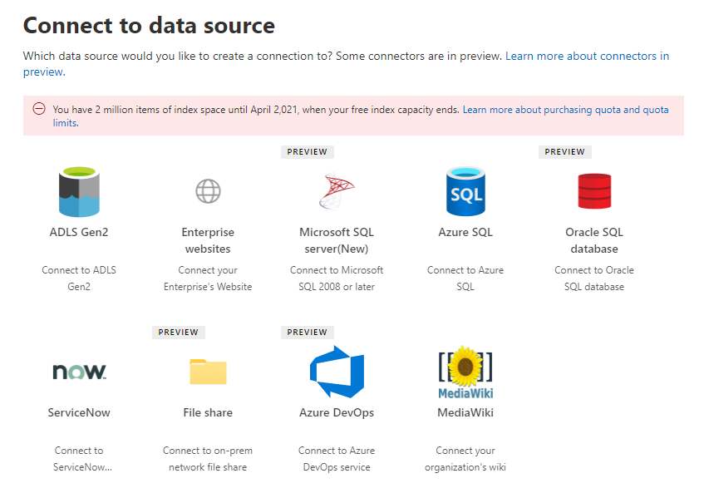
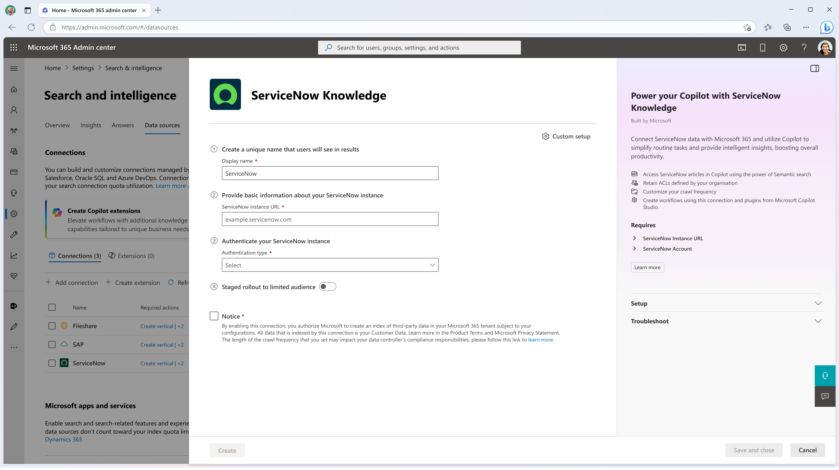
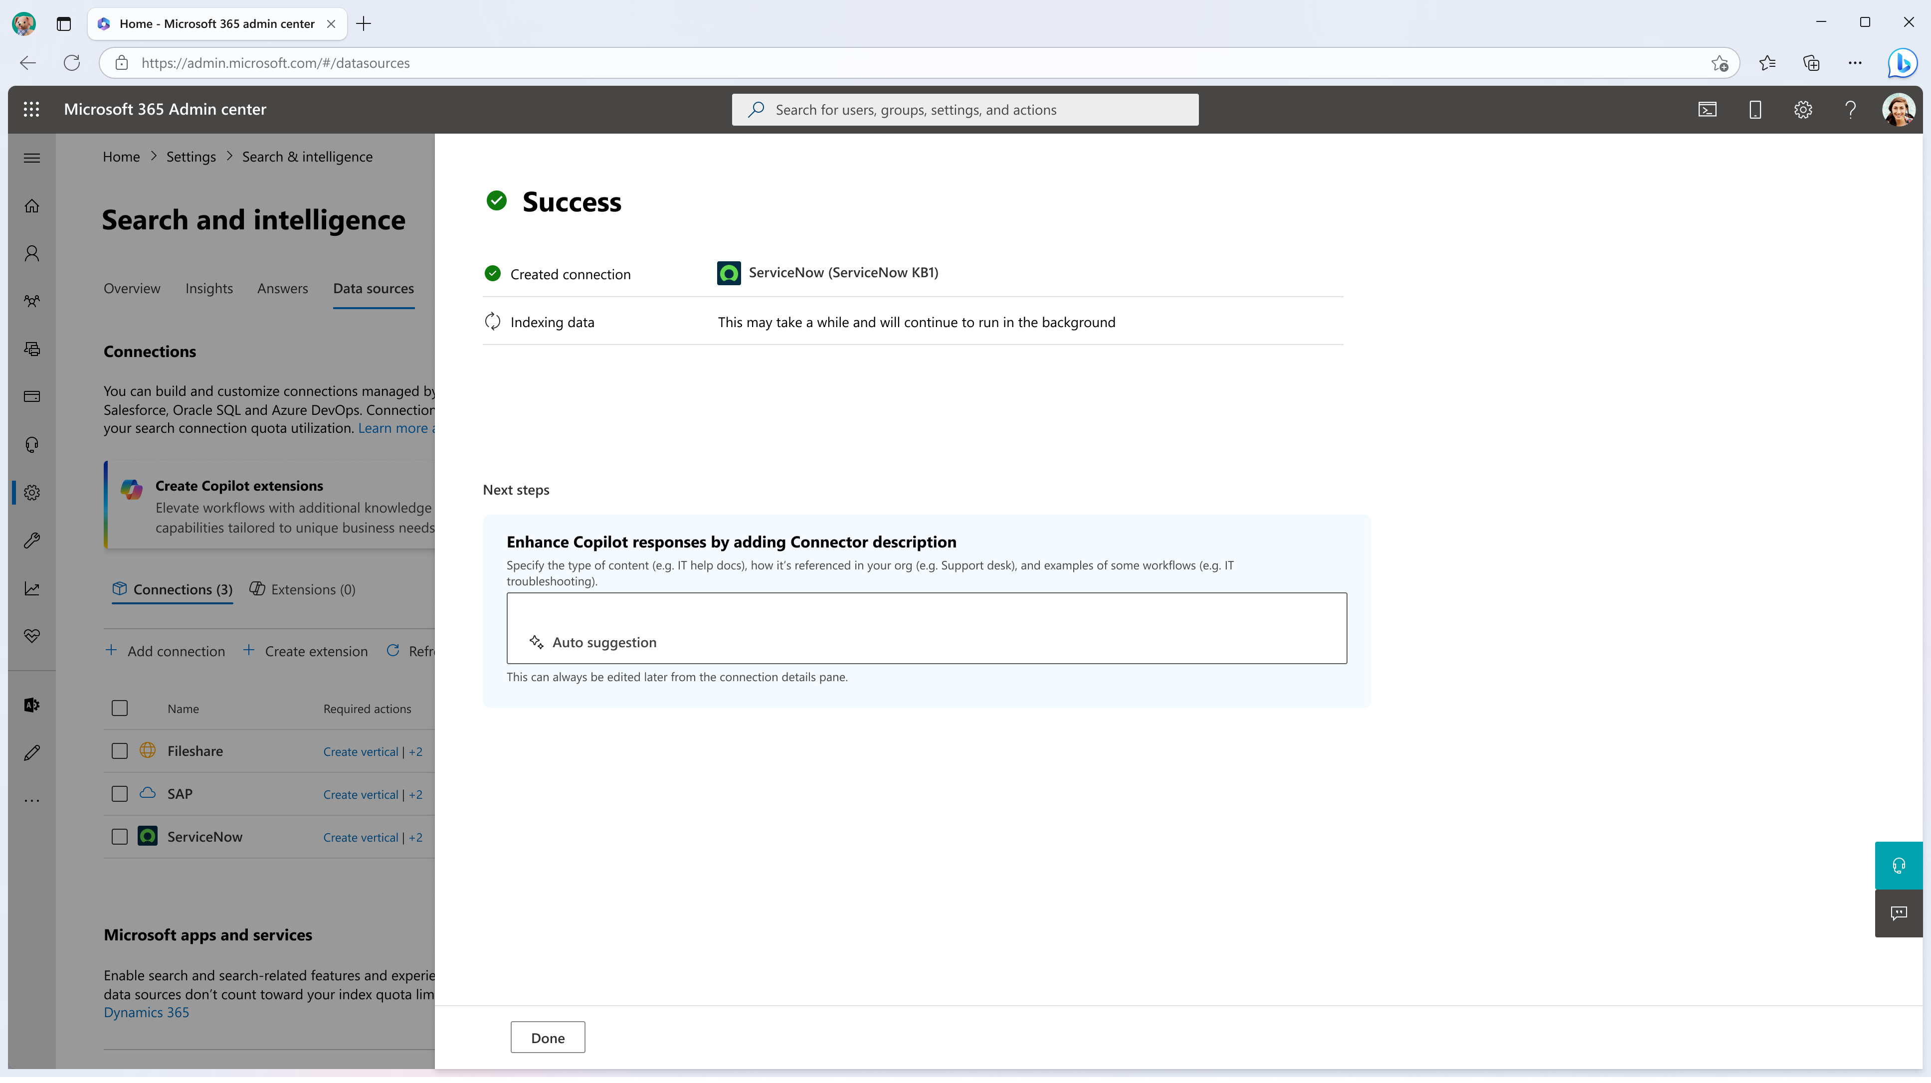
Add Knowledge Sources for Agents
For an agent to access external data sources, you first need to enable access as an IT admin through Microsoft Graph connectors.
1
2
3
Complete creation:
Add a Microsoft Graph connector:
Add a Microsoft Graph connector:
In the Microsoft 365 admin center, Search & Intelligence >Data sources >Add Connection and choose from the list of available connectors.
You can view the full catalog of connectors here.
Fill out the relevant details to establish the connection.
You can also choose to initially rollout the connector to only a subset of your users.
Fill out the relevant details to establish the connection.
You can also choose to initially rollout the connector to only a subset of your users.

Slide 10
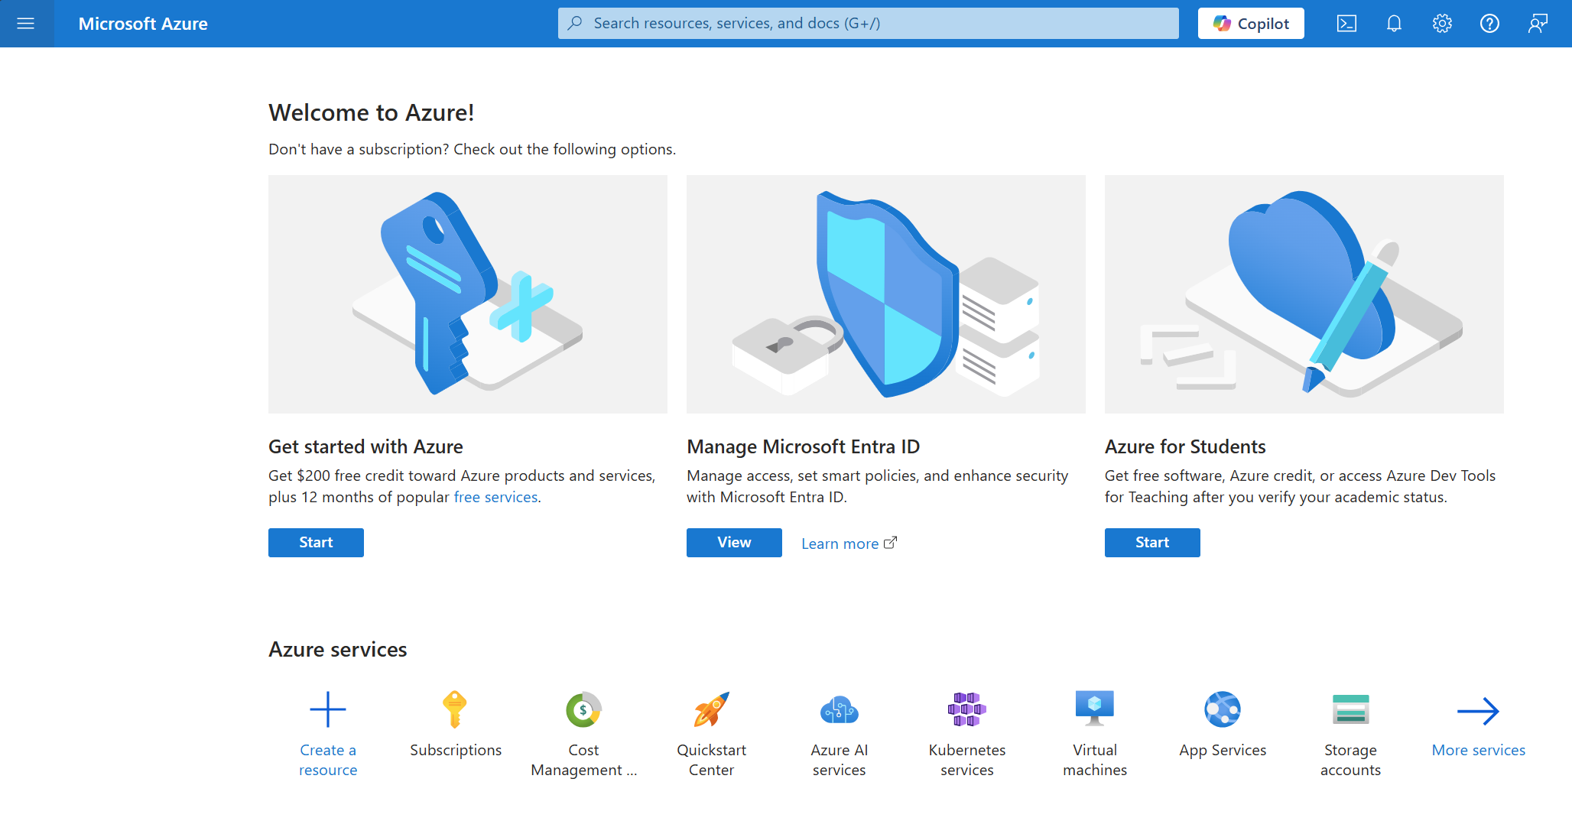
Create Azure subscription
If you have not previously created an Azure subscription, select Get Started with Azure
1
If you already have an Azure profile and subscription, select Subscriptions and skip to Create a new subscription step
2

Slide 11
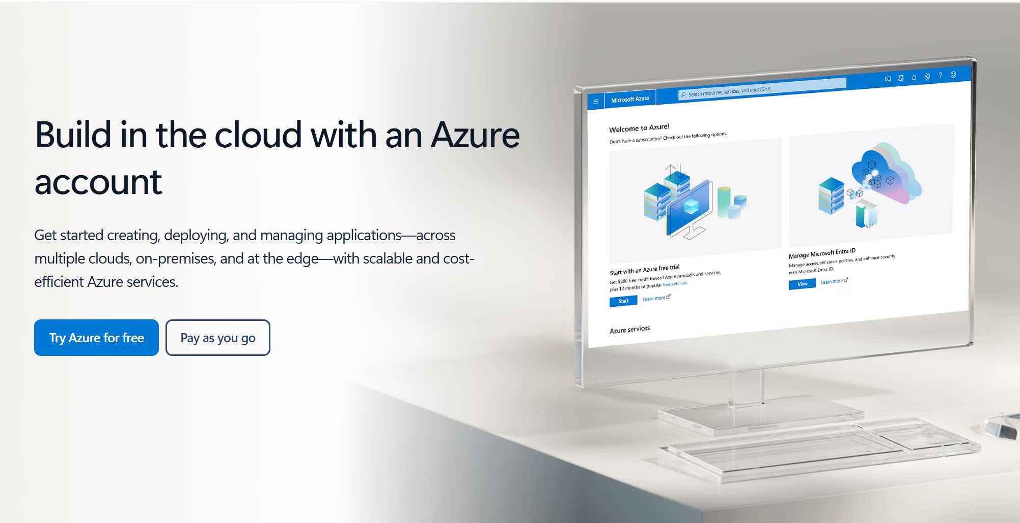
Start an Azure account
Step 1
Select Pay as you go and complete your profile and billing information
1

Slide 12
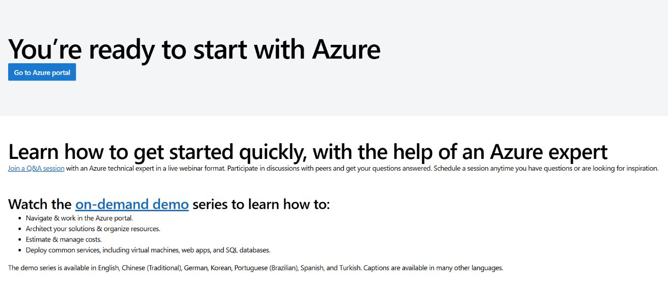
Return to the Azure portal
1

Slide 13
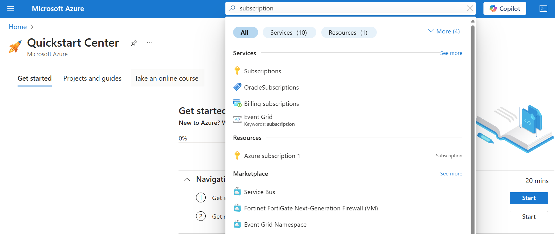
Navigate to Subscriptions
1
You can jump to easily navigate to the Subscriptions page by searching for it at the top of the page.
If you want to get more familiar with Azure, you can always return to the Quickstart Center and complete the onboarding modules.

Slide 14
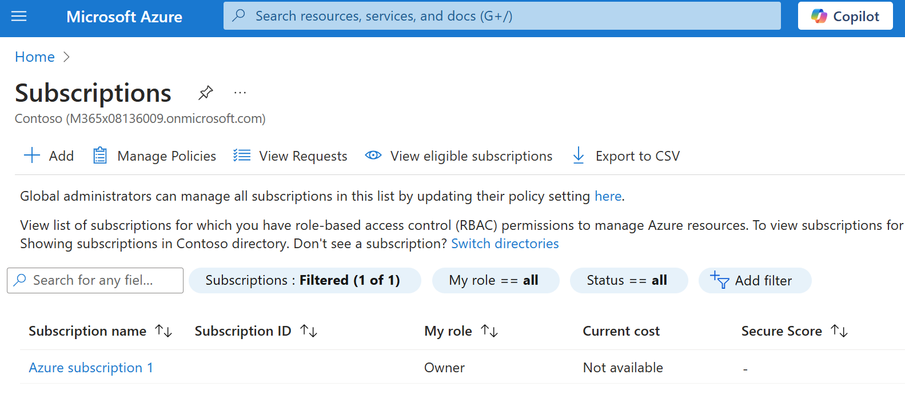
Create a new subscription
Step 3
1

Slide 15
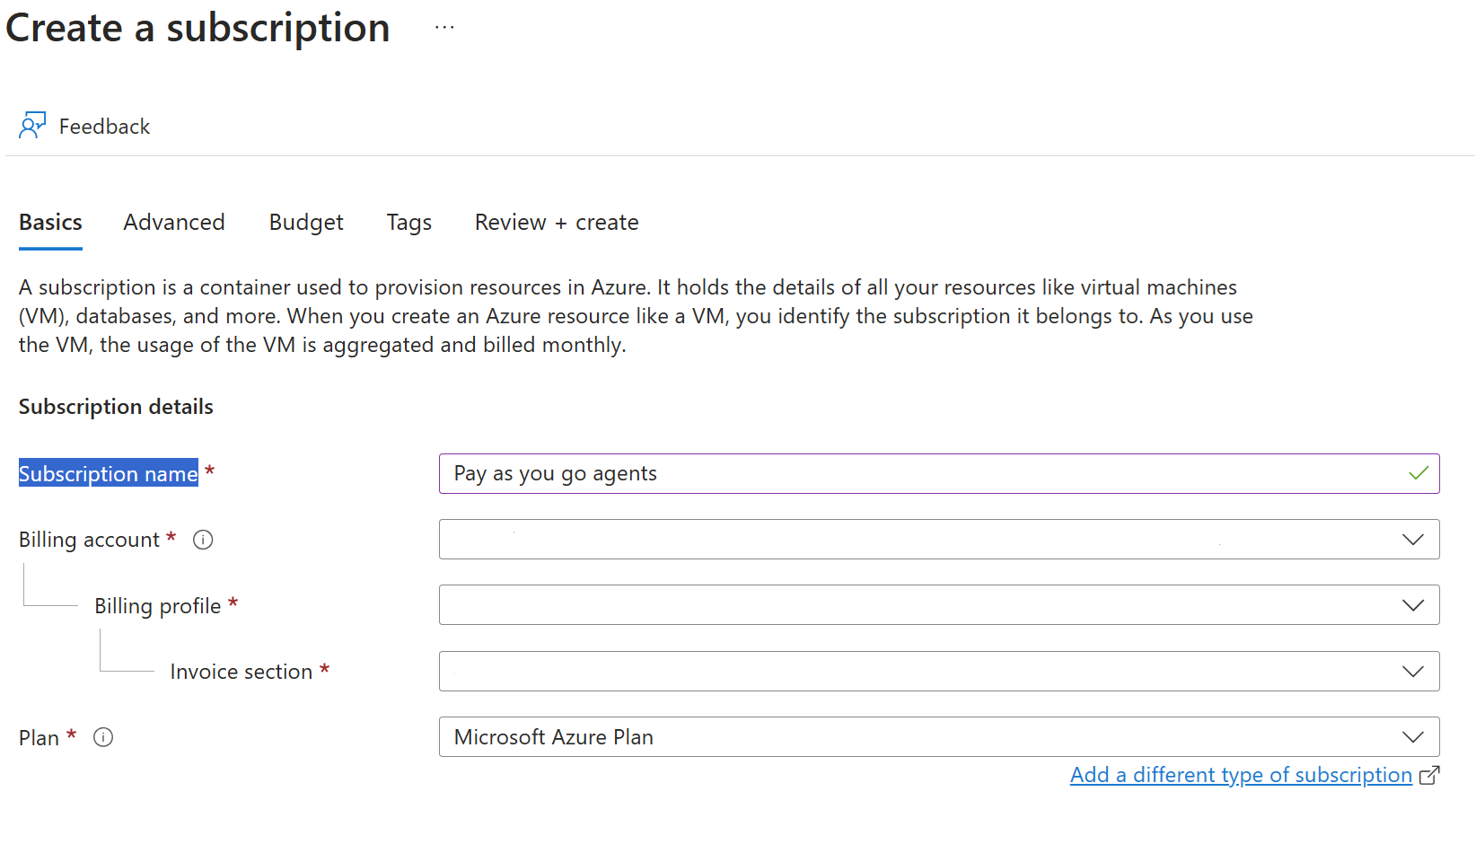
Create a new subscription
Name your subscription.
Billing account and information can be selected from the drop down.
1

Slide 16
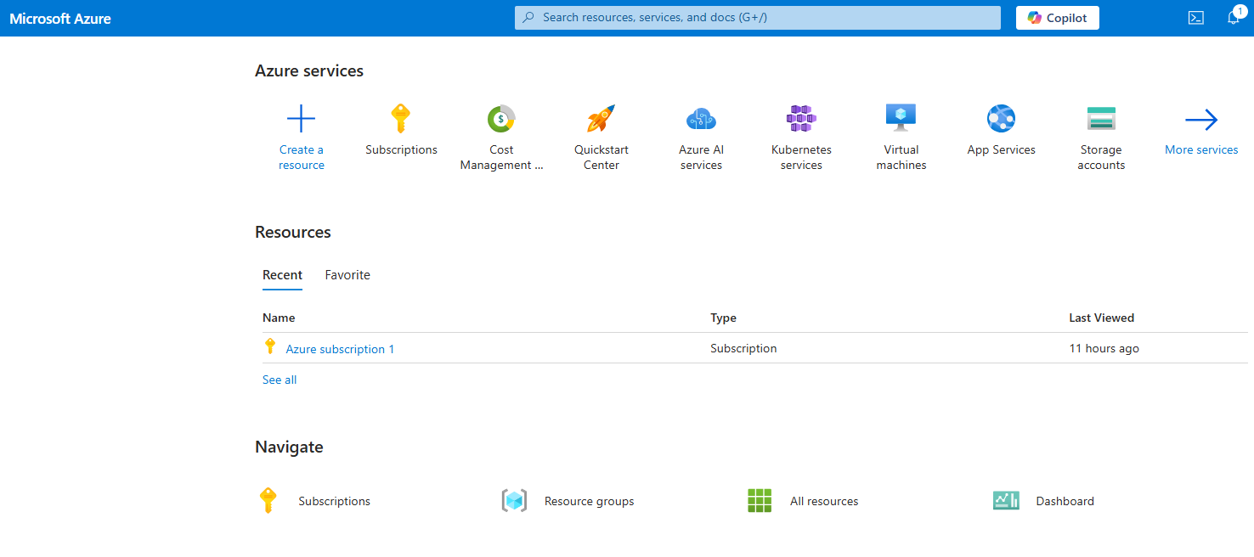
Navigate to Resource groups
1

Slide 17
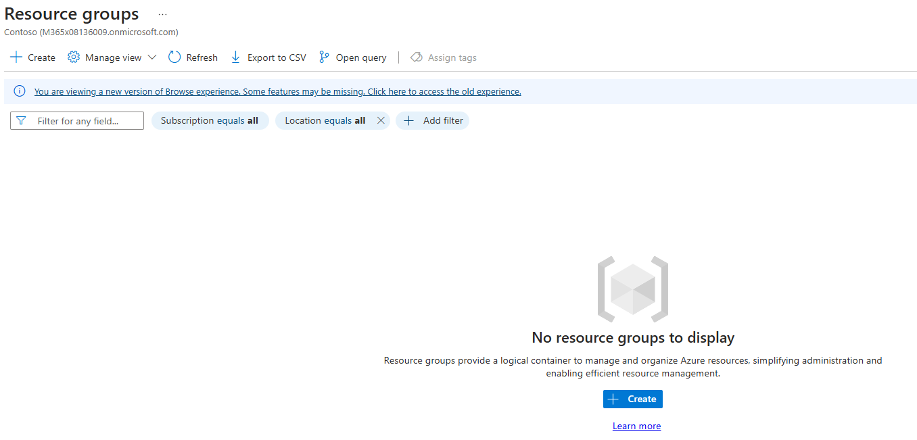
Create Resource group
1

Slide 18
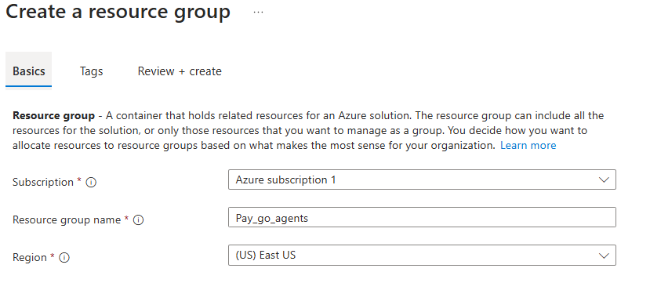
Create Resource group
Select the appropriate subscription, give your Resource group a name, and select the appropriate region.
When done, select Review + Create at the bottom of the page.

Slide 19
FAQ

Slide 20
Top 10 questions and answers 1
Q: What is Copilot Chat vs Microsoft 365 Copilot?
A: Copilot Chat is designed to provide everyone in your organization with a foundational AI solution. It includes free AI Chat powered by GPT-4o, agents accessed through an intuitive chat experience and paid for on a consumptive basis, along with IT controls including enterprise data protection and management.
Microsoft 365 Copilot on the other hand is your complete AI assistant for work. In addition to all the capabilities of Copilot Chat, it includes chat grounded in your tenant work and personal data. It also includes the ability to access and use agents and includes the productivity assistant capabilities of Copilot, like Copilot in Outlook, Copilot in Teams and Copilot in all the M365 apps. In addition, the $30 per user SKU comes with Advanced Management capabilities like SharePoint Advanced Management and Copilot Analytics, including pre-built reports and Viva Insights advanced analytics to measure business outcomes.

Slide 21
Top 10 questions and answers 2
Q: How will users know if they are using Copilot Chat or Microsoft 365 Copilot from the chat UX?
A: Both Copilot Chat and Microsoft 365 Copilot users will see the Microsoft 365 Copilot branding in the user experience.
Microsoft 365 Copilot users will also see the Work/Web toggle at the top of the user experience whereas Copilot Chat users will not see the toggle.

Slide 22
Top 10 questions and answers 3
Q: Do I need to pay to get started with Copilot Chat?
A: No, you can get started with Copilot Chat using web chat, including features like file upload and Pages, for free. Additionally, agents grounded in instructions, public websites, and uploaded files are available to use at no additional cost.
Agents that access SharePoint or Graph Connector data will be billed based on metered consumption.

Slide 23
Top 10 questions and answers 4
Q: What is the difference between m365copilot.com and other URLs I’m seeing like copilot.cloud.microsoft and m365.cloud.microsoft/chat?
A: m365copilot.com is a new, simple URL that will launch alongside Copilot Chat. We created it as an easy entry point for your users to remember that will then redirect them to their Microsoft 365 Copilot or Copilot Chat experience.
When users visit M365copilot.com, they will be automatically redirected to the applicable product urls to access their experience:
Copilot.cloud.Microsoft (if Copilot Chat is not pinned in the Microsoft 365 Copilot app)
M365.cloud.microsoft/chat (if Copilot Chat is pinned in the Microsoft 365 app or if the user has a Microsoft 365 Copilot license)

Slide 24
Top 10 questions and answers 5
Q: What are the agent capabilities of Copilot Chat?
A: Copilot Chat users will be able to create, discover and use agents.
Admins will be required to set up a Copilot Studio subscription prior to the use of agents that are billed based on metered consumption.
Agents grounded in instructions, public websites and uploaded files are available to use at no additional cost for all users.

Slide 25
Top 10 questions and answers 6
Q: What agent building capabilities are available to Copilot Chat users?
A: Copilot Chat users can build agents with Copilot Studio, Agent Builder, and SharePoint, if their IT Admin has configured access in Microsoft 365 Admin Center.

Slide 26
Top 10 questions and answers 7
Q: Are agents on by default?
A: Agents that access SharePoint or Graph Connector content will be billed based on metered consumption. Agents utilizing metered consumption are off by default. Admins will be required to set up a Copilot Studio subscription prior to the use of these agents. These agents will be governed through your Copilot and PowerPlatform configurations.
Agents grounded in instructions, public websites and uploaded files are available to use at no additional cost for all users—these agents do not have access to tenant data. The availability of these agents adheres to how you’ve previously configured to manage agents.
Agent availability in the store to Copilot Chat users will be based on your existing store settings for Teams and Microsoft 365 apps. Based on these settings, agents that are available at no additional cost could be on and available by default.

Slide 27
Top 10 questions and answers 8
Q: Which agents will be billed based on metered consumption in Copilot Chat? Will any agents be available at no additional cost?
A: Agents that access SharePoint or Graph Connector data will be billed based on metered consumption.
Agents grounded in instructions, public websites, and uploaded files are available to use at no additional cost.

Slide 28
Top 10 questions and answers 9
Q: What are the controls to manage agents? Can I control who creates and uses agents?
A: Admin controls will be in place to manage tenant-wide grounding. For more information, read Manage Copilot agents in Integrated Apps - Microsoft 365 admin | Microsoft Learn.

Slide 29
Top 10 questions and answers 10
Q: Will agents cost the same if accessed through Copilot Chat versus other surfaces?
A: Yes. If the user does not have a Microsoft 365 Copilot license, agents will either deduct the same number of messages from your message pack or count the same number of messages at the same rate, irrespective of whether it is through the Microsoft 365 Copilot Chat experience or through the Copilot Studio standalone experience.
If the user has a Microsoft 365 Copilot license, there will be no additional charge.

