Slide 1
Microsoft 365 Copilot prompt-a-thon
Overview and guidance

Slide 2
Contents
1
Event overview
Structure of a prompt-a-thon
2
Thought leadership
3
Running the hack
4
Post prompt-a-thon activities
5
Measuring impact
6
Event team resources
7

Slide 3
What is a prompt-a-thon?
Summary
Hands-on “hack” to build effective prompts, learn from peers, share best practices, and discover impactful prompts together to get the most value out of Microsoft 365 Copilot!​
An interactive event to encourage Copilot adoption among users and stimulate innovation through collaboration.
Objective
The aim is to remove barriers to fluency and explore the potential of Copilot and how it can be used to innovate business processes by simplifying daily tasks.
Target audience​
Microsoft 365 Copilot business users, functional leaders, and champions from different lines of business such as HR, marketing, finance, etc.​

Slide 4
Why run a prompt-a-thon?
Goals
Drive awareness to discover new scenarios and use cases relevant to teams and departments
Make Copilot real, hands-on experience where users collaborate and compete
Equip users with the right tools to drive adoption within their company

Slide 5
Structure of a prompt-a-thon

Slide 6
Prompt-a-thon components
Knowledge and inspiration
Application of skills
Keynote and land the message
How AI can solve work challenges and evolve businesses. Establish the event rules and agenda. This can be Microsoft presented or content from the customer on their strategy if applicable.
Rules of the day
Introduce the structure of the prompt-a-thon, share the final product, give guidance and best practice. Walk through a completed example.
Masterclass: Art of the Prompt
Covering prompting best practices, limitations, and examples. Keep it beginner to intermediate and establish what is possible by defining goals, context, source, and expectations.
Break attendees into teams with business coach and Copilot Coach assignments to begin planning and work on their Hack for a specific department / business unit focus per team.
Support the teams with technical guidance as needed. Teams will build a five-minute presentation on their Hack over the day.
Team presentations and awards
Each team presents their Hack. Have judges / attendees put in their votes. Recognize the top team.

Slide 7
Typical agenda
Time | Item
09:00 - 09:30 | Coffee and registration
09:30 - 09:40 | Welcome
09:40 - 10:00 | Thought leadership on AI journey / plan
10:00 - 10:45 | Masterclass: Art of the Prompt
10:45 - 11:00 | Rules of the day
11:00 - 11:15 | Break / Find your team
11:15 - 12:30 | Hack
12:30 - 13:30 | Lunch / Working lunch
13:30 - 14:20 | Hack
14:30 - 15:30 | Team presentations
15:30 - 15:45 | Awards and next steps
Important: Make sure to allocate at least 2.5-3 hours for the HACK sessions. Participants need to have enough time to come together and brainstorm ideas, do the business process breakdown, and then learn how to use Microsoft 365 Copilot to improve each step.
7

Slide 8


Know your role
Team
Copilot Coach
Business coach
Team members

Slide 9
Our Copilot coaches
What’s the role of the Copilot Coaches?
Copilot Coaches guide less experienced team members who may be less advanced with their use of Copilot. They inspire team members by helping them to match business problems to capabilities in Copilot. They don’t write prompts for team members, but they may help them to refine prompts.
Who are the Copilot Coaches?
These are more experienced Copilot users from your organisation who can fulfil this coaching role. An example of these users would be your Copilot Champions.
Forename Surname
Copilot Coach
Forename Surname
Copilot Coach
Forename Surname
Copilot Coach
Forename Surname
Copilot Coach

Slide 10
Our business coaches
What’s the role of the business coaches?
Think of them as team captains who can guide scenario creation, keep the focus on the business problem, and pull the team together to achieve success.
Along with the Copilot Coaches, they keep the team focused on answering a high value business problem.
Who are the business coaches?
These people are experienced users from within the business.
It would be beneficial to identify these people ahead of time, so they know their role on the day.
Forename Surname
Business area
Forename Surname
Business area
Forename Surname
Business Area
Forename Surname
Business area

Slide 11

Our judges
Forename Surname
Role
Forename Surname
Role
Forename Surname
Role

Slide 12
Prompt-a-thon set up
The Team
Content Set up
Venue Set up
(in-person)
The Event
(in-person)
At/Post-event Follow up
Set up a v-team with the expertise you need to bring the prompt-a-thon to life.
Create a prompt-a-thon planning channel on Teams to collaborate.
Leverage the prompt-a-thon structure to firm up what you want to share at the event
  AI strategy
  Prompting masterclass
  Copilot Demos: mobile, web and through Microsoft 365
  Other messages you want to land with this audience
  Check if high value scenarios have been identified
  Identify the team
  Who will host the event?
  Who will be your trainers, delivering the content you’ve planned above?
  Who will run the prompt-a-thon? (A big personality with a lot of energy works well!)
  Who will be the business coaches for each team?
Remember to specify the need for a Microsoft 365 Copilot license to participate
Set up your prompt-a-thon Teams channels for each persona before the event starts – have your customer set it up in their environment. Your audience will use the channels to collaborate during the prompt-a-thon.
Set up a template for each persona (business area)
Build the content for the event – we use PowerPoint and include all content for the day in one main guide – and leverage the content in the Session content folder
Host an internal briefing with the team who will support
Our experience suggests a minimum of five teams and each team should be no larger than six people (not including Copilot Coach). This is important so that everyone is involved.
Do you have the right space to host a prompt-a-thon? Cabaret style room set up works best.
  Each table should signpost the persona / team, e.g., Finance
  As laptops will be required, it’s a good idea to have a power supply for charging devices
  Consider what AV support will be needed (microphones / accessibility adjustments, e.g., to allow for live subtitles).
  What else will you include on the tables, e.g., water
  Attendees need access to Teams; share the WiFi details if needed
Plan timings with multiple breaks
  Avoid pre-10am start times if people are travelling long distances
  Schedule morning and afternoon coffee breaks (leg stretching)
  Have a timekeeper
Catering is often a high priority for attendees – keep people fed and watered throughout the event
Think about how you will run the presentation and awards, and make it fun, interactive and high energy
Create a “Book of Prompts”- an artifact with all the prompts generated during the event. This is a nice takeaway for attendees and supports their prompt learning journey.
Post event communications
Follow up survey after the event, find out what they are doing differently now with Copilot

Slide 13
Follow up
1
Measure and celebrate the outcomes
2
Keep the community engaged via a power user pathway
3
Assign business leads to implement the prompt-a-thon scenarios
4
Start planning the next immersive event

Slide 14
Thought leadership

Slide 15
Thought leadership & prompt masterclass
Time | Item
09:00 - 09:30 | Coffee and registration
09:30 - 09:40 | Welcome
09:40 - 10:00 | Thought Leadership on AI journey / plan
10:00 - 10:45 | Masterclass: Art of the prompt
10:45 - 11:00 | Rules of the day
11:00 - 11:15 | Break / Find your team
11:15 - 12:30 | Hack
12:30 - 13:30 | Lunch / Working lunch
13:30 - 14:20 | Hack
14:30 - 15:30 | Team presentations
15:30 - 15:45 | Awards and next steps
This part of the day is to inspire participants and get them enthused about prompting better.
It is split into thought leadership about why AI is important to you as an organisation, and the Masterclass where you teach the elements of good prompting.
Both of these are fundamental to build out high value prompts during the hands-on part of the day where participants build AI into business processes.

Slide 16
Thought leadership on generative AI
What to include in this section:
Research on the rise of power users
Organizational AI strategy
Organizational goals for AI adoption
Real examples from early adopters in your organization
Other information that would motivate participants to maximize value of this experience
Help participants understand the value of Microsoft 365 Copilot and how it can drive personal, team, and business value.
Attendees can gain insights into the importance of AI, understand the need for change, and see practical demonstrations of Copilot's impact on productivity and customer engagement.

Slide 17
Prompt Masterclass
Prerequisites for attendees
Attendees of the hack day should have:
an assigned Microsoft 365 Copilot license at least two weeks prior to the hack day
ensured access to all Microsoft 365 Copilot services that are part of the organization’s adoption roadmap
a basic understanding of Microsoft 365 Copilot features and functionality
At least two weeks of experience or at least one hands-on training
Additional information
This session can be performed prior to the hack day in case there is not enough time on the hack day itself.
The Prompt Masterclass is designed to enhance participants' skills in crafting effective prompts for Microsoft 365 Copilot.
The goal of this session is to equip attendees with the knowledge and techniques needed to create precise and impactful prompts, ultimately improving their productivity and interaction with Copilot.
The recommended duration for this lecture is 1 hour.

Slide 18
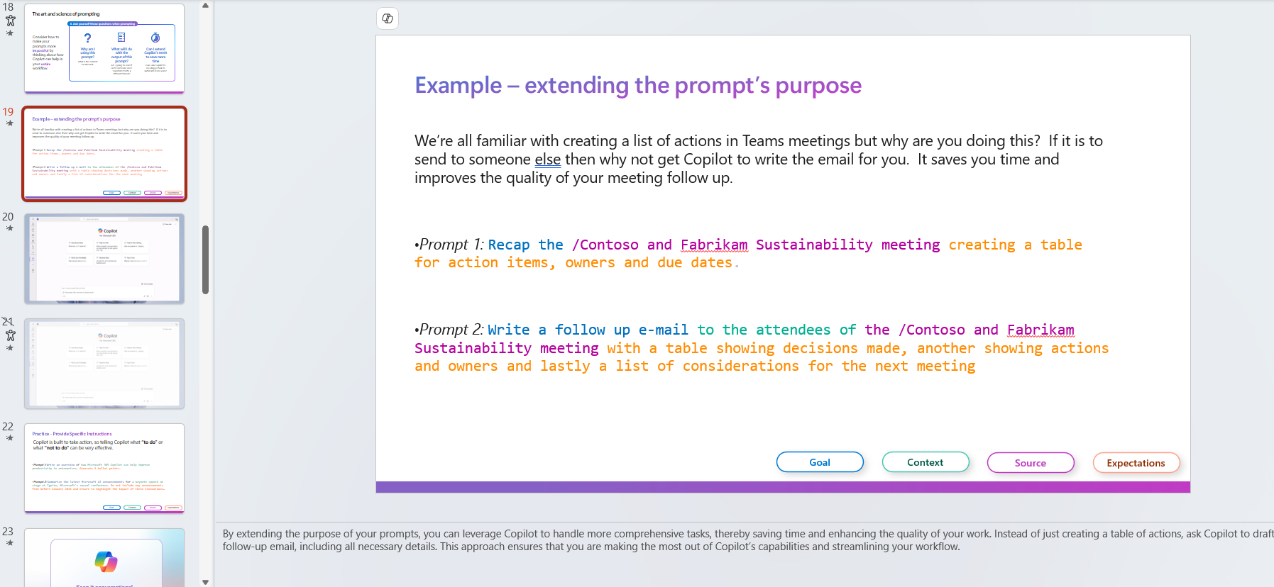
Demos are built in with or without narration

Slide 19
Running the hack

Slide 20
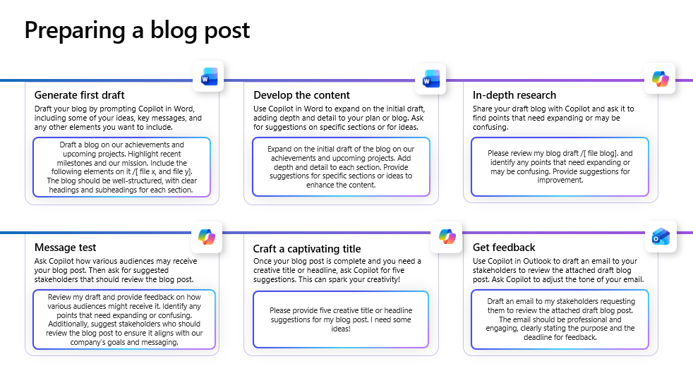
Goal of the day
Create a set of “prompt cards” detailing an improved business process using AI.
Compiled deck with all prompt cards called “The Big Book of Prompts”.

Slide 21
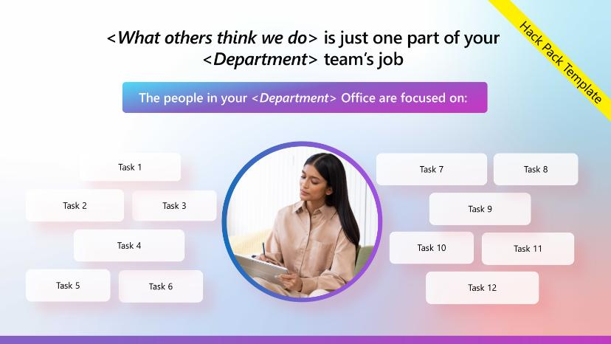
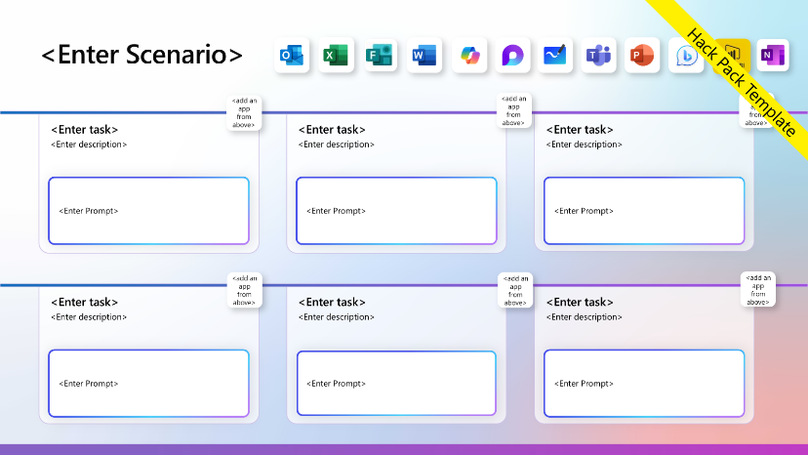
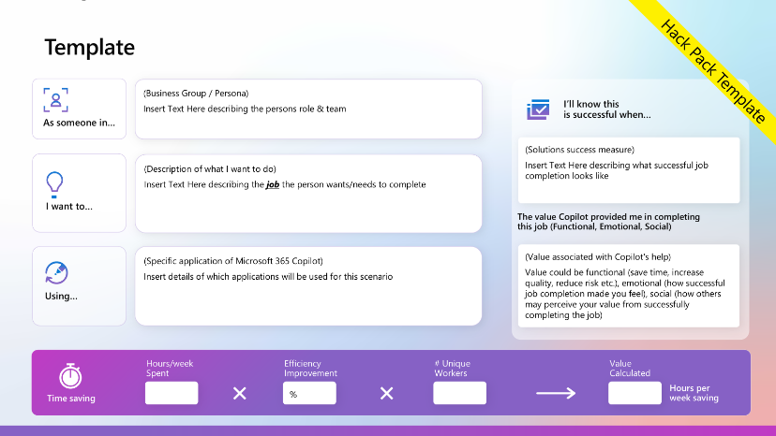
Hack pack

Slide 22

Sending email is just one part of your Enterprise Communication team’s job
Completed Example
The people in your Communications Office are focused on:
Create comms plans
Interview users and stakeholders
Evaluate feedback
Measure engagement
Employee Communications
Create awareness campaigns
Create company’s blog posts
Executive Communications
Create training materials
Develop success metrics
Build communities
Monitor project progress

Slide 23
Preparing a blog post
Completed Example
A communications manager in my organization's Enterprise Communications Department
I’ll know this
is successful when…
As someone in…
Time to produce a blog post is reduced
Readership of the blog post increases
Users engage with comments in communities
Be able to
Research article content
Write articles in the company style
Get sign-off from stakeholders
Review articles with users
I want to…
The value Copilot provided me in completing
this job (Functional, Emotional, Social)
Allows me to be more creative as I can do the research for articles much quicker.
Provide greater range of articles for the company as we can create more content.
Engage deeper with audience through reviews of blog posts and articles.
Outlook to send email campaigns out and ask for feedback
Word to write articles
Edge to research articles
Using…
Hours/week Spent
Efficiency Improvement
# Unique Workers
Value Calculated
6
50%
4
12
Hours per week saving
Time saving

Slide 24


Preparing a blog post
Generate first draft
Develop the content
In-depth research
Draft your blog by prompting Copilot in Word, including some of your ideas, key messages, and any other elements you want to include.
Use Copilot in Word to expand on the initial draft, adding depth and detail to your plan or blog. Ask for suggestions on specific sections or for ideas.
Share your draft blog with Copilot and ask it to find points that need expanding or may be confusing.
Draft a blog on our achievements and upcoming projects. Highlight recent milestones and our mission. Include the following elements on it /[ file x, and file y]. The blog should be well-structured, with clear headings and subheadings for each section.
Expand on the initial draft of the blog on our achievements and upcoming projects. Add depth and detail to each section. Provide suggestions for specific sections or ideas to enhance the content.
Please review my blog draft /[ file blog]. and identify any points that need expanding or may be confusing. Provide suggestions for improvement.
Message test
Craft a captivating title
Get feedback
Ask Copilot how various audiences may receive your blog post. Then ask for suggested stakeholders that should review the blog post.
Once your blog post is complete and you need a creative title or headline, ask Copilot for five suggestions. This can spark your creativity!
Use Copilot in Outlook to draft an email to your stakeholders to review the attached draft blog post. Ask Copilot to adjust the tone of your email.
Review my draft and provide feedback on how various audiences might receive it. Identify any points that need expanding or confusing. Additionally, suggest stakeholders who should review the blog post to ensure it aligns with our company's goals and messaging.
Please provide five creative title or headline suggestions for my blog post. I need some ideas!
Draft an email to my stakeholders requesting them to review the attached draft blog post. The email should be professional and engaging, clearly stating the purpose and the deadline for feedback.

Slide 25
How are the presentations scored?
A scale of 1-5 for each:
Innovation
Impact
Feasibility
Prompt excellence
Presentation
How creative and original is the solution?
Does it bring something new to the table?
How much potential does the solution have to improve the user experience with Microsoft 365 Copilot?
Does it solve a real problem or address a pain point?
How practical is the solution?
Can it be realistically implemented within the constraints of the hackathon?
How well does the solution make use of the available technology?
Is the prompt
well-written and efficient?
How well does the team communicate their solution and its benefits?
Is the presentation clear, concise, and engaging?
Five minutes to present your scenario

Slide 26
Best practices for an in-person event
When inviting your participants, make sure you mention that you’d like to have at least 3-5 people from across different departments (one each). For example: HR manager, Sales manager, Finance manager, Legal / Procurement...
Make your team aware of the hack pack. However, advise them not to fill out the slides in advance. They should only populate a few examples in the slide about what their department or team is focused on, to distinguish processes from tasks. The idea is for the working group to collaboratively decide on the process or scenario they want to work on.
Assign minimum one Copilot Coach for each group. Better if the Copilot Coach is fully familiar to the “art of prompting” and knowledgeable for customers' insights and adoption.
Make sure you have secured a commitment from the business to provide coaches.
You should avoid running the event without some sort of business representation.
Define in advance the criteria to evaluate the outputs of each group. Example: business impact, feasibility of implementation, productivity boost, quality improvement, innovation, and creativity.
Keeping participants engaged, motivated, and excited throughout the event is essential for its success!

Slide 27
Book of Prompts
Compile the outputs of each team’s prompt-a-thon slides (e.g., where they filled in relevant prompts for functions’ activities).
Share out the compiled PowerPoint as a take-away from the day with attendees.
Ideally, while judges are making the decision, this activity is done prior to end of day, so that participants can walk away with the book.
Encourage participants to save the prompts and share it with their colleagues.
Sample Book of Prompts: aka.ms/bigbookofprompts

Slide 28
Post prompt-a-thon activities

Slide 29
Follow up
1
Measure and celebrate the outcomes
2
Keep the community engaged via a power user pathway
3
Assign business leads to implement the prompt-a-thon scenarios
4
Start planning the next immersive event

Slide 30
Top-down communications
37%
Leadership signals are more impactful than you think
increase in Copilot usage after leadership comms were sent¹
¹Source: MW + BA Marketing Copilot Experiment. Leaders sent out comms every Monday throughout the 6-week experiment encouraging Copilot usage. At the end of the experiment, the researchers denoted a 37% statistically significant boost in usage on Tuesdays.

Slide 31

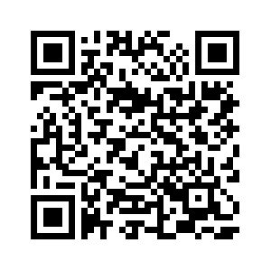
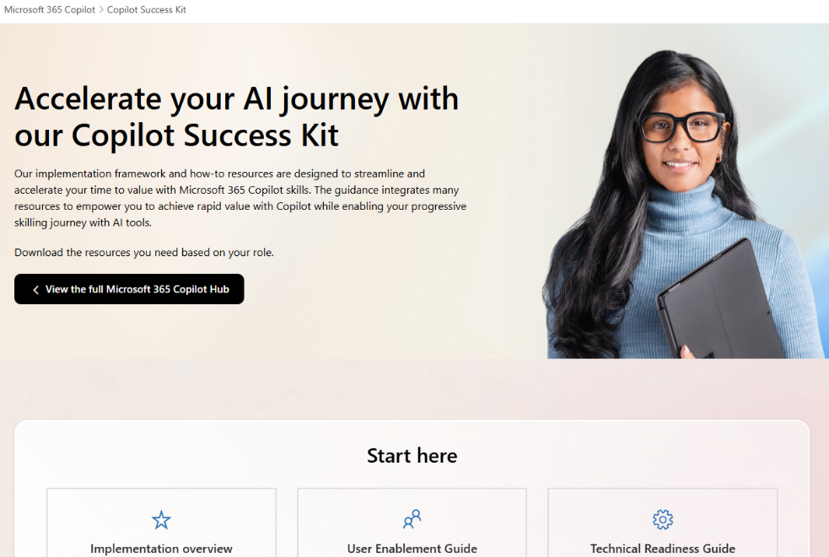
Copilot
Success Kit
Copilot Success Kit – Microsoft Adoption

Slide 32
Peer network effects
Power users are 1.7x more likely¹ to agree that Copilot helps them achieve their business objectives and goals
Power users are 2.4x more likely¹ to consider how Copilot might help when new challenges come up
Power users are 4.5x more likely¹ to say that they help people learn about Copilot
Every adoption strategy should include a power user pathway
¹Source: MW + BA Marketing Copilot Experiment; n-size 72 (final survey). The 1.7x and 2.4x differences refer to power users who identified as having received interventions. The 4.5x difference refers to all power users in the survey, whether they received interventions or not.

Slide 33
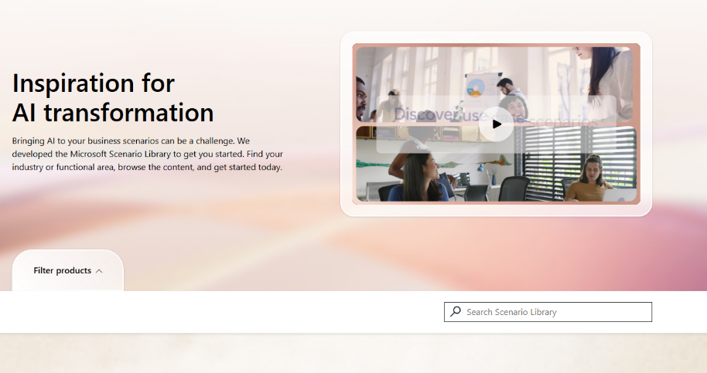

Copilot Scenario Library
Copilot brings AI value across lines of business
Use the Scenario Library to identify top use cases and key metrics you would like to improve.
https://aka.ms/Copilot/ScenarioLibrary
All roles & execs
HR
Marketing
Operations
IT
Sales
Finance
Improve meetings
Content creation
Manage daily agenda
Cost per hire
Employee turnover
Compliance risk reduction
Leads created
Brand value
Cost per lead
Customer retention
Product time to market
Supply chain efficiencies
Outstanding support tickets
Application downtime
Departmental spending
Number of opportunities
Close rate
Revenue per sale
Accelerate cash flow
Spend on ERP system
Risk reduction

Slide 34
Experimentation and learning
60%
Experimentation happens collectively, synchronously
boost in Copilot usage after a 6-week experiment designed to drive experimentation
1Source: MW + BA Marketing Copilot Experiment. This number represents a statistically significant increase in usage of Microsoft 365 Copilot Chat for participants in the treated group, comparing their usage from the beginning to the end of the experiment with participants in the control group.

Slide 35
Boost AI confidence and success with Copilot Prompt Gallery
Foster a community-driven approach to AI adoption, making it easier for teams to find inspiration and share their Copilot success with others
Inspirational prompt collections
In-app prompt ideas and suggestions
Viral prompt discovery and engagement
Explore prompts tailored to a variety of roles, industries, or scenarios to help users unlock greater value with Copilot.
Find, save, and manage prompts directly in your favorite Microsoft 365 Copilot apps.
Foster a community-driven approach to AI adoption by empowering users to share and celebrate their Copilot successes.
Learn more: aka.ms/prompts

Slide 36
Copilot team workshops
Running the session
Getting prepared
During the session
1
Set up time to run the Power Session
1
Introduce the Power Session
Example:
The Copilot Power Session is a hands-on workshop for your team. Discover how to use Copilot for relevant tasks, share successes, and learn from peers. Experience real productivity gains by grounding Copilot in your day-to-day work.
5 – 10 minutes to introduce the session
Run through the tasks with the team and ask each team member to choose one (or more) task they would like to do
Share the great prompt slide
You’ll need around 1.5-2 hours to run the session
Recommend in person but can be run hybrid /online
2
Create a list of tasks
2
Experiment with Copilot
Create a list of 10 tasks which your team can do within their role but could use Copilot to help them with
The tasks should have varying levels of difficulty
Ensure the tasks give the opportunity to use different apps across Copilot (including Copilot on the web for those who don’t have access)
30-45 minutes for team members to use Copilot to do their selected tasks
Copy (and paste into Word/OneNote, etc.) the prompts they used
3
Share insights
½-1 hour for each team member to run through the task they chose, how they used Copilot (include prompts used), and what they found did / didn’t work well
This isn’t about the output but sharing the process of using Copilot
Include the best prompts in Prompt Gallery

Slide 37
Measuring impact

Slide 38







Which functional KPI has improved?
Customer Service
Sales
Finance
Marketing
HR
Legal
IT
First Call Resolution (FCR) rate
Opportunities pursued
Finance outsourcing spend
Leads generated
Employee onboarding time
Outside counsel spend
IT operation costs
Calls answered
by agents
Deal size
Cost per analysis request
Agency spend
Calls answered
by agents
Cost per
internal review
IT issue/ticket resolution time
Issue resolution time
Win rate/Close rate
Deal review time
Customer retention
Issue resolution time
Compliance rate
IT outsourcing costs
Customer retention
Customer retention
Time to close
Employee retention
Employee retention
Contract error rate
Product adoption & usage
Case volume
Average
discount size
Compliance rate
Cost per lead
Hiring costs per employee
Number of disputes
Application downtime
Time to first response
Upsell/Cross sell rate
Forecast accuracy
Brand value
Admin cost per employee
Dispute win rate
Network/infra reliability score
Average call time
Cost per lead
Employee retention
Lead conversion rate
First call
resolution rate
Reduce shadow IT risk
Customer experience (CSAT)
Sales cycles length
Day sales outstanding
Revenue per lead generated
Workforce demographics
NSAT- User Satisfaction

Slide 39
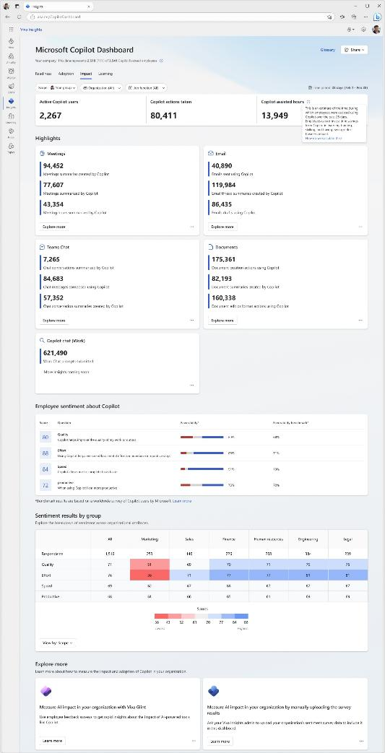
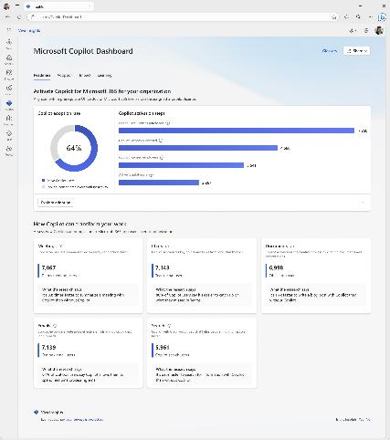
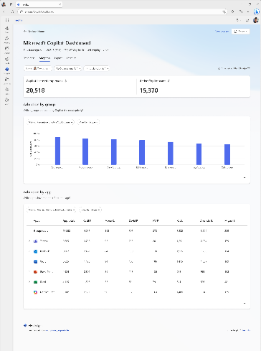
Microsoft Copilot Dashboard
Included with Microsoft 365 Copilot
Get ready
Activate Copilot by understanding eligibility based on licensing status.
Drive adoption
Understand usage and adoption trends across products, groups, organizations and job functions.
Measure impact
Measure time savings and Copilot user behavior before and after adoption, as well as user sentiment.

Slide 40
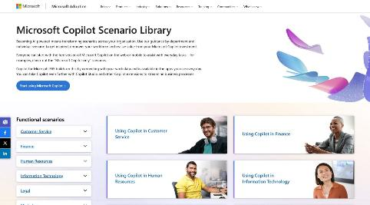
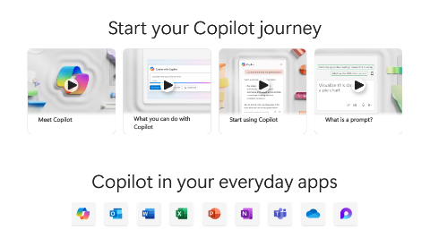
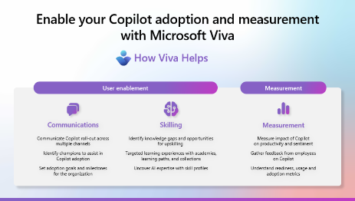
Next steps
Essentials for Copilot success
Business Leaders
Business users
IT, L&D, Corp Comms, Analysts
Scenario Library
Copilot Prompt Gallery
Copilot Dashboard
https://aka.ms/Copilot/SuccessKit

Slide 41
Event team resources

Slide 42

Asset overview
Please leverage the asset kit: aka.ms/Copilot/Promptathon
Overview and guidance (this guide)
Best leveraged by the change management and event team leads.
Session content
Content to be used during the session. It includes the primary guide for the presenters, as well as the Hack Pack for participants to use.
Support materials
Leverage pre-built email templates and best practices around running the event.

Slide 43
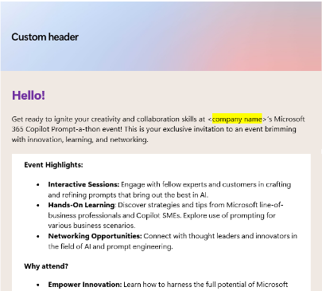
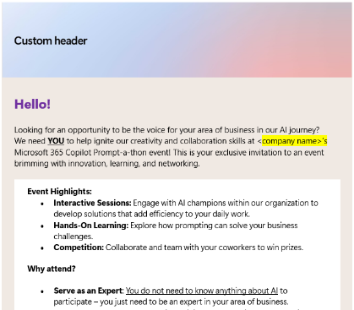
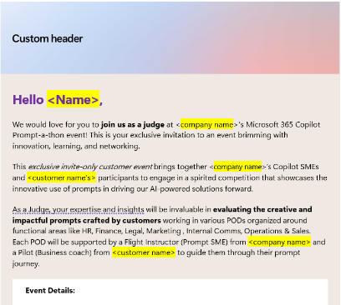
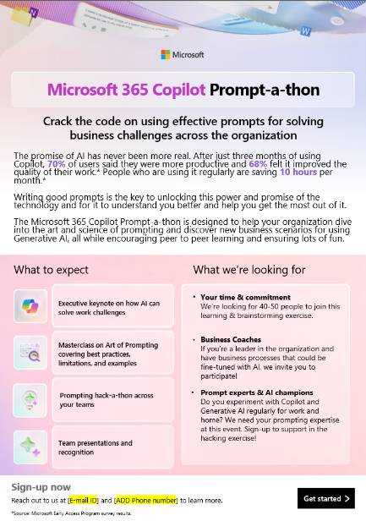
Assets to communicate the event
Use these email assets and flyer as a base for crafting your invitations. All content is available in the Support materials folder.
Invite email
Invitation email to participants
Invite email
Invitation email to Business Coaches
Invite email
Invitation email to Judges
Printable asset
Flyer

Slide 44
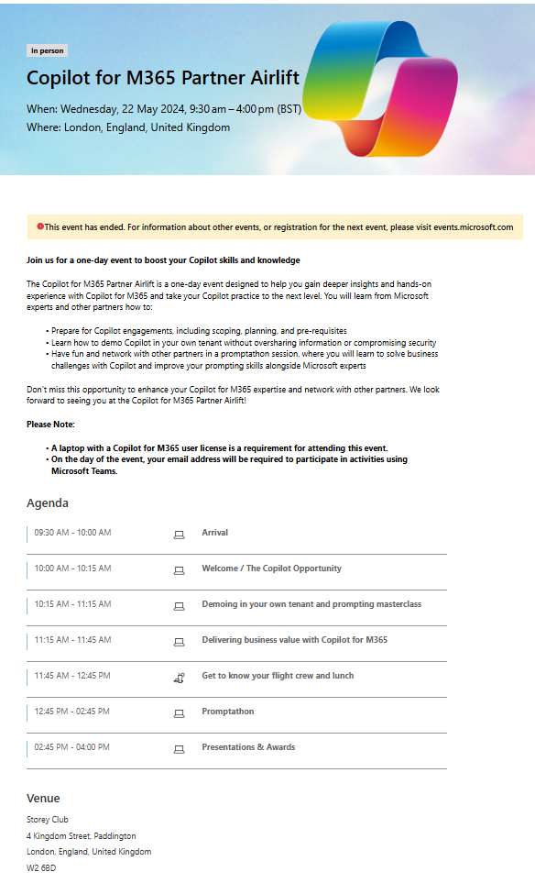
Example of registration page
Setup a registration page so you know how many participants to expect. The page would also allow you to set expectations with attendees with regards to time-commitments.
Let attendees know that they need to bring their laptop and need to have a Microsoft 365 Copilot license.

Slide 45
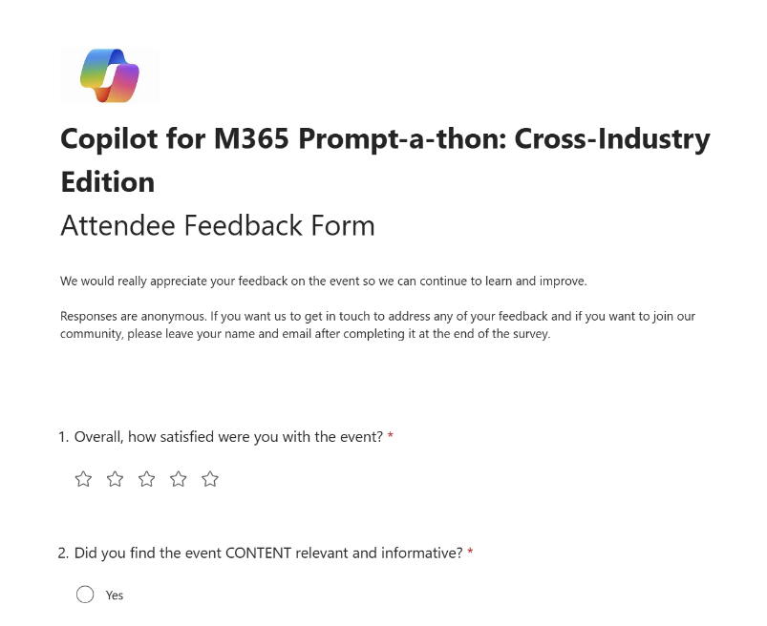
Example of post-event survey
Feedback from participants is crucial to understand whether there’s value in running more of these events and how to fine-tune.
  More questions you can consider adding:
  “Would you like to run a prompt-a-thon within your organization?
  “Did today’s session help you understand how you can make the most of Copilot?”
  “What other Copilot events would you like to attend?” List other events that you may run.
Tip
Have participants fill in the survey before you send any added resources.

Slide 46
Thank you.

