Slide 1
Copilot Kickstart
Your friendly guide to efficiency!
Originally presented by Brian Shaw for Microsoft audiences
Notes:
Welcome to Copilot Kickstart!
This session is intended to be a friendly overview of Microsoft 365 Copilot. So, we’ll start with some of the basics and also review a few advanced capabilities.

Slide 2
Agenda
Introduction
Understanding Copilot
Types of Copilot
Using Copilot effectively
Copilot in different interfaces
Advanced features
Practical tips
Conclusion
Notes:
This presentation will focus on the following:
Introduction to Copilot
Understanding Copilot
Types of Copilot
Using Copilot effectively
Copilot in different interfaces
Advanced features
Practical tips
Conclusion

Slide 3

What is Microsoft 365 Copilot?
Notes:
What is Microsoft 365 Copilot?
For most of us, interacting with AI involves typing in some words, hitting enter, and then receiving a response as if by magic. However, there's a lot happening behind the scenes before you get that response. Once you hit enter, several processes kick into action. These activities include understanding your input, processing it through various algorithms, and generating a coherent and relevant response. I'll walk you through these steps to give you a better understanding of what happens in the back end.

Slide 4
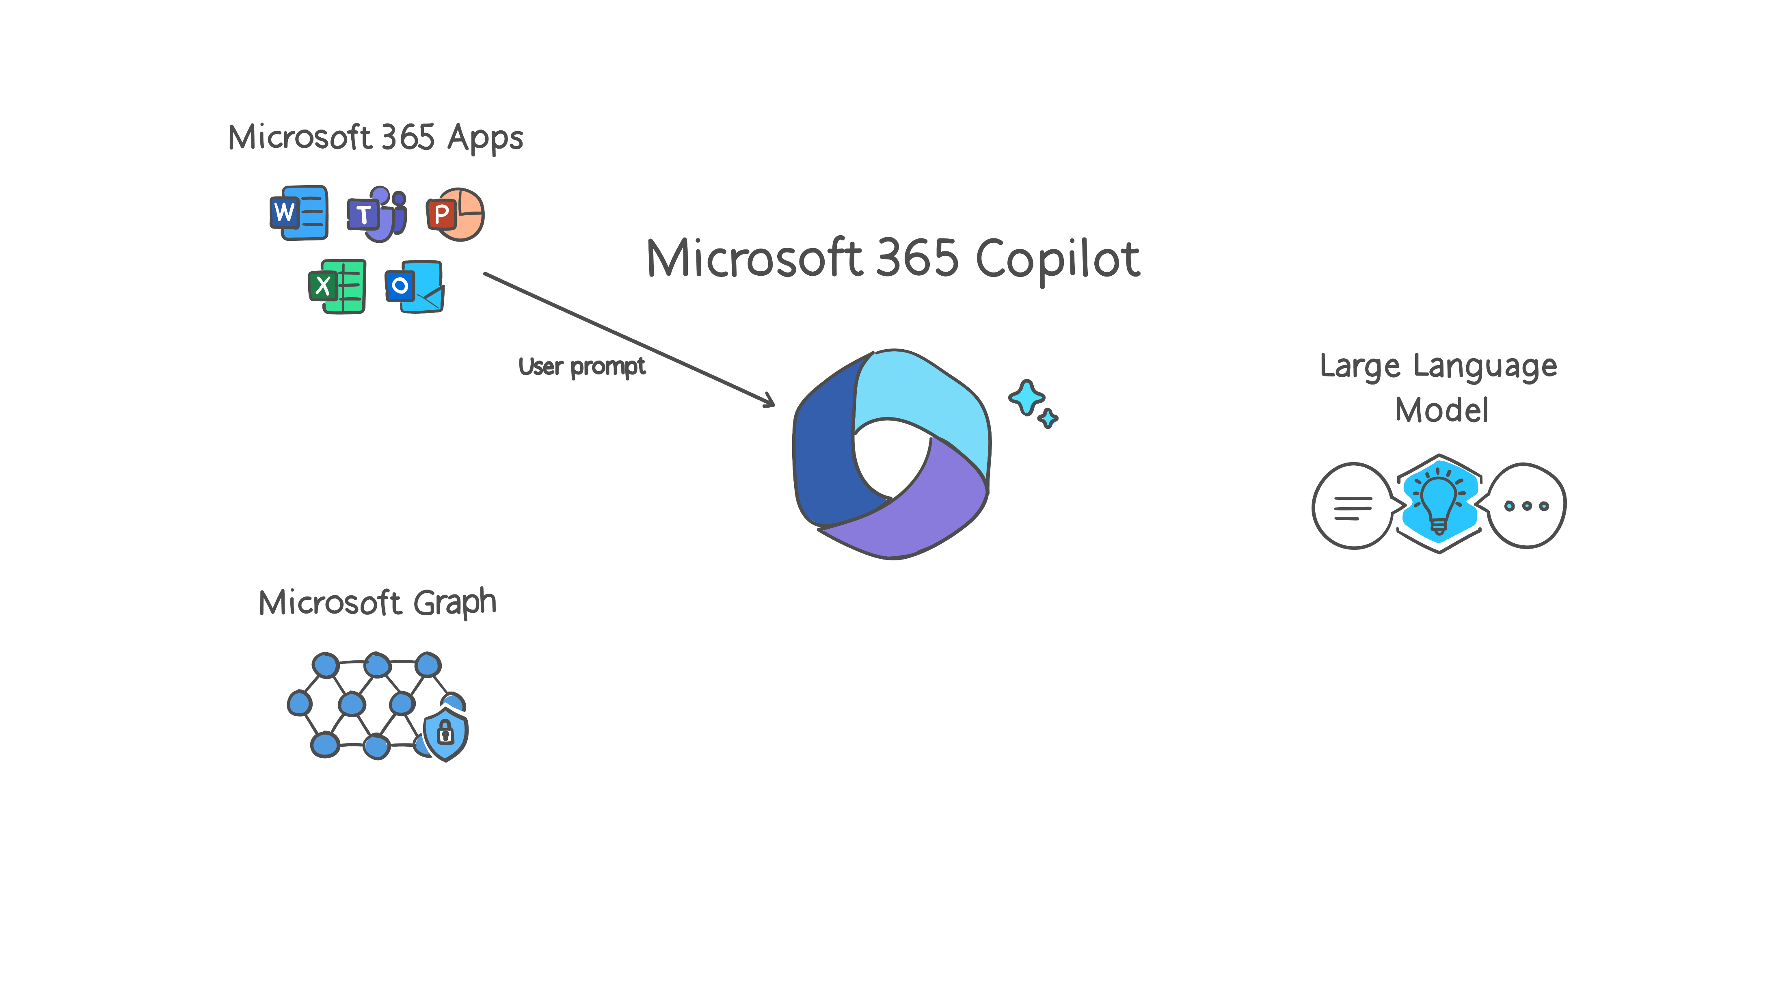
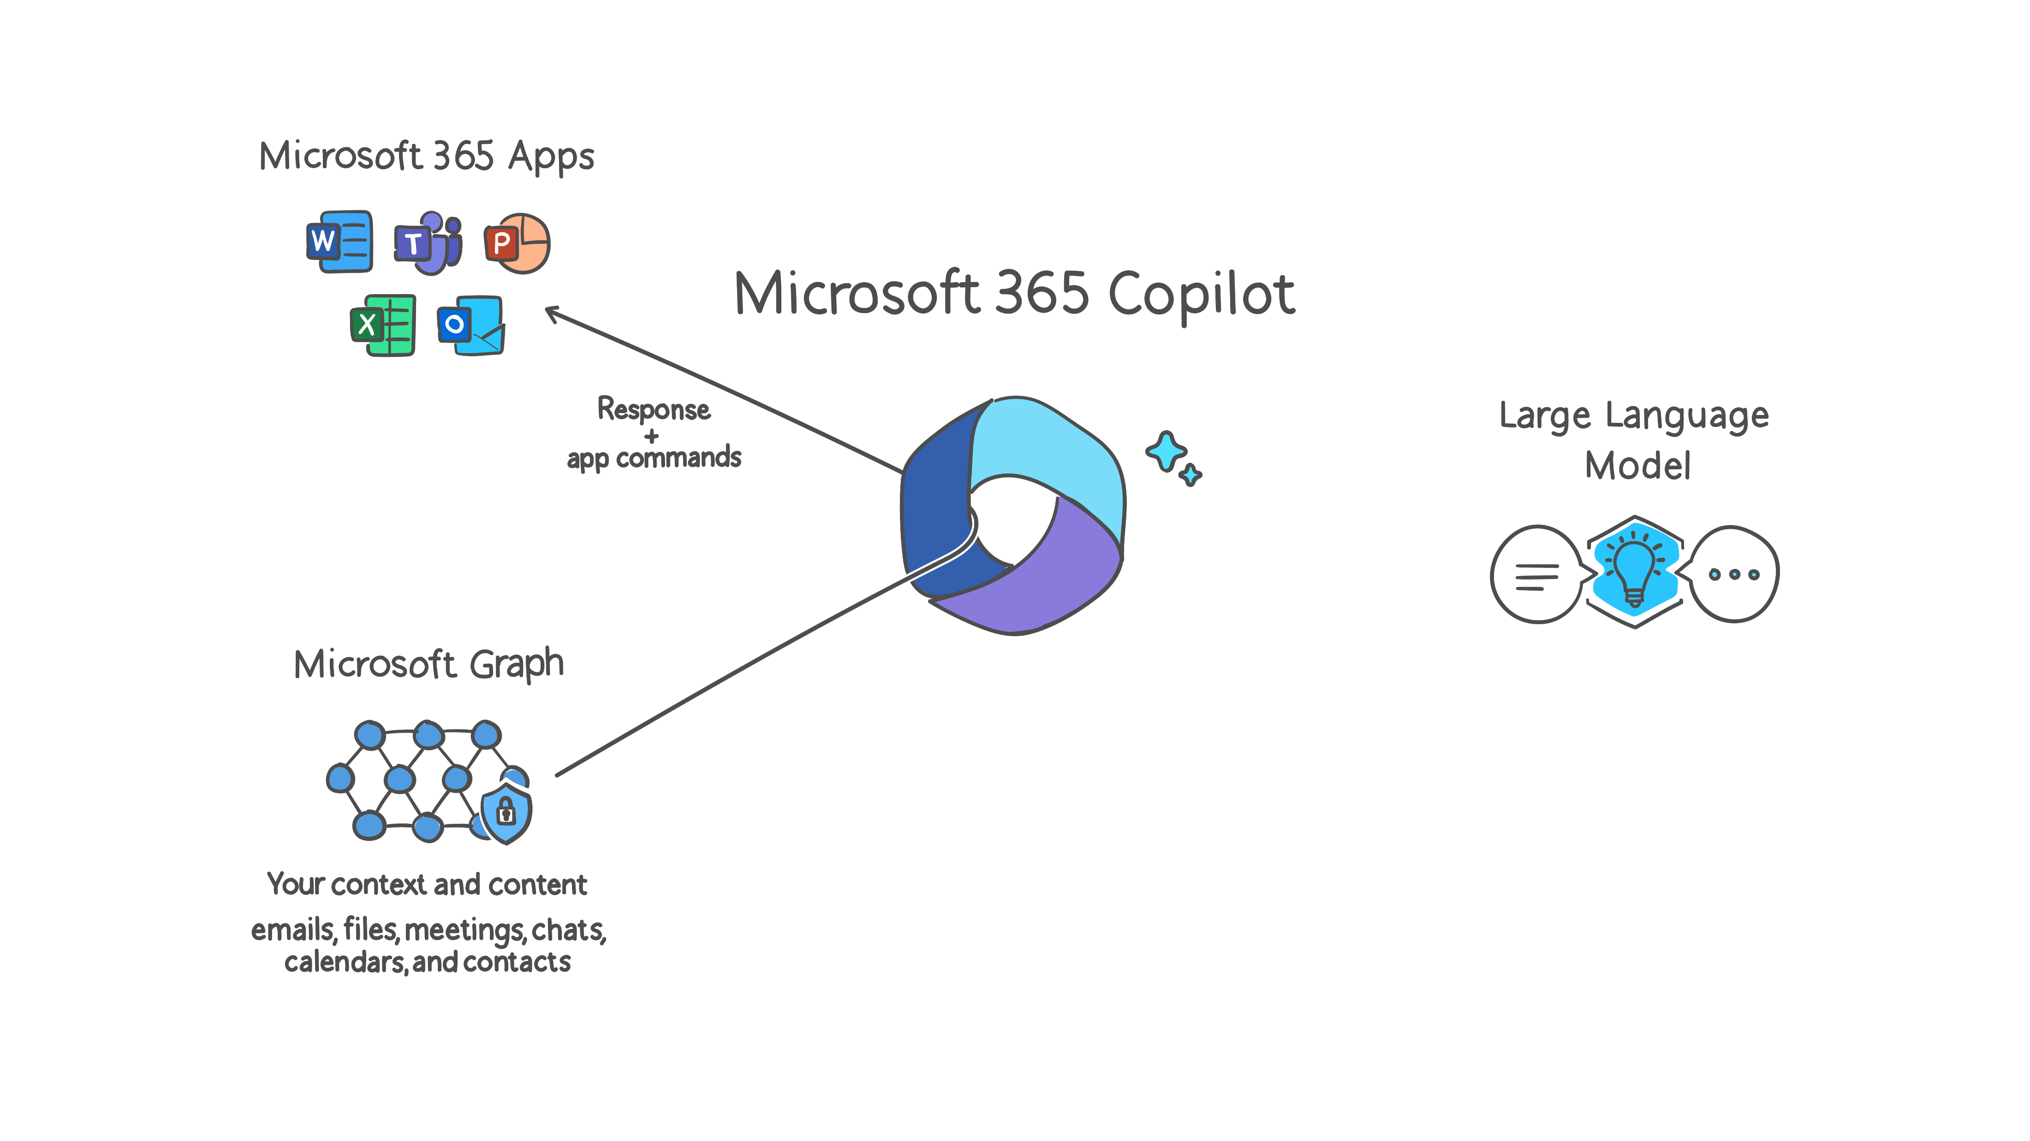



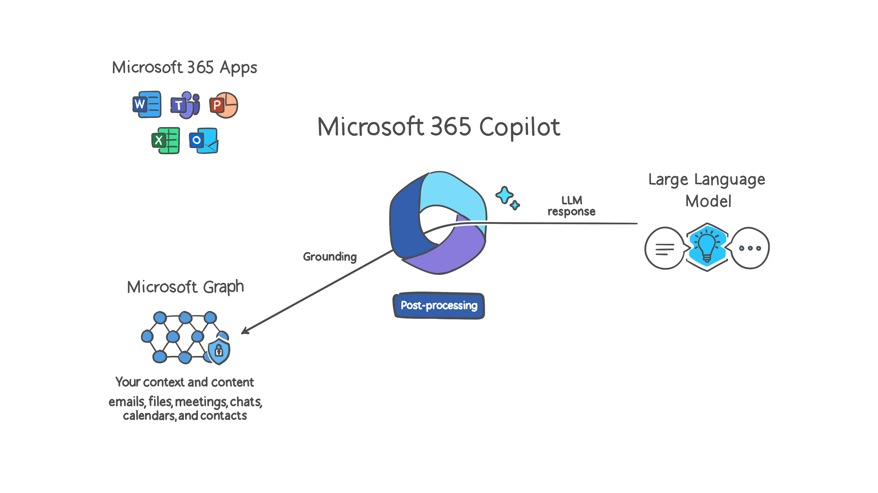
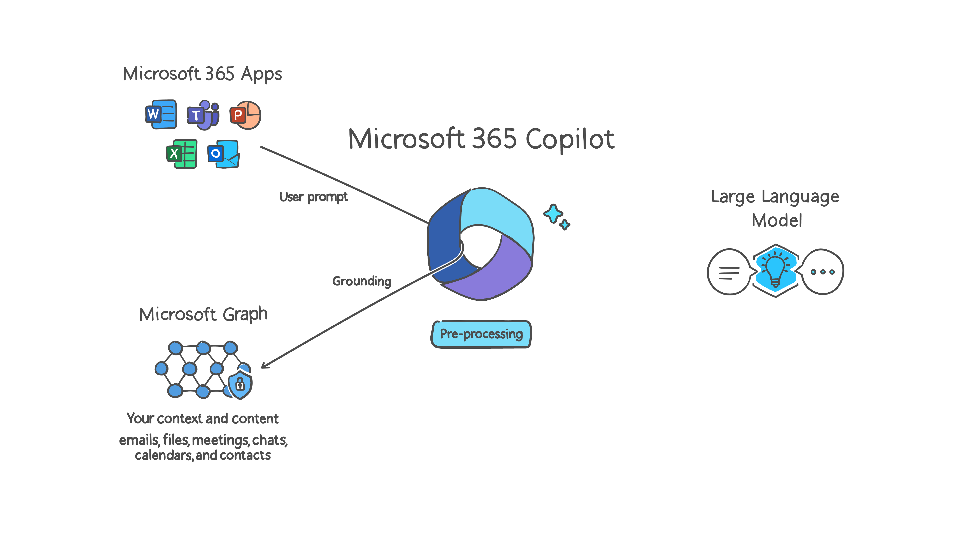
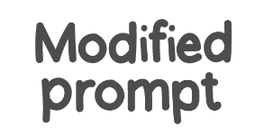
Overview of how a Copilot prompt is processed
Copilot sends the response, and app command back to Microsoft 365 Apps
1
6
User prompts from Microsoft 365 Apps are sent to Copilot
Copilot receives LLM response
4
Azure OpenAI
3
2
3
Copilot sends modified prompt to Large Language Model
Azure OpenAI instance is maintained by Microsoft. OpenAI has no access to the data or the model.
Copilot accesses Graph and Semantic Index for pre-processing
RAI
5
Responsible AI is performed on input prompt and output results
Copilot accesses Graph and Semantic Index for post-processing
Microsoft RAI principles: Fairness, Reliability and Safety, Privacy and Security, Inclusiveness, Transparency, Accountability
Your context and content:
emails, files, meetings, Teams chats, calendars, and contacts
Notes:
Note to presenter: This slide builds. Click to advance for each bullet below.
Let's break down how Microsoft 365 Copilot works into six main steps, which all happen in a matter of seconds for the user.
First, the entire process revolves around the Copilot agent. This agent connects to our Microsoft 365 Apps like Word, Teams, PowerPoint, Excel, and Outlook. When you enter a prompt in any of these apps, it gets sent to the Copilot agent.
Next, the Copilot agent sends your prompt to the Microsoft Graph. The Graph is a rich source of content and context from your emails, files, meetings, Teams chats, calendars, and contacts. This step, known as pre-processing, helps Copilot ground its response in the most relevant data for you.
After that, the graph-grounded response is sent back to the Copilot agent, which then modifies the prompt and forwards it to the Large Language Model (LLM). This is where AI models like ChatGPT come into play to help generate an answer.
One of the unique aspects of Copilot is the Responsible AI (RAI) policies that Microsoft applies to the LLM. These principles include fairness, reliability and safety, privacy and security, inclusiveness, transparency, and accountability.
From there, the prompt is sent through Azure OpenAI to generate the response. Finally, in a step called post-processing, the Copilot agent reviews the LLM response, cross-checks it with relevant information from your Microsoft Graph, and prepares the final response that is sent back to you.

Slide 5
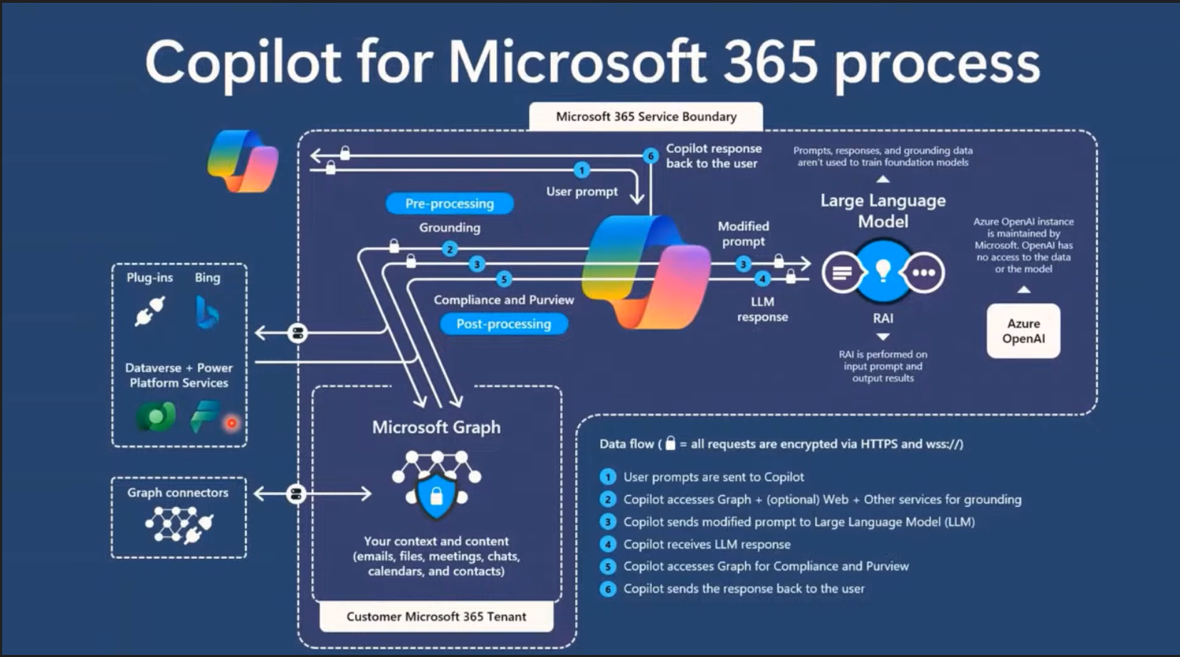
Notes:
In this view, an illustration of the Microsoft 365 Service Boundary is presented. This boundary represents the Microsoft Tenant, where all six steps of prompt processing occur. This ensures that your data never leaves the tenant, keeping it secure and protected without going to the internet.
On the left side of the screen, there are steps where a prompt might be sent to the internet through extensions and plugins. We'll cover how these work later on. However, this slide emphasizes that your data stays within the Microsoft 365 Service Boundary. So, while the prompt itself might go to the web for information, your data remains securely within the tenant.

Slide 6
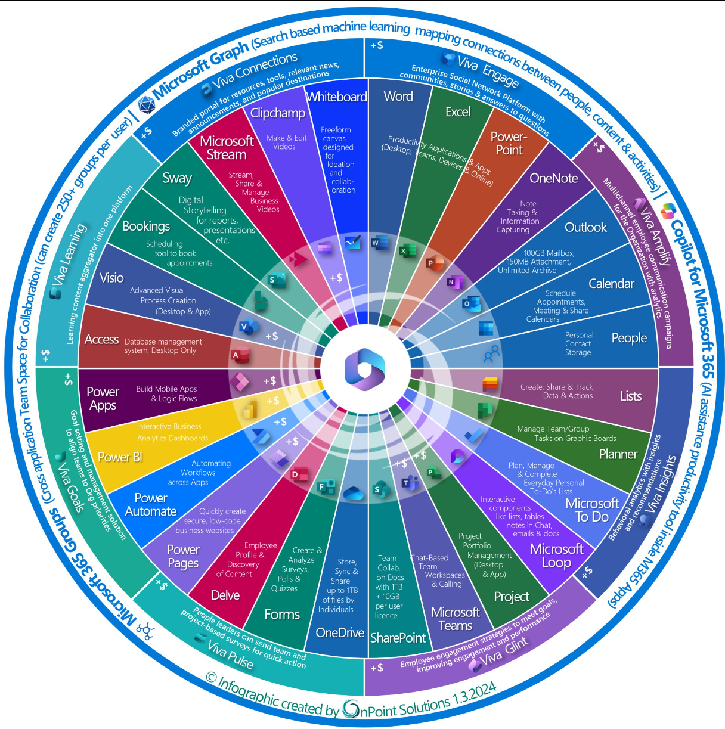
Copilot meets you where you work!
Notes:
There are many Copilots available today, each designed to enhance your productivity within your current workflow.

Slide 7


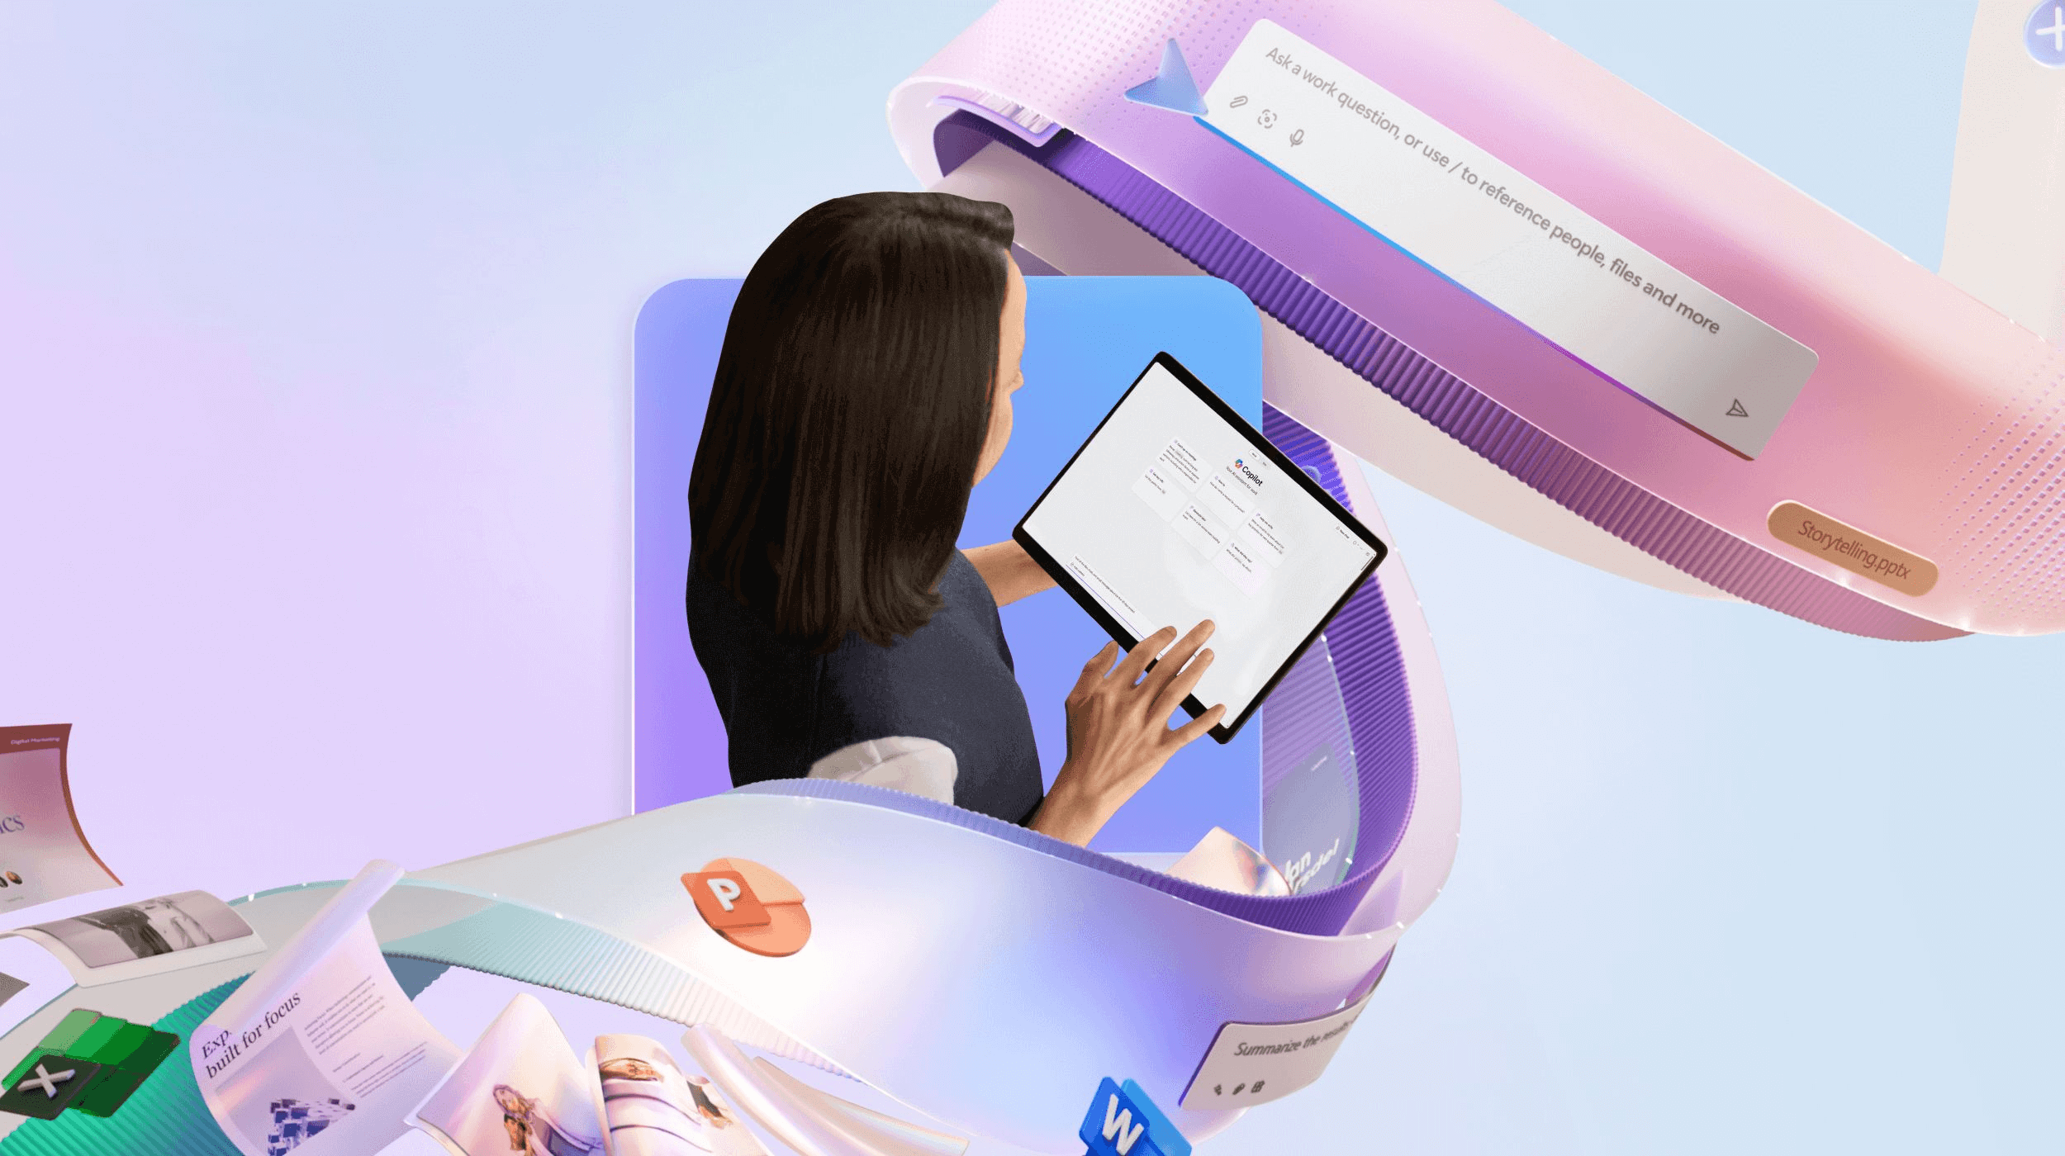
Overview of Copilot types
Application specific Copilot
  Available in Word, Excel, PowerPoint, Teams, and Outlook
  Fine-tuned to work with specific applications
Copilot as a tool
  Click a button and it performs a task
  No need to enter a prompt
Microsoft 365 Copilot
  Graph grounded chat
  Supports workflow automation
Notes:
Copilot can be categorized into three types: as a tool, application-specific, and Microsoft 365 Copilot. The tool version performs tasks with a click, application-specific versions are fine-tuned for apps like Word and Excel, and Microsoft 365 Copilot supports workflow automation.
Application-Specific Copilots: These are tailored for individual apps like Word and Excel, providing context-aware suggestions to boost productivity.
Task Execution Without Prompts: Copilot can perform tasks proactively without needing specific prompts, streamlining your workflow by generating content and organizing information.
Microsoft 365 Copilot: Microsoft 365 Copilot integrates these features across the suite, offering seamless collaboration and contextual insights for tasks like meeting preparation and presentation creation.

Slide 8
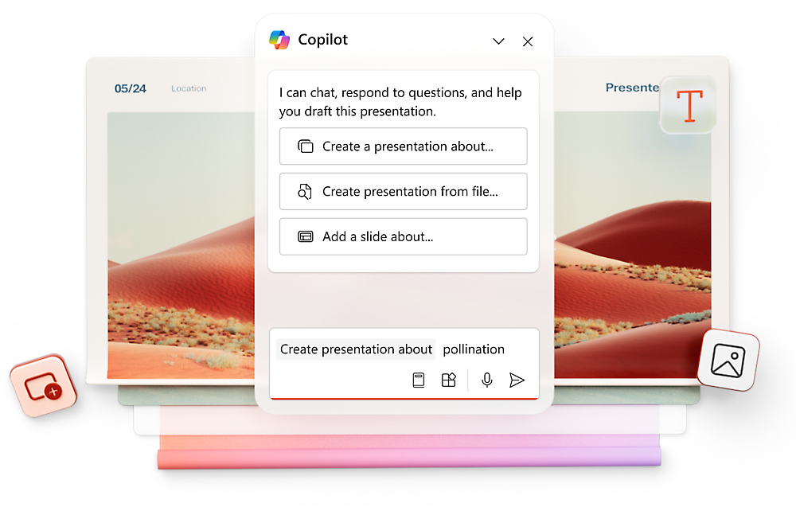
Application-specific Copilots
Versions of Copilot that are configured to work specifically with each particular app.
In most Microsoft 365 applications, the Copilot button is in the top ribbon.
Selecting the button opens a side pane with app-specific prompts.
For example, in PowerPoint Copilot assists with:
Creating slide layouts and designs, suggesting content and images, and enhancing presentations with design ideas.
Copilot can also help with generating speaker notes, recommending transitions and animations, providing feedback on slide clarity and impact.
Notes:
First, let’s define what we mean by Application-Specific Copilots. These are tailored versions of Copilot that work specifically within individual applications.
In most applications, you’ll find the Copilot button conveniently located in the top ribbon. When you select this button, it opens a side pane filled with prompts and suggestions specifically designed for the application you’re using, whether it’s Word, Excel, or Outlook.
In this example, we’re pulling up Copilot in PowerPoint. As we do so, Copilot provides a list of prompt suggestions and recommendations for how it can assist you, such as:
Creating Slide Layouts: It helps you design visually appealing slides by suggesting layouts and themes.
Content Suggestions: Copilot can recommend relevant content and images to enhance your message.
Design Ideas: It offers design enhancements to make your presentation stand out."
Beyond just design, Copilot in PowerPoint also provides:
Speaker Notes: It can generate notes to help you during your presentation.
Transitions and Animations: It recommends smooth transitions and animations to keep your audience engaged.
Feedback: Copilot can analyze your slides and provide feedback on clarity and impact.

Slide 9
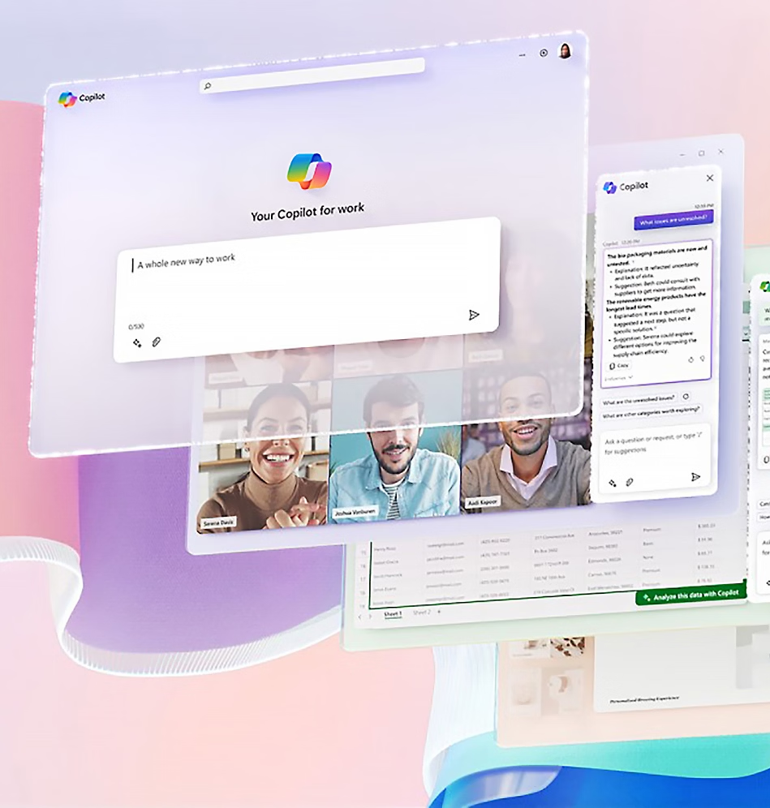
Microsoft 365 Copilot
Microsoft 365 Copilot features graph-grounded chat and works across all applications, enabling you to ask about people, prepare for meetings, and create files.
Key Differences from app-specific Copilots:
Scope:
Graph Grounded Chat: Cross-application functionality.
Application-specific Copilots: Focused on individual applications.
Data Integration:
Graph Grounded Chat: Holistic view across Microsoft 365.
Application-specific Copilots: Suggestions tailored to one app.
Notes:
Let’s explore the capabilities of Copilot for Microsoft 365 Graph Grounded Chat and how it differs from Application-Specific Copilots.
Overview of Graph Grounded Chat: Copilot for Microsoft 365 Graph Grounded Chat integrates data from various Microsoft 365 applications, providing a contextual chat experience. This means that when you’re having a conversation, it can pull in relevant information from your emails, documents, and calendar events, making discussions more informed and productive.
Collaboration Features: It enhances collaboration by offering insights based on the collective data from your team, ensuring everyone stays aligned on projects.
Differences from Application-Specific Copilots: Now, let’s look at how this differs from Application-Specific Copilots. The Graph Grounded Chat is designed for cross-application functionality, allowing you to interact with data from multiple apps in one chat interface. In contrast, Application-Specific Copilots focus on optimizing the user experience within a single application, providing tailored prompts and suggestions relevant to that app.
Data Integration: Another key difference is in data integration. Graph Grounded Chat offers a holistic view of your work across Microsoft 365, while Application-Specific Copilots utilize features and data specific to the application you’re using.

Slide 10
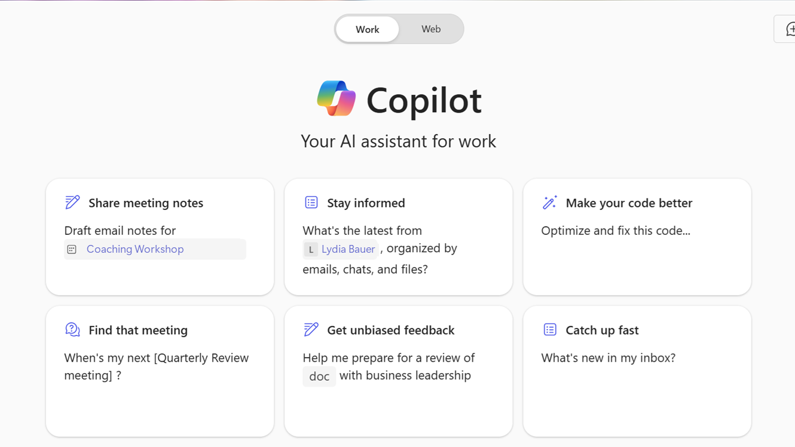
Copilot for Microsoft 365 Chat
Copilot provides quick, relevant suggestions based on your context and activities:
Daily Copilot habits: Tips and tricks to integrate Copilot into your daily workflow
Top prompts of the week: Highlighting the most popular and useful prompts used by other users
Learning resources: Links to courses and guides to help users get the most out of Copilot
In work mode, organizations can provide tailored recommendations on the Microsoft 365 Copilot chat page based on the user's role, tasks, and organizational data.
Notes:
Prompt suggestions are designed to help you get started with Copilot by providing quick and relevant suggestions based on your context and activities.
There are several types of prompt suggestions available. For example, 'Daily Copilot Habits' offers tips and tricks to integrate Copilot into your daily workflow. 'Top Prompts of the Week' highlights the most popular and useful prompts used by other users. Additionally, there are learning resources that link to courses and guides to help you get the most out of Copilot.
In work mode, Microsoft 365 Copilot offers a powerful feature where organizations can provide tailored recommendations to enhance user productivity and efficiency. These recommendations are based on the user's role, tasks, and organizational data, ensuring they are relevant and timely.
For example, organizations can suggest task-specific prompts that align with the user's current projects, provide links to internal training materials and guides, and share best practices tailored to their workflows. Additionally, by connecting to organizational data through Microsoft Graph, Copilot can offer contextual insights based on recent interactions, such as emails, meetings, and documents.
Overall, these personalized recommendations help users make the most of Microsoft 365 Copilot, providing them with the guidance they need to work more effectively and efficiently.

Slide 11
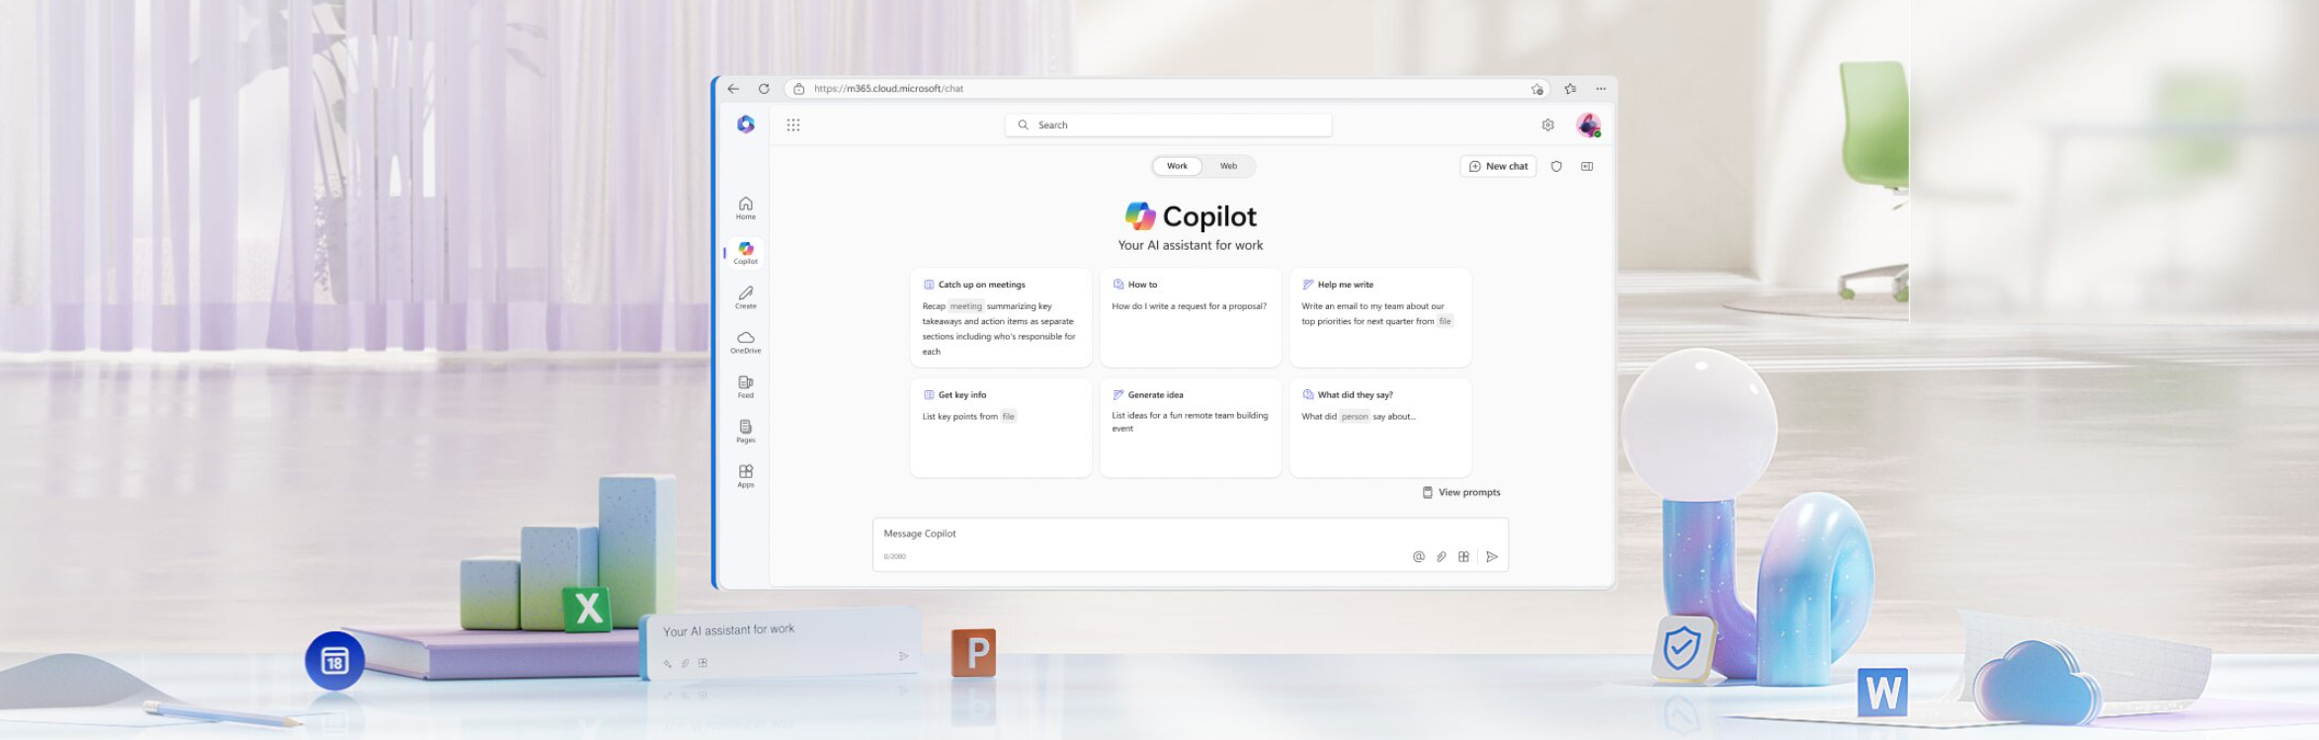
Interacting with Copilot
Opening shared files
  Files include PowerPoint, Word docs, PDFs, etc.
Copilot indexing
  Starts indexing as soon as the file is opened
Microsoft Graph integration
  Indexed files become part of your Microsoft Graph
Querying information
  Indexed files can be queried for information
Ensuring file inclusion
  Opening files ensures they are part of your graph
  Helps in answering questions based on your data
Notes:
Let’s go over some of the benefits of opening shared files and how it integrates with our systems. When you open shared files, whether they are PowerPoint presentations, Word documents, or PDFs, Copilot starts indexing them immediately. This indexing process ensures that these files become part of your Microsoft Graph, making them easily accessible and searchable.
Once indexed, these files can be queried for information, allowing you to quickly find the data you need. By opening these files, you ensure they are included in your graph, which helps in answering questions based on your data. This seamless integration enhances your ability to manage and utilize your documents effectively

Slide 12
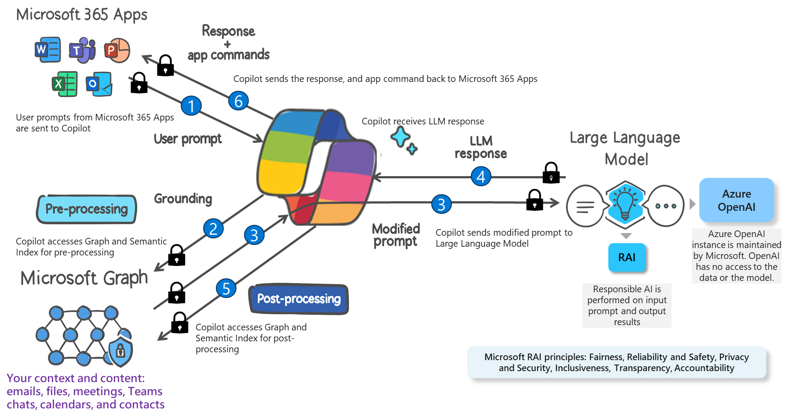
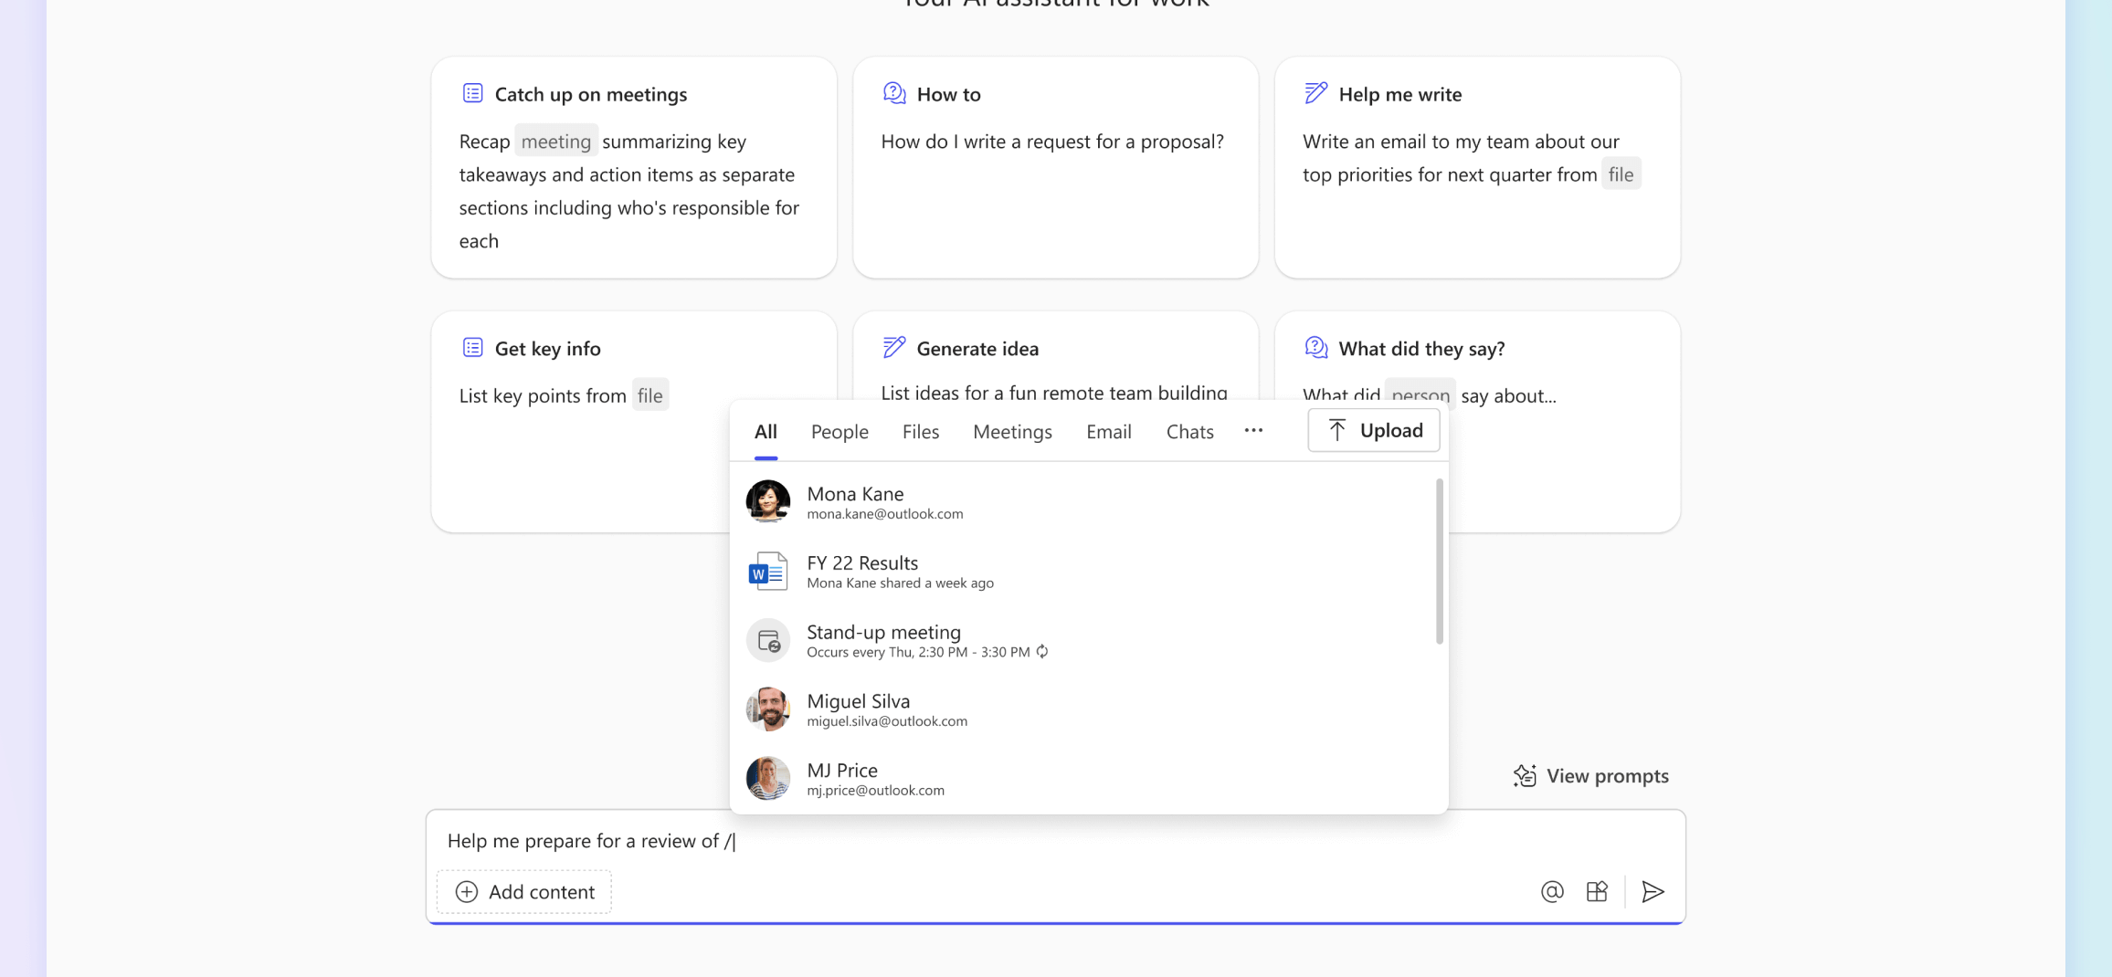
Context IQ in Copilot
What is Context IQ?
AI-powered feature enhancing grounding and collaboration.
Provides relevant content suggestions based on intelligent scanning.
Supports referencing files, people, meetings, and emails.
How to use Context IQ
Accessible through the forward slash (/) command.
Type the forward slash (/) and begin typing to get suggestions.
Select the appropriate suggestion to insert it directly into your workspace.
Notes:
Context IQ in Copilot, is an AI-powered feature designed to enhance grounding and collaboration. Context IQ intelligently scans your files, emails, conversations, and other Microsoft 365 apps and services to provide relevant content suggestions. This feature supports referencing files, people, meetings, and emails, making it easier to access the information you need.
To use Context IQ, you can initiate it using the forward slash (/) command. Simply type the forward slash (/) and begin typing the name of the file, person, meeting, or email you want to reference. Context IQ will suggest relevant options based on your recent activity and interactions. You can then select the appropriate suggestion to insert it directly into your workspace, whether you're in a document, email, or chat.
By understanding how Context IQ works, we can see how Copilot seamlessly integrates with our daily tasks, providing us with the right information at the right time. This connection between Copilot and the user is what makes it such a powerful tool for enhancing productivity and efficiency.

Slide 13
Summarizing what we learned
Introduction to Microsoft 365 Copilot: We started with an overview of what Copilot is and how it works within the Microsoft 365 ecosystem.
Types of Copilot: We explored the different types of Copilot, including application-specific Copilots and the Microsoft 365 Copilot, highlighting their unique features and functionalities.
Using Copilot effectively: We discussed how to interact with Copilot, use prompts and bookmarks, and manage Copilot chat history.
Copilot in different interfaces: We looked at how Copilot integrates with various interfaces like Windows, Web, and Teams.
Advanced features: We covered advanced features such as plugins, extensions, and saving and sharing results.
Practical tips: We provided practical tips on accessibility, voice commands, and using the Prompt Buddy.
Context IQ: We wrapped up with an explanation of Context IQ, an AI-powered feature that enhances grounding and collaboration by providing relevant content suggestions.

