Slide 1
Upleveling your work with Microsoft 365 Copilot agents
Microsoft 365 Copilot licensed users

Slide 2
What’s inside
Here’s what we’ll cover
Microsoft 365 Copilot includes pre-built agents that help you work smarter, from creating content and analyzing data to running meetings.
1
Word, Excel, and PowerPoint Agents
Create polished documents, spreadsheets, and presentations from chat
2
Researcher
Collect and synthesize information for deeper, more informed decisions
3
Analyst
Turn raw data into actionable insights with advanced reasoning
4
Facilitator
Run more effective meetings with real-time notes, agendas, and action items
5
Coaches
Leverage coaches for better prompting, brainstorming, and everyday tasks
Included with Microsoft 365 Copilot

Slide 3
Word, Excel, and PowerPoint
Included with Microsoft 365 Copilot

Slide 4
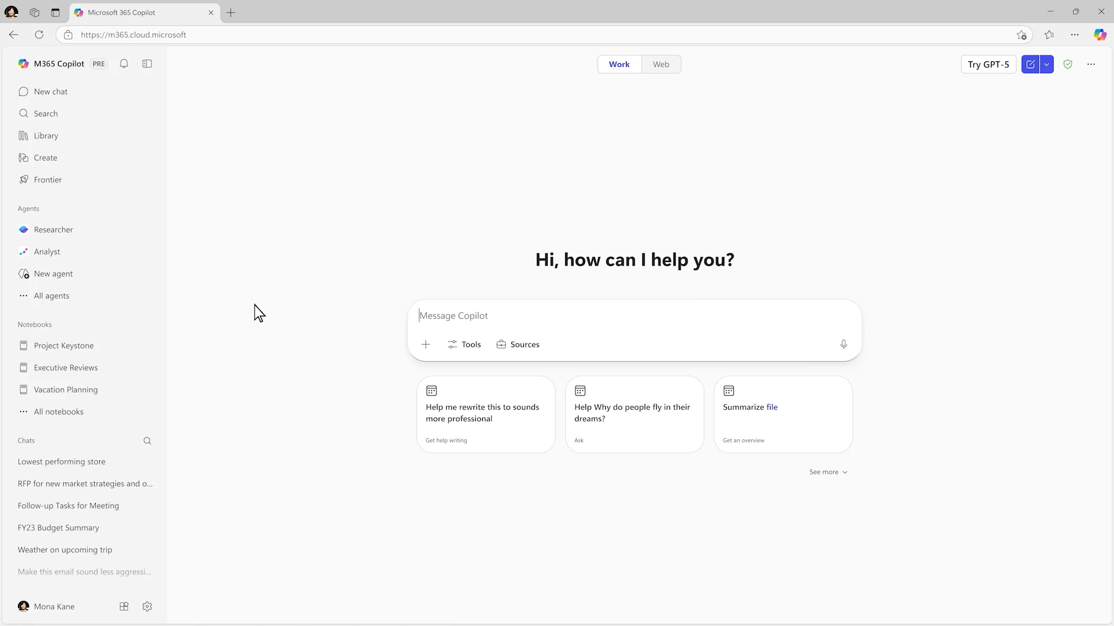
Word, Excel, and PowerPoint Agents
  Turns ideas into polished documents, spreadsheets, and presentations directly in chat.
  Reasons over content with both Work IQ and web sources to research, analyze and create high-quality outputs.
  Works to clarify your request through targeted questions about focus, structure and files.
  Refine results in Chat or open in the Word, Excel, or PowerPoint apps to edit and collaborate further.
Notes:
With dedicated Word, Excel, and PowerPoint Agents in Microsoft 365 Copilot, users can now start projects in Copilot Chat—using natural language prompts to quickly generate documents, spreadsheets, and presentations.
These agents don’t just create; they guide users with clarifying questions, helping shape outputs that match specific goals and use cases. This chat-first approach makes it easy to get started, whether you’re drafting a strategic plan, analyzing data, or building a presentation.
Once the initial draft is ready, Copilot makes it seamless to move into Word, Excel, or PowerPoint for deeper editing and customization. Inside each app, Copilot continues to assist, help refine content, apply formatting, and
Key differentiators:
Office-native file generation
Enterprise grounding with Work IQ and context
Compliant storage with OneDrive
Multi-step reasoning

Slide 5
Why choose Word, Excel & Power Point Agents for content creation
Copilot creates AI content the same way teams already work — collaboratively, securely, and in one shared version.
1
2
3
Grounded in your work
Uses Work IQ, so edits reflect what’s current and relevant across your files, meetings, emails, chats and relationships.
Native app fidelity & integration
Creates real Excel formulas, Pivot Tables, and charts; uses company templates in PowerPoint; and applies approved Word templates, so outputs work as intended.
Built for collaboration
Supports team collaboration in shared files stored in OneDrive and SharePoint, so teams iterate on a single, shared version.
4
5
6
Trusted
Enforces M365 permissions and labels, saves to OneDrive/SharePoint and applies tenant control, preventing unauthorized processing and enabling governance at scale.
Full visibility & control
Applies changes directly in Word, Excel, PowerPoint and Outlook, so edits are transparent, reviewable, and reversible as you iterate.
Model choice
Brings leading models from multiple providers into your work experience, so you can get high-quality output for the task without switching tools.

Slide 6
How the agents work
How to use Word, Excel & PowerPoint Agents
Find the file(s) that you want Copilot to analyze and pull information from. Add the files to your prompt to the agent, either by uploading directly or selecting from your Microsoft 365 files.
The agents support up to 5 files at once across multiple formats (Word, PPT, PDF) and datasets (Excel, CSV).
Provide the agents context of the problem and what you’re trying to achieve by creating a new document. Mention if you want the information in a specific format like a table or graph.
Word, Excel & PowerPoint agents will then understand the data, construct a plan, and ask a few questions to refine before producing the draft document.
    Where to find the agents
For users with a Microsoft 365 Copilot license
Word, Excel and PowerPoint agents are accessible as an agent in Copilot Chat in the Microsoft 365 Copilot app – select the + button in Copilot Chat.
Access them via the Agents menu in the Microsoft 365 Copilot app or type @Word, @Excel, or @PowerPoint in Copilot Chat
    What makes these agents special
Word, Excel and PowerPoint agents leverage WorkIQ providing them context about your work and your organization’s information such as your shared documents, emails, conversations, making the results relevant to your business needs.
These agents will store created files in OneDrive, and follow your organization’s security, privacy and compliance policies.
TIP The process may take a few minutes - you can follow the chain-of-thought reasoning or continue with other priorities while it works.

Slide 7
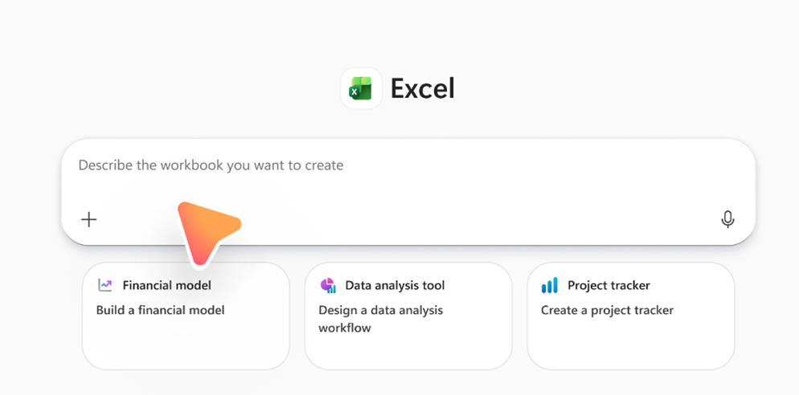
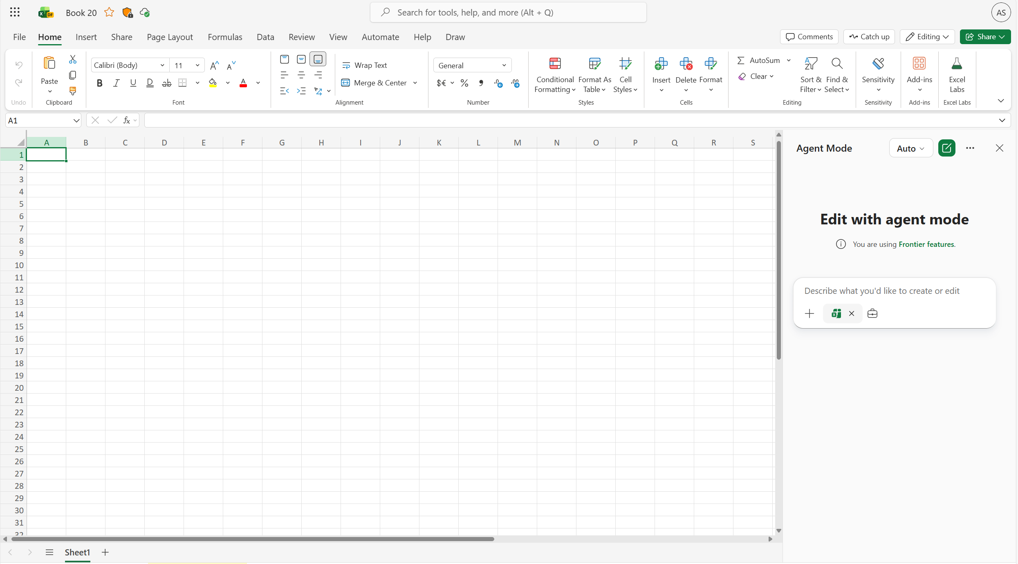
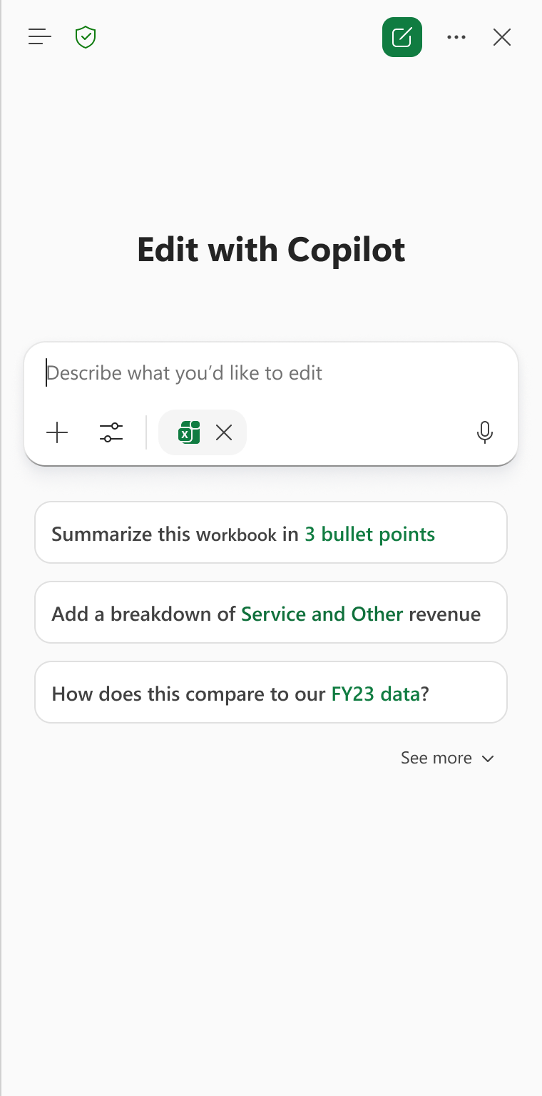
Copilot can help create and then refine content in app
1
2
Create a file
Continue editing in app
In the Microsoft 365 Copilot app on the web or in Teams, go to the Agents menu, and choose the Word, Excel, or PowerPoint Agent. Enter your prompt describing the file you want to create.
The Word, Excel, and PowerPoint Agents can also be accessed via the Agent Store.
After creating a first draft with the agent, you can open it and edit immediately in Word, Excel, or PowerPoint. Open Copilot chat in the app and select the Tools icon below the area where you would input your prompt, then select ‘Edit with Copilot’.

Slide 8
Cheat sheet: When to use Copilot for Word, Excel, and PowerPoint creation
App | What you can do | Example prompts to create a file | Example prompts to continue editing in app
Excel | Build and iterate on spreadsheets Create structured workbooks Analyze and model scenarios Visualize data with charts and summaries | Create from scratch (in chat or in Excel): “Create a project tracking workbook with tasks, owners, due dates, and status, plus a summary sheet.” | Multi-step actions (in Excel): “Add formulas to calculate on‑time completion rate and highlight overdue items.” Model scenarios and sensitivity (in Excel): “Add best‑, base‑, and worst‑case scenarios for this forecast and explain the assumptions along with a sensitivity analysis.” Visualize data (in Excel): “Create a PivotTable and charts showing status by owner and overall risk in a dashboard format to share with my team.”
Word | Create, refine, and maintain real documents Draft net‑new content Improve tone, clarity, and structure Update recurring documents with new info | Create (in chat or in Word): “Create a 2‑page customer brief explaining our Q3 product strategy, including goals, key initiatives, and success metrics.” | Refine (in Word): “Rewrite the executive summary to be more concise and executive‑ready, and add clear section headers.” Targeted edits (in Word): “Turn this section into a table comparing options and bold the recommended choice.” Update an existing doc (in Word): “Update this monthly report with the latest September results and adjust the conclusion to reflect the new data.”
PowerPoint | Create, transform, and polish presentations Generate a first‑draft deck fast Transform text into visuals Edit while preserving layout and brand | Create (in chat or in PowerPoint): “Create a 6‑slide executive update on our go‑to‑market plan, including progress, risks, and next steps.” | Polish (in PowerPoint): “Tighten slide titles, simplify the content, and keep the existing layout.” Transform (in PowerPoint): “Turn the bullet list on this slide into a chart.” On‑brand edits (in PowerPoint): “Add a new slide using my company template.” + “Make sure this deck follows brand guidelines.”

Slide 9





Word Agent in Action
Included with Microsoft 365 Copilot
Word Agent creates and refines long‑form documents from a prompt — handling structure, research, and formatting so you can focus on ideas.
Examples
 | Proposal creation | Event update | Build a report | Evaluate options | Executive Summary
Prompt | Create a proposal for [customer/product] using [file] as a template. Pull context from emails, Teams chats, meeting transcripts, and recent customer files (last 90 days) Include: customer situation, recommended solution (and options), assumptions, milestones, risks, ROI/pricing placeholder Add the following sections: cover page, executive summary, table of contents, and next steps | Summarize [Company name] 2025 announcements and themes Use Announcement-related emails, files in [folder], Teams chats, meetings, and internal strategy/roadmap docs (last 60–120 days) Map announcements to our priorities Include: top themes, project implications, opportunities/risks, next actions Also draft a 5–7 minute podcast script | Write a report on [industry] trends: Use internal project docs, design notes, OKRs, emails, chats, and meeting notes (last 12–18 months) Consider web sources: [research sites], [regulation sites], [industry reports] Focus on [customer segments] Include: internal vs external themes, roles/skills table, 12–24 month outlook, prioritized recommendations | Create a document to compare [option 1] and [option 2] to develop [project name]: Use project requirements, strategy doc, documents describing [option 1] and [option 2], and experiment notes in [project folder] and documents Use emails and chats and meetings related to [project name] and from [team names] Include: introduction, background, description of the options, pros and cons, recommendations, and next steps | Create an executive summary of the main discussion points over [project name] Consider my Teams chats in [channels] and Outlook threads about [project name] for the last 4 weeks Include: background, discussion points, proposed actions, risk and mitigation, and recommended next steps Limit the document to 3 pages

Slide 10
Excel Agent in Action
Included with Microsoft 365 Copilot
Excel Agent builds and analyzes spreadsheets using natural language — generating formulas, summaries, and performing multi‑step data tasks with iterative reasoning.
Examples
 | Sales planning | Financial model | Project tracking | Scenario modeling | Market forecast
Prompt | Create a workbook called ‘Q2 Sales Plan’: Include sheets for Pipeline, Actuals, and Assumptions Fill last 6 months with data from [Dataset.xlsx] for [customer segments] across [regions] Use clean tables and proper dates | Create discounted cash flow (DCF) model for [project name]: Consider project financials in [data file] and model assumptions in [data file] Include: assumptions tab, revenue build, full income statement and free cash flow bridge, DCF valuation and terminal value, sensitivity table across WACC and terminal growth ranges Formatting: use standard financial formatting | Create a project tracking system for [project name]: Include tasks, owners, milestones, budgets, and risk ratings Use recent workback plans in [folder], sprint notes, and budget files [data files] Generate: Gantt-style timeline, conditional formatting for at-risk/overdue tasks Include: dashboard with burndown charts, budget tracking, risk heatmap, and status-ready summary | Build a multi-year growth model for [product name]: Consider historical revenue, cost, pipeline, renewal, and pricing guidance data [data file] Include: full P&L, cash flow, balance sheet views Use: driver-based forecasting, base/upside/downside scenarios Add: sensitivity analysis (price, win rate, churn), error checks, dashboard, and executive summary | Build a market forecast for [category] in [region] for [range of years] Use latest data on [category] sales and growth rates from [file], and adjustable assumptions in [file] Include: assumptions, revenue forecast by segment, summary

Slide 11
PowerPoint Agent in Action
Included with Microsoft 365 Copilot
PowerPoint Agent turns prompts into complete presentations — generating slides, layouts, visuals, and helping refine content.
Examples
 | Project update | Financial analysis | Retirement savings plan | Business planning | Campaign readout
Prompt | Create a leadership-ready project update deck on [topic] Pull: decisions, milestones, owners, dates from emails, Teams chats, meeting notes Add: external benchmarks and competitor/news context Include: status vs goals, top risks with mitigations, open asks, timeline, action-item table | Build a presentation to discuss [range of years] forecast for [business unit] in [region] Use: internal assumptions, prior models, stakeholder notes from emails, chats, meeting recaps Include infographic for TAM and growth drivers with industry reports and public filings from [file] Include: assumptions, business unit forecast charts and tables, breakdowns by key segments, and sensitivity analysis | Create an employee-facing slide deck to increase retirement plan participation Pull: program details (match %, eligibility, enrollment steps, deadlines) from HR emails, benefits PDFs, Teams posts Include: FAQs, narrative with examples, ‘How to enroll’ guide, key reminders, manager talk-track | Draft an 8-slide plan the launch of [event name] in [location] with budget [amount]: Use: internal templates [template file], past event runbooks, vendor notes in [folder] Consider: permit/health requirements from city/county guidance Include: working backward timeline, milestones, staffing, budget breakdown, compliance checklist with owners | Create a deck summarizing our demand gen campaign performance for [quarter]: Consider structure from past campaign readout in [file] and data from [data file] Consider all major channels (paid search, paid social, onsite, and events) Include: key performance indicators, spend/ROI, top performing channels and assets, learnings, and recommendations Limit to 10 slides intended for marketing leadership

Slide 12
Top Industry Use Cases
Included with Microsoft 365 Copilot
Researcher gives organizations the capability they’d expect from a highly paid strategist or researcher, by combining the most advanced deep reasoning models with your organization’s work data and information on the web.
  Healthcare
  Retail
  Legal
Doctors and researchers face information overload with vast amounts of medical data
Try this prompt in PowerPoint Agent: “Build a 10-slide presentation summarizing the latest research on [medical topic] for a hospital leadership briefing, including key findings and implications.”
Retail managers struggle with inconsistent data from various sales channels
Try this prompt in Excel Agent: “Build a dashboard comparing online vs in-store sales by region and product category, with trendlines and inventory turnover rates.”
Lawyers and legal researchers need to sift through vast amounts of case law and legal documents.
Try this prompt in Word Agent: “Draft a legal brief summarizing recent case law on [topic], referencing internal memos, past case files, and regulatory updates.”
  Finance
  Manufacturing
  Technology
Financial analysts need to stay updated with market trends and regulatory changes
Try this prompt in Excel Agent: “Build a financial model for a new product launch, including revenue projections, cost breakdowns, and ROI scenarios.”
Engineers and production managers need to monitor and analyze production data
Try this prompt in PowerPoint Agent: “Build a presentation for the operations team showing bottlenecks, downtime trends, and proposed process improvements.”
Need to stay ahead of rapidly evolving technology trends and security threats
Try this prompt in Word Agent: “Write a whitepaper on emerging AI security risks, using internal threat reports, industry publications, and recent incident data.”

Slide 13
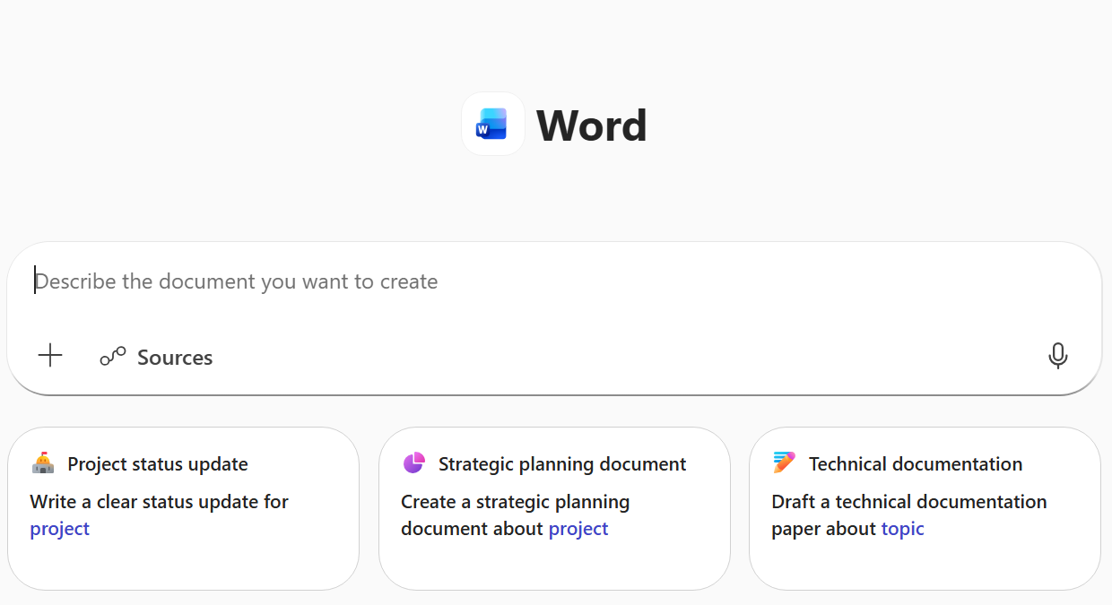
Experience the Benefits today
Microsoft 365 Copilot licensed employees now have access to the Word, Excel and PowerPoint Agents within the Agent menu in the Microsoft 365 Copilot app.
Try it today on Microsoft 365 Copilot.
Also available via the M365 Copilot Mobile App
Learn more
See the Excel, Word and PowerPoint agents in action in our announcement blog
Get started with Word, Excel, and PowerPoint Agents in Microsoft 365 Copilot

Slide 14
Researcher
Included with Microsoft 365 Copilot

Slide 15

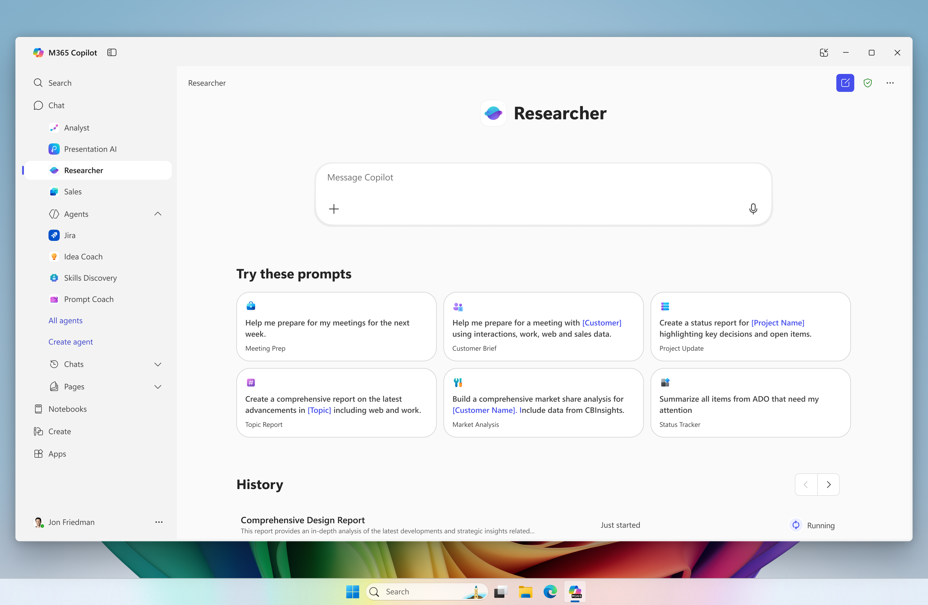
Researcher
Researcher gives organizations the capability they’d expect from a highly paid strategist or researcher, by combining the most advanced deep reasoning models with your organization’s work data and information on the web.
Delegate complexity. Gain clarity. Stay ahead.
Thorough
Purposeful
Trusted
Researcher goes beyond quick answers - it comprehensively compiles data, trends and insights for proposals or decisions
Researcher considers the outcome and works FOR you - autonomously synthesizing multi-step, multi-source analysis
Enterprise security for your M365 data combined with external insights transparently source-cited for increased confidence
It searched everywhere—my meeting transcripts, shared files, the web—[ït] makes me trust the final recommendation much more. I have found myself using Researcher daily. Product Manager
Included with Microsoft 365 Copilot

Slide 16
How it Works
Knowledge workers rely on
two types of data:
Copilot Chat relies on the latest large language models to quickly search work and web data sets and provide rapid quick, concise answers.
Researcher builds on Copilot Chat with a new class of models – advanced reasoning models – to create a research plan, execute it, and build more comprehensive, complex, and exec-ready reports.
    Web Data
    Publicly available data that helps define the current state of the world.
    Retrieval Augmented Generation
    Copilot Chat uses a tool called Retrieval Augmented Generation to search across all of a user’s data – and the web – to extract the items most relevant to the question asked.
    Chain of Thought
    In response to a prompt, Researcher uses recursive reasoning to understand a task, perform research, and create a report.
    Work Data
    The proprietary data that a user has access to, from emails and call transcripts to SharePoint sites and databases.
    Research
    Researcher is built on a model that’s been taught to think like a professional researcher.
Tip !
Researcher works FOR you to compile deeper, more thorough content – this may take minutes.
Continue tasks, attend a meeting or use M365 Copilot via another channel while it works!

Slide 17

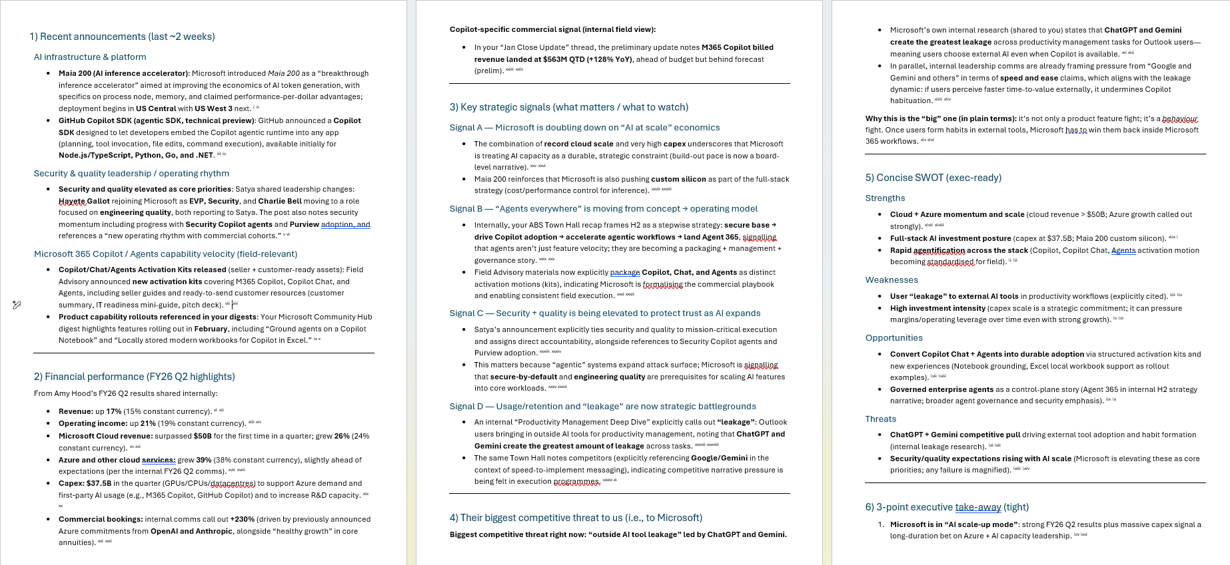
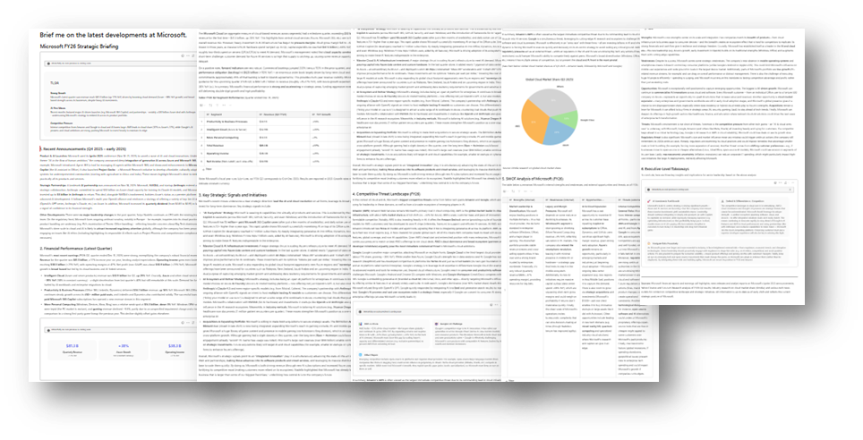
How it Compares
Deep Thinking
Researcher
Enhances the reasoning engine, but interaction remains conversational | Purpose‑built to reason within your enterprise & produce trusted, decision‑ready outputs
Included in all Microsoft 365 Enterprise SKUS via Chat GPT 5.2 LLM | Included with M365 Copilot licensed SKU as pre-built agent
Output: Conversational, user-driven interactions | Output: Thorough, synthesized report compiled over several minutes
Use it when: You’re iterating, brainstorming, or drafting You know what to ask and how deep to go Speed matters more than completeness | Use it when: You want inputs with an ambiguous or cross‑domain construct You want Copilot to do the research, not help you do it The output must be trusted, cited, and shareable E.g. for a plan, proposal, client summary, executive report, business case
Sources: Optional/light weight | Sources: Built-in, explicit source citing
No agent orchestration | Can call other agents
Example: Deep Thinking Output, 3 prompts (~1 minute), exported to edit | Example: Researcher Output, single prompt (~3 minutes), editable

Slide 18
Researcher in Action – no PhD required!
Included with Microsoft 365 Copilot
Researcher gives you the capability you’d expect from a highly paid strategist or researcher, saving you time and producing quality outputs, by combining the most advanced deep reasoning models with your organization’s work data and information on the web.
Examples
 | Competitive Analysis | Client Prep | Industry Research | Project Status Updates | Personal Productivity
Pain point | Hard to track competitors quickly and consolidate insights across sources. | Preparing for client meetings requires gathering scattered context under tight deadlines. | Teams drown in information when trying to understand industry trends. | Project updates live in many places, making status and blockers unclear. | Busy schedules make it hard to prioritize tasks and plan effectively.
Researcher can help | Get fast, competitive insights with internal and external data. | Summarize client history and insights into a meeting brief. | Get relevant trends into focused, actionable insights. | Consolidate updates, highlight decisions, and surface risks. | Analyze your workload and create a clear, prioritized weekly plan.
Prompt | Brief me on the latest developments at [Company Name]. Include: Recent announcements Financial performance Key strategic signals Then outline their biggest competitive threat to us and a concise SWOT analysis Summarize with a 3-point executive-level take-away | Prepare a briefing for my meeting with [Client Name]. Include: Recent news and business priorities Past interactions with us Roles of stakeholders attending Outline potential objections and how to address them with tailored recommendations for how we can add value | Produce a synthesized report on the current state of [Industry]. Include: Key trends and regulatory shifts Emerging players and technology disruptions Then explain how these developments may impact our business, product, or strategy with 3–5 strategic considerations we should monitor or act on | Aggregate all updates for Project [Name] across documents, chats, meetings, and emails. Provide: A detailed timeline of actions, decisions, open issues, and risks Flags for blockers and likely owners Recommended next steps Then summarize what leadership should know for a status review | Using my calendar, emails, chats, and current documents, create a prioritized weekly plan. Identify: My top objectives, deadlines, and required follow‑ups Meetings to keep or decline Prep work needed Then suggest: Focus blocks aligned with current company context

Slide 19
Top Industry Use Cases
Included with Microsoft 365 Copilot
Researcher gives organizations the capability they’d expect from a highly paid strategist or researcher, by combining the most advanced deep reasoning models with your organization’s work data and information on the web.
Healthcare
Doctors and researchers face information overload with vast amounts of medical data
The Researcher Agent synthesizes data from medical journals, patient records, and clinical trials to provide comprehensive reports, aiding in faster and more accurate diagnoses.
Retail
Retail managers struggle with inconsistent data from various sales channels
The Researcher Agent consolidates data from online and offline sales, customer feedback, and market trends, helping managers optimize inventory and improve customer satisfaction.
Legal
Lawyers and legal researchers need to sift through vast amounts of case law and legal documents.
The Researcher Agent analyzes legal texts, case law, and regulatory information, delivering comprehensive reports that support legal arguments and case preparation.
Finance
Financial analysts need to stay updated with market trends and regulatory changes
The Researcher Agent aggregates data from financial reports, market analysis, and regulatory updates, delivering detailed insights for informed investment decisions.
Manufacturing
Engineers and production managers need to monitor and analyze production data
The Researcher Agent compiles data from production logs, quality control reports, and supply chain information, providing insights to improve efficiency and reduce downtime.
Technology
Need to stay ahead of rapidly evolving technology trends and security threats
The Researcher Agent gathers data from tech blogs, security reports, and industry publications, providing detailed insights to help IT professionals make informed decisions and stay ahead of threats.

Slide 20
Analyst
Included with Microsoft 365 Copilot

Slide 21

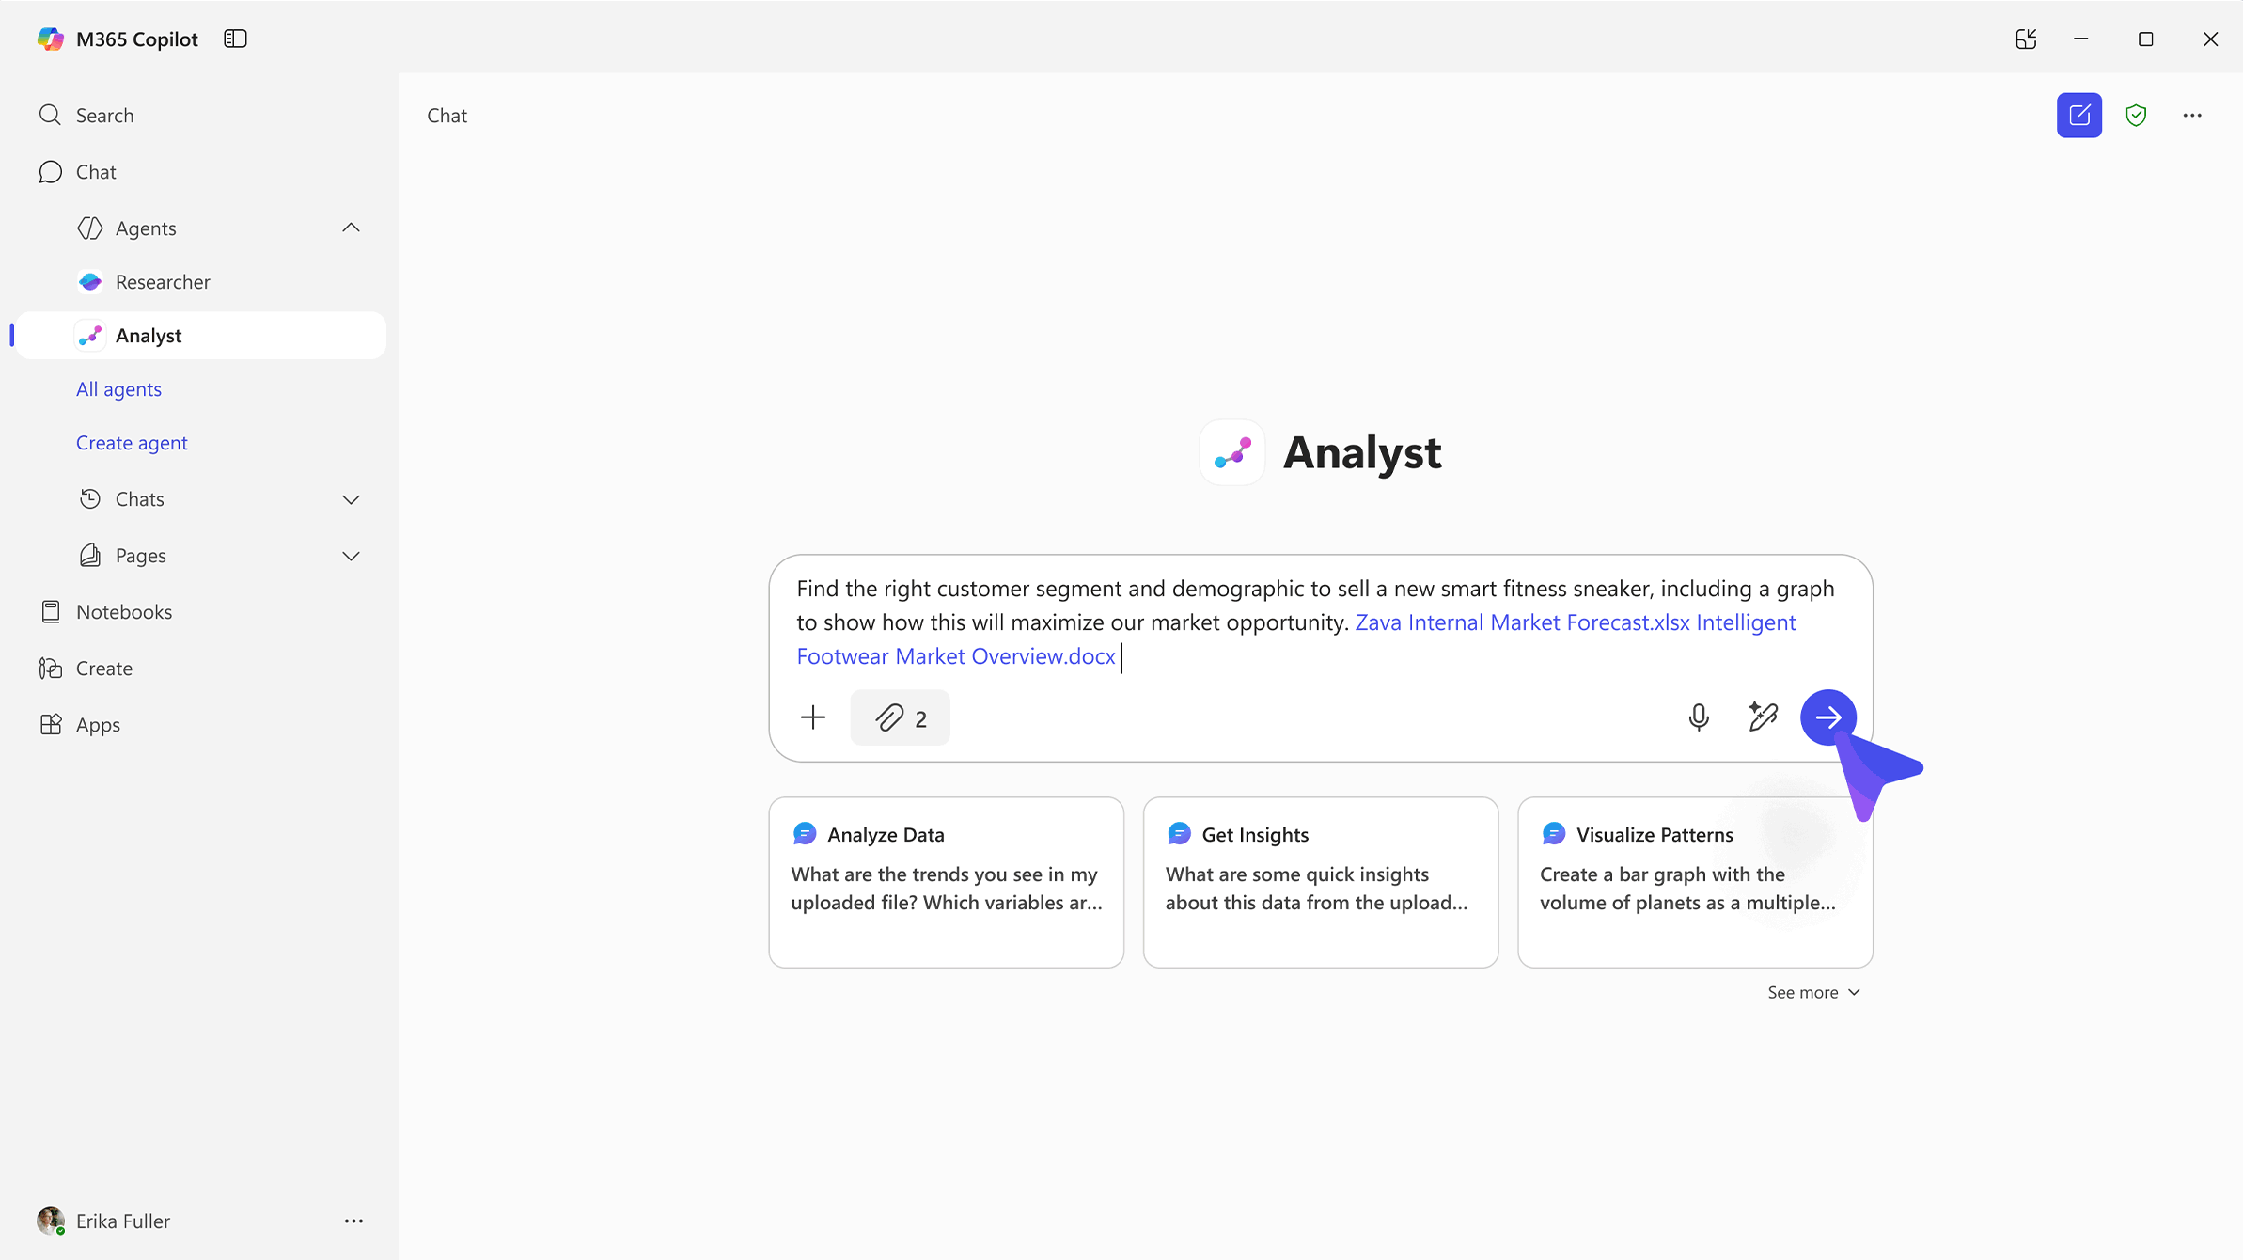
Analyst
is a reasoning agent that uses iterative chain-of-thought reasoning for advanced data analysis – turning raw data to insights in minutes with the power of OpenAI models optimized by Microsoft for data analysis.
From data to insight. Make decisions with confidence.
Decisive
Intuitive
Reliable
Surfaces insights that matter with clear next steps - turning complexity into confident, timely decisions.
Makes insights easy to grasp, guiding anyone to clear understanding with no need for data science expertise
Grounded in your secure M365 data, Analyst produces transparent, source‑linked summaries and recommendations you can trust
Analyst helps users “ask their data questions in plain language — and get back not just answers, but actionable analysis.” Alan Cox, Microsoft MVP
Included with Microsoft 365 Copilot

Slide 22
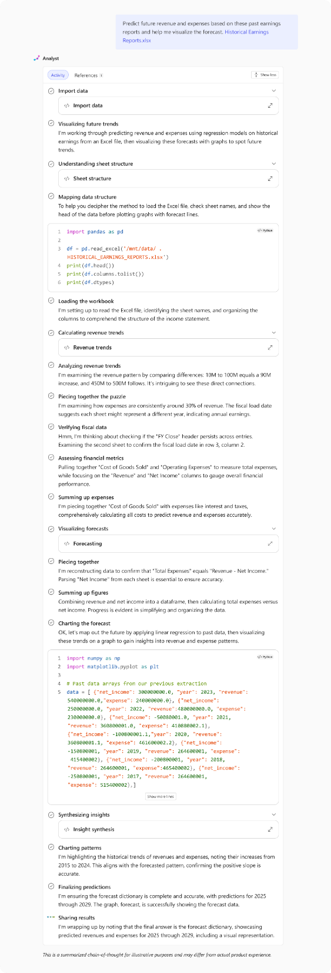
Addresses Data Challenges
Data overload: Organizations are inundated with structured and unstructured data from countless sources—making it difficult to extract timely, actionable insights.
Reliance on specialized skills: Extracting value from complex data often requires technical expertise—SQL, Python, BI tools—creating bottlenecks and reliance on specific roles
Fragmented tools and silos: Data lives in disconnected systems—Excel files, reporting systems, internal dashboards—making it difficult and time consuming to distill tangible insights
Traditional large language models jump too quickly from problem to proposed solution - often failing to adjust to new complexities or gracefully recover from mistakes.
Analyst:
Implements reasoning-driven, chain-of-thought (CoT) architecture derived from OpenAI reasoning models.
Progresses through problems iteratively by hypothesizing, testing, refining, and adapting – adjusting to complexity to mirror human analytical thinking.

Slide 23
How it works
How to use Analyst
Find the file(s) with the raw data to analyze and add it to your prompt in Analyst, either by uploading directly or selecting from your M365 files.
Analyst supports up to 5 files at once across multiple formats (Word, PPT, PDF) and datasets (Excel, CSV, JSON).
Ask Analyst to provide the insights you’re looking for, including specifying the type of visualization or graph.
Analyst will then understand the data, construct a plan, and execute Python code to reason over the prompt.
    Where can you use Analyst
Analyst is accessible as an agent in Copilot Chat in the Microsoft 365 Copilot app, Teams, and Outlook.
You can @mention Analyst from a Copilot chat or choose it from the Agents menu.
    Turning on Analyst
The agent will appear in the Agent Store under ‘Built by Microsoft’ located within the ‘All agents’ and ‘Get agents’ landing page.
For users with a Microsoft 365 Copilot license, Researcher and Analyst agents will be pre-pinned for all eligible users.
TIP The process may take a few minutes - you can follow the chain-of-thought reasoning or continue with other priorities while it works.

Slide 24
When to use Analyst
When to use Analyst
Consulting multiple data sources: Gathers and integrates data from different file types for comprehensive analysis.
Step-by-step problem solving: Progresses through challenges by hypothesizing, testing, and adapting responses, making it useful for iterative decision-making.
Visualizations: creates key visualizations for data analysis and presentation.
Best practices
Upload both structured (Excel, CSV, JSON, etc.) and unstructured (PDF, Word, PowerPoint etc.) data files, up to 5 files at once
Ask complex, multi-variable questions that require advanced data analysis
Specify the type of insight or visualization needed
Review chain-of-thought and Python generated insights for accuracy

Slide 25





Analyst in Action
Included with Microsoft 365 Copilot
Your personal data analyst that can reason over raw data from multiple sources to provide insights and visualizations in minutes. Analyst works with both structured (.xlsx, .csv) and unstructured (.docx, .pptx, .pdf) data, conducting advanced data analysis by executing Python code.
Examples
 | Sales Data Analysis | Executive Briefings | Revenue Forecasting | Customer Feedback | Marketing Targeting
Pain point | Fragmented sales data that impacts the ability to analyze performance and trends. | Leaders need concise, data‑anchored talking points for reviews. | Forecasting requires consolidating data from many sources, slowing decisions. | Recurring issues and trends are hard to identify quickly when customer feedback is scattered. | Pinpointing the right audience segments and understand their behavior is difficult.
Analyst can help | Analyze sales data from multi-sources to form trends and insights. | Distill the week’s insights into clear narrative with visuals. | Build accurate forecasts using historical and current data. | Quickly detect common themes, anomalies, and summarize trends. | Analyze engagement data to pin-point refined targeting.
Prompt | Analyze these sales datasets to uncover key trends to: Identify patterns in sales volume and revenue Highlight correlations between price and sales performance Provide insights for pricing or marketing strategies Present findings using clear visualizations and charts | Create a weekly executive brief from [data sources]. Provide: 5 talking points with metric, variance, and source. 2–3 charts (trend/variance/funnel) Top risks, decisions needed, and next steps (owner, due date) Begin with summary status; keep under 400 words; bold items needing attention | Using historical revenue by product/region/segment and pipeline data from [data source], build forecasts for the next 12 months. Show: Seasonality, win‑rate assumptions, and deal‑slip risk A forecast table and drivers’ waterfall A sensitivity analysis for two variables (price and conversion) Provide a slide‑ready chart | Analyze customer feedback from support tickets, surveys, and reviews over the past quarter. Please identify: The top 5 recurring issues Sentiment trends Any emerging concerns Then present: Visual charts summarizing insights Recommended actions | Analyze engagement across email, web, events, and social to identify high‑value audience segments. Build segments by Firmographics and Behavior Then provide: Propensity‑to‑convert ranking and estimated revenue 3 segment profiles with key messages, channel mix, and sample offers A targeting matrix and a next‑best‑action list

Slide 26
Facilitator
Included with Microsoft 365 Copilot

Slide 27

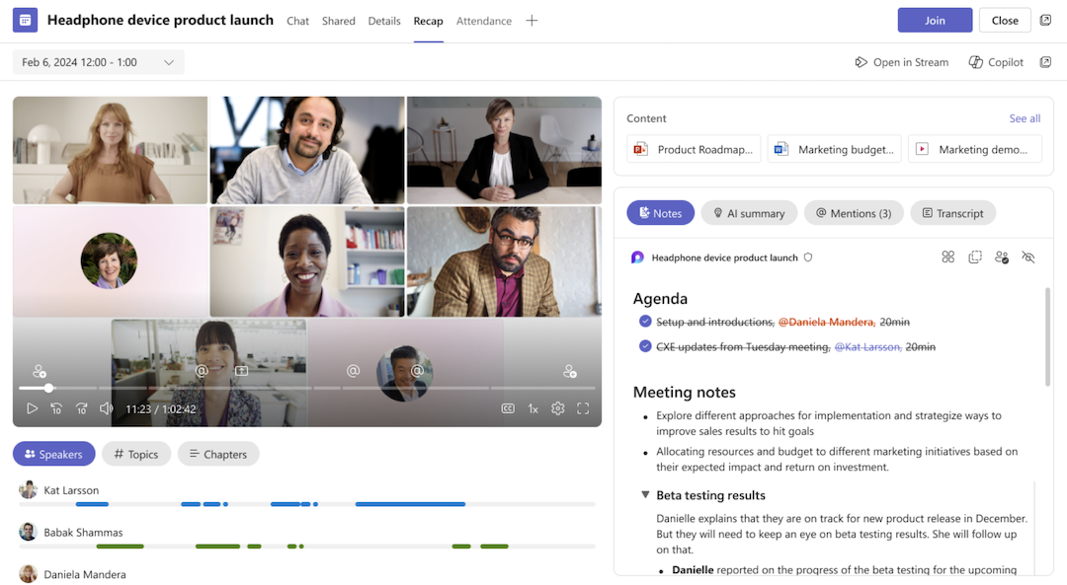
Facilitator
Facilitator transforms meetings from conversations into coordinated action. It works alongside your team in real time to structure discussion, capture decisions, and turn ideas into next steps. So every meeting drives clarity, alignment, and measurable progress. ​
Run more effective meetings. Move work forward, together.
Real-Time
In Work-Flow
Collaborative AI
Works during the meeting, guiding discussion, answering questions, and capturing decisions live
Tasks, notes, and documents are created and organized as you speak
A shared experience that keeps everyone informed, engaged, and moving together
*Only available with Microsoft 365 Copilot

Slide 28
How it works with Copilot
Facilitator joins your meetings and understands the conversation as it unfolds. It builds and tracks agendas, captures real time notes, answers questions, and turns discussions into tasks and documents that everyone can see. You can interact with it naturally through chat, making it feel like a seamless extension of your team.
Copilot Role – Your Assistant
  Copilot serves as a personal assistant, providing private insights, summaries, and answers tailored to individual users before and after meetings.
  e.g. Recap the meeting so far, what was just agreed
  Only visible to you
Facilitator Role – Your Meeting Assistant
  Facilitator improves group meetings by managing agendas, tracking time, capturing notes, and summarizing decisions in real time.
  e.g. @Facilitator add [topic] to the agenda and allocate 10 minutes
  Visible to everyone
Complementary Use
  Facilitator ensures team alignment and actionable outcomes, while Copilot enhances individual productivity and preparation.

Slide 29
Key Benefits
The Facilitator agent in Microsoft Teams enhances productivity and collaboration by providing real-time summarization of meetings and chats. This AI-powered feature captures ongoing conversations and generates notes instantly, ensuring key points and actions are documented accurately.
 | Stay on track effortlessly | Never lose a decision or action item | Get answers in the moment | Turn discussions into deliverables | Capture work anywhere
How Facilitator can help | Dynamic agendas, time tracking, and gentle reminders keep meetings focused and productive. | Real time shared notes and automatic task capture ensure clear follow through. | Instantly surface relevant insights from the meeting, your work data, or the web. | Generate documents, summaries, and drafts directly from what was said. | From Teams Rooms to hallway chats, every important moment becomes structured output.

Slide 30
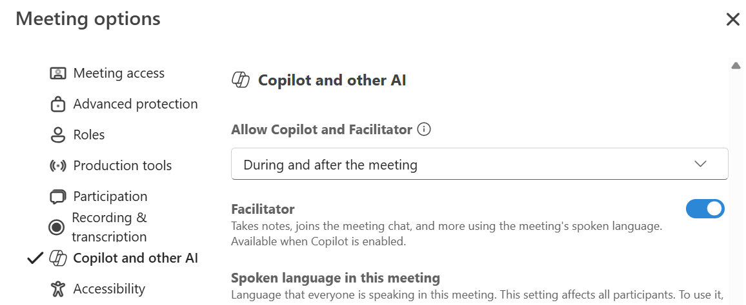
Experience the Benefits today
    Turn on during scheduling
Select Turn On Facilitator during meeting creation.
Or
Select
Options >
Copilot and AI
Toggle Facilitator ​​​​​​​On
Activate via Admin Settings
Verify licensing:
Users have Microsoft 365 Copilot + Teams licenses
2. Allow the Facilitator app
Teams Admin Center → Teams apps > Manage apps
Search Facilitator → set to Allowed
3. Assign access (recommended)
Create / update App permission policy
Allow Facilitator
Assign to tenant, groups, or users
4. Enable Microsoft Loop
Required for shared AI‑generated meeting notes
5. (Optional) Control AI notes
AI meeting notes enabled by default
Can be disabled tenant‑wide via PowerShell
    Turn on during the Meeting
Select >More actions … from the meeting controls.
Select >Turn on Facilitator from the menu.
Learn more
Set up Facilitator in Microsoft Teams - Microsoft Teams | Microsoft Learn
Facilitator Video Overview

Slide 31
Coaches
Added agents available to all users, including users of Copilot Basic.

Slide 32
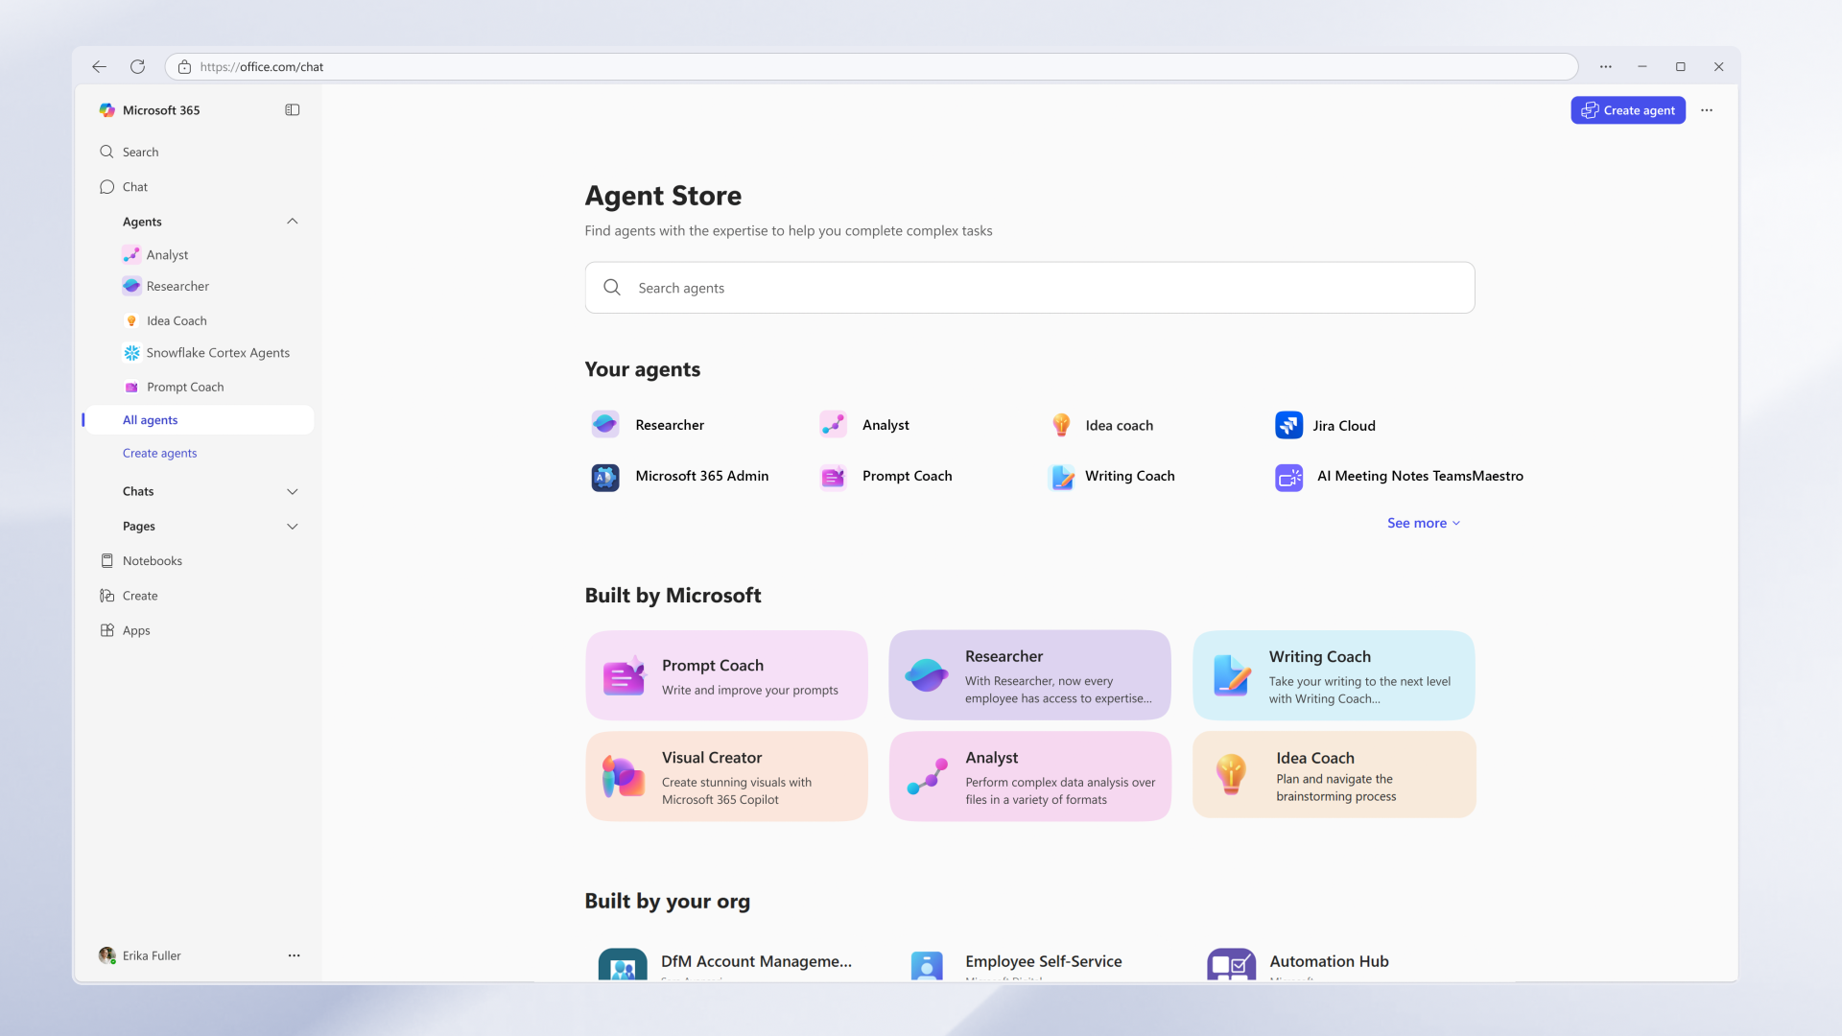
Agent Store
Discover agents from your own organization, Microsoft and partners.
Step 1: View the Agent Store by clicking the “All agents” option on the left rail.
Step 2: Scroll down to the “Built by Microsoft” section to find agents made available to you by your organization.
Step 3: Select one of the “coach” agents to get started. Details for each coach are in the next few slides.
1
2
3

Slide 33

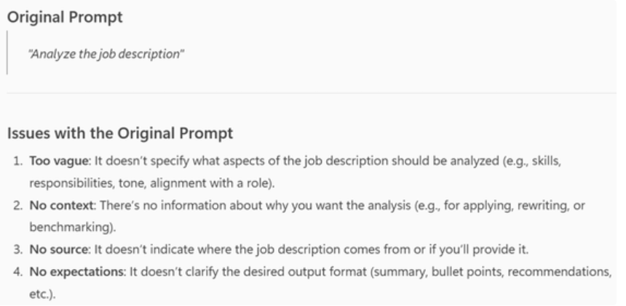
Prompt Coach
A real‑time, in‑the‑flow guide that teaches users how to write better prompts to get higher‑quality results from Copilot.
Capabilities
Interactive prompt guidance to help users develop well-structured prompts through an iterative feedback process that help clarify user goals, context, and expectations.
Prompt analysis that evaluates and helps refine user prompts to ensure clarity, optimal phrasing, and compliance with Responsible AI guidelines.
Concrete prompt examples, with step-by-step explanations, to help users
Scenario | Description
Prompt creation | Helps users create effective prompts.
Prompt analysis | Evaluates user prompts and offers detailed suggestions for improvement.
Prompt Compliance | Checks to determine whether prompts follow Responsible AI guidelines.
Prompt Correction | Analyzes and fixes problematic prompts, providing more context for better results.
Prompt Examples | Provides well-structured prompt examples and explains their purpose, context, sources, and expectations to help users learn to improve their own prompts.
Prompt Engineering | Helps tailor prompts to accomplish a particular task by iterating over a prompt and making incremental changes.

Slide 34

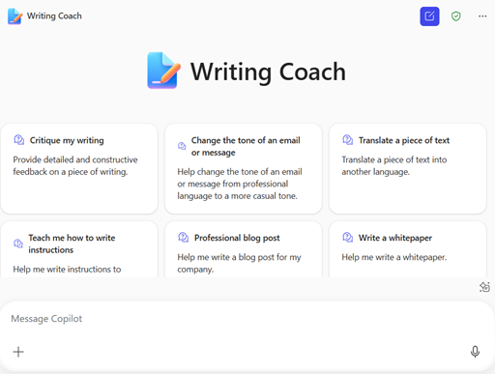
Writing Coach
A writing assistant that improves clarity, tone, and structure to help users produce professional, audience‑ready content
Capabilities
Provide detailed feedback on clarity, coherence, grammar, and tone to elevate overall writing quality.
Help transform casual text and narratives into formal documents, such as instructions and whitepapers.
Offer specific suggestions to help adjust the tone or style of a document or make it easier to translate a document into other languages.
Scenario | Description
Writing refinement | Provides a wide range of suggestions to help users refine their writing. Suggestions can include: ways to improve grammar, clarity, coherence, and key concepts and details to focus on.
Audience targeting | Suggests ways to tailor the voice and tone, and details of a document to your target audience. The agent provides examples of the suggested changes.
Writing for a global audience | Identifies wording that might be culturally sensitive and offers alternatives.
Descriptive and procedural | Provides feature descriptions as well as clear and concise instructions for using products and services.
Customer story writing | Asks customer details and story goals; provides suggestions for structuring the story with a clear beginning, middle, and end.
Creating whitepapers | Provides assistance in identifying the audience, generating topics, and structuring the document.

Slide 35

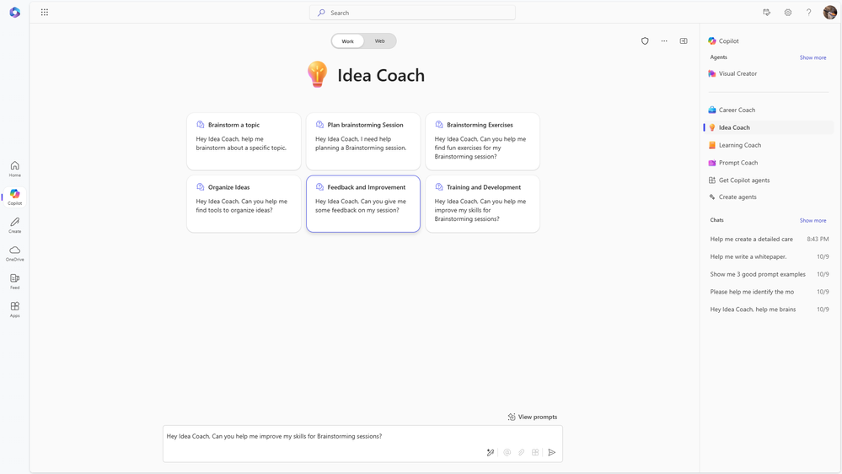
Idea Coach
A creative brainstorming agent that helps turn vague ideas into clear, actionable concepts using proven ideation techniques
Capabilities
Provide AI-driven brainstorming through a guided dialogue and creative exercises to help users effectively develop and refine their ideas.
Customize agendas and exercises for brainstorming based on user input to ensure engaging and productive brainstorming sessions.
Collect session insights and feedback to iteratively enhance brainstorming techniques and creative outcomes.
Scenario | Description
Brainstorming Assistance | Provides a question-based dialogue to help users brainstorm ideas.
Brainstorm Session Planning | Customizes brainstorming session agendas by gathering context and offering creative suggestions.
Creative Exercises | Proposes activities tailored to user goals and session details.
Idea organization | Provides unbiased tools for prioritizing ideas.
Feedback and Improvement | Collects session feedback and makes recommendations for improving the brainstorming session.
Training and Development | Helps users grow their brainstorming skills.

Slide 36

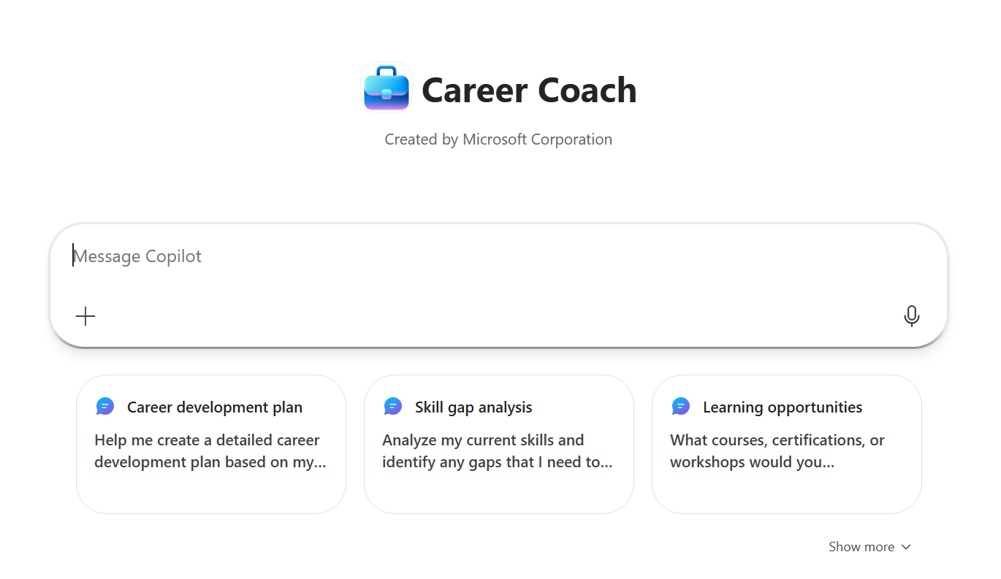
Career Coach
A personalized career development agent that provides tailored suggestions and actionable plans to help users learn, grow, and advance in their careers.
Capabilities
Personalized career roadmapping with detailed development plans and actionable advice based on the user’s role, skills, and career aspirations.
Comprehensive skill gap analysis to identify target areas for growth and recommendations for tailored learning opportunities.
Holistic career support including guidance on career transitions, performance improvement, and strategic networking.
Scenario | Description
Career Development Plans | Creates detailed plans based on your current role and future goals.
Skill Gap Analysis | Identifies gaps in your skills and suggests ways to fill them for career advancement.
Learning Opportunities | Recommends courses, certifications, and workshops to help you grow professionally.
Career Transition Advice | Provides guidance for successfully changing careers and navigating transitions.
Networking Strategies | Offers tips and strategies to leverage your professional network for career growth.
Performance Improvement | Gives advice to improve your performance in your current role to prepare for future opportunities.

Slide 37
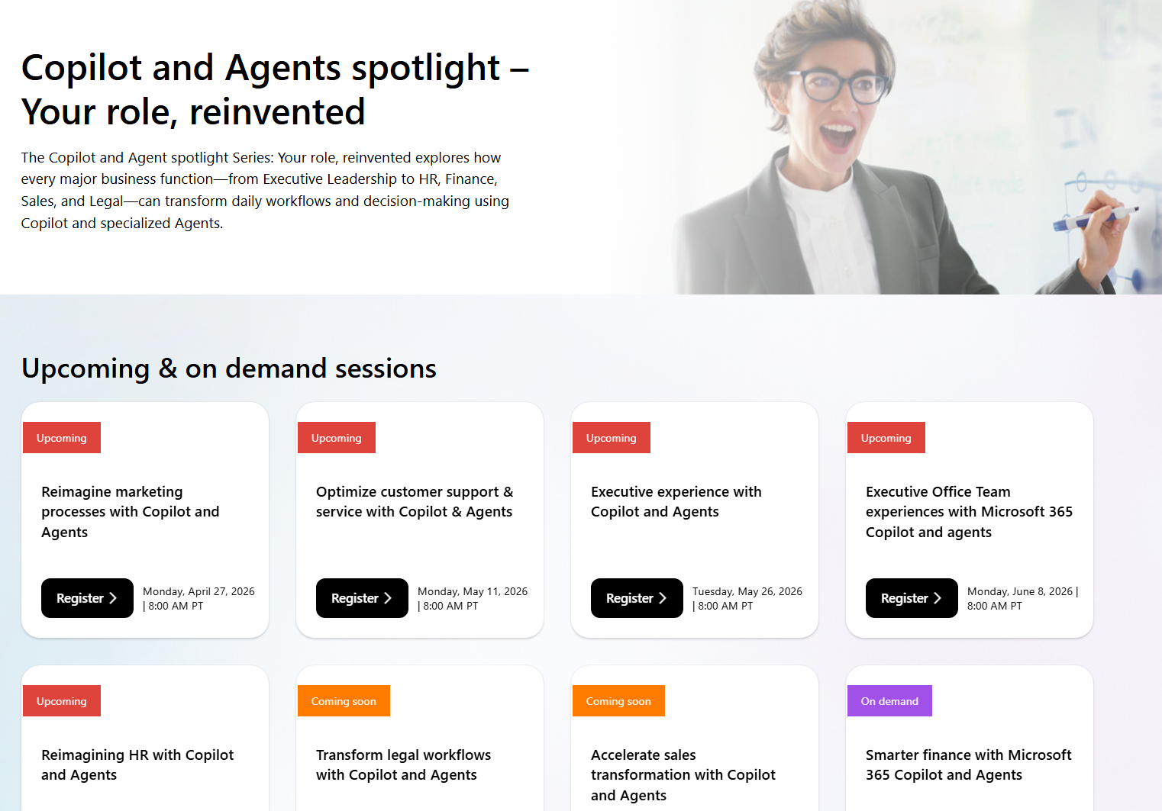
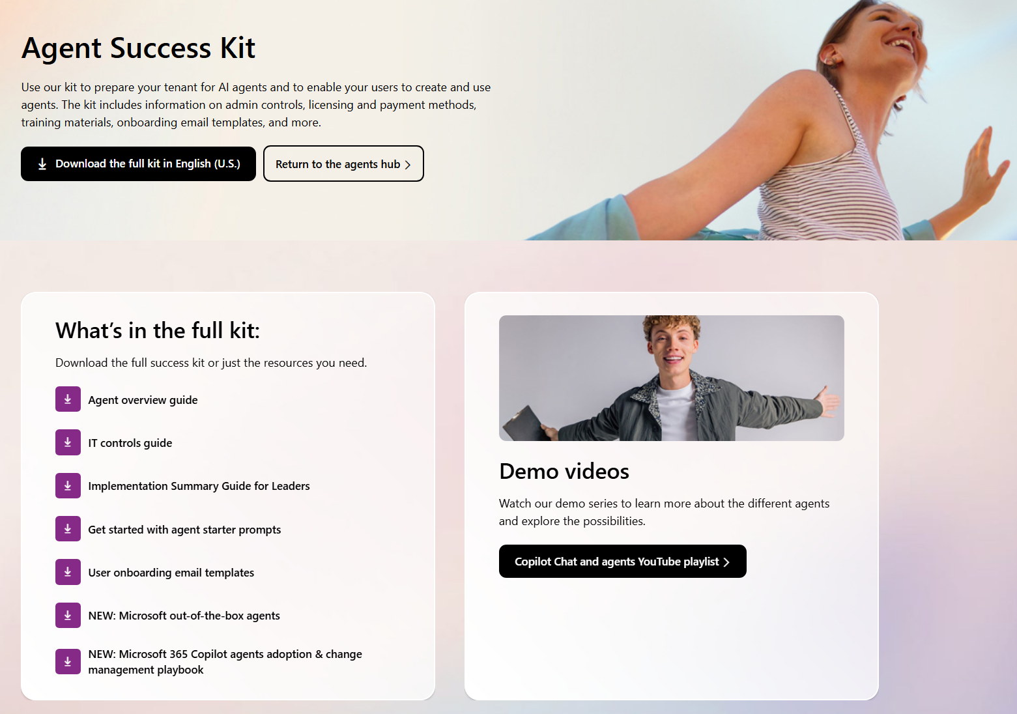
Learn More to Accelerate Adoption & Value
Skill up your organization
Stay up to date
Land agent adoption
  Microsoft Skilling
  AI Skills Navigator
  Learning Path: Transform your everyday business processes with agents
  ‌Microsoft 365 Copilot Agent Management Essentials
Visit Customer Hub for upcoming sessions and On-Demand videos.
    Leverage the Agent Success Kit

