Slide 1
Agent overview guide
Learn how to quickly unlock the value of Copilot through agents
January 2026

Slide 2

How to use this guide?
1
Start by learning “What is an agent?”
Get familiar with the concept of agents and how they can unlock value for your business.
2
Understand where you can start using and build agents
Explore your options: Use pre-built agents, build a custom agent, or bring in your own agent to Copilot Studio.
3
Learn step-by-step how to build a custom agent and use templates
Follow the guide’s instructions to create agents tailored to your organization’s needs, using templates or starting from scratch.
4
Explore the resources available to you
Take advantage of linked videos, demos, and documentation to deepen your understanding and accelerate adoption.

Slide 3
View agent starters and scenarios based the level of agent complexity. Ranging from Simple → Advanced.
Simple
Advanced
Retrieval
Task
Autonomous
Agents vary complexity and capabilities depending on your need
Simple agents can be made in the Copilot Studio lite version in Copilot Chat + M365 Copilot
Advanced agents need to be made in the Copilot Studio full version
Notes:
So what are agents?
Agents exist on a spectrum. Different organizations are at different stages of their AI transformation. Some are advanced and building the next generation of agents with autonomous capabilities. Others are still building out their AI agents to focus on getting information and completing tasks.
In 2025 agents are mostly associated with the right side of autonomy. However, we believe agents live on a spectrum of capabilities:
Retrieval: Designed with specific instructions on how to behave, their personality, and their overall objectives. They follow predefined rules and guidelines set by the creators.
Task: connected to specific workflows or processes. They operate based on knowledge, skills, and rules based automation. Their primary purpose is to automate repetitive tasks.
Autonomous: Operate independently, dynamically planning and learning from the processes. They adapt to changing conditions and make decisions without human intervention.

Slide 4

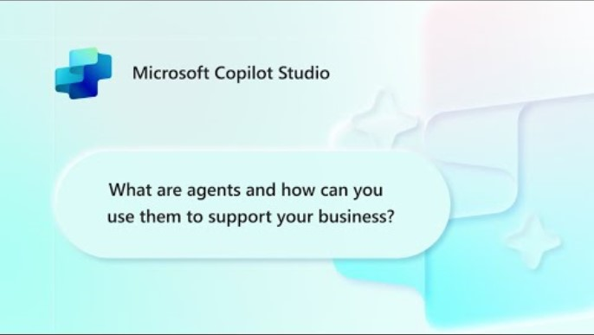
What are agents?
For other helpful videos – Visit our Mastering Copilot Studio video series
Disclaimer: As of June 2025, the agent pane has transitioned to the left side of M365 Copilot
As of October 2025, there is a new logo for Microsoft Copilot Studio

Slide 5







Choose your path
Whether you’re a beginner or a pro, agents enhance Copilot to better fit your business needs
Start with a pre-built agent
Build an agent from scratch or from a customizable template
Bring your own agent
Researcher
Analyst
Facilitator
Lead
Prediction
Automated Contract Review
Document Compliance
M365 Agents SDK
Azure AI Foundry
Visual Studio
Looking for immediate impact?
Pick from a variety of pre-built agents designed to automate common business tasks in the Agent Store or
Microsoft 365 apps.
Have a specific vision?
Quickly build your agent using natural language in Copilot Studio—through the embedded Copilot Chat or the full experience. Start faster with a customizable template tailored to your business.
Looking to build on what you have?
Bring existing agents into Copilot Studio
to unlock the benefits of a fully managed enterprise-grade platform that is governed, compliant, and extensible.
View more in the Agent Store. Copilot Chat,
and M365 apps.
View more in Copilot Chat and Copilot Studio
View with M365 Agents SDK, Azure AI Foundry,
or where you build your agents
Beginner
Agent Pro
Notes:
Get inspired by a wide selection of pre-built agents that are ready to configure and deploy, by building your own, or bringing your own agent.

Slide 6
Start with a pre-built agent from Microsoft

Slide 7


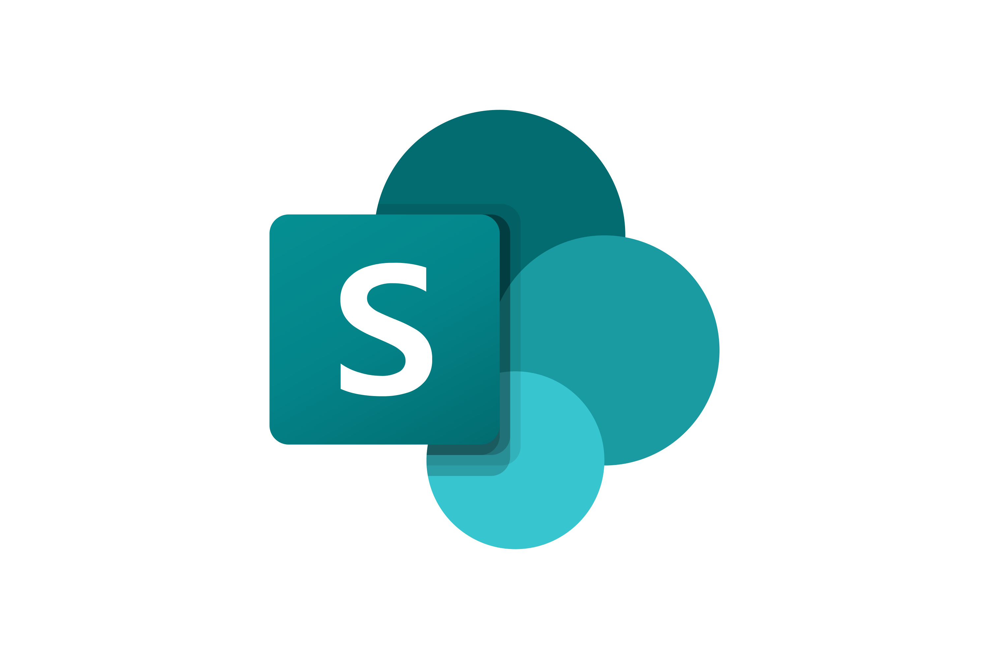








Examples of Microsoft agents
Automate tasks with pre-built agents by Microsoft that are designed for work
Researcher
Analyst
Surveys
Interpreter
Facilitator
Advanced reasoning
Advanced reasoning
End-to-end survey mgmt.
Multi-lingual translation
Teams meeting moderation
Generally available
Generally available
Generally Available
Generally available
Generally available
Knowledge
Channels
Project Manager
Communities
Workforce Insights
Content mgmt. & organization
AI teammate
Automate project mgmt.
Community mgmt.
Organizational insights
Public preview
Public preview
Public preview
Public preview
Frontier Program
Word
Excel
PowerPoint
People
Learning
Document creation
and iteration
Data visualizations
and insights
Build and iterate on presentations
Colleague connector & collaboration planner
Curated AI skill building resources
Frontier Program
Frontier Program
Frontier Program
Frontier Program
Frontier Program
This is a sample of agents built by Microsoft available in the Agent Store and in specific applications. Agents available to you will vary depending on your license and which agents your Admin has enabled for you.
Notes:
To help you get started, we’ve created “pre-built" agents in Microsoft 365 Copilot.
For example, you can use the project manager agent to help you track status and updates against a broader project plan. Or the Facilitator agent, which can help you run meetings in Teams more efficiently.
Let me show you a few examples.

Slide 8
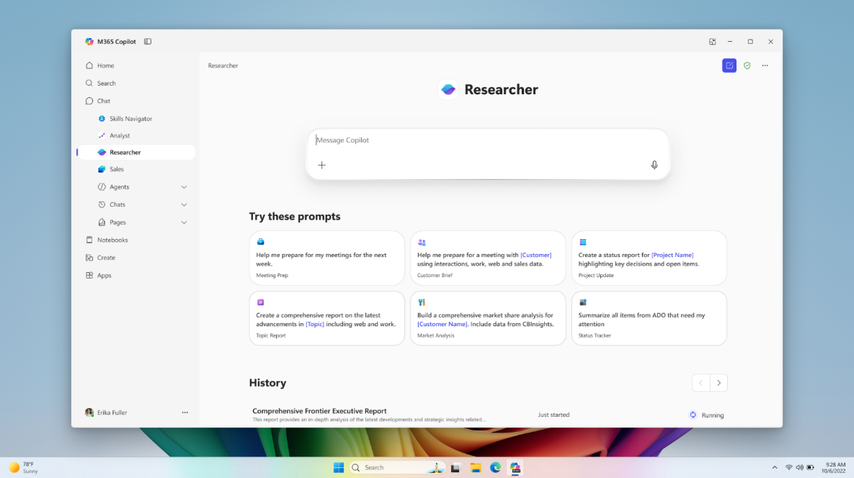
Researcher
Copilot Chat
Researcher gives organizations the capability they’d expect from a highly paid strategist or researcher.
Combines the most advanced deep reasoning models with Copilot Chat’s web- and work-grounding, as well as its agent ecosystem.
Provides well-reasoned responses to complex prompts with the data that matters most.​
Gives users a thought partner that can perform advanced reasoning grounded in their unique context.
Gives organizations on-demand access to the types of work they typically expect from highly paid employees.
Generally available
Notes:
The Researcher Agent gives organizations the capability they’d expect from a highly paid strategist or researcher.
By bringing company data from the Graph and third parties to the latest deep reasoning models, and by giving this agent the ability to call other agents, companies can ask the Agent to do the work that underlies the most value-add operations, from product strategy to research to strategic planning.
End users use the prompt-based model to ask a question whose response builds off internal and/or external data, answer a few clarifying questions to help guide the Agent’s research, adjust the Agent’s proposed research plan, then in a matter of minutes will receive an in-depth report in a Copilot Page.
From there, they can use multi-turn prompting to edit or append that report, and can dynamically edit or share via the page.
COMPETITIVE DIFFERENTIATION
The Researcher Agent builds off the models that’ve driven significant excitement in the market by adding the key to unlocking value in organizations—proprietary, organizational data. This data goes beyond a file or even a large database, as it includes the collaborative data that makes up an organization’s processes and the metadata + organizational data that defines the organization itself. By giving Researcher the ability to call other Agents, it serves as a centralized tool to accomplish even the most complex and nuanced business challenges. With this added data, the Researcher Agent is unique in its ability to reference the most relevant data while responding with contextually appropriate responses.

Slide 9
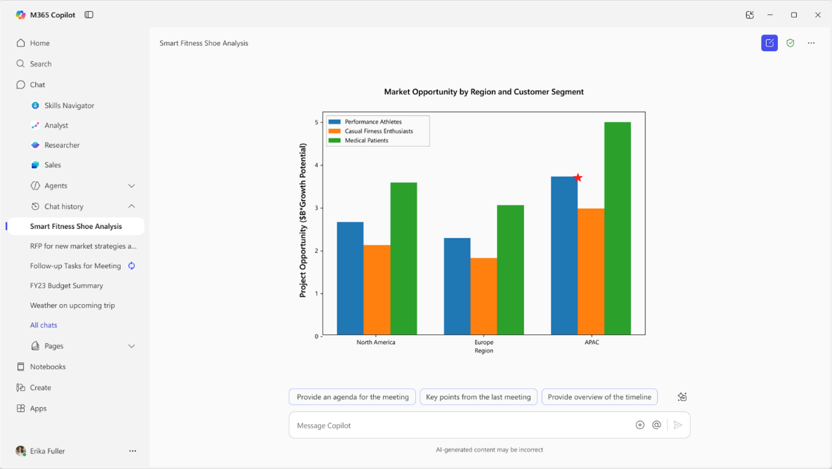
Analyst
Copilot Chat
Analyst thinks like a skilled data scientist, so you can go from raw data to insights in minutes. ​
Built on OpenAI’s o3-mini reasoning model and optimized to do advanced data analysis at work.
Analyst uses chain-of-thought reasoning to progress through problems iteratively, to refine its reasoning and provide a high-quality answer.
Runs Python to tackle your most complex data queries—you can view the code it’s running in real time to check its work.
Generally available
Notes:
Analyst is one of the first reasoning agents of its kind in M365 Copilot, placing sophisticated data analytics capabilities right at your fingertips.
Powered by our advanced reasoning model post-trained on OpenAI o3-mini, Analyst uses chain-of-thought reasoning to provide a high-quality answer to data analysis questions.
It progresses through problems iteratively, taking as many steps as necessary to refine its reasoning in a process that mirrors human analytical thinking.
It can even run Python to tackle your most complex data queries—and you can view the code it’s running in real time to check its work.
For example, you can use Analyst to turn raw data scattered across multiple spreadsheets into a demand forecast for a new product, a visualization of customer purchasing patterns, or a revenue projection.
COMPETITIVE DIFFERENTIATION
Traditional LLMs have historically jumped too quickly from problem to proposed solution while failing to adjust to new complexities or gracefully recover from mistakes. With the capability to generate and execute code at every step within its reasoning trajectory, this agent excels at incremental information gathering, constructing hypotheses, course correction, and automatic recovery from errors.
The best product comparisons are ChatGPT Advanced Data Analysis, and Google Data Science Agent (not apples to apples given it’s not integrated in Workspace).

Slide 10
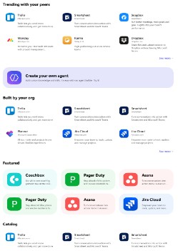
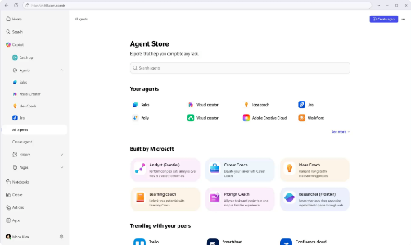
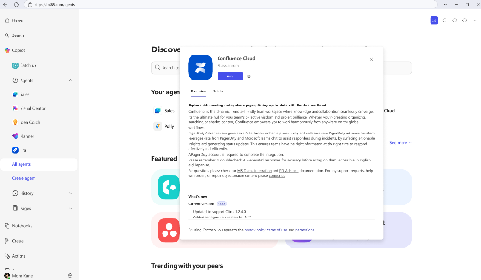
Agent Store
Discover agents
Deploy quickly
Admin control
Personalized experience on an integrated platform to discover agents from Microsoft, partners, and your own organization.
Accelerate results with ready-to-deploy agents that help boost efficiency and enable smarter decisions.
Agents are validated for security, compliance, and performance, and IT retains full control and oversight.
Notes:
Agent Store, also accessed through the Copilot app, is an agent marketplace featuring agents from Microsoft, partners and customer organizations. If your org builds an agent it wants to deploy org wide in Copilot, Agent store is how you do it.
Its immersive and personalized experience can help customers find and use agents to transform work processes and elevate productivity. You can also share agents with colleagues via Copilot Chat or other Microsoft 365 Copilot endpoints to boost collaboration.
All agents, whether developed by Microsoft or partners, undergo strict validation processes to meet enterprise standards for functionality, security, and compliance.
IT admins have full visibility and control over how agents are deployed in their organization.

Slide 11
Agent creation options
Feature | Agent Builder | Copilot Studio
Access point | www.microsoft365.com/copilot | www.copilotstudio.microsoft.com
User type | Information workers | Makers and developers
Agent target audience | Individuals or small teams | Department, organization, or external customers
Agent type | Lightweight Q&A agents with organizational knowledge | Agents with complex scenarios like multi-step workflows or business system integration, and that require enterprise governance and robust controls
Key capabilities | Natural language authoring Content-focused Q&A scenarios based on organization context from Microsoft Graph Respects user permissions to Microsoft 365 data Uses the Microsoft 365 Copilot orchestrator, foundation models, and services | Broad and external publishing Supports multistep logic, approvals, and branching workflows Supports advanced AI models and integration with Azure AI services Provides access to prebuilt and custom connectors to connect with data sources beyond Microsoft 365 Autonomous capabilities Lifecycle management tools including versioning; development, test, and production environments; role-based access controls; and telemetry and analytics
Use cases | Use the lite experience to build: Project FAQ bots that answers common questions based on project documentation. Product documentation assistants that help employees find information from internal product manuals or wikis. Onboarding agents that help new team members get answers from internal knowledge bases. | Use the full experience to build: Customer support agents that create support tickets and escalates issues to a human IT help desk triage agents that handle employee IT requests and routes them to the right support team Sales assistants for CRM that retrieve sales data, makes notes, or kicks off an approval workflow
Management and governance | Managed primarily through the Microsoft 365 admin center | Managed through the Power Platform admin center with finer-grained controls for enterprise scenarios

Slide 12
Start with a template in Agent Builder

Slide 13
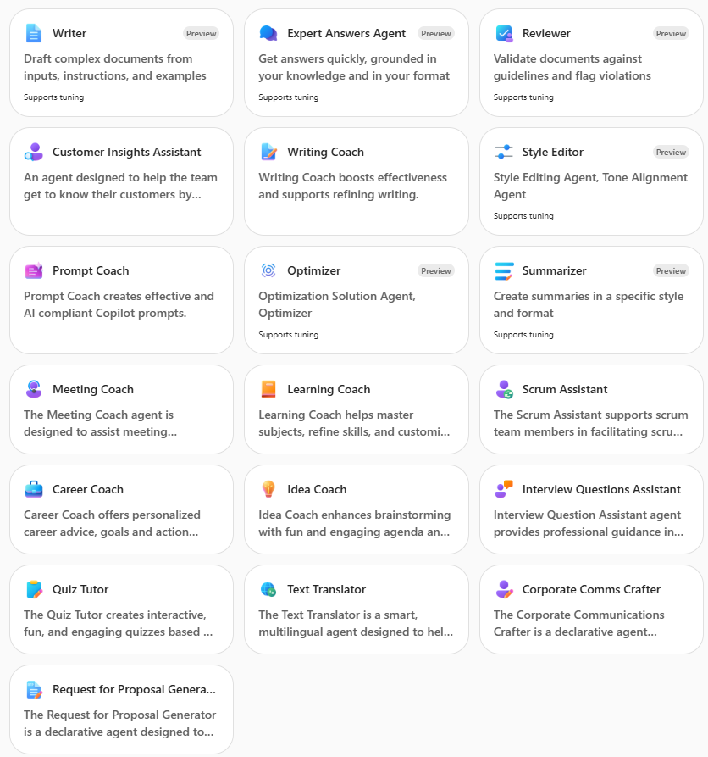
Examples of templates in Agent Builder
Get started quickly when creating an agent in Copilot Chat by using pre-made templates in Agent Builder and customizing them to fit your needs.
This is a sample of templates available in Copilot Chat after selecting New Agent.
Watch template demos
Learn more about using these templates in Agent Builder
Notes:
You’ll notice that some of these templates also appear as Microsoft agents. In these cases, Microsoft has created a version of the agent already that you can try out. If you want to modify the agent such as by adding knowledge sources you can use the template to create a new agent that better meets your needs.

Slide 14
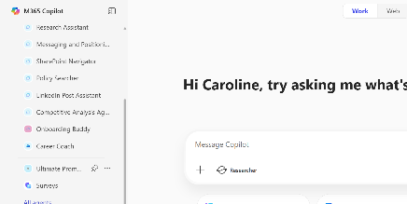
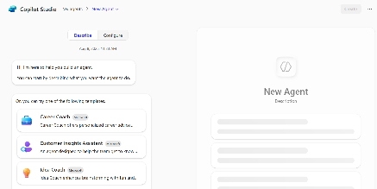
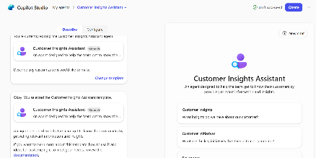
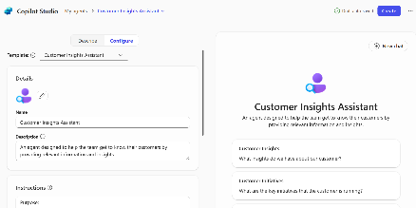
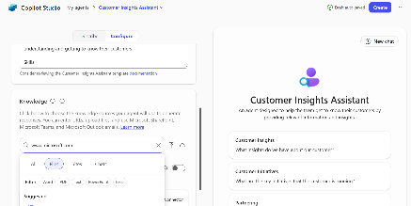
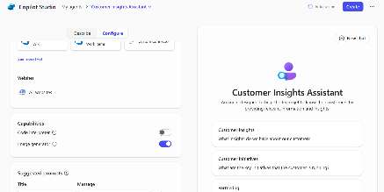
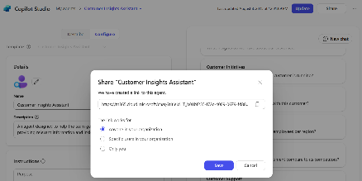
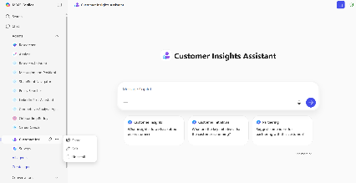
How to start with a template in Agent Builder
Agent Builder
Use a template for a quick win or to gain inspiration for custom scenarios
Step 1
Start in Copilot Chat
Begin your agent journey right in Copilot Chat by selecting “New Agent”. View agents that have been shared with you or created by you in the left pane.
Step 2
View pre-made templates
In Agent Builder, there are many options to get started. After opening, either start from a template or build from scratch. To start with a template, either pick from the beginning list, or select “View all templates” to explore a more expansive list.
Step 3
Select a template
For an example, let’s select the “Customer Insights Assistant”. After selecting this template, you will learn more about what the template can do for you or your organization. The right pane is your testing pane to view your agent in action while you are customizing.
Step 4
Customize further
After selecting your agent, select “Configure” to customize the template further to better fit your business needs (recommended). Or leave as is if it feels sufficient and select “Create”. You can always go back and customize later.
Step 5
Edit knowledge, instructions and prompts
Enhance the agent’s functionality by adding in your organization’s knowledge. This could be SharePoint sites, direct files, public websites, or one of our many Copilot Connectors. Other customization options including editing the agent instructions to pertain more to what you’d like your agent to focus on/do for you. And prompts, to make it easy for you or others you share with to quickly use and understand your agent.
Step 6
Add advanced capabilities
Agent Builder offers advanced capabilities to give your agent extra skills. Code interpreter converts natural language into code to create visualizations, solve math problems, and analyze data. Image generator creates visual aids (like images and art) in response to user prompts. For this agent, let’s select image generator on as I’d like to use its capabilities when learning about a customer.
Step 7
Publish your agent and share
To publish your agent, select “Create” in the upper right corner. After publishing, the share settings will pop up. If you’d like to share with those across your organization or specific users, select “Change share settings” and select which applies best to you. Select “Save”, then copy the link and share! Sharing agents are a great way to expand the value of Copilot for your organization, even the simplest agent.
Step 8
Use and edit your agent after publishing
After publishing, your agent will pop up in your left agent pane. Select your agent to start using it, it’s that easy! To edit your agent further, select the three dots next to your agent in the right pane while hovering over. Then, select “Edit”. This will give you the opportunity to customize your agent further or edit any customizations you did previously.

Slide 15
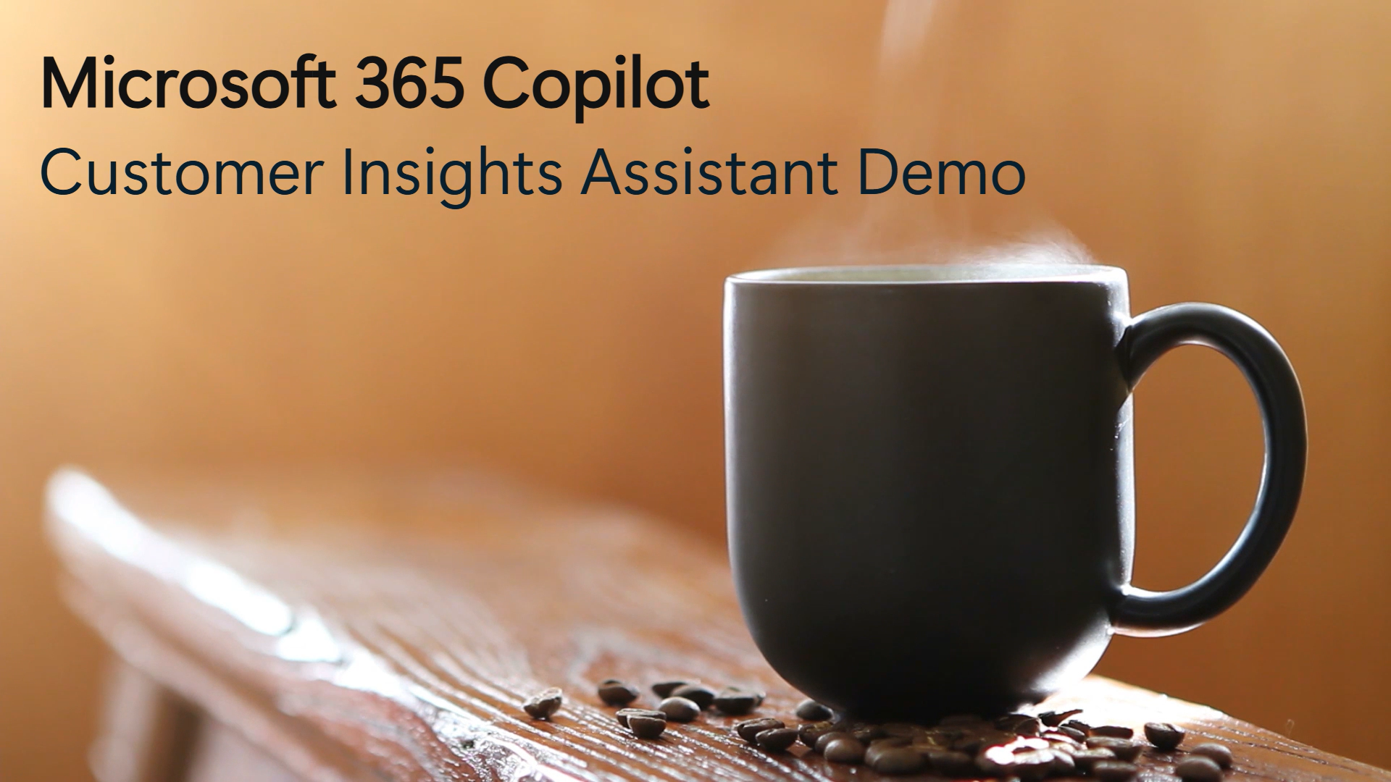
Explore a new template – Customer Insight Assistant
MICROSOFT 365 Copilot
WATCH THIS DEMO VIDEO!
The Customer Insight Assistant empowers teams to deeply understand their customers by automatically generating rich, structured profiles.
By streamlining customer research and surfacing actionable insights, the assistant helps sales and business development teams tailor their strategies, reduce preparation time, and increase engagement.
More info on the Customer Insight Assistant template can be found on
Microsoft Learn
How to further enhance your Customer Insight Assistant*
Personalize your customer insight report template by adding it to the agent’s instructions (learn more…)
Create customer-specific agents by adding relevant public websites. For example, the customer’s official webpage or industry news sites (learn more…)
Adapt the agent to your customer engagement and sales process by adding a SharePoint site containing customer engagement guidelines and sales best practices to the agent’s knowledge (learn more…)
View other template demos
* May require additional licensing and/or development

Slide 16

Explore a new template – Interview Questions Assistant
MICROSOFT 365 Copilot
WATCH THIS DEMO VIDEO!
The Interview Question Assistant helps hiring teams quickly generate high-quality, role-specific interview questions with a focus on fairness, clarity, and relevance.
This assistant reduces prep time, reliance on external agencies and improves question quality and consistency across interviews. It also supports collaboration between HR and hiring managers, ensuring structured and inclusive candidate experiences.
More info on the Interview Questions Assistant template can be found on
Microsoft Learn
How to further enhance your Interview Questions Assistant*
Use your corporate voice in your interview questions by describing it and giving examples in the agent’s instructions
(learn more…)
Optimize your questions with the job description by integrating your recruitment software with Copilot Connectors
(learn more…)
Create domain-specific questions by adding a SharePoint with relevant documentation to the agent’s knowledge (learn more…)
View other template demos
* May require additional licensing and/or development

Slide 17
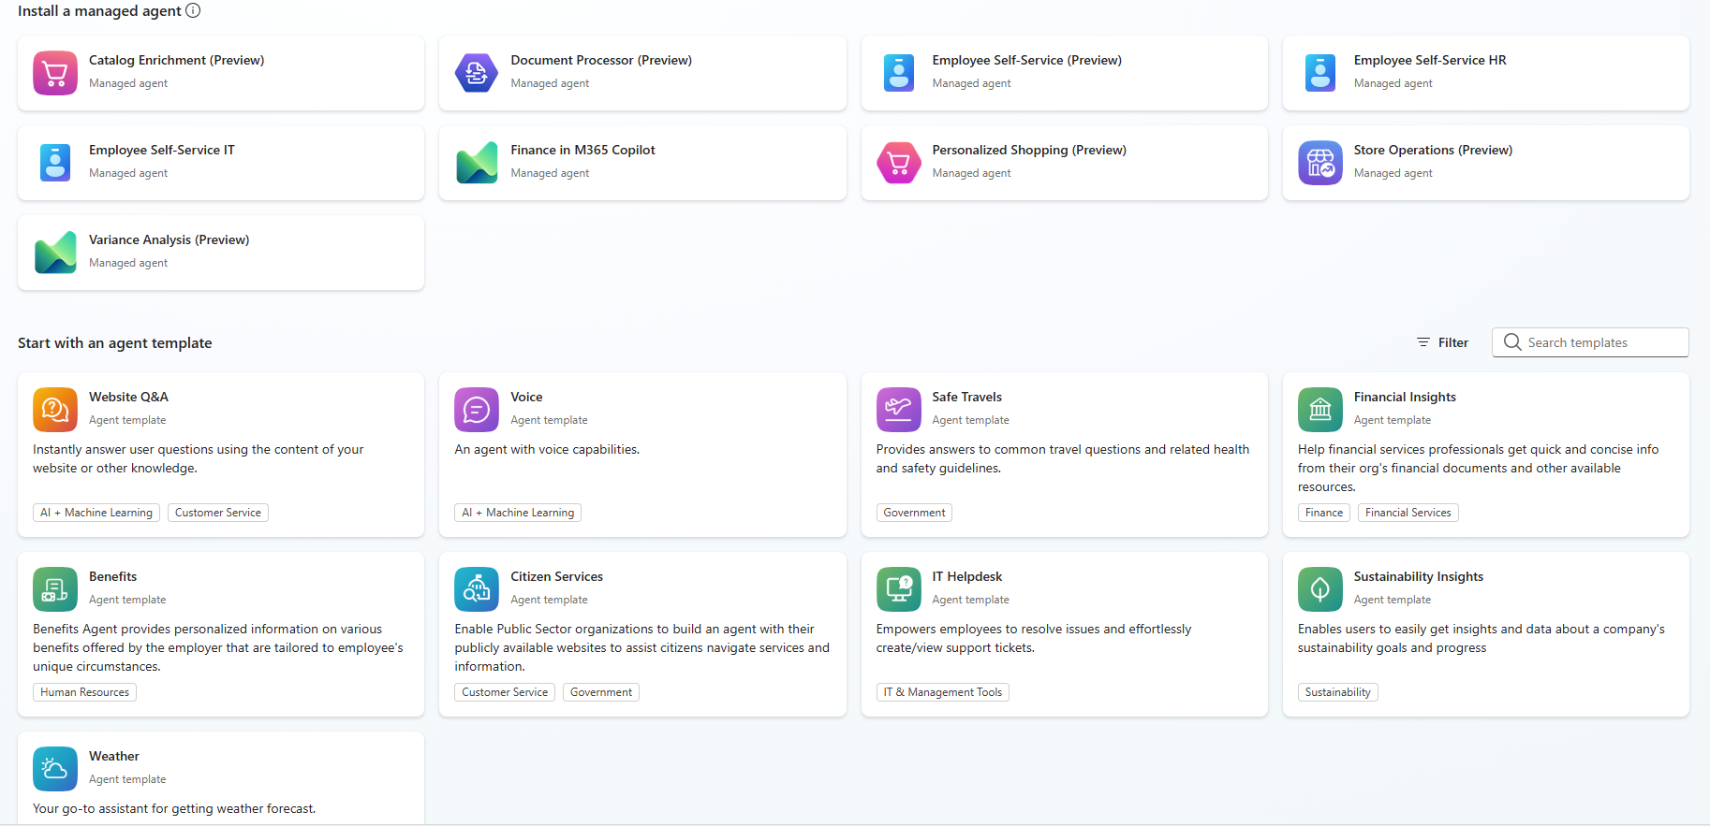
Examples of templates in Copilot Studio
Copilot Studio offers developers options for templates and managed agents. Templates act as a starting point for building your own agent and you are fully in control. Managed agents are maintained by Microsoft, but you configure them to connect to your data sources.
This is a sample of managed agents and agent templates available in Copilot Studio after selecting Create an agent.

Slide 18
Build an agent from scratch

Slide 19
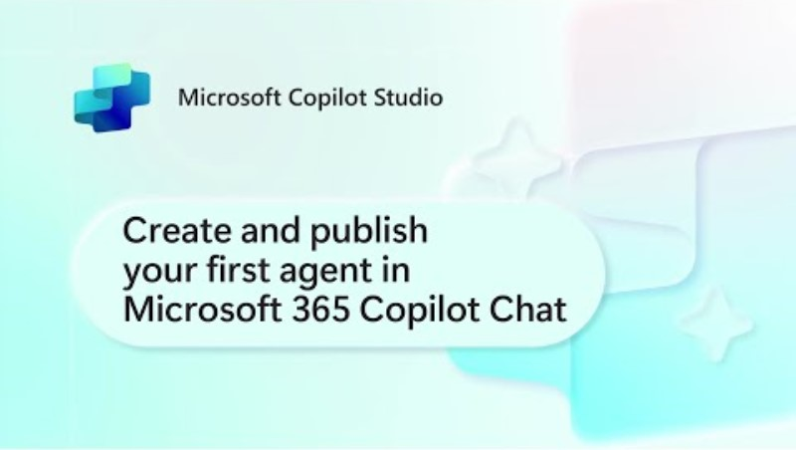
Create an agent with Agent Builder
For other helpful videos – Visit our Mastering Copilot Studio video series
Disclaimer: As of June 2025, the agent pane has transitioned to the left side of M365 Copilot
As of October 2025, there is a new logo for Microsoft Copilot Studio

Slide 20
Examples of agents that can be created in Agent Builder
Agent Builder
These agents can be easily built using Agent Builder or in Copilot Studio. Share with colleagues or across your organization to expand their impact!
 | Agent Name | Description
 | Peer Feedback Agent | Supports content creators in writing post content, brainstorming ideas, identifying trending topics, and suggesting content improvements.
 | Marketing Agent | Supports content creators in writing post content, brainstorming ideas, identifying trending topics, and suggesting content improvements.
 | Statement of Work Creator | Guides users through the process of gathering project information, defining scope, responsibilities, deliverables, and other essential elements.
 | Training Content Writer | Provides support throughout the content creation process, ensures learning materials are tailored to your corporate audience and aligned with your organizational goals.
 | Product Comparison Agent | Supports procurement managers by automating research and analyzing feature sets, pricing models, customer reviews, and integration capabilities to offer data-driven recommendations.

Slide 21
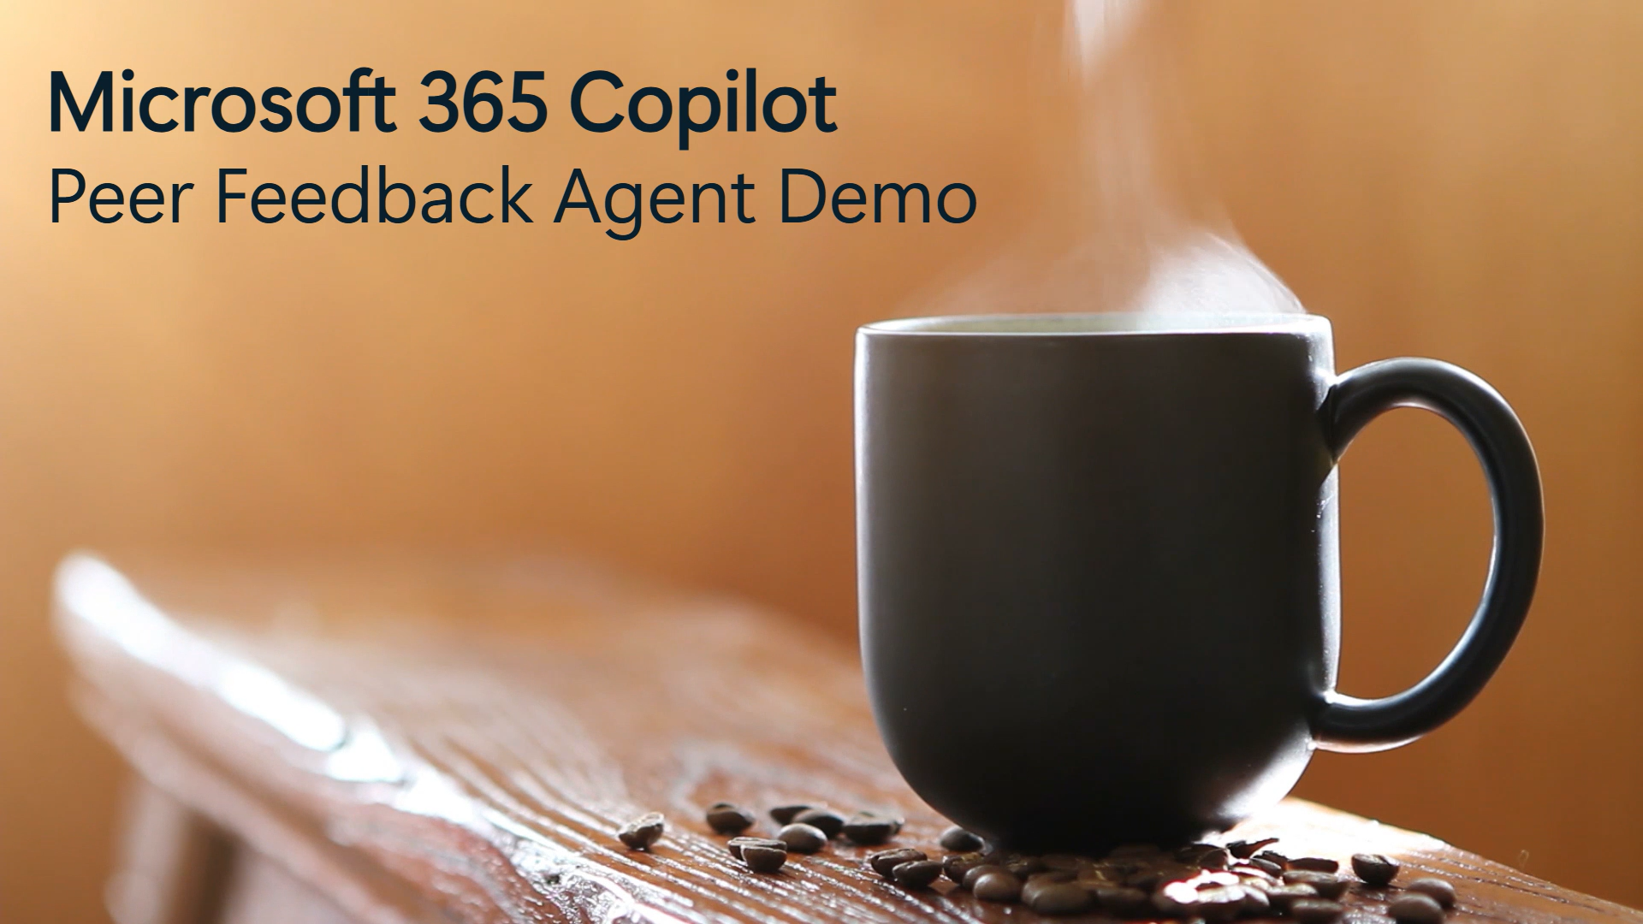
Peer Feedback Agent
MICROSOFT 365 Copilot
WATCH THIS DEMO VIDEO!
The Peer Feedback Agent helps employees craft thoughtful, professional feedback and praise for colleagues. It guides users through a structured conversation to ensure messages are specific, well-worded, and aligned with workplace best practices.
By making recognition and constructive feedback easier to express, the assistant fosters a culture of appreciation, collaboration, and continuous improvement.
The necessary instructions and information to build this agent are available in PeerFeedbackAgent_AgentFiles.zip, which can be downloaded on the Microsoft Adoption page.
How to further enhance your Peer Feedback Agent*
Personalize the recommendations to your company’s standard by adding a SharePoint site containing internal guidance on recognition to the agent’s knowledge (learn more…)
The agent can identify topics for praise from your peer interactions if you add emails and Teams messages as knowledge sources (learn more…)
* May require additional licensing and/or development

Slide 22

Marketing Agent
MICROSOFT 365 Copilot
WATCH THIS DEMO VIDEO!
The Marketing Agent supports professionals in writing effective content that can be posted on social media platforms. It helps with writing post content, brainstorming ideas, identifying trending topics, and suggesting improvements.
By accelerating content creation and optimizing for engagement, the assistant empowers teams to stay relevant, creative, and consistent across platforms.
The necessary instructions and other information to build this agent are available in MarketingAgent_AgentFiles.zip, which can be downloaded from the Microsoft Adoption page.
How to further enhance your Marketing Agent*
Use your company’s style and voice by adding a file with your marketing policies and design style guide to your agent’s knowledge. (learn more…)
Build on your existing campaigns and reuse existing content by adding a SharePoint folder with your published posts
(learn more…)
Enhance your posts with images for more engagement by adding image generation capabilities to the agent (learn more…)
* May require additional licensing and/or development

Slide 23
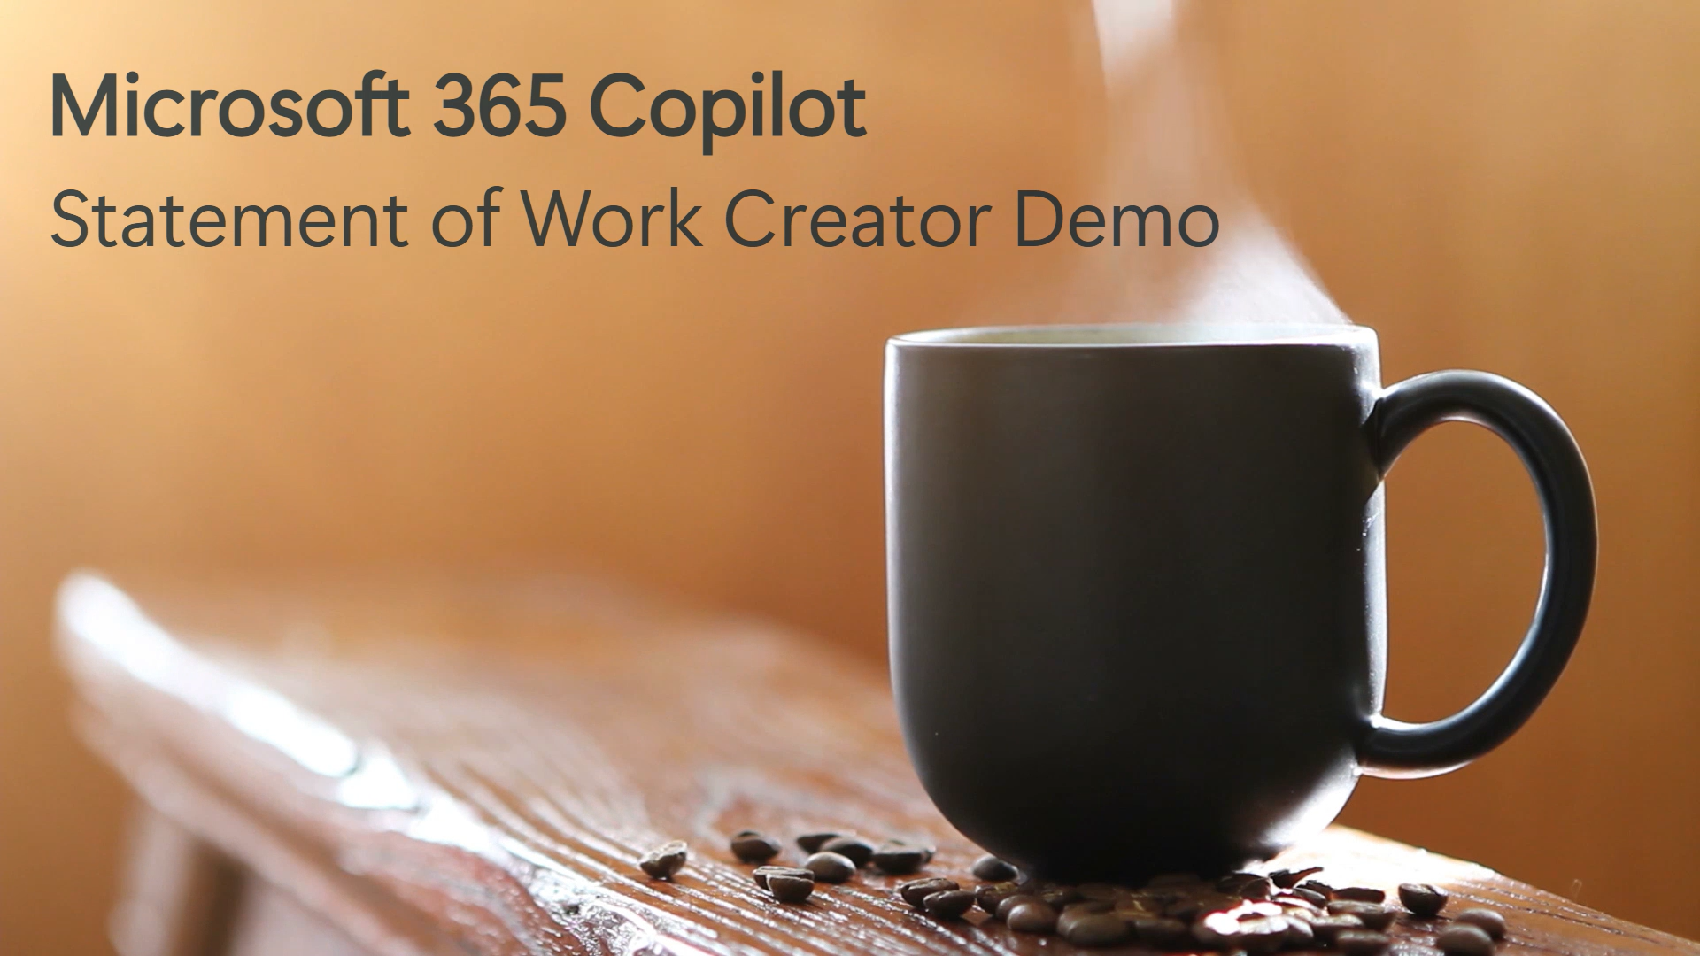
Statement of Work Creator
MICROSOFT 365 Copilot
WATCH THIS DEMO VIDEO!
The Statement of Work Creator creates detailed and effective documents. It guides users through the process of gathering project information, defining scope, tasks, responsibilities, and other essential elements.
By streamlining the drafting process and embedding best practices, the assistant reduces delays, improves document quality and consistency, and supports more predictable project outcomes.
The necessary instructions and other information to build this agent are available in StatementOfWorkCreator_AgentFiles.zip, which can be downloaded from the Microsoft Adoption page.
How to further enhance your Statement of Work Creator*
Increase the Statement of Work quality and consistency across your organization by adding a template to the agent instructions (learn more…)
Leverage your previous statements of work by adding a SharePoint folder with the files to the agent knowledge (learn more…)
Incorporate your corporation’s knowledge by integrating your tools and services via Copilot Connectors (learn more…)
* May require additional licensing and/or development

Slide 24

Training Content Writer
MICROSOFT 365 Copilot
WATCH THIS DEMO VIDEO!
The Training Content Writer assists content creators in developing high-quality, engaging, and effective materials designed for corporate learning.
It offers comprehensive support throughout the entire content creation process, ensuring that learning materials are carefully tailored to meet the specific needs of your corporate audience and are fully aligned with your organization’s strategic goals and objectives.
The necessary instructions and other information to build this agent are available in TrainingContentWriter_AgentFiles.zip, which can be downloaded from the Microsoft Adoption page.
How to further enhance your Training Content Writer*
Use your company’s style and voice by adding a SharePoint folder with your content creation best practices and style guide. (learn more…)
Access, rewrite or update your current training materials by using a Copilot Connector to connect to your learning services and publishing tools. (learn more…)
Enhance your materials with images for more engagement by adding image generation capabilities to the agent (learn more…)
* May require additional licensing and/or development

Slide 25
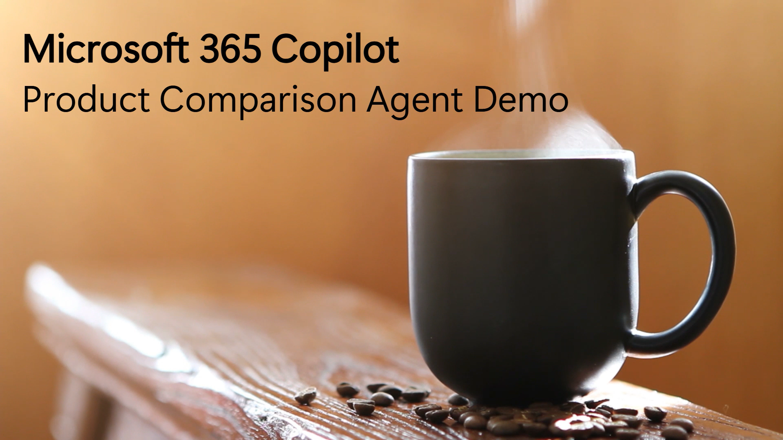
Product Comparison Agent
MICROSOFT 365 Copilot
WATCH THIS DEMO VIDEO!
The Product Comparison Agent is designed to support procurement managers and decision-makers by providing insights into products. It automates research, analyzes feature sets, pricing models, customer reviews, and integration capabilities, and offers data-driven recommendations.
By reducing manual effort and surfacing relevant comparisons, the assistant helps teams make faster, smarter, and more cost-effective purchasing decisions.
The necessary instructions and other information to build this agent are available in ProductComparisonAgent_AgentFiles.zip, which can be downloaded from the Microsoft Adoption page.
How to further enhance your Product Comparison Agent*
Align the agent to your company’s purchasing practices and processes by adding a SharePoint folder with the documentation to the agent’s knowledge (learn more…)
Include additional data from external services or integrate it to your internal validation tools by using Copilot Connectors as the agent’s knowledge (learn more…)
* May require additional licensing and/or development

Slide 26


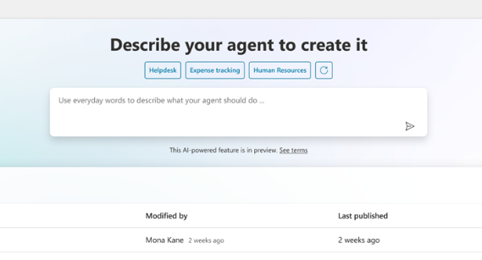
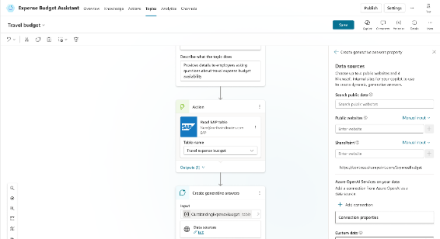
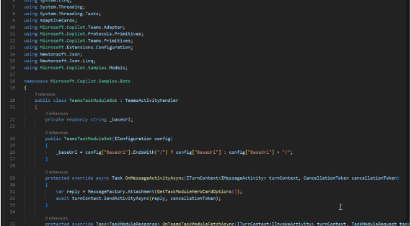
Create agents using natural language in Copilot Studio and customize further, if needed, with code using advanced tools like Azure AI
For business users and developers
For developers
Natural language
Drag and drop
Code
Build agents by engaging in a conversational, natural, human-like experience in Copilot.
Design your agent by uploading files, adding capabilities, and providing instructions with a few clicks.
Customize agents using advanced developer tools like the Microsoft 365 Agents SDK, VS code, and Azure AI.
Notes:
Now that you’ve seen the components of an agent, you can choose how you want to build them, whether that’s with natural language, drag and drop, or code
Natural language: Start building by describing what you want your agent to do and watch AI do the heavy lifting for you
Visual canvas: Design your agent by adding knowledge and tools with a few clicks, uploading files, and providing instructions
Code: Develop agents using the Agents SDK or Azure AI Foundry services for highly customized solutions

Slide 27
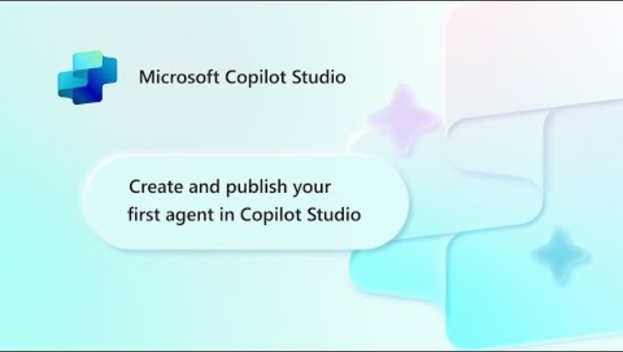
Create an agent with Copilot Studio
For other helpful videos – Visit our Mastering Copilot Studio video series
Disclaimer: As of October 2025, there is a new logo for Microsoft Copilot Studio

Slide 28
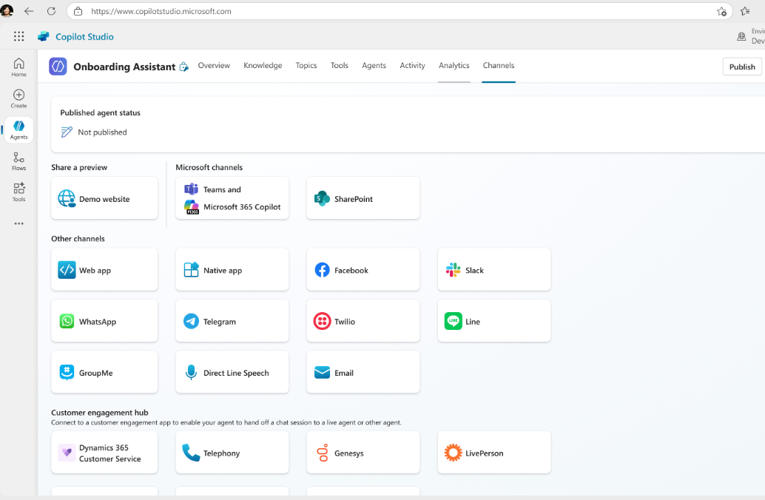
Channels
Publish and deploy to your websites and channels with a single click, including Slack, WhatsApp, Facebook, and more.
Easily extend Microsoft 365 Copilot with custom agents.
Add your agent to a custom app built with Power Apps or a custom website built with Power Pages.
Connect to your contact center so your agent can escalate and hand off the conversation with full context to a human agent.
Specific to the Copilot Studio full version
Notes:
You can publish and deploy to your channels of choice with a single click, including Facebook, Twilio, WhatsApp, SharePoint, Email, Teams, and others
Add your agent to a custom app built with Power Apps or a custom website built with Power Pages.
You can access even more channels through ISVs, including Google and Apple Messages for Business, WeChat, and custom channels

Slide 29
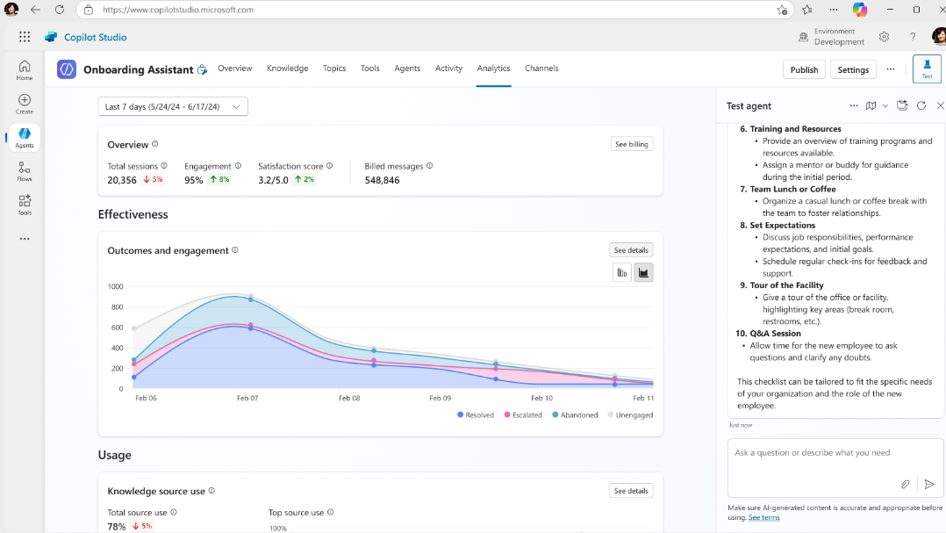
Analytics
See how effective agents are at solving problems by measuring outcomes.
Measure usage, engagement, success rates, knowledge use rate, and satisfaction to improve your agents over time.
Specific to the Copilot Studio full version

Slide 30
Examples of industry-focused agents that can be created in Copilot Studio
Copilot Studio
These agents need to be built in the full Copilot Studio experience. For more scenarios and downloadable battlecards to aide in creation – explore the Microsoft Scenario Library and select “Agents” as the filter.
 | Industry | Agent Name | Description
 | Public Sector | Citizen Q&A Agent​ | Equip public service agents with instant, accurate answers from policy docs and internal knowledge.
 | Retail | Return Fraud Detection Agent | Identifies and flags potentially fraudulent return activity based on transaction patterns.
 | Finance | Customer Inquiry Agent | Resolves customer questions using bank knowledge and guides to the next best step.
 | Manufacturing | Production Schedule Optimizer Agent | Continuously adapts production schedules to maximize throughput and reduce delays​.

Slide 31
Citizen Q&A Agent
PUBLIC SECTOR INDUSTRY
Subindustry
Maturity
Equip public service agents with instant, accurate answers from policy docs and internal knowledge
Social Services, Public Safety
Homerun
Current Workflow Challenges
High volume of repetitive citizen inquiries, increase wait times and reduce focus on strategic tasks
Inconsistent responses across different communication channels erodes citizen trust
Knowledge base updates lag policy changes, resulting in outdated information to citizens
Lack of centralized access to data, resulting in fragmented responses during interactions
Key Features
Business Impact
From
Manual search of policy documents leads to inconsistent answers, increases workload, reduces operational efficiency and impacts decision-making
Ingests FAQs, manuals, and policy documents into searchable knowledge base
First Call Resolution Rate → Resolving citizen queries immediately on the first interaction significantly boosts their satisfaction and trust
Support Teams Time → Orchestrating responses to common queries reduces manual effort, Allowing support teams to focus on tasks that require human interventions
Searches knowledge base for relevant articles based on citizen’s query
Resolution Efficiency → Efficient query resolution minimizes back-and-forth, boosting process efficiency and citizen alignment
Synthesizes answers with links to source documentation
Response Speed → Streamline employee collaboration, reducing time and effort to meet communication demands
To
Agents automate responses, parse queries, retrieve exact policy passages – provides consistent and accurate data from ERP and policy documents
Routes complex citizen questions to live agents with summary and background
Key User(s)
Contact Center Agents
Policy/Knowledge Base Managers/Supervisors
Sends summarized emails and messages to supervisors and case managers to track urgent communications (policy violations, compliance issues, escalated complaints, or time-sensitive requests)
Citizens

Slide 32
Return Fraud Detection Agent
RETAIL INDUSTRY
Subfunction
Maturity
Identifies and flags potentially fraudulent return activity based on transaction patterns
Supply Chain & Operations
Homerun
Current Workflow Challenges
Inconsistent practice of auditing returns can result in financial leakage, including increased processing costs and potential losses from undetected fraudulent activity
Manual audits make it difficult to consistently detect deceptive behavior or distinguish between legitimate and fraudulent return requests
Manual reviews frequently overlook nuanced patterns or repeat-offender behavior that could be caught through advanced behavioral or historical analysis
Key Features
Business Impact
From
Manual fraud reviews are inconsistent, resource intensive and often miss subtle fraud signals, which results in increased operational costs, and reduced trust in the review process
Analyze return transaction logs across POS and eCommerce systems
Average Return Processing Rate → Increases accuracy and speed in identifying fraudulent returns to reduce revenue loss
False Positive Rate → Reduces unnecessary manual reviews, and accelerates accurate decision-making
Detect anomalies in customer’s buying patterns like purchase frequency, volume, or item category and continuously retrain on emerging fraud patterns
Shrinkage Rate → Enhances workforce availability, improves service levels, and optimizes resource utilization
To
Automates fraud workflow and uses pattern recognition and anomaly detection to flag suspicious returns and routes
real-time alerts to loss prevention teams to automate fraud detection
Cross-reference return patterns with known fraud signatures
Key User(s)
Loss Prevention Risk Team
Flag suspicious returns and sends real time alerts to fraud or loss prevention teams

Slide 33
Customer Inquiry Agent
FINANCIAL SERVICE INDUSTRY
Subfunction
Maturity
Resolves customer questions using bank knowledge and guides to the next best step
Banking
Homerun
Current Workflow Challenges
Information is scattered across fragmented and disconnected systems/sources
Knowledge retrieval and interpretation is manual, inconsistent, and can cause response delays
Inconsistent responses based on individual agent skill levels
Volume spikes, inflates average-handle-time and thus erode CSAT
Manual post-call summarization and documentation delays queue and follow-ups
Key Features
Business Impact
From
Customer inquiries are handled manually across channels by searching for information and interpreting queries, which leads to delays and inconsistent answers
Capture customer questions from chat, IVR, or API
First-contact Resolution → Smart classification and contextual insights resolve issues the first time
Resolution Time → Instant data access and auto-responses cut delays
Classify intent and sentiment using trained AI models to detect urgency and emotion
Customer Satisfaction Score → Accurate, fast answers improve customer trust by ensuring consistent handling of regulated inquiries
Extract customer context from CRM, core-banking systems and identify root cause
Average Handle Time (AHT) → Agents get summaries and next steps pre-generated
To
Fetch relevant knowledge articles and case precedents
AI-driven understanding of intent and context to deliver instant, accurate, and tailored answers from knowledge base with clear next steps
Ticket Deflection Rate → Fewer issues escalate with better self-service and AI routing
Auto-draft personalized responses with citations. Recommend next steps with escalating dissatisfaction-prone queries to live agents
Accuracy & Relevancy Rate → Policy precision meets customer intent for trusted, tailored answers maintaining an audit trail with consistency
Document case summarization for live agent review
Key User(s)
Customer Support Agent
Customers

Slide 34
Production Schedule Optimizer Agent
MANUFACTURING
Subfunction
Maturity
Continuously adapts production schedules to maximize throughput and reduce delays
Hi-Tech, Industrial
Homerun
Current Workflow Challenges
Siloed systems delay visibility into real-time constraints (machine downtime, labor gaps)
Reliance on outdated forecasts and manual spreadsheet
Static schedules don’t adapt to changing production conditions
Manual reschedule takes hours and delays fulfillment
Missed constraints (e.g., labor or equipment clashes) cause bottlenecks and idle time
Key Features
Business Impact
From
Production planners manually update schedules using static forecasts and spreadsheets, reacting to equipment breakdowns, labor shortages, and rush orders after delays and disruptions occur
Ingests production orders and schedules from ERP systems (e.g., SAP, Dynamics 365)
On-Time Fulfillment Rate → Optimized schedules improve on-time delivery and customer satisfaction
Production Downtime → Optimal schedules reduce unplanned downtimes
Pulls equipment condition (performance, health status, etc.) and availability from IoT sensors and MES
Stockout Rate → Smarter scheduling prevents production delays that lead to inventory shortfalls
Incorporates workforce availability from HR systems and shift rosters
Inventory Carrying Cost → Smoother operations reduce overproduction and excess stock holding
To
Generate optimized schedules that account for machine status, workforce availability, and order priority
Key User(s)
Uses smart scheduling logic to create optimized production plans that respect capacity, material, and labor constraints
Production Planner
Factory Supervisor
Notifies production planners of potential schedule conflicts, schedule adjustments and delay alerts via email
Supply Chain Scheduler

Slide 35
Examples of function-oriented agents that can be created in Copilot Studio
Copilot Studio
These agents need to be built in the full Copilot Studio experience. For more scenarios and downloadable battlecards to aide in creation – Explore the Microsoft Scenario Library and select “Agents” as the filter.
 | Function | Agent Name | Description
 | Customer Service | Document Compliance Agent | Monitor and analyze documents to prevent compliance violations and recommend process improvements.
 | Sales | Lead Prediction Agent | Leverage behavioral and CRM data to score leads, predict conversion probabilities, and optimize follow-up prioritization.
 | Marketing | Marketing Research Agent | Collect and analyze structured and unstructured data from multiple sources to uncover market trends, audience insights, and competition insights.
 | Finance | Invoice Exception Agent | Automatically detect and resolve invoice exceptions using AI-driven validation, matching, and correction​.
 | HR | Smart Onboarding Agent | Streamline onboarding with personalized steps, real-time query resolution, and seamless document processing.
 | Legal | Automated Contract Review | Detect risks, deviations, and compliance issues and recommend changes for faster legal review.
 | IT | Admin Agent | Automate IT ticket creation, routing, follow-ups, and resolution communication.

Slide 36
Document Compliance Agent
CUSTOMER SERVICE FUNCTION
Monitor and analyze documents to prevent compliance violations and recommend process improvements
Current Workflow Challenges
Customer service document compliance violations are identified manually, which is time-consuming and prone
to errors
Documents are analyzed after interactions, leading to delayed confirmation to acceptance/rejection to customers
Traceability can be difficult and inefficient because violations are manual reported
Key Features
Business Impact
From
Document monitoring and compliance checking processes are manual, intermittent, time-consuming and prone to errors
Continuously monitors customer service documents (ex: customer service scripts, dispute resolutions reports, etc.) for potential compliance violations against compliance benchmarks
Compliance Rate → Automated violation monitoring will reduce the likelihood of compliance oversights
Customer Satisfaction → Real-time recommendation on corrective action reduces TAT and thus increases CSAT
Alerts customer support reps and supervisors in real-time when compliance steps are missed
Manual compliance check time → Reduce average time taken to manually check compliance
To
Real-time compliance monitoring and alerts powered by AI agents help prevent violations and suggest process enhancements to maintain accuracy, consistency, and boost efficiency
Suggests compliant alternatives to documents based on company guidelines
Key User(s)
Customer Support Agent
Customer Service Supervisor
Stores compliance check history, suggested edits, user overrides, and approvals in an auditable log
All functional teams –
Sales, Marketing, Finance, HR, Legal and IT team

Slide 37
Lead Prediction Agent
SALES FUNCTION
Leverage behavioral and CRM data to score leads, predict conversion probabilities, and optimize follow-up prioritization
Current Workflow Challenges
Manual lead prediction and prioritization processes
Individual predictions are often based on incomprehensive analysis, due to significant volume
Key Features
Business Impact
From
Lead scoring and prioritization is manual and limited in actionable insights
Scores leads using behavioral, CRM, and external data
Sales Pipeline Efficiency → Increase in the effectiveness and speed with which leads are converted
Lead Conversion Rates → Percentage increase in leads that are most likely to convert to customers
Enhanced conversion predictions using historic patterns allowing businesses to focus their efforts on high-potential leads, increasing the overall
conversion rate
Increased Efficiency and ROI → Prioritization process reduces the effort required from sales teams, allowing them to focus on closing deals
To
Recommends optimized follow-up prioritization by continuously monitoring and re-evaluating leads based on new data, ensuring that follow-up actions are timely and relevant
Agent automates the scoring and prioritization of leads while offering predictive insights on conversion probabilities, enhancing the sales lifecycle and delivering valuable follow-up information
Key User(s)
Sellers
Suggests optimal routing path like assigning a senior sales rep who is an SME on a niche skill that will be required for the lead

Slide 38
Market Research Assistant
MARKETING FUNCTION
Collect and analyze structured and unstructured data from multiple sources to uncover market trends, audience insights, and competition insights
Current Workflow Challenges
Research data is collected manually, leading to delays in insights generation
Difficulty in analyzing unstructured data like social media conversations, market performance trends, and customer behavior
Inconsistent insights limit marketers’ ability to adapt strategies in real-time
Lack of proactive identification of emerging trends and competitive movements
Key Features
Business Impact
From
Research processes are manual, delayed, and inconsistent, resulting in slower insights, missed trends, and inefficient decision-making
Synthesizes data from social media platforms, 3P research reports, customer sentiment analysis, and competitor insights to construct a comprehensive market view for strategic marketing decisions
40% Decrease in Time to Insight → Faster identification of trends and insights
20% Increased Speed to Product Market Fit → Accelerates insights that drive strategic marketing decisions
Identifies emerging trends, audience behaviors, and competitive shifts, enabling marketers to proactively adapt strategies
80% Reduction in Data Collection & Processing → Automates data synthesis for faster insights
To
Research and insights generation is AI-driven, accelerating data analysis, identifying key trends, and delivering actionable recommendations for improved marketing strategies
Key User(s)
Provides automated reports with insights on market trends, audience behaviors, competitor analysis, and cultural trends, along with actionable recommendations to inform campaign, content and creative strategies
Planning & Insights Team
Campaign Strategists
Marketing Managers
Product Managers

Slide 39
Invoice Exception Agent
FINANCE FUNCTION
Automatically detect and resolve invoice exceptions using AI-driven validation, matching, and correction
Current Workflow Challenges
Manual handling of large numbers of invoices with varying terms
Inconsistent 4-way matching difficulties in matching PO, invoice, receipt, and goods/services manually creates payment errors and compliance issues
A lack of a streamlined process for handling mismatched invoices increases processing time
Challenges checking on duplicate payments because of manual checks and multiple sources
Key Features
Business Impact
From
High volumes of invoices cause delayed payments, excessive manual effort, inefficiencies, and compliance risks
Extracts structured and unstructured data from ERP Systems, Account, Payable System, Email attachment etc.
Invoice Processing Time → Faster processing through orchestrated data extraction, validation, and matching
Exception Handling Efficiency → Quick resolution of invoice discrepancies with automated exception management
Matches invoice with PO, invoice, receipt, and goods/services, & flags inconsistencies, errors & duplicate payments.
Workflow Optimization → Streamlined end-to-end invoice approvals based on predefined business rules and hierarchy
Duplicate payments → With Transaction Matching, Pattern recognition, Anomaly detection, Real-Time Flagging and suggested corrective actions
To
AI Agent drives invoice processing with automated validation, matching, error resolution, and compliance checks
Provides a concise invoice summary, highlighting key details, anomalies, and compliance risks.
Payment Accuracy → Identified missing or incorrect information before submission, variance thresholds and business rules are applied in real-time
Key User(s)
Follows up with the Engagement Manager for additional inputs if discrepancies persist like vendor clarification and policy checks.
Finance operations team
Accounts payable Team
Internal audit and compliance
Procurement Team

Slide 40
Smart Onboarding Agent
HR FUNCTION
Streamline onboarding with personalized steps, real-time query resolution, and seamless document processing
Current Workflow Challenges
Candidate information is scattered across multiple systems, requiring manual intervention to track progress and configure onboarding steps
HR teams manually collect, validate, and follow up on documents, leading to inefficiencies and delays
Onboarding experiences lack role-specific recommendations, making it difficult to tailor training and introductions effectively
New hires rely on HR personnel for onboarding-related questions, slowing down response times and increasing dependency on human support
Key Features
Business Impact
From
Manual and fragmented onboarding processes lead to inefficiencies, delays, and inconsistent new hire experiences
Retrieves candidate details from HR systems to configure onboarding steps
Time to Proficiency → Ensures that employee receives all resources required to be productive from Day 1
User Experience → Faster resolution of queries, tailored guidance and seamless transition
Automates document collection, submission validation, and
follow-ups
Operational Efficiency → Reduces administrative load and compliance risk by timely submission of documents
Provides real-time responses to candidate queries via chat or voice assistants
To
AI-Agent automates onboarding, retrieving candidate details, configuring candidate onboarding steps, creating onboarding documents, creating learning plans, and answering candidate questions
Key User(s)
Generates personalized learning plans based on role, team, and required skills
HR managers/team
Team leads/managers
Summarizes interactions to provide HR with insights into onboarding progress and challenges
Employees

Slide 41
Automated Contract Review
LEGAL FUNCTION
Detect risks, deviations, and compliance issues and recommend changes for faster legal review
Current Workflow Challenges
Analysts spend considerable time and resources reviewing contracts by hand
Manual reviews can occasionally overlook risks or deviations
Key Features
Business Impact
From
Contract reviews are manual, delayed, and require extensive billable hours, as analysts must parse through contracts searching for risks and compliance issues
Compares uploaded contract against standard templates
Contract Review Time → Reduced duration of reviewing a contract
Risk Exposure → Decreased exposure to potential risks in the contract review process
Identifies deviations
and risky clauses
Legal Compliance → Increased percentage of contracts that fully comply with legal standards
To
Optimized contract reviews with AI-Agents automate risk identification and mitigation recommendations
Suggests alternative clauses based on policy/risk standards and recommends negotiation edits or redlines
Key User(s)
Legal analysts
Summarizes findings
for legal review

Slide 42
Admin Agent
IT FUNCTION
Automate IT ticket creation, routing, follow-ups, and resolution communication
Current Workflow Challenges
Ticket intake and creation is manual
Tickets are routed manually and do not leverage knowledge base nor
historical tickets
Inconsistent ticket creation and misrouting requires customer follow-ups and creates delays in ticket ownership and time-to-resolution
Open-ticket follow-ups
are manual
Communication updates are manual and delayed to customers
Manual processes do not scale with volume of tickets
Key Features
Business Impact
From
IT support is fragmented with manual ticket requirements intake, creation, and routing with delayed communications/ limited visibility
Manages intake communication with customer and retrieves details from database if required
Ticket Resolution Rate → Faster issue resolution via automated ticket intake, creation, and routing
CSAT Score → Improved IT service experience through a digital, automated, and streamlined bug submission process
Automatically creates a ticket and assigns type, resolution team, and priority based on historical tickets
Operational Efficiency → Reduction in time and manual interventions to process IT requests
To
IT ticketing is automated and intelligent—where AI handles intake, classifies issues, routes to the right team, and keeps users informed throughout resolution
Follows up with customer for additional required details
Key User(s)
Employees
IT support teams
Provides ticket lifecycle updates and follows up with teams on open items
Customer service representatives

Slide 43
Connect your existing agents

Slide 44
Connect agents to each other, regardless of where they’re built
Build with Copilot Studio
Agents
Connect agents from AI services like:
Azure AI Foundry
Semantic Kernel
Amazon Web Services
Google Cloud Platform
IBM Cloud
OpenAI
LangChain
Other...
Notes:
Using the M365 Agents SDK, you can connect Copilot Studio agents with other agents, regardless of where they’re built, so that they work better for you.

Slide 45
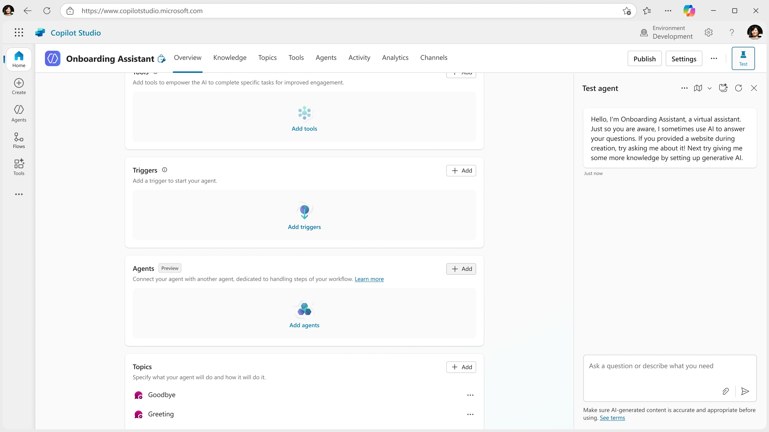
Multi-agent orchestration
Connect agents to each other so that they can exchange data, collaborate, and complete processes for you more effectively than a single agent on its own
Disclaimer: As of October 2025, there is a new logo for Microsoft Copilot Studio
Notes:
When you have agents working together, we call it multi-agent orchestration
That’s when agents can exchange data, collaborate, and complete processes for you more effectively than a single agent on its own
Again, Copilot Studio is great because you need a platform that can handle thousands to millions of agents down the line

Slide 46
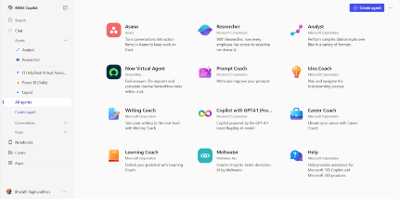
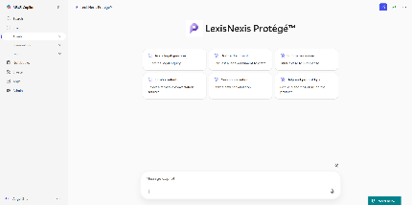
Bring your own agents to Microsoft 365 Copilot
Turn your existing AI investments into powerful, native Microsoft 365 Copilot experiences—tailored to your workflows, your data, and your users.
Maximize ROI on AI investments
By bringing your own agent, you can reuse you’ve already built—no need to start over.
Bring your own agents with the M365 Agents SDK
Full Developer Control
Define custom workflows, tools, knowledge, integrate APIs, and use proprietary or fine-tuned LLMs, all with enterprise-grade security and compliance in Microsoft 365 Copilot.
Publish to the Agent Store
Frictionless user experience
Agents feel like a natural part of Microsoft 365 Copilot—no training, no installs, Copilot-native experience.
Access in
M365 Copilot
Notes:
This means by Bringing your own agents developers have two powerful paths:
Connect agents into Copilot Studio to build multi-agent systems that orchestrate across specialized flows.
And bring agents directly into Microsoft 365 Copilot, enabling them to operate natively across the Copilot experience—without needing to rebuild or rehost, powered by the M365 Agents SDK and Toolkit
NOTE FOR SELLERS
Why it matters
For the Field:
This unlocks a powerful new value prop: Bring your own agent enables customers to integrate their existing agents or build custom ones to work directly in Microsoft 365 Copilot or power multi-agent systems in Copilot Studio. This means faster time-to-value, stronger differentiation in competitive deals, and a compelling reason to re-engage Azure AI Foundry customers with Copilot Chat. It’s a clear path to drive Copilot Chat MAU and Agent MAU.
‌
For Post-Sales & Adoption Teams:
This simplifies the agent landscape. Customers no longer need to choose between their custom agents and Copilot—they can have both. This unification boosts adoption, reduces friction, and helps you land broader usage across workloads. It’s a win for retention, and expansion.
‌For Everyone:
This is a strategic lever. Bringing your own agent into Microsoft 365 Copilot aligns directly with our AI strategy—positioning Copilot as the ‘UI for AI’. It transforms Copilot into the central interface for enterprise intelligence. Every agent integrated strengthens engagement, accelerates adoption, and drives measurable business impact.

Slide 47



Bring your own agents to Microsoft 365 Copilot
Bring your own AI agents—built with your models, logic, and tools—into Microsoft 365 Copilot for a seamless, secure, and native experience that meets your unique business needs.
Full Developer Control: Define workflows, integrate APIs, and use proprietary or fine-tuned LLMs.
Asynchronous Capabilities: Support for long-running tasks, proactive alerts, and background processing.
AI Agents from Azure AI Foundry or other AI stack
Enterprise-Ready: Built-in security, compliance, and deployment across Microsoft 365 Copilot and Teams.
Microsoft
365 Copilot
Unified Experience: Agents appear natively in Copilot Chat via the Agent Store—no separate install needed.
Microsoft Agents Toolkit & SDK
Pro-code ready: Leverage Azure AI Foundry and Visual Studio with the Microsoft 365 Agents Toolkit and SDK.
Notes:
ALT FOR MORE TECHNICAL DECKS
Whether you’ve built agents using Azure AI Foundry, Visual Studio, or any other AI stack, the Microsoft 365 Agents Toolkit and SDK make it easy to integrate them directly into Copilot.
You get full developer control—from defining workflows and integrating APIs to using your own fine-tuned models.
These agents can now support asynchronous capabilities like long-running tasks and proactive alerts, keeping users productive while agents work in the background.
And because they’re enterprise-ready, you can deploy them securely across Microsoft 365 Copilot and Teams with built-in compliance and governance.
Best of all, these agents show up natively in Copilot Chat via the Agent Store—no extra installation needed.
So whether you’re building from scratch or extending existing solutions, you can now bring your own agents into the flow of work—securely, flexibly, and at scale.

Slide 48

Achieve goals faster by connecting all your agents to your organization’s data, tools, and agents
1 | Microsoft Graph Automatically leverage your productivity data for a more personalized Copilot + agents
2 | Integrations Connect to your LOB apps, developer tools, business data, and analytics​
3 | Agent Store Discover, deploy, and manage pre-built 1P and 3P agents
4 | Agents in Copilot Enhance Copilot by adding agents with specialized knowledge and skills
5 | Multi-agent orchestration Easily connect agents to Copilot and each other
6 | Azure AI Foundry integrations Bring your own model, knowledge, and agents
1
2
3
4
5
6
The enterprise-grade manage agent platform for Copilot
Copilot Studio advanced agent building capabilities including:
Notes:
We believe you can achieve goals faster by connecting your agents to your organizations existing data, systems, and even agents.
This is through the Microsoft Graph, extensive integrations, including to your LOB apps, Copilot and Azure AI, and multi-agent orchestration

Slide 49


Microsoft Graph
Management
Business Processes
Knowledge
Security + Compliance
Office
Teams
People
Edge
Automatically connects your data, people, and workflows across M365, enabling agents that are personal to your team and organization
Graph Data
Security
Outlook
Windows
Devices
Notes:
The first concept here is the Microsoft graph. Graph data helps provide personalized experiences for customers when they use Copilot and agents, by pulling details from emails, chats, documents, and more work artifacts.

Slide 50



















Connect to your data, wherever it lives
Data connectors
External systems
Microsoft Graph
Productivity data (Microsoft 365)
Microsoft Azure
Developer tools
Microsoft Dataverse
Business data
Microsoft Fabric
Analytics
Notes:
But productivity data is only one piece of it. Copilot Studio also connects to developer tools, business data, analytics and external systems, including Salesforce, ServiceNow, SAP, Oracle, Databricks, and so much more.

Slide 51
Resources

Slide 52

Resources
Learn more about agents in Microsoft 365
Blog | https://aka.ms/AgentsinM365Updates
Agent information | Facilitator in Teams meetings
 | Project Manager in Planner
 | Interpreter in Teams meetings
Adoption resources | https://aka.ms/AdoptM365agents
Learn more about Copilot Studio
Website | https://aka.ms/copilotstudio
Blog | https://aka.ms/copilotstudio-blog
Demo | https://aka.ms/copilotstudiodemo
Product documentation | https://aka.ms/copilotstudiodocs
Learning resources | https://aka.ms/copilotstudiolearn
Community page | https://aka.ms/copilotstudiocommunity
Implementation guide | https://aka.ms/copilotstudioimplement
Adoption resources | https://aka.ms/adoptcopilotstudio
Scenario library | https://aka.ms/scenariolibrary

Slide 53
Appendix

Slide 54
Appendix 1A
1p agents continued
Learn more at
Microsoft Copilot Studio |
Customize or Create Copilots

Slide 55
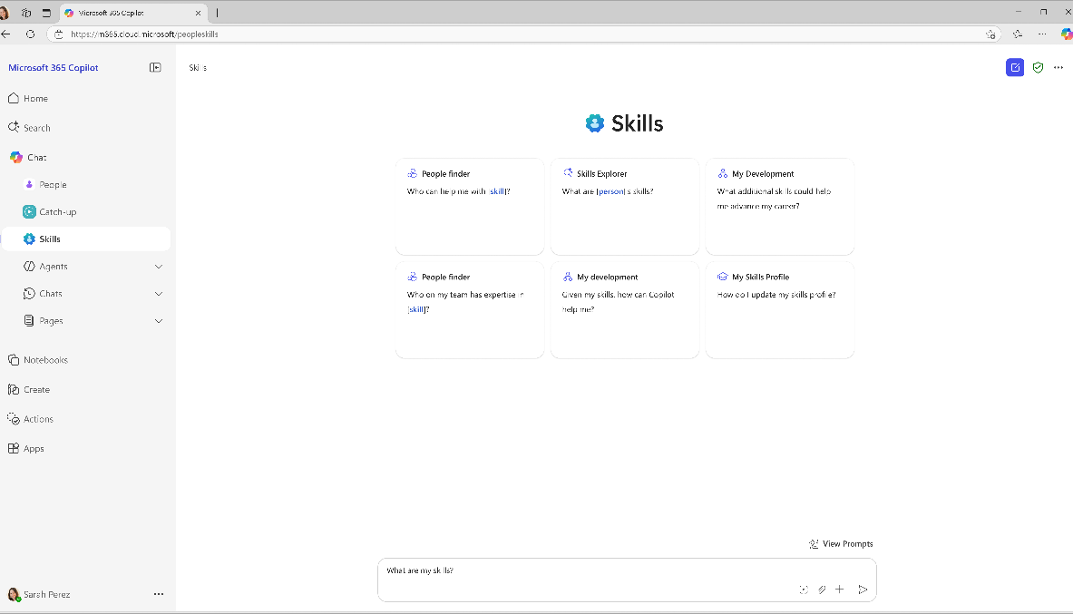
Skills agent
Copilot Chat
Powered by People Skills – An intelligent data layer in Microsoft 365 Copilot that infers individual’s skillsets derived from user activity such as meetings, documents, chat, search, and other signals.
Enables employees to easily find experts in the organization, understand colleague’s skillsets, edit their own skill profiles, and make informed decisions about skill development.
Inform strategic workforce decisions with an up-to-date view of talent landscape strengths, gaps, and opportunities.
Generally available
Notes:
The Skills agent is built on top of the new People Skills data layer. It provides a direct 1P agent access point to People Skills.
People Skills is an intelligent data layer in Microsoft 365 Copilot that infers skills derived from user activity mapped to a customizable built-in skill taxonomy, enhancing Copilot Chat, Microsoft 365, and Viva experiences with contextualized information about the people in your organization.
With this advanced AI inferencing methodology, Microsoft 365 Copilot can equip leaders with critical workforce insights to prepare and accelerate their AI transformation while empowering employees with personalized skill profiles and development tools.
Whether identifying critical skill gaps, finding colleagues with specific expertise, or fostering continuous learning, People Skills in Microsoft 365 Copilot helps organizations stay agile, informed, and ready to thrive.
COMPETITIVE DIFFERENTIATION
The inference model is differentiated in two key areas:
it does not require user action to derive skill inferences
inferences are highly accurate (~85%).
With the People Skills data layer built into M365 Copilot, Copilot will now deeply understand people context in addition to business context for a better user experience. This people context component is highly differentiated for a genai solution. Our strategic vision for Microsoft 365 Copilot Search is to capitalize on the power of generative AI/LLMs to provide employees and customers with accurate and personalized answers leveraging the Graph—thus enhancing their experiences and increasing productivity. We enable customers to find the right information at the right time in the context of their work. Microsoft 365 Copilot Search will deliver parity with our competitors in addition to bringing more personalized answers, leveraging the Graph that our competitors cannot deliver.
People Skills will not be available to EDU customers at GA.
Skill Discovery agent.png

Slide 56
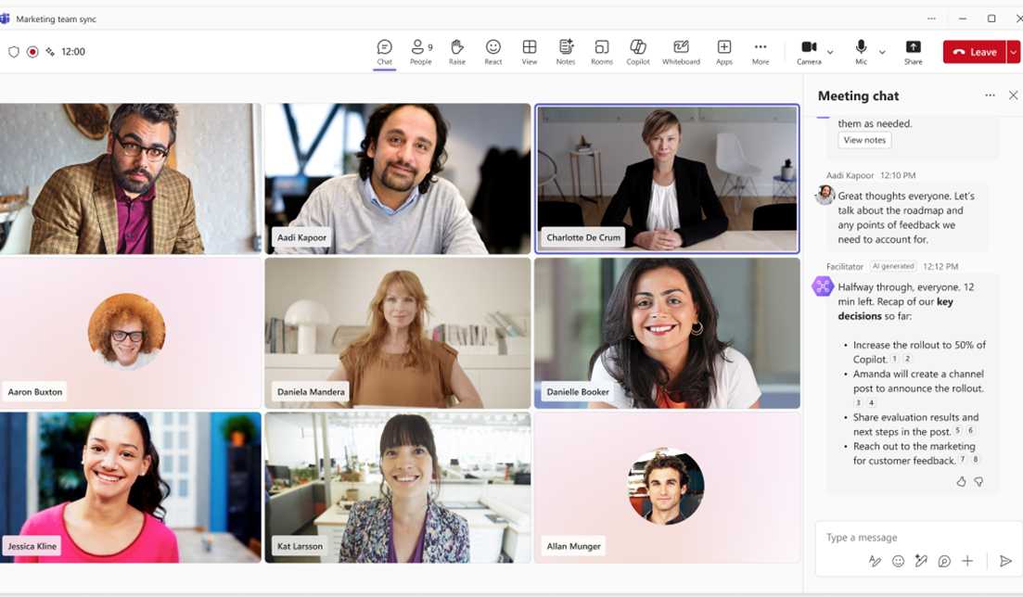
Facilitator
Teams meetings
Works alongside you and your team in Teams meetings.
Takes real-time notes, allowing everyone to easily co-author.
Helps moderate meetings by leveraging the set agenda or goal, checking in midway, and before wrapping up to recap key decisions made and open items.
@ mention Facilitator in the meeting chat to get summarized insights from the conversation or search the web for information.
Generally available

Slide 57
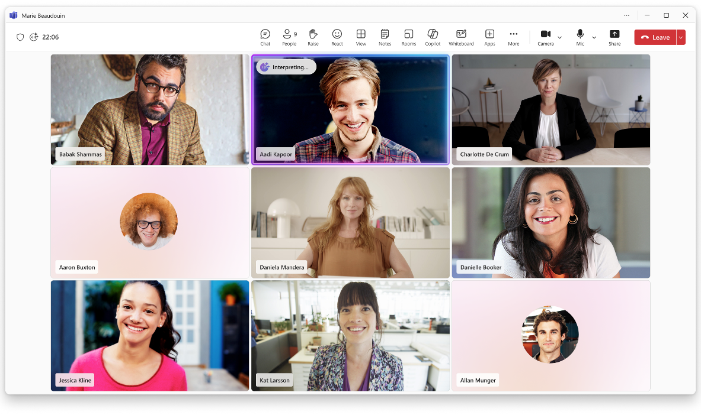
Interpreter
Teams meetings
Enables real-time speech-to-speech interpretation in Teams meetings so each participant can speak and listen in the language of their choice.
Supports nine languages for interpretation.
Generally Available
Notes:
With the new Interpreter agent, each participant can enable real-time speech-to-speech interpretation in Teams meetings so they can speak and listen in the language of their choice, instantly overcoming language barriers.
Meeting participants can also have the Interpreter simulate their personal voice for a more inclusive experience.

Slide 58
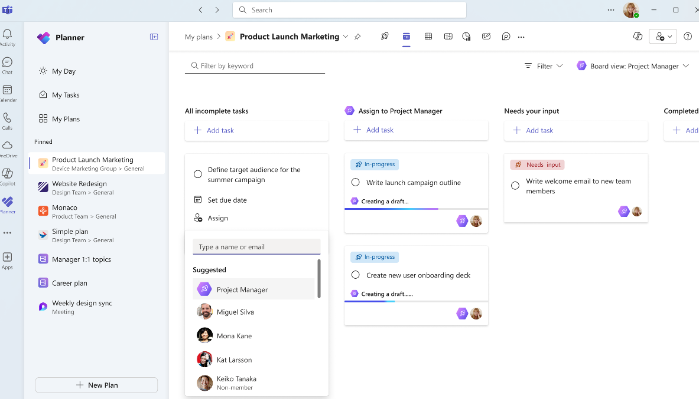
Project Manager
Planner
Create new plans by inputting goals and generating tasks.
Assign tasks to the agent to complete with progress tracking.
Generate status reports for any project.
Available in public preview
Notes:
The new Project Manager agent automates project management, handling everything from plan creation to executing tasks for you and the team.

Slide 59
Appendix 1B
Copilot Connector details
Learn more at Copilot connectors gallery

Slide 60
ServiceNow Knowledge Base Connector
Learn more
    Solution summary
    The Microsoft Graph connector for ServiceNow Knowledge Base allows organizations to index knowledge base articles from ServiceNow into Microsoft Graph, to be used across Microsoft 365 experiences, including Copilot. This means that users can search for these articles directly within Microsoft 365 Copilot clients. Content indexed via Graph connectors can be combined with other Copilot agents to create declarative agents that support acting on the content as well as queries and reasoning. This integration helps streamline workflows and enhances productivity by making critical information more accessible and easier to find
Enable ServiceNow Knowledge Base Connector to increase the ROI of Copilot by improving business metrics like
Tickets reduction
Faster time to ticket resolution
Increased productivity
    Functional scenarios alignment
    Customer Service: By leveraging the Microsoft Graph connector for ServiceNow Knowledge Base, customer service representatives can enhance their efficiency, provide better service, and ensure they have the most accurate information at their fingertips
    Employee Self-service: Employees can
    self-serve and find solutions to root causes themselves
    Key challenges
      Time-Consuming Searches: Customer service representatives often spend a lot of time searching for relevant information to resolve customer issues
      Fragmented Information: Information scattered across different platforms can be hard to manage
      Inconsistent Responses: Representatives need easy access to up-to-date knowledge articles to provide more consistent and accurate responses to customers
      Scattered IT Resources: In some cases, employees may not know how to solve issues or who to contact when they face
      IT issues
    Key value propositions
    Enhanced Knowledge Management & Access: Centralizes data and knowledge, ensures consistent and unified information access across the organization’s
    productivity tools
    Improved Decision-making: The power of Copilot allows users to reason over ServiceNow Knowledge Base data, providing insightful analysis and recommendations
    Increased Efficiency and Productivity: Reduces time spent searching and aggregating information from
    various sources
    Sample prompts for target persona
      Any prompts seeking answers from Knowledge Base articles
      Example 1: How do I reset a customer’s password in ServiceNow?
      Example 2: Show me the latest refund policy
      Example 3: What are the features of the latest software update?
      Example 4: Provide the user manual for our new product

Slide 61
ServiceNow Catalog Connector
Learn more
    Solution summary
    The Microsoft Graph connector for ServiceNow Catalog allows organizations to index service catalog items from ServiceNow into Microsoft Graph, to be used across Microsoft 365 experiences, including Copilot. This means that users can search for these catalog items directly within Microsoft 365 Copilot. Content indexed via Graph connectors can be combined with other Copilot agents to create declarative agents that support taking action on the content as well as queries and reasoning. This integration helps improve efficiency and user satisfaction by making it easier to find and request necessary services and products
Enable ServiceNow Catalog Connector to increase the ROI of Copilot by improving business metrics like
Improved operational efficiency
Faster time to request fulfillment
Enhanced request management
    Functional scenarios alignment
    Employee Self-serve: Help employees raise catalog requests by finding the right information
    Customer Service: By leveraging the Microsoft Graph connector for ServiceNow Catalog, customer service representatives can provide quicker responses, enhance their efficiency, and ensure they have the most accurate and up-to-date information about catalogs at the ready
    Key customer challenges
    Inefficient Service Requests: Customer services representatives often spend time navigating multiple systems to request services or products
      Delayed Responses: Waiting for approvals or information from different departments can slow down service
    Lack of Visibility: Representatives may not always know what services or products are available
      Manual Processes: Many service requests involve manual steps that can be automated
    Key value propositions
    Easier Service Request: Contains details of all products and services, allowing users to place requests directly. With Copilot, users can quickly find request instructions and receive a direct link through the ServiceNow Catalog just with the natural language
    Faster Workflow Creation, Tracking and Follow up: Allows users to create, find details from catalog quickly in the flow of work- which will help in overall productivity and user experience
    Sample prompts for target persona
      Example 1: Order a new laptop for a customer
      Example 2: What software licenses are available for new employees?
      Example 3: Show me the available mobile devices for staff

Slide 62
ServiceNow Tickets Connector
Learn more
    Solution summary
    The Microsoft Graph connector for ServiceNow Tickets allows organizations to index various tickets from ServiceNow into Microsoft Graph, to be used across Microsoft 365 experiences, including Copilot. This means that users can search for these tickets directly within Microsoft 365 Copilot clients. Content indexed via Graph connectors can be combined with other Copilot agents to create declarative agents that support taking action on the content as well as queries and reasoning. This integration helps improve efficiency and user satisfaction by making it easier to find and manage tickets, ultimately enhancing productivity
Enable ServiceNow Tickets Connector to increase the ROI of Copilot by improving business metrics like
Increased customer satisfaction
Faster time to ticket resolution
Better ROI for IT investment
    Functional scenarios alignment
    Customer Service: Using Microsoft Copilot, quickly search for relevant tickets, check status, and provide the customer with an update. If an issue needs to be escalated, customer service representatives can do so directly through Copilot, ensuring that the problem is addressed swiftly and efficiently
    Key customer challenges
    Delayed Ticket Resolution: Customer service representatives often face delays in finding and accessing relevant tickets
    Fragmented Ticket Management: Managing tickets across multiple platforms can be cumbersome
    Lack of Visibility: Representatives may struggle to get a comprehensive view of
    all open tickets
    Manual Tracking: Keeping track of ticket statuses manually can lead to errors and inefficiencies
    Key value propositions
    Intelligent Querying and Data Analysis: With Copilot querying capabilities, users can ask complex questions about the tickets and receive comprehensive, context-aware responses
    Improved Decision-making: Enables quick data-driven decision making. Helps IT team to do effective prioritization and management of IT issues
    Enhanced User Experience: Enhances the user experience by resolving issues more accurately and efficiently, and by integrating all relevant details into the flow of work
    Sample prompts for target persona
      Example 1: Find the ticket for the network outage reported yesterday
      Example 2: What is the current status of the high-priority ticket?
      Example 3: Escalate the ticket for the server issue to the IT manager

Slide 63
Salesforce Connector
Learn more
    Solution summary
    The Microsoft Graph connector for Salesforce allows organizations to index Salesforce objects such as Contacts, Opportunities, Leads, Cases, and Accounts into Microsoft Graph, to be used across Microsoft 365 experiences, including Copilot. This means users can search for these Salesforce items directly within Microsoft 365 Copilot clients. Indexing Salesforce data for Copilot analysis drives enhanced customer insights, improved sales performance, data-driven decision making, and a competitive advantage, ultimately leading to significant business growth and customer satisfaction. Content indexed via Graph connectors can be combined with other Copilot agents to create declarative agents that support taking action on the content as well as queries and reasoning
Enable Salesforce Tickets Connector to increase the ROI of Copilot by improving business metrics like
Improved customer retention
Higher leads conversion rate
Average customer revenue increase
Reduced cost
    Functional scenarios alignment
    Sales: Personalize customer interactions with AI-assisted insights and recommendations to improve sales performance and customer satisfaction
    Key customer challenges
    Fragmented Data Access: Sales professionals often need to switch between multiple platforms to access customer information, which can be time-consuming
    Inefficient Workflow: Manually searching for and updating Salesforce records can slow down the sales process
    Lack of Real-time Information: Sales teams need up-to-date information to make informed decisions
    Key value propositions
    Quicker Discovery and Management on Data: Copilot can retrieve and display Salesforce records during tasks like drafting emails or preparing reports, saving time and effort
    Streamlined Workflows: Users can seamlessly integrate Salesforce data into their daily tasks without switching between platforms
    Improved Collaboration: Copilot can surface relevant Salesforce data in
    real-time during meetings or collaborative sessions, ensuring everyone has the latest information
    Sample prompts for target persona
      Example 1: Who is the owner of account XYZ?
      Example 2: Who is the contact person for account ABC?
      Example 3: What is the opportunity size
      of XYZ?
      Example 4: What is the status of
      opportunity ABC?

Slide 64
Confluence Connector
Learn more
    Solution summary
    The Microsoft Graph connector for Confluence allows organizations to index content from Confluence into Microsoft Graph, to be used across Microsoft 365 experiences, including Copilot. This means that users can search for Confluence spaces, pages, blogs, and comments directly within Microsoft 365 Copilot clients. This allows users to combine information related to a project from different data sources like Email, SharePoint, Meetings and Confluence to get better insights. Content indexed via Graph connectors can be combined with other Copilot agents to create declarative agents that support taking action on the content as well as queries and reasoning
Enable Confluence Connector to increase the ROI of Copilot by improving business metrics like
Efficient knowledge and content management
Effective collaboration
    Functional scenarios alignment
    Engineering and DevOps: Engineering and DevOps teams can significantly enhance their productivity, reduce friction in accessing critical information, and improve overall collaboration
    Key customer challenges
    Information Overload: Engineers and DevOps professionals often deal with vast amounts of documentation
    Context Switching: Constantly switching between tools can disrupt workflow
    Collaboration Challenges: Ensuring all team members have access to the latest information can be difficult
    Time-consuming Searches: Finding
    specific information in Confluence can
    be time-consuming
    Key value propositions
    Unified Information Ecosystem: Centralizes data and knowledge,
    ensures consistent and unified information access across the organization’s productivity tools
    Improved Decision-making: The power of Copilot allows users to reason over Confluence data, providing insightful analysis and recommendations
    Enhanced Data Accessibility and Discoverability: Users can seamlessly query and retrieve data from Confluence through Copilot, ensuring critical information is easily accessible across Microsoft 365 apps
    Sample prompts for target persona
      Example 1: Find the Confluence page on our return policy
      Example 2: Show me the latest troubleshooting guide for our product
      Example 3: What is the procedure for handling escalated tickets?
      Example 4: What has changed since I’ve been on parental leave?
      Example 5: What is the design pattern for error notifications?

Slide 65
Jira Connector
Learn more
    Solution summary
    The Microsoft Graph connector for Jira allows organizations to index Jira issues into Microsoft Graph, to be used across Microsoft 365 experiences, including Copilot. This means that users can search for Jira issues directly within Microsoft 365 Copilot clients. Users can retrieve detailed Jira task information and summaries through natural language prompts, maintaining context across queries. It also provides updates from Jira and other sources, aiding in project planning, decision-making, and increasing productivity by centralizing access to information without switching applications. Content indexed via Graph connectors can be combined with other Copilot agents to create declarative agents that support taking action on the content as well as queries and reasoning
Enable Jira Connector to increase the ROI of Copilot by improving business metrics like
Reduced cycle time
Increased velocity
Improved engineer productivity
    Functional scenarios alignment
    Engineering: By leveraging these capabilities, engineering teams can significantly enhance their productivity, reduce friction in accessing critical information, and improve overall collaboration
    Key customer challenges
    Task Management Overload: Engineers often juggle multiple tasks and projects
    Context Switching: Constantly switching between Jira and other tools can disrupt workflow
    Collaboration Challenges: Ensuring all
    team members are on the same page can
    be difficult
    Time-Consuming Searches:
    Finding specific issues in Jira can be
    time-consuming
    Key value propositions
    Intelligent Querying and Data Analysis: With Copilot querying capabilities, users can ask complex questions about their
    Jira data and receive comprehensive, context-aware responses
    Streamlined Project Management: Copilot helps streamline project management by providing intelligent summaries and updates from Jira
    Enhanced Decision-making: By integrating Jira with Copilot, users can access insights from their project data. This enables quicker, data-driven decision-making, reducing the time spent on manual data retrieval and analysis
    Sample prompts for target persona
    Example 1: Find me comments on the Jira issues about the customer’s feedback
      Example 2: Show me details on the issue about website not loading properly
      Example 3: Get me the issue created by John yesterday

Slide 66
Enterprise Websites Connector
Learn more
    Solution summary
    The Microsoft Graph connector for Enterprise Websites allows organizations to index content from their company-owned websites into Microsoft Graph, to be used across Microsoft 365 experiences, including Copilot. This means users can search for this content directly within Microsoft 365 Copilot clients. Content indexed via Graph connectors can be combined with other Copilot agents to create declarative agents that support taking action on the content as well as queries and reasoning. This integration enables users to quickly locate and utilize website content, streamline collaboration on projects, and access the latest information and metadata, such as publish dates and authors. By centralizing access to website content, it ensures that all efforts are based on the most current and accurate data
Enable Enterprise Websites Connector to increase the ROI of Copilot by improving business metrics like
Enhanced collaboration
Improved click-through rate
Increased conversion rate
Reduce research time
    Functional scenarios alignment
    Marketing: Quickly locate and utilize
    website content, streamline collaboration on marketing projects, and access the latest information and metadata directly through Microsoft 365 Copilot, ensuring campaigns are based on the most current and accurate data
    Key customer challenges
    Disorganized Content: Marketing teams often struggle with finding and managing content spread across various websites
    Inconsistent Information: Ensuring that all team members have access to the most up-to-date content can be challenging
    Time-consuming Searches: Searching for specific content across multiple websites
    can be time-consuming
    Key value propositions
    Comprehensive Content Access: Users can easily find articles, pages, and other content from both on-premise and cloud-hosted company websites through Copilot
    Enhanced Search Capabilities: The connector enhances search by crawling all sitemap-listed pages, including dynamic content, with options to exclude certain pages for more relevant results
    Improved Collaboration: By integrating website content into Microsoft Copilot, users can seamlessly access and share information, improving team collaboration
    Sample prompts for target persona
    Example 1: Can you check the compliance requirements as per policy are met in this design proposal?
    Example 2: Find the webpage with our new product launch details
    Example 3: What is the publish date of the case study on our website?
    Example 4: Find and link the webpage on our brand guidelines

